Slide 1
Image foreground/background segmentation using Max Flow Algorithm
Team: Ayush Shirsat & Sarthak Arora

Slide 2
Overview
Command Line Interface:
Allows user to mark foreground and background pixels.
Energy Minimization problem of pixels (nodes in graph) is done using:
GMM ^{[2]}
Max Flow Algorithms:
Edmonds-Karp algorithm O(VE²)
Dataset:
Berkeley Segmentation dataset

Slide 3


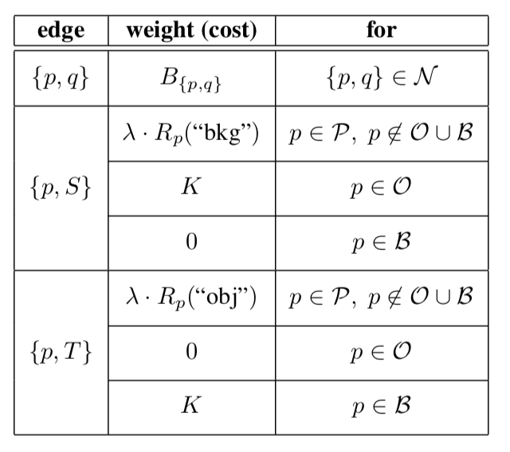
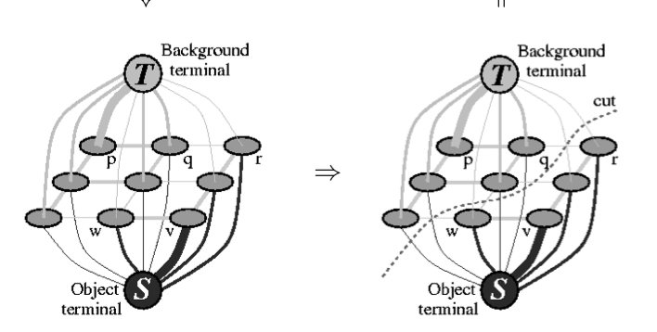
Methodology
Seeds
Region Property (T-Links)
Boundary Property(N-Links)
O- Object
B- Background
S- Source
T- Sink

Slide 4
Analysis
Image size: 30 x 30
Graph Nodes: 902 x 902 (+2 for Source & Sink)
Graph Edges:
N-edges + T-edges = 1740 + 900 = 2640 (All pixels Source or Sink)
Time Taken: 3 min 43 seconds
Only seeds, T-edges reduce (Time Taken around 1 min)

Slide 5
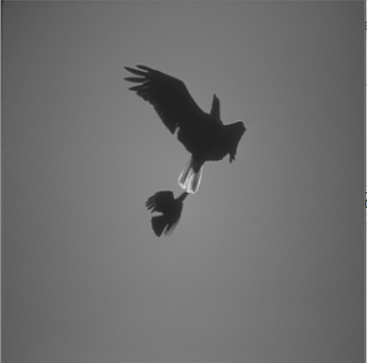
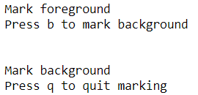
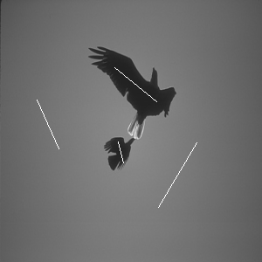
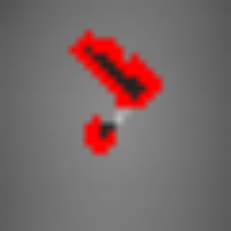

Results

Slide 6
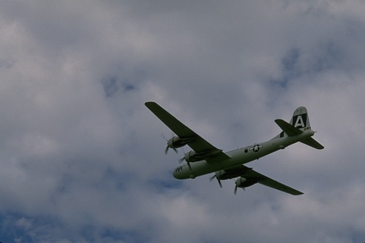
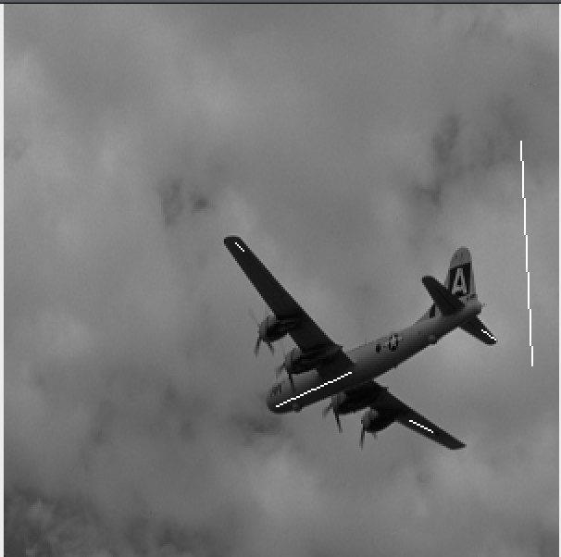
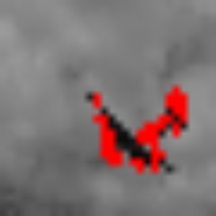
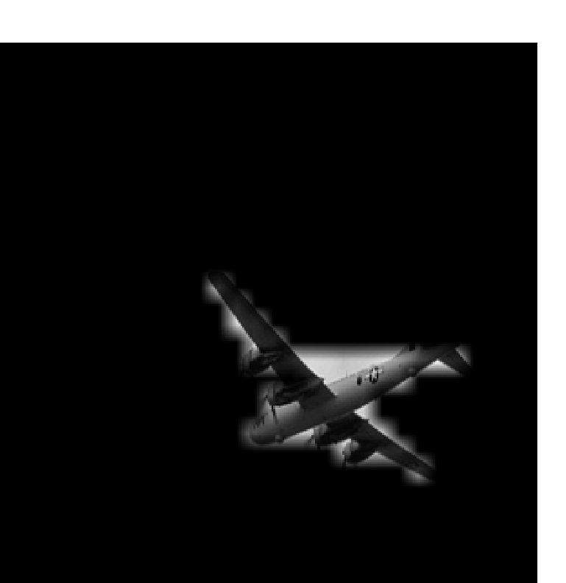
GMM result

Slide 7
Conclusion
CLI with graph cut
Worked with 2 neighbors (Right and bottom pixels). Look at more neighbors.
GMM and boundary Pen: set Properties. Kmeans to get edge weights
Edmond Karp used. Boykov Algorithm for maxflow/mincut
Grayscale Images. Colored Images
Challenges Faced
Generating same output dependent on seeds chosen. Save & Load seeds
Polygon through cuts not closed. Difficult to fill/segment

Slide 8
Work division
Ayush Shirsat: CLI, image processing and Edmonds Karp algorithm
Sarthak Arora: GMM, Edmonds Karp algorithm and image processing
References
^{[1]} Boykov, Yuri Y., and M-P. Jolly. "Interactive graph cuts for optimal boundary & region segmentation of objects in ND images." Proceedings eighth IEEE international conference on computer vision. ICCV 2001. Vol. 1. IEEE, 2001.
^{[2]} Kulkarni, Mayuresh, and Fred Nicolls. "Interactive image segmentation using graph cuts." Pattern Recognition Association of South Africa (2009): 99-104.

