Slide 1

Basic Details of the Team and Problem Statement
Ministry/Organization Name/Student Innovation: Ministry of Home Affairs
PS Code: SIH1440
Problem Statement Title: An application under which all rescue agencies are registered, and which can display the location of other rescue relief agencies during natural/ man made calamities
Team Name: SmurfCat
Team Leader Name: Siddhant Singhania Institute Code (AISHE): U-0405
Institute Name: The LNM Institute of Information Technology
Theme Name: Disaster Management

Slide 2
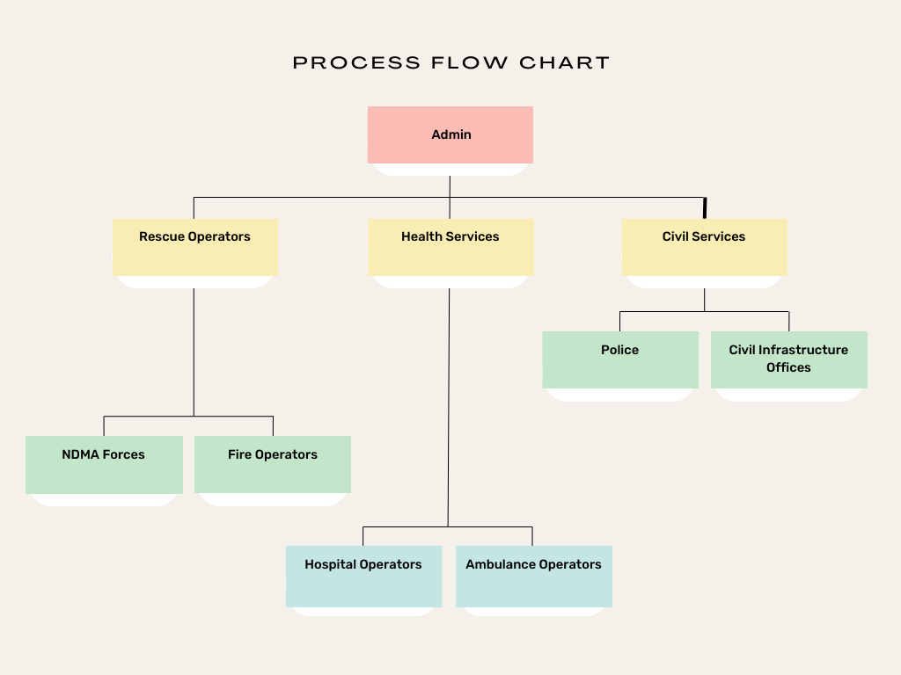
Idea/Approach Details
Idea Description:
Central monitoring system, each operator will get assigned a zone. All emergency requests of that zone will be handled by that operator.
User presses SOS button, his/her live location is shared and can be monitored by the admin user / moderator.
Live location of each rescue personnel is also known so they can monitor it and act accordingly.
Technology Stack:
Frontend:
Desktop Website: React.js
Mobile App: React Native
Backend: Express
Database: Postgress

Slide 3
Idea/Approach Details
Describe your Use Cases here
Describe your Dependencies / Show-stopper here
In case of disasters/calamity, we see large number of requests coming to rescue agencies that need to be handled efficiently.
People generally have difficulty in describing their location, so we have access to their live locations so that we can have an accurate estimate of the geographical location and take into consideration any nearby rescue agencies that should be informed.
All the rescue personnel in the nearby proximity of about 1 km are automatically alerted regarding the same and they will be directed to act accordingly. This ensures swift and coordinated response efforts.
If multiple requests are within a certain proximity, then these requests are clubbed together and elevated to a higher priority.
Whenever SOS button is pressed, all units within a radius of 1 km are immediately alerted.
All emergency services are consolidated on one platform.

Slide 4
Team Member Details
Team Leader Name: Siddhant Singhania
Branch: BTech Stream: CSE Year: IV
Team Member 1 Name: Aryan Gera
Branch: BTech Stream: CSE Year: IV
Team Member 2 Name: Souhardya Malakar
Branch: BTech Stream: CSE Year: IV
Team Member 3 Name: Ayush Dhoot
Branch: BTech Stream: CSE Year: IV
Team Member 4 Name: Ayush Shukla
Branch: BTech Stream: ECE Year: IV
Team Member 5 Name: Astha Singh
Branch: BTech Stream: CSE Year: IV

