Slide 1
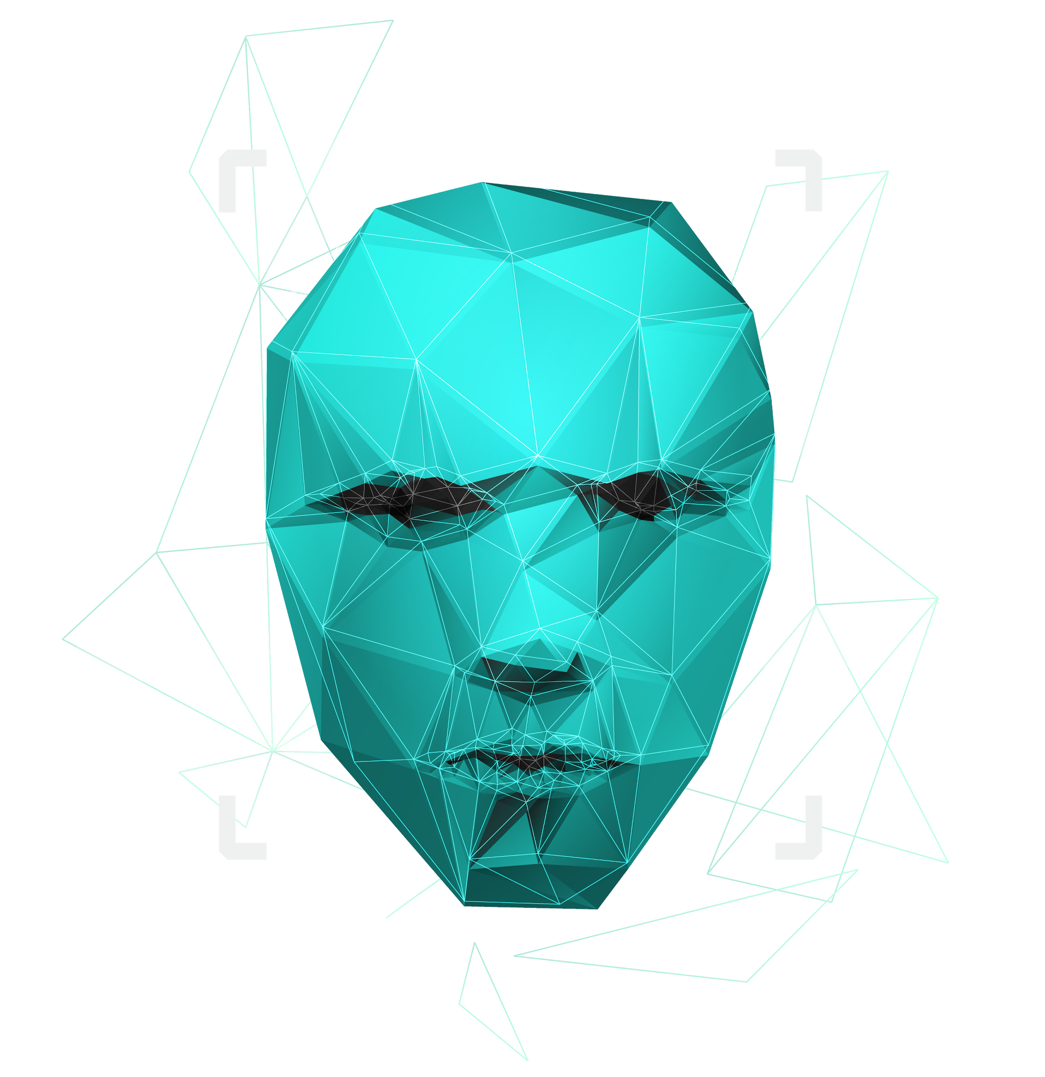


FACE RECOGNITION
AI FUTURE IS NOW
CODELANDERS
Ayush Kumar
Advaith Das
Abijith Pradeep
Srinath Murali
HackOFiesta-Flagship Hackathon of India
01

Slide 2

About Us & why this project?
A pack of AI enthusiasts aiming out for the revolutionary transformation of ways of the world. Simplifying the challenges in our lives through the Statistics and Machine Learning.
This project is a piece of our aspiration for the goal of deploying AI to our everyday lives of society on security, surveillance and logging using facial recognition using neural networks.

Slide 3
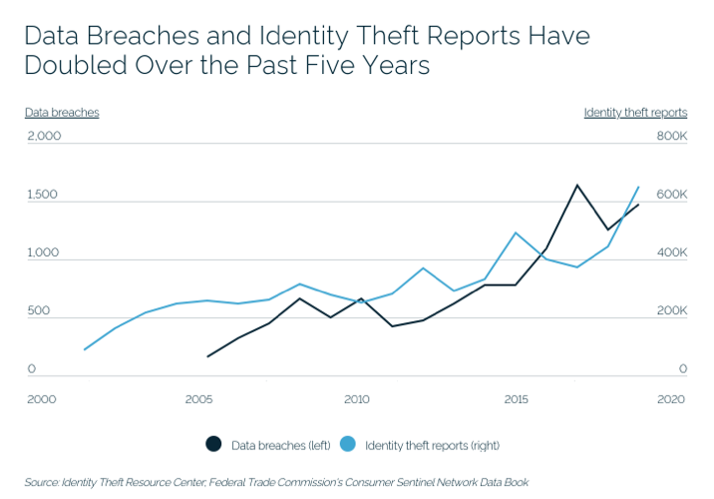
PROBLEM STATEMENT:
Surveillance is the most critical part of our society, from a football game, baby monitoring to military restricted area. Even though computer aided these operating systems need additional watch over by personals which still has a risk of negligence.
In this modern world of data breach and high advanced incidents of terrrorism and criminal activity - cyber and real, we face problems in all parts of industry and government. Private firms are targeted with ransoms over some data breach happening from a close point. Military defined areas are encountered with intruders etc.
Let alone criminal forensics, even in a football game it's hard to track stats of players to qualify them and compare their skill levels.

Slide 4
PROBLEM STATEMENT:
Surveillance isn’t only a branch of security, it is synonymous in many ways of keeping a constant watch over something over time with some ability of decision making based on the observations. We in this project let ease this idea with the help of Artificial Intelligence and AI.
We tried to deploy a model, which is potentially a start-up plan which is based on selling low cost and efficient surveillance systems yo tackle over this problem.

Slide 5

HOW DO WE DO IT ?
CONVOLUTIONAL NEURAL NETWORKS

Slide 6
PROPOSED SOLUTION
We now have touchless access control, touchless sanitizer dispensers and other new features in every facet of life.
This technology is going to play a critical role in enabling a safer world going forward.
It’s important that people align themselves with companies that invest in protecting their privacy and data security.
The solution we have given is a Face Recognition AI model with high accuracy
This model requires limited hardware and lesser knowledge of the user.
This makes it easy accessible and friendly towards the users.
Notes:
which uses the concept of neural networks. It is a very important model in the ML domain which is based on the self training ability of a human brain. It is a very simple model which will get the work done.

Slide 7
UNIQUE SELLING POINTS
1.
EFFECTIVE AI PRODUCT AT A LOW COST
2.
AVAILABLE FOR ANYONE WITH SUITABLE HARDWARE
3.
LIMITED HARDWARE REQUIRED
4.
OF MUCH IMPORTANCE IN SECTORS LIKE PRIVATE SECURITY
5.
CAN BE DEPLOYED EFFECTIVELY ANYWHERE:
EVEN WITH LOW POWER HARDWARE WITH TFLITE MODELS

Slide 8

YOUR TECH STACK
1.
PYTHON3
One of the most prominent languages in the current world of programming.
2.
TENSOR FLOW
One of the current leading APIs in AI and Machine learning created by Google.
3.
SCIKIT LEARN
An important ML library used widely in many ML models.

Slide 9
THANK YOU
GITHUB:Ayush-Shyam-Kumar/EQUINOX-21-HACK (github.com)

