Slide 1
ASSIGNMENT 09
Impact of Generative AI
Synthetic Data on Text
Classification with Limited
Training Data
SMS Spam Detection | TF-IDF + Logistic Regression
Modern AI (AI26501) • M.Tech CSE AIML • Semester I
Team members: [Ayush Tiwari; MT/AI/10007/26] | [Himanshu Shekhar; MT/AI/10027/26]
October 2026
MODERN AI • AI26501 • ASSIGNMENT 9
01 / 09

Slide 2
01 / PROBLEM
Why study synthetic training data?
Real text classification often depends on enough labelled examples—especially for the less common class.
Labelling takes effort
Class imbalance
Potential role of synthetic data
• Real messages must be collected and labelled before supervised training.
• In this experiment, we intentionally restrict the available real training data.
• The original dataset contains far more HAM than SPAM messages.
• A model can achieve high accuracy while missing many spam messages.
• Generative AI can produce additional labelled SMS-style examples.
• The experiment tests whether those examples improve model performance.
The core question
Can generated examples help when only a small real training set is available?
Task: binary SMS classification — ham (legitimate) vs. spam.
MODERN AI • AI26501 • ASSIGNMENT 9
02 / 09

Slide 3
02 / RESEARCH QUESTION
Question, hypothesis & variables
The experiment changes the quantity of synthetic training examples while keeping the evaluation data fixed.
RESEARCH QUESTION
HYPOTHESIS
Can Generative AI-generated synthetic labelled text compensate for limited real training data in SMS spam classification?
Adding synthetic data will improve predictive performance under limited real-data conditions.
Independent variable
Measured outcomes
Held constant
Synthetic-data amount: 0%, 25%, 50%, or 100% of the restricted real training-set size.
Accuracy, Macro-F1, Matthews Correlation Coefficient (MCC), and training time.
Same real test set, same TF-IDF settings, and same Logistic Regression pipeline.
MODERN AI • AI26501 • ASSIGNMENT 9
03 / 09

Slide 4
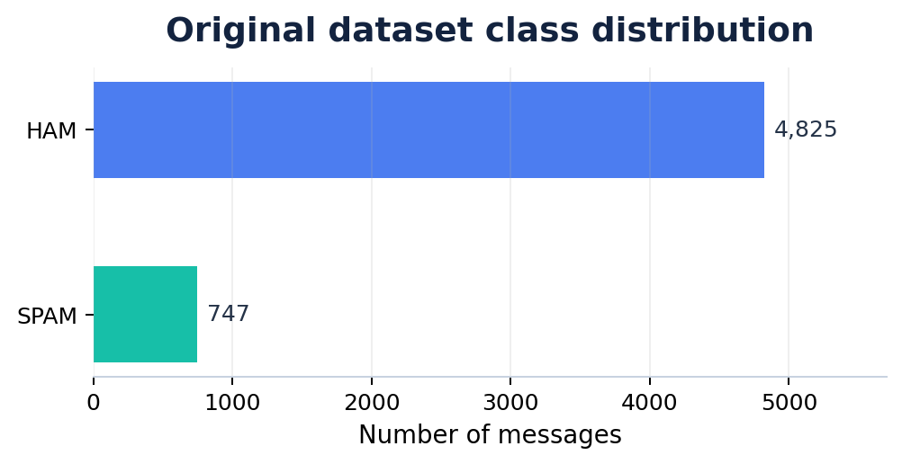
03 / DATASET
SMS Spam Collection
A binary text-classification dataset from the UCI Machine Learning Repository.
5,572
total messages
4,457
training split (80%)
1,115
real test messages (20%)
After the split, only 20% of the training portion was retained: 891 real messages (771 ham, 120 spam).
Source: UCI Machine Learning Repository — SMS Spam Collection.
MODERN AI • AI26501 • ASSIGNMENT 9
04 / 09

Slide 5
04 / METHODOLOGY
From limited real data to model evaluation
The same real test set is used in each condition to make the comparison consistent.
01
Original dataset
02
Train/test split
03
Restrict real data
5,572 real SMS
4,457 train • 1,115 test
Keep 20% of train = 891
04
Add synthetic data
05
TF-IDF + Logistic Regression
06
Evaluate
+0 / 223 / 446 / 891
Train one pipeline per condition
Same 1,115 real test messages
Fixed across all conditions
test set • vectorizer settings • classifier
MODERN AI • AI26501 • ASSIGNMENT 9
05 / 09

Slide 6
05 / EXPERIMENTAL SETUP
Four controlled training conditions
Only the amount of synthetic training data changes.
Condition | Real | Synthetic | Total
Real only | 891 | 0 | 891
Real + 25% | 891 | 223 | 1,114
Real + 50% | 891 | 446 | 1,337
Real + 100% | 891 | 891 | 1,782
Evaluation metrics
• Accuracy — overall correctness
• Macro-F1 — balances class-wise F1
• MCC — correlation of predictions and labels
• Training time — fit duration in seconds
Control:
all conditions are evaluated on the same 1,115 real test messages.
Synthetic data are added to training only; the test set remains real and unchanged.
MODERN AI • AI26501 • ASSIGNMENT 9
06 / 09

Slide 7
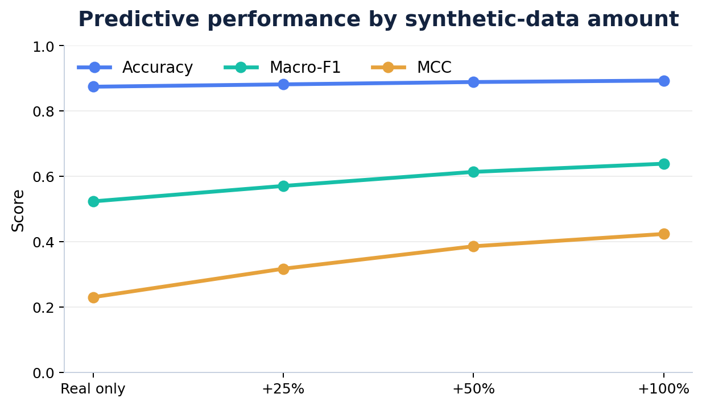
06 / RESULTS
Predictive performance improves with more synthetic data
Observed values from the experiment; scores are evaluated on the same real test set.
Condition | Accuracy | Macro-F1 | MCC
Real only | 0.8744 | 0.5232 | 0.2297
+25% synthetic | 0.8816 | 0.5704 | 0.3168
+50% synthetic | 0.8888 | 0.6135 | 0.3856
+100% synthetic | 0.8933 | 0.6386 | 0.4234
+1.88 pp
Accuracy
+11.54 pp
Macro-F1
+0.1937
MCC (absolute)
pp = percentage points; MCC difference is shown as an absolute score change.
MODERN AI • AI26501 • ASSIGNMENT 9
07 / 09

Slide 8
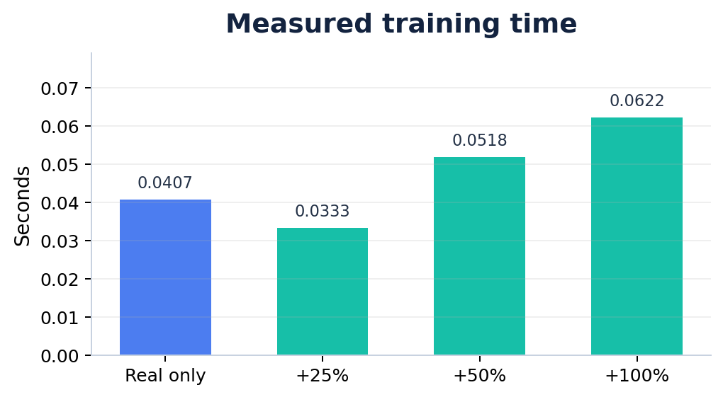
07 / INTERPRETATION
The baseline exposed a class-imbalance failure
High accuracy alone did not mean the baseline detected spam well.
Real-only classification report
HAM recall
1.00
SPAM recall
0.06
HAM F1
0.93
SPAM F1
0.11
Interpretation: baseline predictions strongly favoured HAM and missed many SPAM messages.
Training remained fast; the largest condition took 0.0622 s.
With augmentation, Macro-F1 and MCC improved.
Single-run timing can vary by execution environment.
MODERN AI • AI26501 • ASSIGNMENT 9
08 / 09

Slide 9
08 / CONCLUSION
What did we learn?
Within this SMS spam experiment, synthetic labelled examples improved the observed metrics.
KEY TAKEAWAY
Limitations
Future work
Real + 100% synthetic achieved the best observed result.
• One dataset and one classifier
• Synthetic quality may vary
• Runtime was measured once
• Try more classifiers
• Use other datasets
• Measure data diversity
Accuracy 0.8933 • Macro-F1 0.6386 • MCC 0.4234
Interpretation
Macro-F1 rose by 11.54 percentage points and MCC rose from 0.2297 to 0.4234 compared with the real-only baseline.
Conclusion: results support the hypothesis for this dataset and setup—not a guarantee for every text-classification task.
Dataset source: UCI Machine Learning Repository, SMS Spam Collection.
MODERN AI • AI26501 • ASSIGNMENT 9
09 / 09

