Slide 1


Slide 2


Members
Ayush Ranjan
Kunvar Snehil
Mann
Nikhil
Satyabrat
Surbhi
•

Slide 3
Co nte nt s
Table of Contents
A Quick Outline of our esteemed presentation.
01
Abstract and Introduction
02
Approach
03
Requirements
04
Modules
05
Object ives
06
Existing System
07
Proposed System
08
Feasibilty
09
Screenshot s
10
Conc lusion
•••

Slide 4


A bst r a ct
Abstract
II
..A -'
E-Health Care Management System
This project deals with the Corporate Medicare Management. This project is very helpful to both Medicare staff as w ell as to the public. All the branches of the Medicare can be integrated with one to another. So any body can get the status of each branch easily from the Medicare center. People can take appointments online by approaching the website of
Medicare Center. That site also includes Information about the Facilities, Specialties available in every Medicare Branch. So they can also send their problems about their health and get some useful tips from the doctors ...and many much available.

Slide 5





A pproa c h
Approach
The story of this project creation...
··
•
-
-
l
Project Study Phase
Design Phase
Development Phase
Implementation Phase
In this phase we did the preliminary investigation on the topic and determine the system requirements
we design the system making use of study phase and the
data flow diagrams. We make use the general access for designing.
In the development
phase we mostly did the coding part following the design of the system.
Quality assurance is the primary motive in this phase. we did the unit testing followed by the integration testing

Slide 6

Requirements
Req uire ment s
Hardware and software Requirements specifications
Processor :PentiumlV (2.4Ghz}
OS :WIN 98/2000/XP,UNIX/LINUX
Language :JAVA
IDE :Netbeans,lntelliJ Idea
RAM :512Mb+ ,Hard disk :40Gb

Slide 7



Modules
Mod ules
Project have mainly 2 mainly modules
Administrator Module
Client module
All Doctor Details
All Patients Details
Add new Doctors
Add new patients
Registration Form
Available Doctors
Appointments
Client History
Client info.

Slide 8
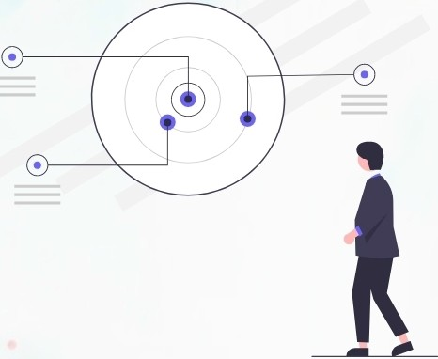
Objectives
Object ives
Brief Introduction of our project
All the branches of the Medicare can beintegrated with one to another.
To deal with the Corporate Medicare Management.
To create an efficient Electronic heath record system (EHR's)
anybody can get the status of each branch easily from the Medicare center.
Provide Client an efficient and convenient way to manage health care services

Slide 9
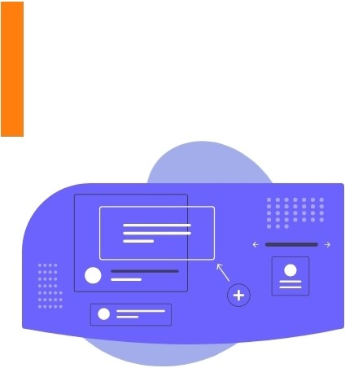
Exist ing Syste m
Existing System
Flaws within Existing System
01
02
03
04
Integration of Corporate Medicare centers is very difficult
privacy and secur ity concerns,and several unintended consequences.
Existing System
Lack of generic and unique model we have to implement the same set of data model for every newly established Medicare Center.
Disadvantage of an EHR is disruption of work-flows for medical staff and providers, which result in tempora ry losses in productivity

Slide 10

Pro posed Syst e m
Proposed System
We Must not allow other people's limited perceptions to define us :)
01
Integrated E-health care services for admin doctors and patients/clients
Proposed System
₀₂ A system through which we can optimize the bed occupation , ICU's and other services of a healthcare center

Slide 11

Feasibility
Feas ibility
Feasibility study performed on the basis of various criteria and parameters.
Economic Feasibility
Operational Feasibility
Technical Feasibility

Slide 12
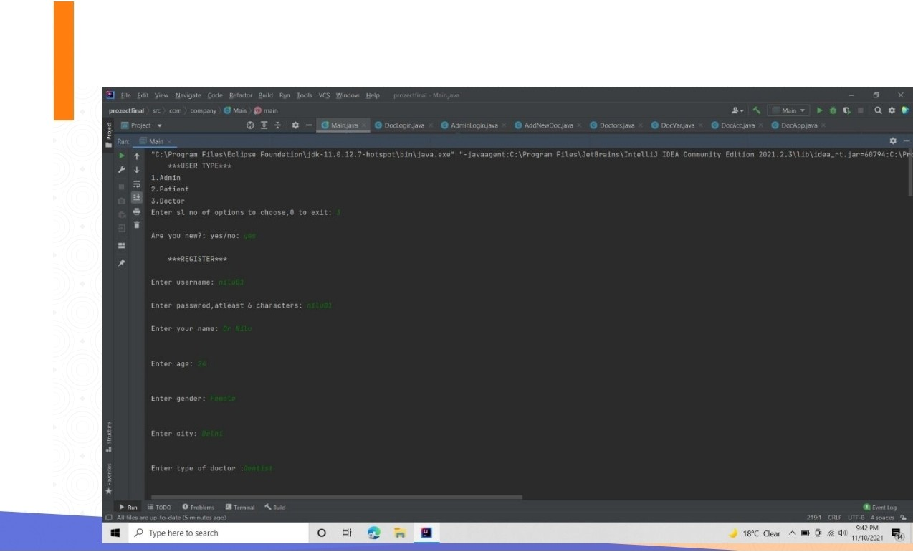
Screenshots
Sc ree ns hots

Slide 13

Screenshots
Sc ree ns hots

Slide 14

Screenshots
Sc ree ns hots

Slide 15

Screenshots
Sc ree ns hots

Slide 16

Screenshots
Sc ree ns hots

Slide 17

Screenshots
Sc ree ns hots

Slide 18

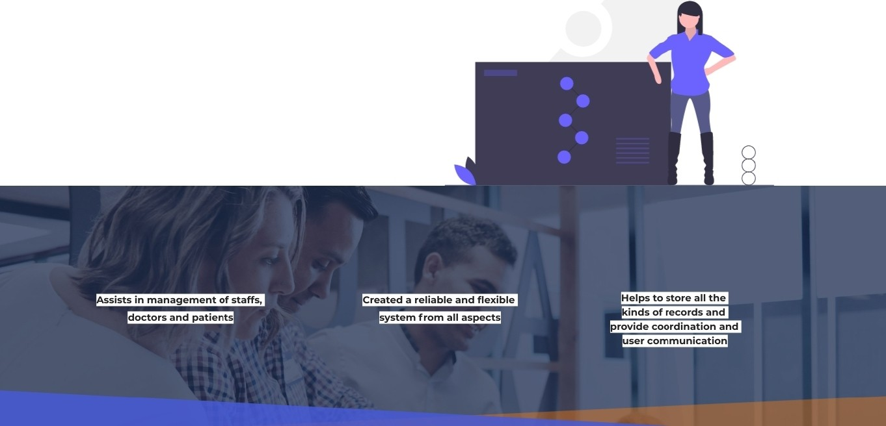
Conclusion
0
0
The growing quality demand in the hospital sector makes it necessary to exploit the whole potential of stored data efficiently, not only the clinical data, in order to improve diagnoses and treatments, but also on management, in order to minimize costs andimprove the care given to the patients.

Slide 19


