Slide 1
BOOK RECOMMENDATION
SYSTEM

Slide 2
CONTENTS
Project Overview & Objective
Data Overview
Data Preprocessing & EDA
Overview of Recommendation Models
SVD & Hybrid Models
Snapshot
Tools, Impact & Conclusion

Slide 3
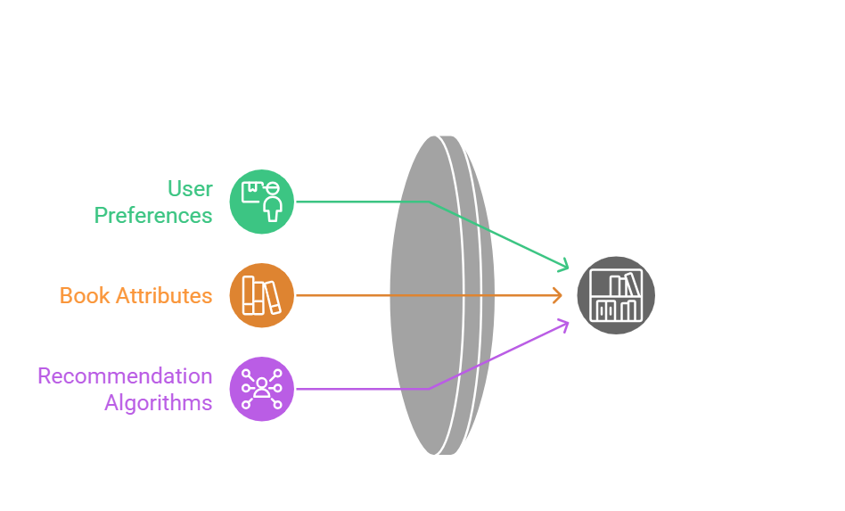
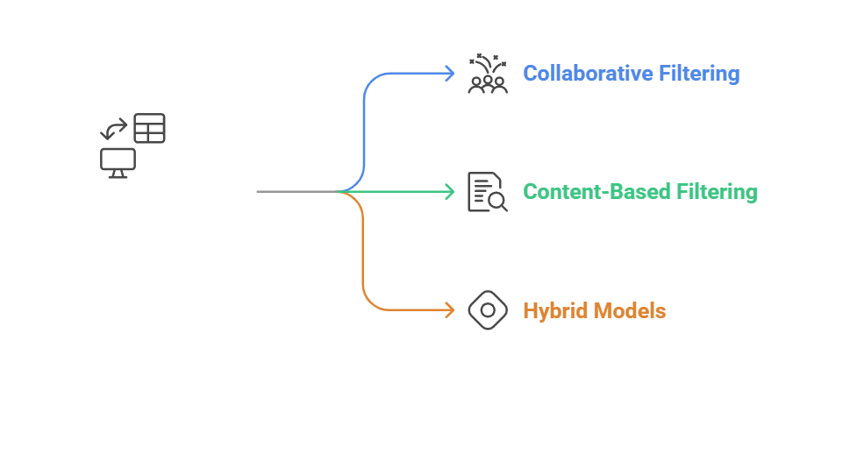
Project Overview & Objective

Slide 4
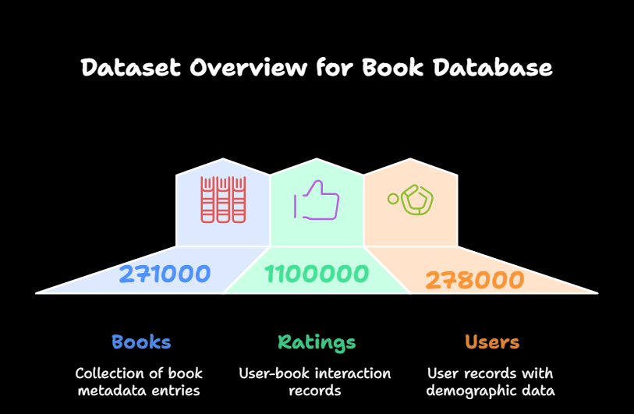
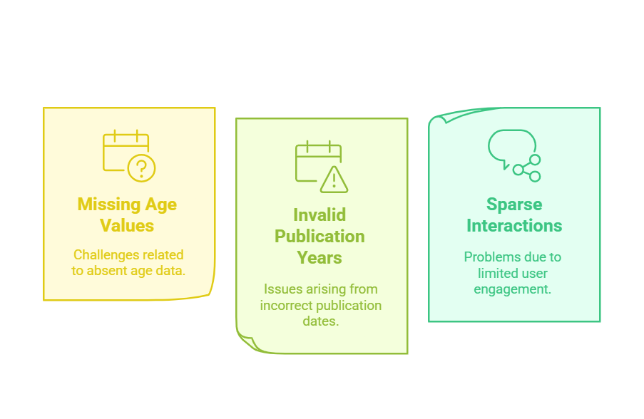
Data Overview

Slide 5
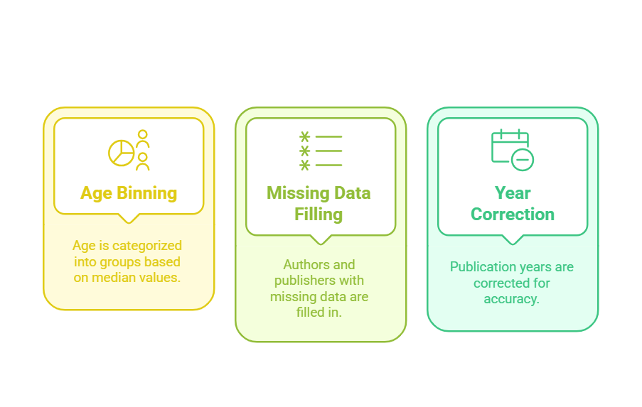
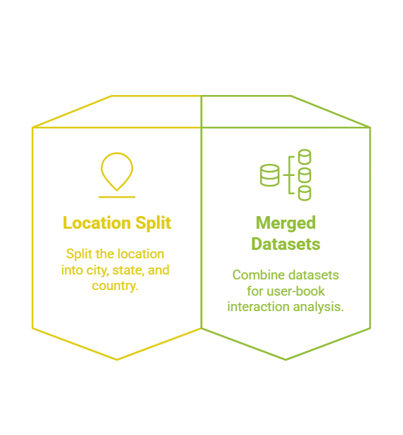
Data Preprocessing & Exploratory Data Analysis (EDA)

Slide 6
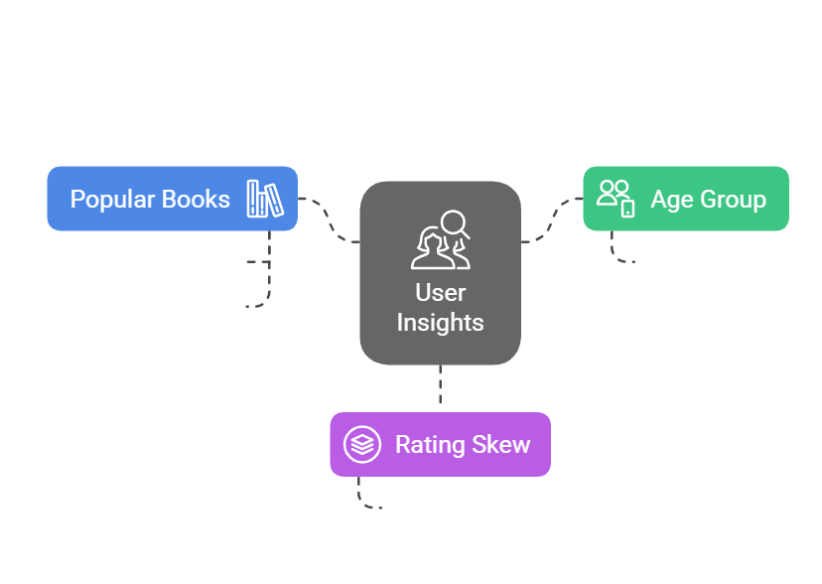
EDA Insights

Slide 7
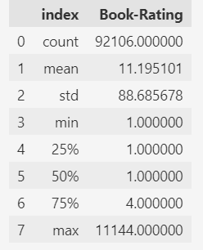
Active Users (Rating Count per User)

Slide 8
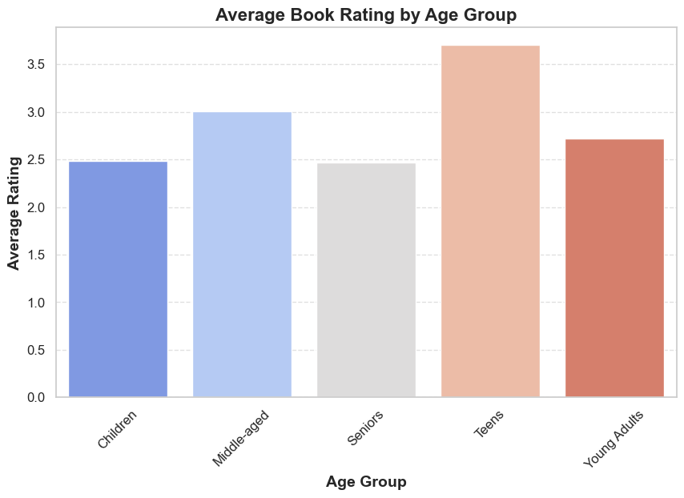
Average Book Rating by Age Group

Slide 9
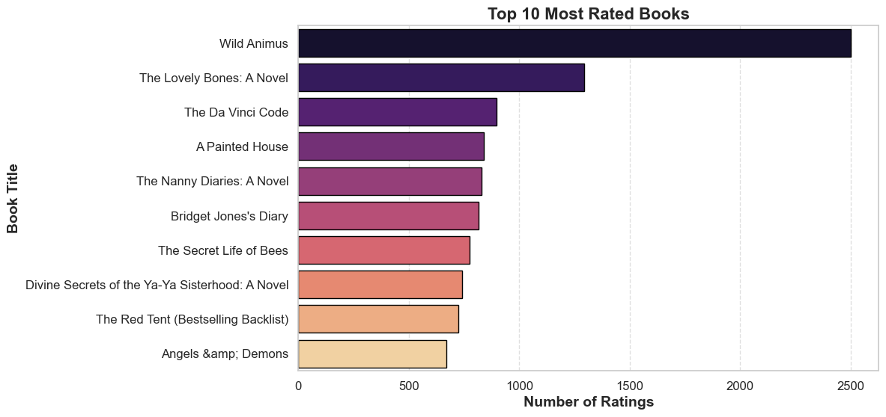
Top 10 Most Rated Books

Slide 10
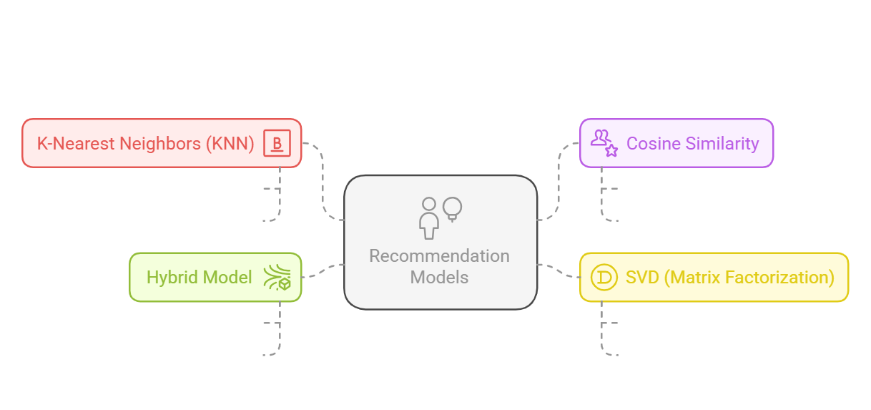
Overview of Recommendation Models

Slide 11
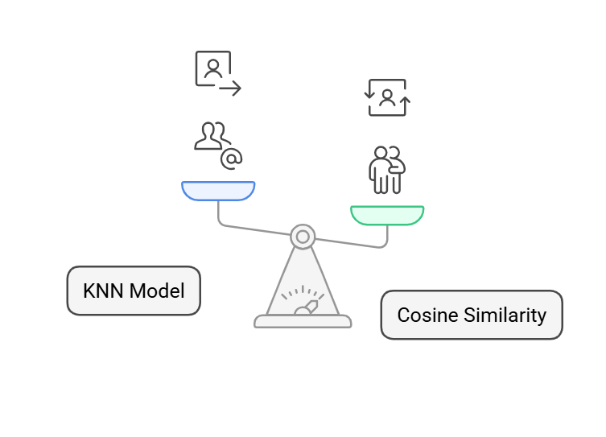
KNN & Cosine Similarity Models

Slide 12
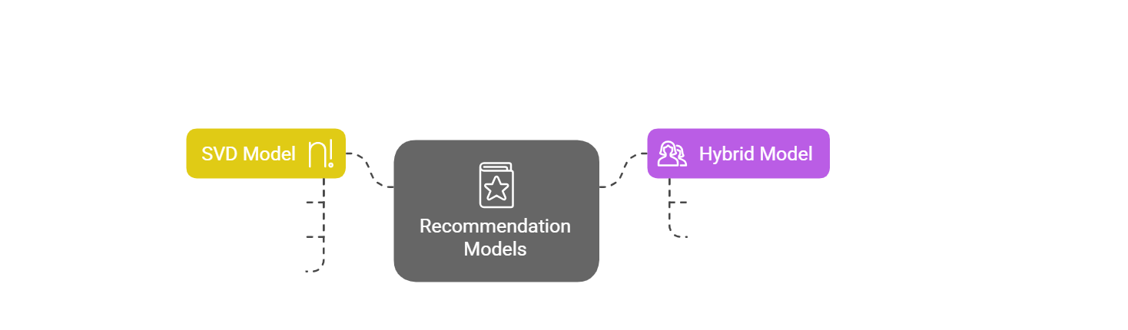
SVD & Hybrid Models

Slide 13
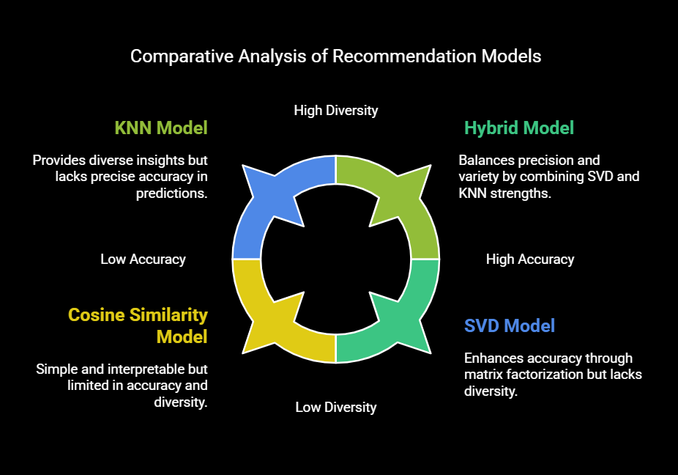
Models Comparison

Slide 14
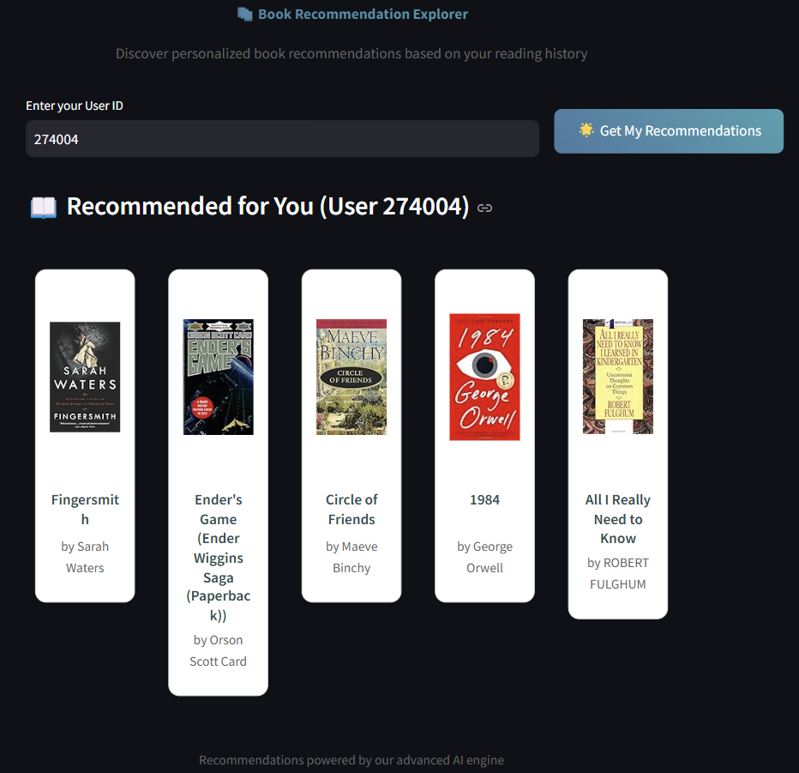
Snapshot:

Slide 15




Tools, Impact & Conclusion
Python, Pandas, NumPy, Scikit-learn, Surprise, Matplotlib/Seaborn. Algorithms: KNN, SVD, cosine similarity.
Provides personalized recommendations, handling cold-start issues with hybrid modeling. Scalable system improving user engagement through tailored suggestions.
A robust, adaptive recommendation system ready for further development and deployment.

Slide 16
THANK YOU…

