Slide 1

Department of Computer Science & Engineering Artificial Intelligence & Machine Learning
A.P. Shah Institute of Technology
G.B. Road, Kasarvadavli , Thane(W), Mumbai-400615
UNIVERSITY OF MUMBAI
Academic Year 2022-2023

Slide 2
Personal Assistant
Computer Science & Engineering
Artificial Intelligence and Machine Learning
By
Meeth Amin (21106025)
Mihir Bhave (21106051)
Om Dubey (21106021)
Tanmay Buchade (21106031)
Under the Guidance of
Prof. Mahesh Pawaskar

Slide 3

Index:
Introduction
Features
Literature survey
Tools/ Softwares, Languages used
Implementation
Conclusion
References

Slide 4
Introduction:
The software uses a device’s microphone to receive voice requests while the voice output takes place at the speaker. But the most exciting thing happens between these two actions.
It is a combination of several different technologies: voice recognition, voice analysis and language processing.
It is completely developed using one of the most powerful language python.3

Slide 5
Feature:
Generating and storing passwords
Fetching weather
Generating a qr code for a specific message
Finding a file within the system
Opening and closing apps
And many more..

Slide 6
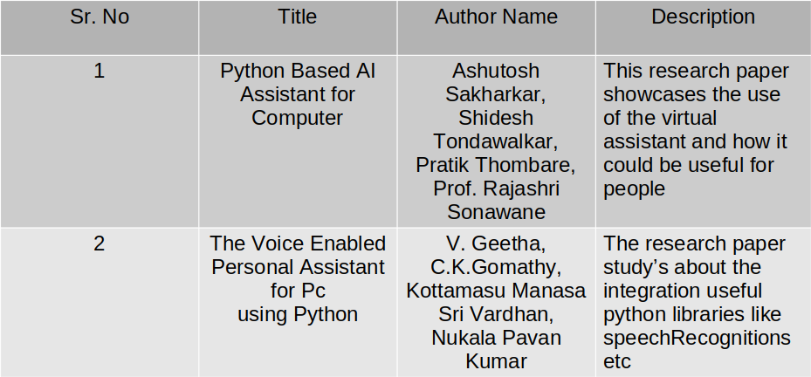
Literature survey:
Introduction
Features
Literature survey
Tools/ Softwares, Languages used
Implementation
Conclusion
References

Slide 7
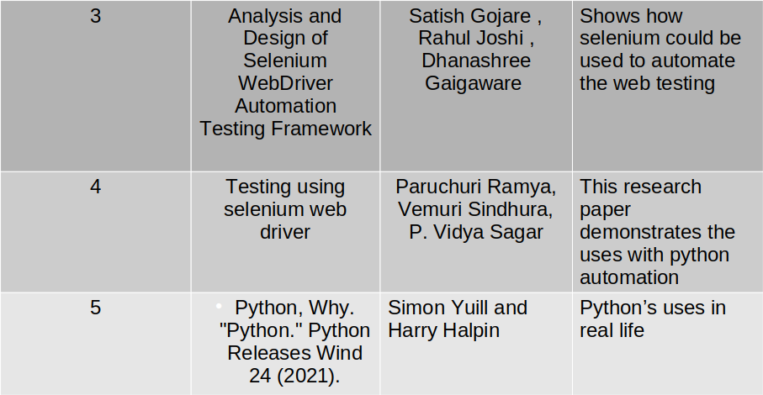

Slide 8
Technology Stack:
Python
Mysql
Pyttsx3
Selenium
SpeechRecognition

Slide 9
Conclusion:
Virtual personal assistant are very effective way to organize your schedule. Now there are many smart personal digital assistant applications available in market for various device platforms
These new software applications are performing really well
VPAs are also reliable than human personal assistant because, VPA's are more portable and you can use them anytime.

Slide 10
References:
[1] Sakharkar, Ashutosh, Shidesh Tondawalkar, Pratik Thombare, and Rajashri Sonawane. "Python based AI assistant for computer." In Conference on advances in communication and control systems (CAC2S). 2021.
[2] Geetha, V., C. K. Gomathy, Kottamasu Manasa Sri Vardhan, and Nukala Pavan Kumar. "The voice enabled personal assistant for Pc using python." International Journal of Engineering and Advanced Technology 10 (2021): 162-165.
[3] Gojare, Satish, Rahul Joshi, and Dhanashree Gaigaware. "Analysis and design of selenium webdriver automation testing framework." Procedia Computer Science 50 (2015): 341-346.

Slide 11
References:
[4] Ramya, Paruchuri, Vemuri Sindhura, and P. Vidya Sagar. "Testing using selenium web driver." In 2017 Second International Conference on Electrical, Computer and Communication Technologies (ICECCT), pp. 1-7. IEEE, 2017.
[5] Python, Why. "Python." Python Releases Wind 24 (2021).

Slide 12
Thank You

