Slide 1

BitBuilders
FutureJourney.ai
Problem Statement Title: AI-Powered Career Guidance for Secondary School Students
Theme: Smart Education
KEY POINTS:
AI based career guidance.
Collaboration with NTA and making the tests mandatory.
Feedback and Suggestion.
Increase Productivity and Planning.
Career path exploration.
Personalized Recommendations.
Educational Pathways.
Aptitude and mandatory English test.

Slide 2
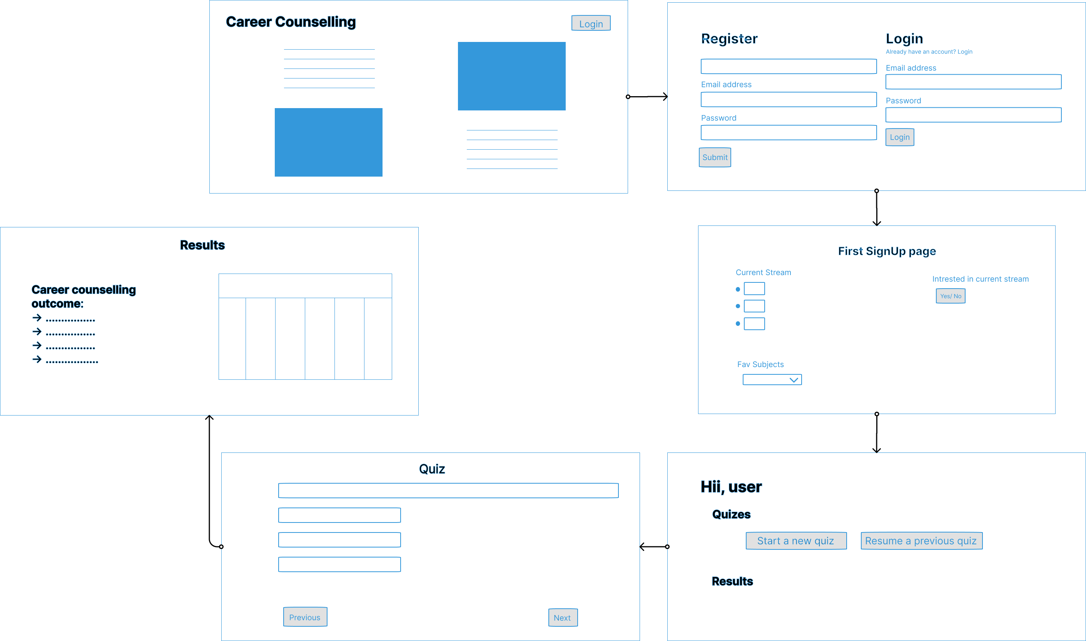
Design/ Wireframing

