Slide 1

HACKTOBERFEST 2026 · GEMMA 4
DevMind AI
Your intelligent coding companion for multimodal understanding.
Mentorship and debugging built for developers, students, and creators who need deeper context, not just copied answers.
STACK · Python · FastAPI · JavaScript · Gemma 4
Notes:
Introduce DevMind AI as a purpose-built coding companion created for Hacktoberfest 2026. Emphasize that while existing chat models emit raw answers, DevMind is designed to teach and guide using Google's Gemma 4 model with a multimodal architecture.

Slide 2

THE DEVELOPER BOTTLENECK
Developers need understanding, not just answers
Modern engineering workflows present fragmented clues. Beginners and builders lose hours piecing together disconnected logs and explanations.
Fragmented context slows momentum
Cryptic stack traces, scattered documentation tabs, and generic chatbot replies force developers to translate error messages in isolation.
Multimodal context bridges the gap
Pairing terminal screenshots, assignment PDFs, and source code allows an assistant to see the entire problem environment as the user sees it.
2
Notes:
Clarify the core friction: traditional chatbots expect cleanly pasted text, but real bugs live in terminal windows, UI render errors, and assignment sheets. DevMind AI accepts raw developer artifacts so users learn the root cause rather than copy-pasting opaque fixes.

Slide 3
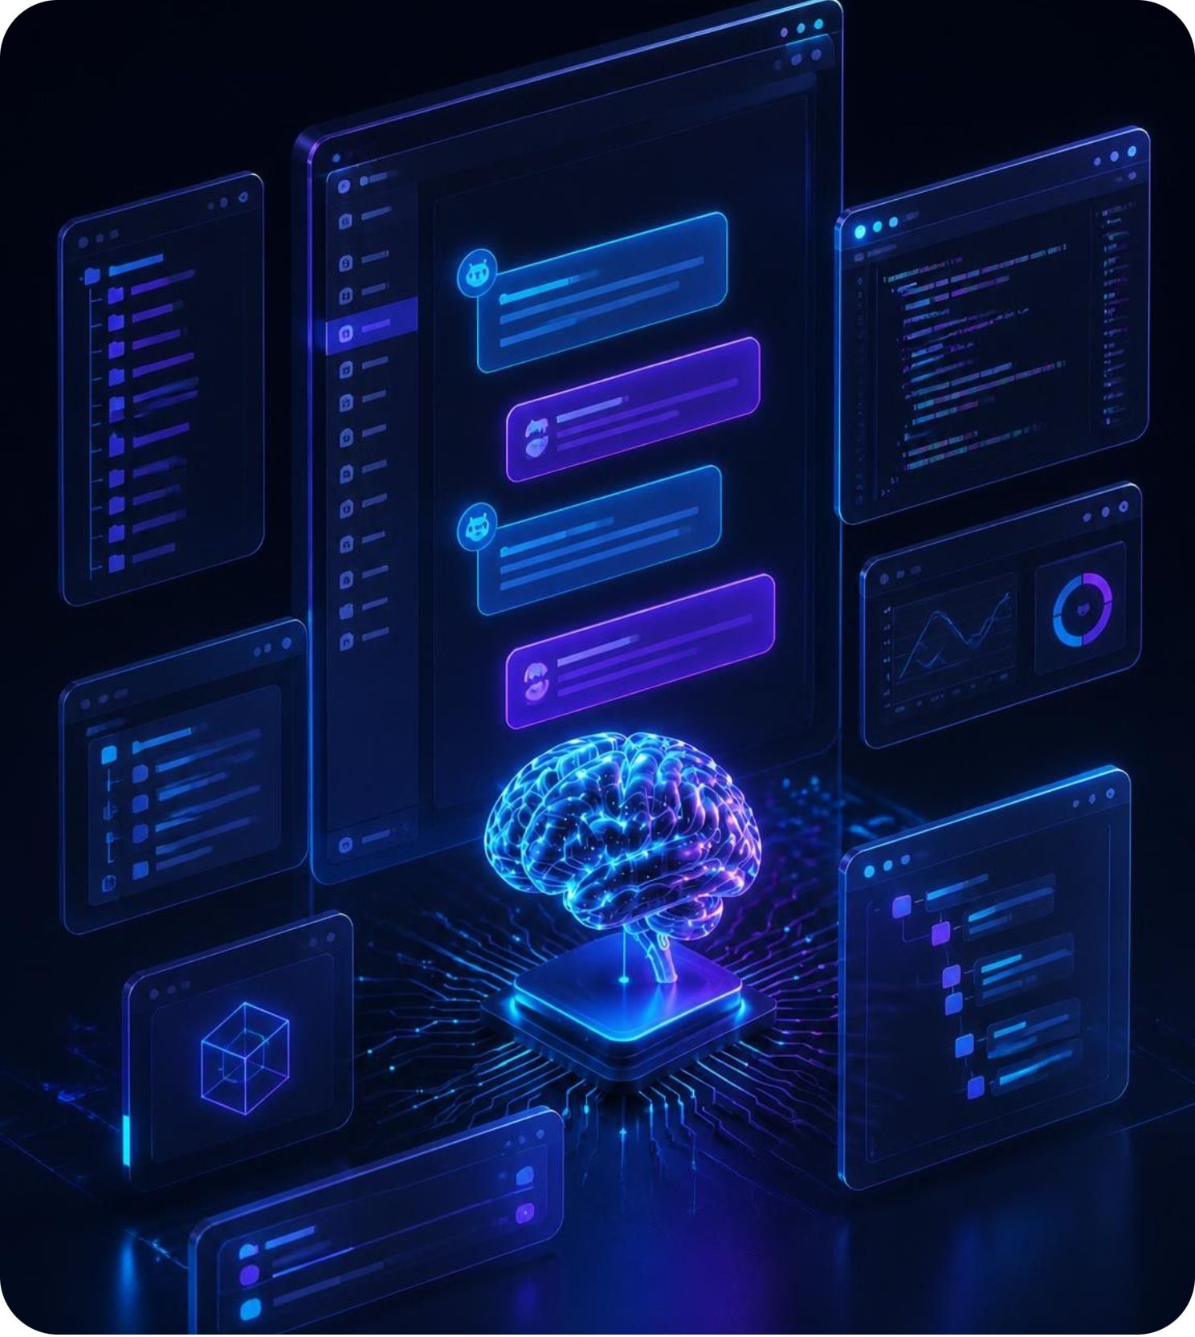
SYSTEM OVERVIEW
Meet DevMind AI
A responsive chat for coding mentorship, debugging, and concept mastery.
Interactive coding mentorship
Iterative guidance on architecture choices, language quirks, and refactoring techniques.
Exploratory project ideation
Curriculum and hackathon project scaffolding for student goals, with milestones and step-by-step roadmaps.
Conceptual interface mockup · Developer interaction preview
ASK
UPLOAD
UNDERSTAND
BUILD
3
Notes:
Walk the judges through the high-level capabilities. Mention that the UI on the right is a conceptual mockup illustrating the dual-pane workflow: source code inspection on one side, conversational diagnostic breakdown on the other.

Slide 4




INPUT MODALITIES
Beyond text: multimodal inputs
Developers communicate through multiple artifacts. DevMind AI accepts diverse media and routes each through dedicated processing pipelines.
Text & Code
Screenshots
PDF & DOCX
Sampled Video
Raw code blocks, stack traces, and natural questions for rapid conversational troubleshooting and syntax review.
Terminal panels, IDE dialogs, and broken browser layouts analyzed directly for visual error recognition.
Assignment sheets, specification docs, and lecture slides extracted server-side into structured prompt context.
Keyframes sampled from short screen recordings; note this implementation samples frames without native audio tracking.
4
Notes:
Highlight the engineering candor on this slide: be clear that PDF and DOCX use server-side text extraction before inference, while video support samples key individual frames rather than running a full multimodal video/audio stream.

Slide 5
PIPELINE ARCHITECTURE
How the system works
From client input to contextual response, requests traverse a secure decoupled validation and inference pipeline.
01
02
03
04
05
Client UI
HTTP Ingestion
File Extract
Google SDK
Gemma 4 Output
Responsive HTML/CSS/JS chat captures text, code, or attachments.
Python processors unpack PDFs, DOCX docs, and image buffers safely.
Assembled context dispatched via Google GenAI SDK with server-held keys.
FastAPI endpoint receives payload with multipart form validation.
Model emits structured diagnosis, corrected code, and learning tips.
SECURITY ASSURANCE · API keys remain strictly contained in server environment variables; client sessions never access external model credentials directly.
5
Notes:
Describe the data flow to the judges. Point out that running inference through FastAPI ensures zero API key exposure in browser client code, while enabling server-side sanitization and validation of uploaded document files.

Slide 6
TECHNOLOGY FOUNDATION
Built on Gemma 4 and a practical stack
A resilient, production-ready stack emphasizing zero client configuration and dependable hosted API inference.
CORE MODEL
BACKEND SERVICES
CLIENT & OPS
gemma-4-26b-a4b-it
FastAPI & Python
Vanilla Web & Render
Targeted model configured via hosted cloud API inference rather than local GPU hosting or custom pre-training, ensuring fast cold-starts and high reasoning quality.
High-throughput asynchronous routing, Pydantic data schemas, document parsing libraries for office and PDF files, and strict environment configuration.
Lightweight HTML5, CSS3, and modern JavaScript with local browser history caching; tracked via Git and configured for cloud container deployment on Render.
6
Notes:
Address implementation scope explicitly: explain that DevMind AI utilizes Google's gemma-4-26b-a4b-it instruct model via hosted API inference. This allowed the Hacktoberfest team to focus on robust document handling, backend security, and UI polish rather than managing raw weight checkpoints.

Slide 7
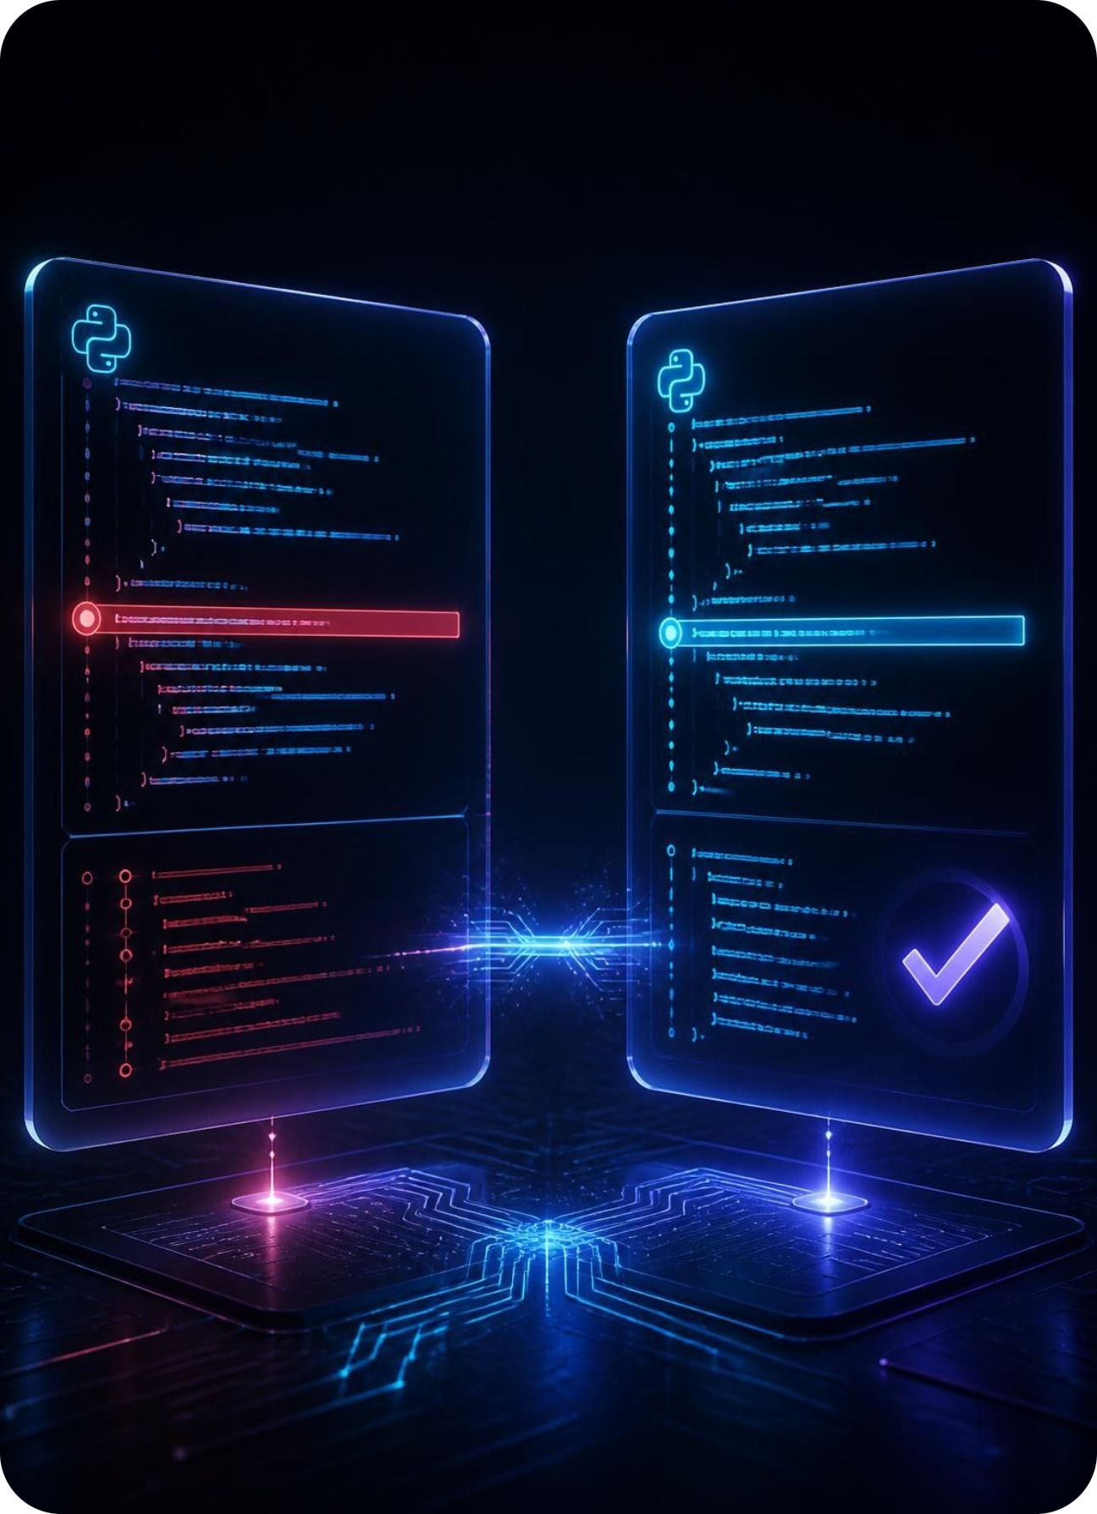
WALKTHROUGH SCENARIO
From an IndexError to understanding
A classroom example shows how DevMind AI can turn an error into a learning moment.
01
Screenshot upload
A student uploads a screenshot of a Python IndexError: list index out of range alongside their loop code.
02
Identify and correct
The assistant identifies the visible error, such as an off-by-one boundary condition, and suggests corrected code.
03
Explain and prevent
It explains the possible cause and zero-indexed lists, with prevention tips such as len() boundary checks.
Diagnostic scenario · Visual stack trace analysis
7
Notes:
Walk through this illustrative user journey: a student encounters an off-by-one error during loop execution, uploads the screenshot, and receives not just corrected code, but an explanation of index boundaries and prevention tips.

Slide 8
SYSTEM ATTRIBUTES
Engineering for reliability and learning
A comparison of how engineering decisions directly support developer trust, data safety, and pedagogical outcomes.
System Focus | Engineering Implementation | Developer Experience Impact
API Security | Server-side secret isolation via FastAPI and environment variables | Eliminates token leaks in client code; supports multi-user sessions
Input Processing | Multi-format parsers with payload sanitization and size guardrails | Handles raw IDE screenshots and assignment docs without failure
State & Ergonomics | Local browser session storage paired with custom responsive CSS |  | Preserves chat context across refreshes with zero cloud tracking
Extensibility | Decoupled modular architecture open-sourced for Hacktoberfest | Enables community contributors to plug in new parsers and UI hooks
8
Notes:
Review the table columns to explain how backend rigor directly improves user trust. Point out that local storage keeps chat history private on the developer's machine without requiring a heavy external database during early hackathon testing.

Slide 9
DEVELOPMENT ROADMAP
What comes next?
DevMind AI establishes a solid hackathon MVP. Future milestones expand realtime capabilities and developer ecosystem integrations.
1
2
3
PHASE 1 · INTERACTION
PHASE 2 · ECOSYSTEM
PHASE 3 · COLLABORATION
Repository Intelligence
Streaming & Comparison
Full Multimodal Workspaces
Direct GitHub repository scanning, automated pull request reviews, automated test generation, and personalized learning paths based on coding history.
Token streaming for lower latency, voice interaction prompts, encrypted cloud history synchronization, and side-by-side multi-model response evaluations.
End-to-end continuous video analysis for live screen debugging, team-shared coding rooms, and tight IDE plugin extensions for VS Code.
9
Notes:
Clearly state that Phase 1 through 3 represent our forward-looking product roadmap. Distinguish these planned features—such as token streaming and GitHub repo reviews—from the currently working multimodal chat MVP demonstrated today.

Slide 10

DEVMIND AI · CONCLUSION
Think Smarter.
Code Better.
Build Faster.
Turning diagnostic complexity into programming comprehension with multimodal AI.
Live Project Demo: DevMind-AI
GitHub Repository: [https://github.com/Ayush-keshri-dev/DevMind-AI]
Built for Hacktoberfest 2026 · Powered by Gemma 4
QUESTIONS & ANSWERS
Notes:
Conclude the presentation by reinforcing DevMind AI's vision: making software development accessible and educational through multimodal context. Invite hackathon judges and audience members to test the live deployment and open the floor for questions.

