Slide 1

IT Ticket Analysis
Performance, efficiency & staffing insights from 5 years of ticket data
Ayush Khobragade

Slide 2




Agenda
What this presentation walks through
01
Problem Statement
Understanding the main problem and what needs to be solved.
02
Data Description
Overview of the data sources and important attributes.
03
Objective Metrics & Visualizations
Key findings from the data using metrics, tables, and charts.
04
Subjective Insights
Observations and useful insights based on the analysis.

Slide 3




Problem Statement
The question we're here to answer
Find high & low performers
Analyze the IT support ticket data to understand how well the support team handles tickets, how quickly issues are resolved, and how satisfied employees are with the service.
Measure resolution efficiency
The goal is use the data to help management make better decisions about employee performance, staffing , training, and future improvements.
Track employee satisfaction
Guide hiring, training & investment

Slide 4


Data Description
The dataset is built from two linked sheets, joined on Agent ID called Cleaned Data.
Tickets
IT Agents
97,498 rows · 10 attributes
50 rows · 6 attributes
ID Ticket
Date (Fecha)
Employee ID
Agent ID
Request Category
Issue Type
Severity
Priority
Resolution Time
Satisfaction Rate
Agent ID · Full Name
Email address
Year of Birth
Month of Birth
Day of Birth

Slide 5




My Analytical Approach
01
02
03
Clean
Summarise
Analyse
Standardised dates and agent names, checked every column for gaps with Power Query.
Built pivot tables to group tickets by agent, category, priority and year.
Compared resolution times, satisfaction and workload to answer each project question.

Slide 6




OBJECTIVE
Data Quality & Structure
16
0
total attributes (10 in Tickets + 6 in IT Agents)
missing or inconsistent values remaining after cleaning
7
41
categorical columns used for grouping and slicing
average agent age in years (range 29 - 54)
Categorical columns: Quarter, Month, Agent Name, Request Category, Issue Type, Severity and Priority. Severity and resolution time are barely correlated (r ≈ −0.04).

Slide 7



Dashboard: Key Charts & Insights
An interactive Excel dashboard with multiple slicers. The next slides walk through each of its charts with the takeaways that matter most.
6 slicers
15 linked charts
Live KPI cards

Slide 8

CHART 1
Category wise ticket volume
Key Insights
System tickets have highest volume(40%).
1
Login Access tickets account for 30% of the total.
2
Software and Hardware tickets contribute 20% and 10% respectively.
3

Slide 9
CHART 2
Severity wise ticket volume
Key Insights
Normal Tickets make up the majority (90.93%).
1
Major Tickets account for (4.98%).
2
Urgent and Unclassified tickets have the lowest volumes.
3

Slide 10
CHART 3
Total Tickets by Issue Type
Key Insights
IT-request tickets are the majority (73220).
1
IT-error tickets are the significantly lower at (24278).
2
The data shows a strong concentration of tickets in IT issues.
3

Slide 11
CHART 4
Category vs Avg. Resolution Time
Key Insights
Hardware has the highest resolution time.
1
System and Software tickets take moderate time to resolve.
2
Login Access tickets have the lowest resolution time.
3

Slide 12
CHART 5
Avg. Resolution Time(Days)
Key Insights
Resolution time stays fairly stable across the years.
1
The highest value is 4.65 days, while the lowest is around 4.50 days.
2
Overall, there is no major change in resolution time over the period.
3

Slide 13
CHART 6
Avg. Satisfaction Rate
Key Insights
Satisfaction shows a gradual upward trend from 2016 to 2020.
1
The highest satisfaction is 4.19, recorded in 2020.
2
Overall satisfaction remains consistently high throughout the period.
3

Slide 14
CHART 7
Total Tickets Over Time
Key Insights
Ticket volume shows a clear upward trend from 2016 to 2020.
1
The sharpest growth occurs during 2019-2020.
2
Ticket volume reaches its highest level in 2020.
3

Slide 15
CHART 8
Distribution Of Tickets based on Resolution Time
Key Insights
Most tickets are resolved within 0-7 days.
1
Ticket volume drops sharply as resolution time increases.
2
Very few tickets take more than 16 days to resolve.
3

Slide 16
CHART 9
Distribution Of Tickets based on Satisfaction Rate
Key Insights
Satisfaction increases significantly with higher satisfaction ratings.
1
Ratings 4–5 account for the largest ticket volumes.
2
Ratings around 2 have the lowest ticket volume.
3

Slide 17
CHART 10
Age Group vs Avg. Satisfaction Rate
Key Insights
The 53–58 age group has the highest satisfaction (4.40).
1
The 41–46 group has the lowest satisfaction (4.00).
2
Satisfaction generally increases with age, with a small dip in the middle groups.
3

Slide 18
CHART 11
Agent with Highest Number Of Tickets
Key Insights
The chart shows the 10 agents with the highest ticket volumes.
1
Aurelio Tanori has the highest ticket count among the top 10.
2
Ticket volume gradually decreases across the remaining top agents.
3

Slide 19
CHART 12
Age Group wise Ticket Volume
Key Insights
The 41–46 age group has the highest ticket volume.
1
High-priority tickets have the highest volume across most age groups.
2
Ticket volume is generally lower in the 53–58 age group.
3

Slide 20
CHART 13
Severity wise avg. Satisfaction rate
Key Insights
Highest satisfaction rate is of Unclassified severity type(4.17).
1
Lowest satisfaction rate is of Minor severity type(4.07)
2
Satisfaction is fairly consistent across all severity levels.
3

Slide 21
CHART 14
Severity vs Ticket Volume
Key Insights
Normal Tickets make up the largest share (88656).
1
Major Tickets are the second largest (4836).
2
Urgent Tickets are the lowest (356).
3

Slide 22
CHART 15
Severity vs Avg. Resolution Time
Key Insights
Normal Tickets have highest resolution time each year.
1
Urgent Tickets have lowest resolution time each year.
2
Resolution time is fairly stable from 2016-2020, with small yearly changes.
3

Slide 23
OBJECTIVE
How Much Each Agent Handles
Tickets handled per agent (50 agents in total). The load is spread fairly evenly.
Busiest agents by volume
~1,950
1
Aurelio Tanori
2,027
tickets handled by a typical agent across the period
2
Jesus Contreras
2,026
3
Elena Velez
2,021
What this means
4
Melinda
2,007
Workload alone doesn't separate good from struggling agents, everyone handles a similar number of tickets. To judge performance, we have to look at satisfaction and resolution speed, not volume.
5
Barbara Grijalva
2,003

Slide 24


SUBJECTIVE
Who Needs Training?
Satisfaction varies far more between agents than the 4.10 average suggests from 3.0 to 4.6.
Top performers
Need support / training
Agent
Satisfaction rate
Resolution rate
Agent
Satisfaction rate
Resolution
rate
Diana Rojo
4.60
3.6d
Alfonso Barraza
3.04
5.0d
Javier D.
4.49
4.1d
A. Trejo
3.59
5.3d
Galindo Guadalupe
4.47
3.7d
Sandra Lujan
3.60
5.2d
Recommendation: Target coaching at the bottom group rather than firing as they carry full workloads, so the issue looks like skill and process, not effort.

Slide 25



SUBJECTIVE
Where Should We Invest?
Comparing the three options against the evidence, hire, train, or upgrade software.
Hire more agents
Improve training
Upgrade software
Lower priority
Best value
Selective
Workload is already even and satisfaction is rising hence capacity isn't the bottleneck yet.
Closes the wide 3.0 - 4.6 satisfaction gap between agents at low cost. Direct, fast impact.
Worth it specifically for self-service login & auto-triage which is not a full platform replacement.

Slide 26

RECOMMENDATION 1
Invest First in Targeted Training
1
RECOMMENDATION
Direct the budget toward coaching the lowest-satisfaction agents before mass hiring or a software overhaul.
WHY - THE DATA
Satisfaction ranges from 3.0 to 4.6 across agents despite similar workloads which is a skill and process gap, not a capacity one.
EXPECTED IMPACT
Lifting the bottom group toward the team average is the cheapest, fastest way to raise the overall 4.10 score.

Slide 27
RECOMMENDATION 2
Automate Login-Access Requests
2
RECOMMENDATION
Roll out self-service password resets and an automated access portal for the Login Access category.
WHY - THE DATA
Login Access is 30% of all tickets (29,000+) and clears in just 0.3 days means high volume, low complexity.
EXPECTED IMPACT
Deflecting these frees agents to focus on Hardware and System tickets, which take 7+ days and need real skill.

Slide 28

RECOMMENDATION 3
Enforce Priority Triage & Scale With Growth
3
RECOMMENDATION
Make priority a required field at intake, and plan hiring against the proven ~15-20% yearly volume growth.
WHY - THE DATA
29,410 tickets (30%) sit 'Unassigned' and drag out to 5.3 days; volume has risen every single year.
EXPECTED IMPACT
Removing the unassigned tier tightens SLAs, and forecast-based staffing protects the rising satisfaction trend.

Slide 29
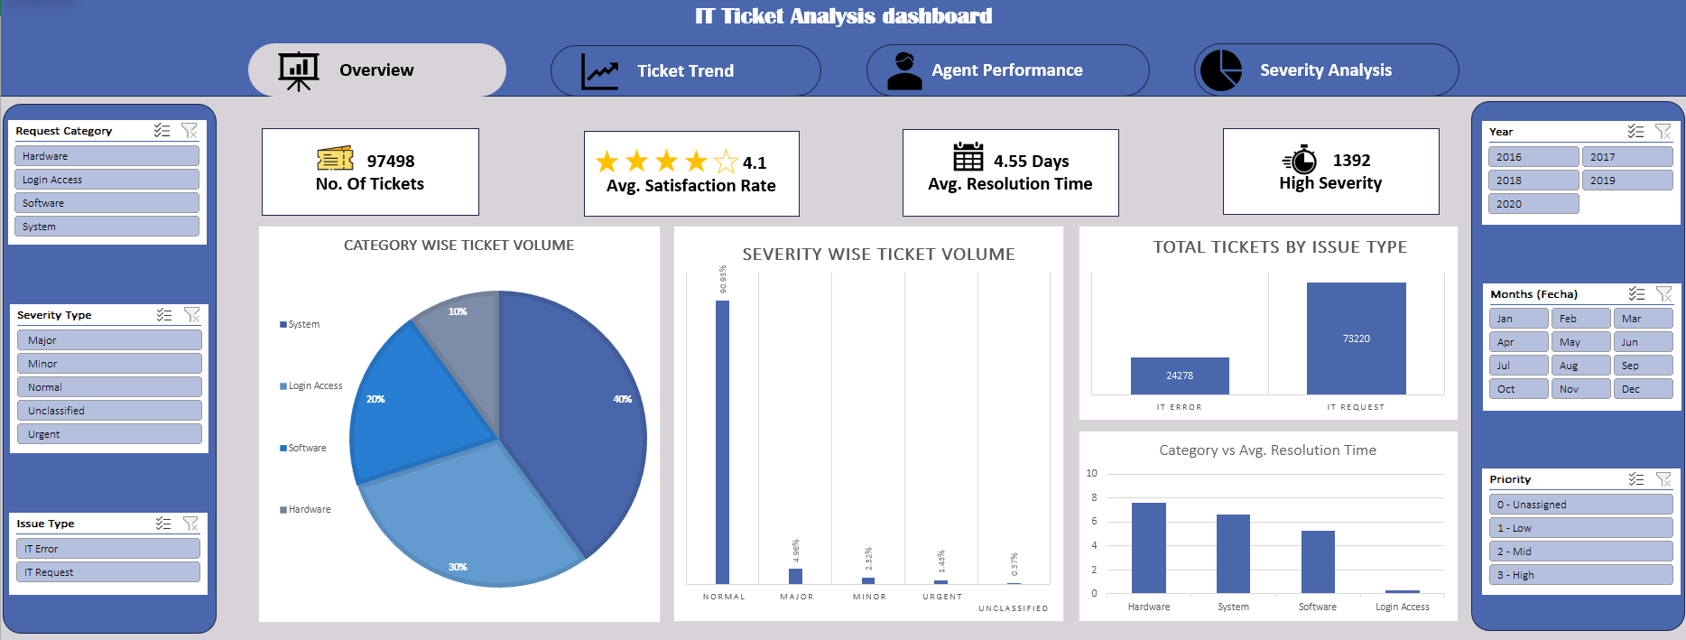
Interactive Performance Dashboard

Slide 30
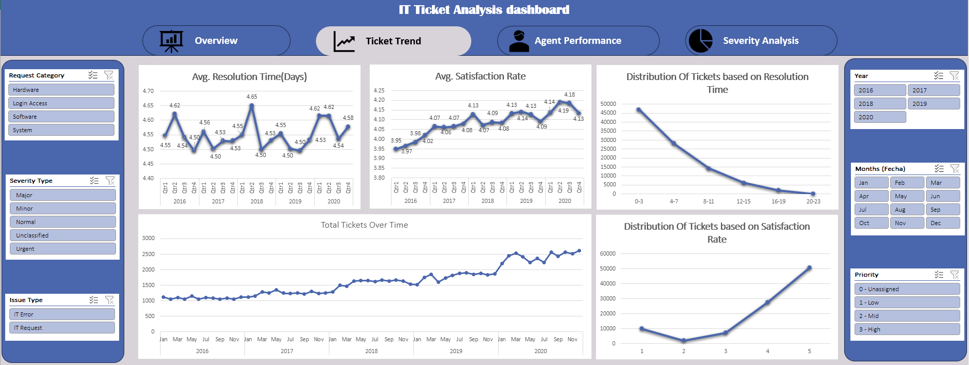
Interactive Performance Dashboard

Slide 31
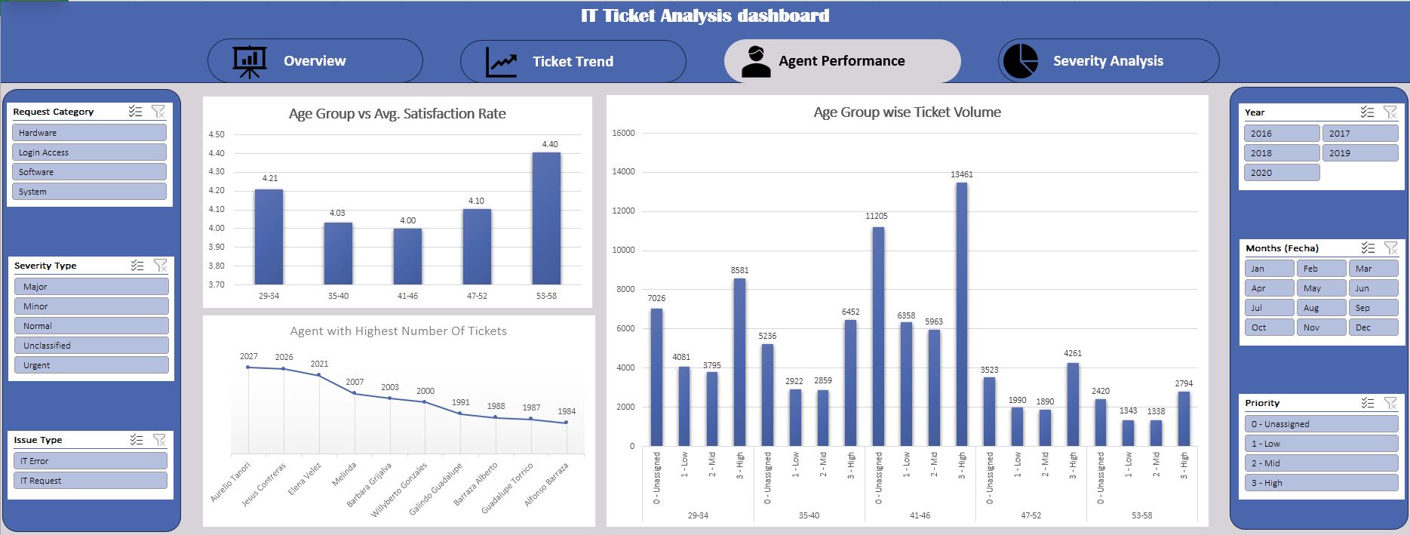
Interactive Performance Dashboard

Slide 32
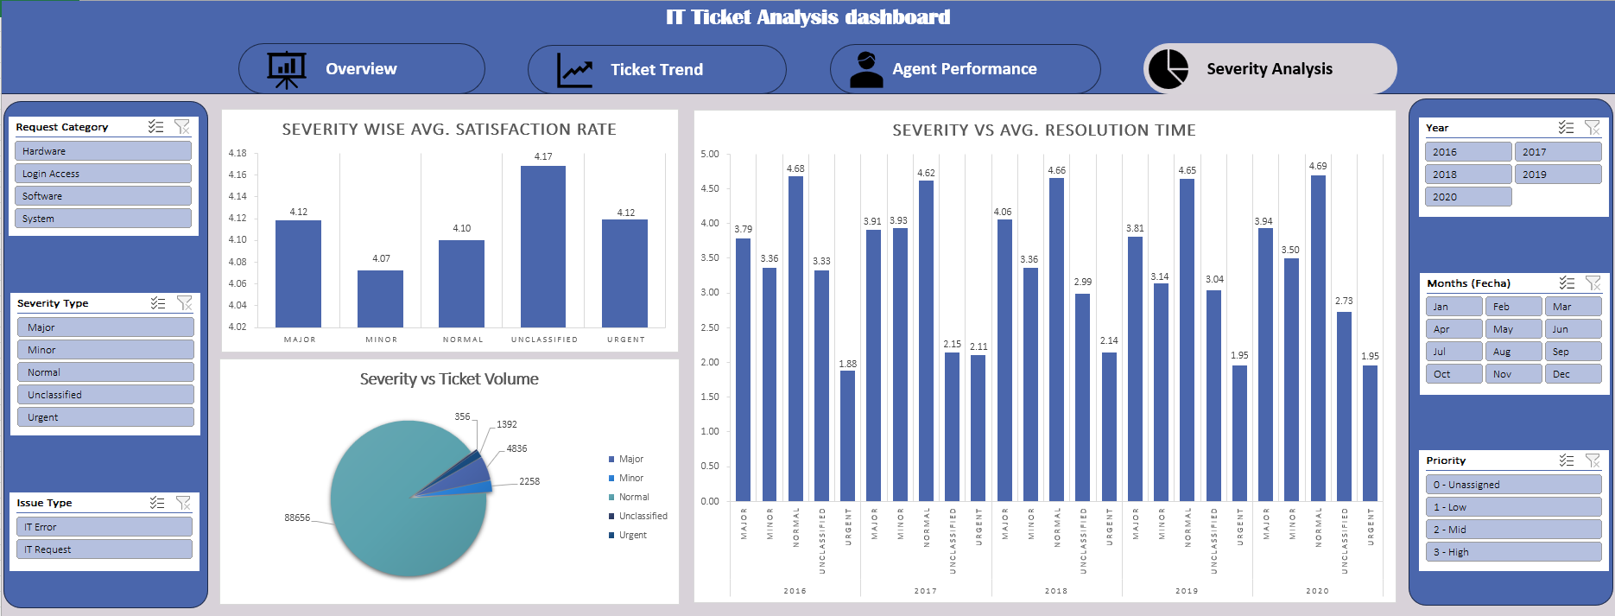
Interactive Performance Dashboard

Slide 33



CONCLUSION
Conclusion
In three numbers
97,498
A capable team is absorbing fast-growing volume while satisfaction keeps rising.
The gains to chase are a wide agent-to-agent skill gap, slow Hardware/System work, and untriaged tickets.
Invest in training first, automate routine logins, and enforce triage and then scale staffing with growth.
tickets analysed across 5 years
3.0 - 4.6
satisfaction gap between agents
25×
resolution gap between categories

Slide 34



Acknowledgements & References
Data source
IT Tickets Analysis dataset - Tickets & IT Agents sheets, 2016-2020.
Tools used
Microsoft Excel - Excel Formulas, pivot tables, charts, filters, conditional formatting and slicers.
Thanks
To my mentors and reviewers for the chance to present this analysis.
Thank you

