Slide 1

Ecothon
THEME - Hack for Environment

Slide 2
MPPT INTEGRATED SOLAR POWERED GRID CONNECTED SYSTEM FOR AIRPORT ENERGY DEMAND AND ELECTRIC VEHICLE CHARGING SYSTEM
TEAM :: DESTRO
Team Members
Rishabh Raj
Ayush Negi

Slide 3
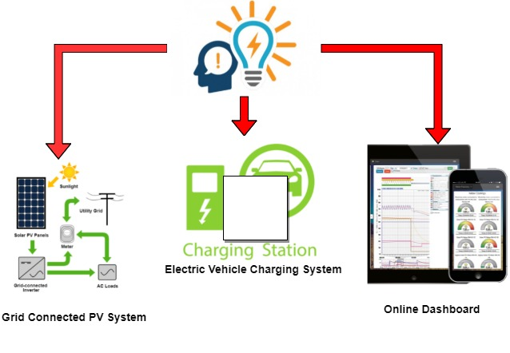
IDEA AND IMPLEMENTATION
To develop a Grid connected MPPT Integrated solar PV System for electric vehicle charging and Airport Energy Demand Management.
Solar Powered Fast Charging System to Charge Electric Tow Tugs / Luggage Cart/ Passenger Vehicles.
online dashboard using IOT for 24/7 monitoring of System.

Slide 4
The main idea of our project is divided into two major parts :
The first part majorly focuses on drawing maximum power from solar PV array to reduce load on grid.
Integration could be done to charge Electric Tow Tugs / Luggage Cart/ Passenger vehicle.
This could be highly reliable as:
the efficiency of controller can be upto 99% .
High initial cost but low maintenance cost and high durability .
This is Scalable, Profitable and Sustainable.

Slide 5
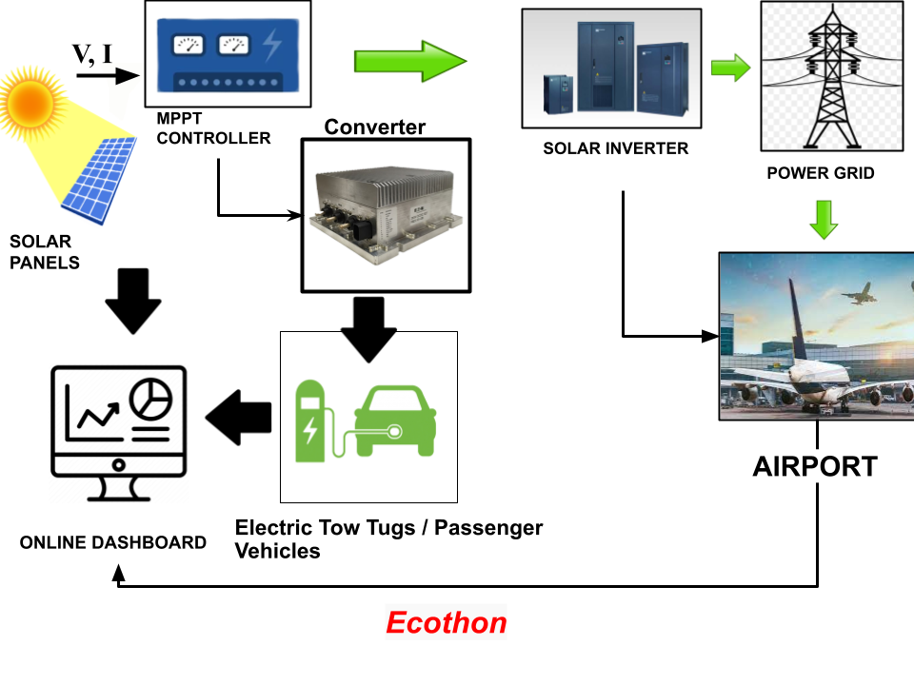
Block Diagram of the Model:

Slide 6
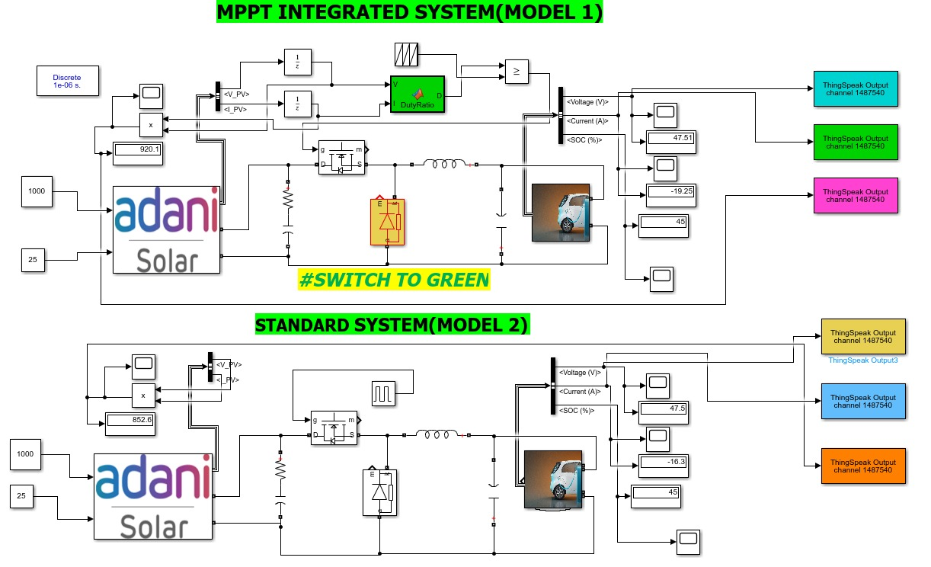
DEMO MATLAB SIMULINK MODEL

Slide 7
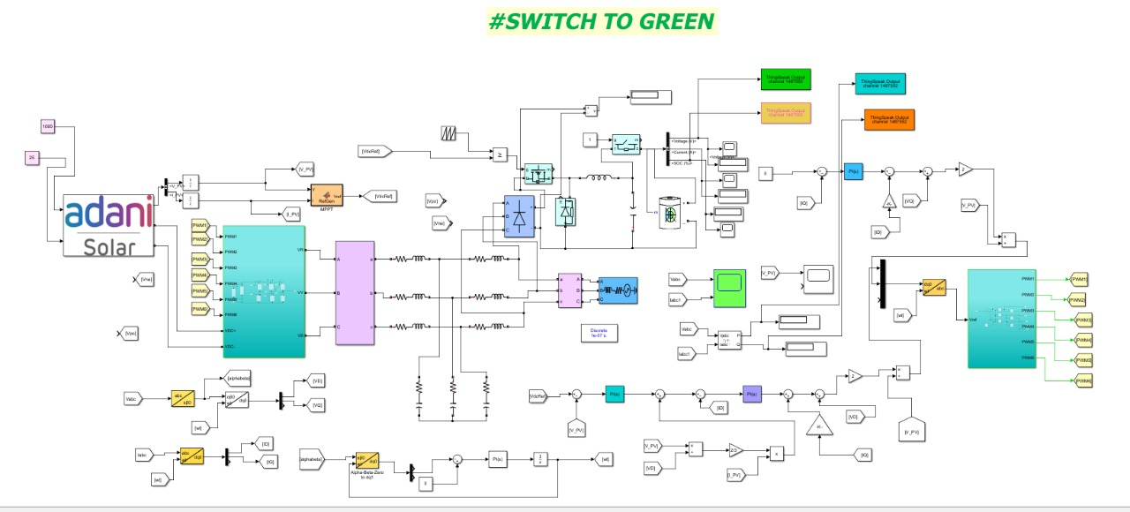

Slide 8
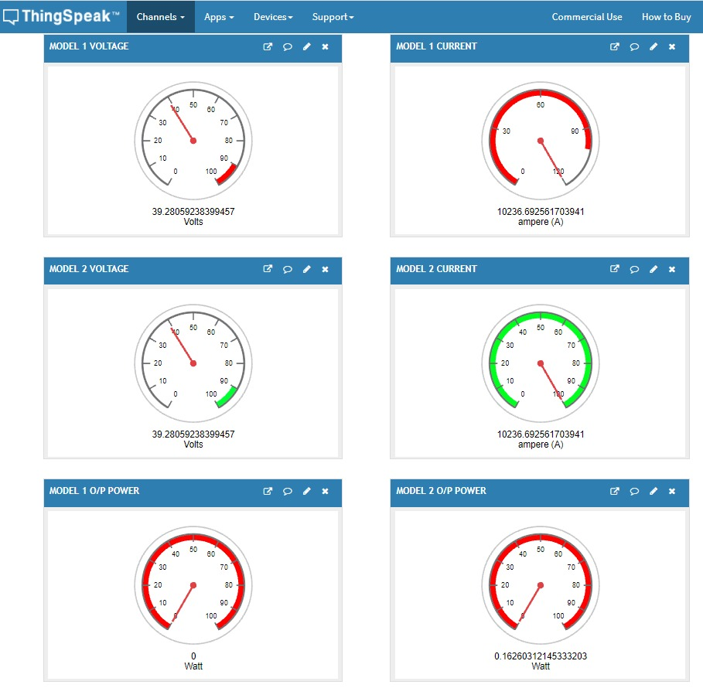
ONLINE DASHBOARD

Slide 9

AVERAGE OUTPUT POWER OF STANDARD AND MPPT INTEGRATED PV MODEL 𝐸𝑓𝑓𝑖𝑐𝑖𝑒𝑛𝑐𝑦 = $\frac{Pout}{Pmax}$×100
Technique | 1000 W/m² |  | 500 W/m² |  | 100 W/m²
 | P max | Pout | P max | Pout | P max | Pout
Standard (without MPPT) | 1200.9 | 838 | 609.5 | 413 | 117 | 81.5
P&O MPPT | 1200.9 | 1200 | 609.5 | 608.9 | 117 | 116.6

Slide 10
TRACKING EFFICIENCY OF SYSTEM
IRRADIANCE | EFFICIENCY
 | STANDARD | WITH MPPT
1000 W/m² | 69.78% | 99.92%
500 W/m² | 67.76% | 99.90%
100 W/m² | 69.66% | 99.66%
AVERAGE EFFICIENCY W/m² | 69.07% | 99.83%

Slide 11
EV BATTERY CHARGING TIME WITH DIFFERENT IRRADIANCE
Technique | Irradiance
 | 1000 W/m² | 500 W/m² | 100 W/m²
P&O MPPT | 2.5 hrs | 4.6 hrs | 20 hrs
Standard ( Without MPPT) | 3.2 hrs | 7.0 hrs | 40 hrs

Slide 12
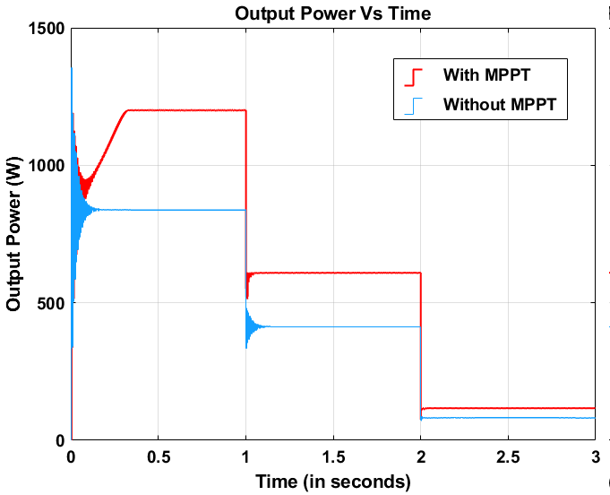
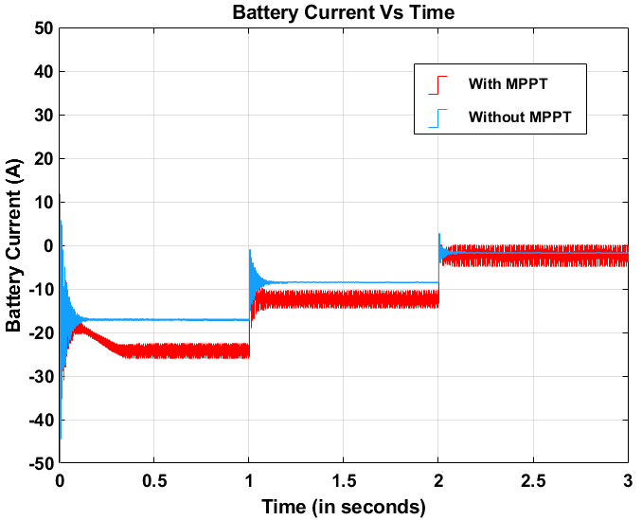
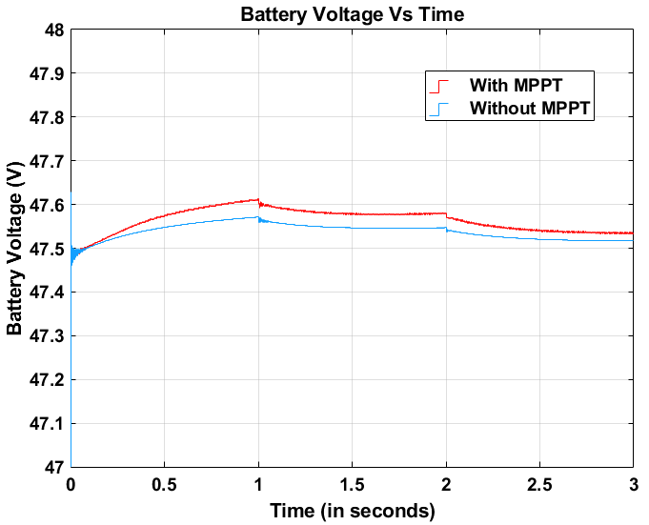
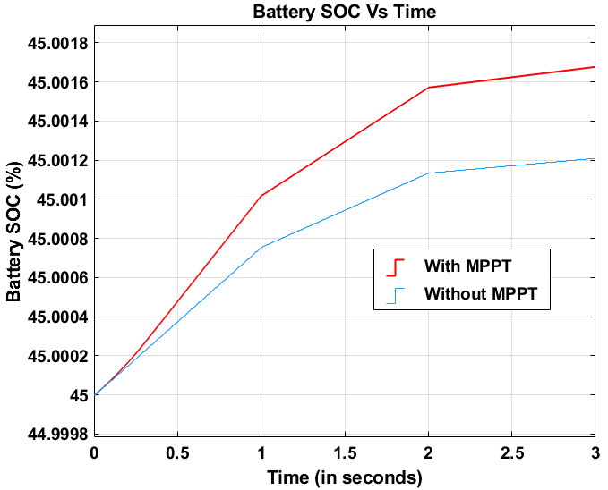
COMPARISION OF OUTPUT POWER , VOLTAGE ,CURRENT AND BATTERY SOC WITH AND WITHOUT MPPT INTEGRATED SYSTEM.

Slide 13
COST ESTIMATION / REVENUE GENTRATION
On an average per unit of electricity cost about 6-7 rupees.
Our setup is designed for 500 KWp.
Cost for setup would be 2.8 crores – 3.2 crores.
Annual electricity consumption = 0.70 millions units.
1515 highly efficient Adani multi crystalline solar PV panel generates 2000 units of energy per day and saves 8 - 10 lakh rupees per month.
This will reduce carbon emission footprints by 6570 metric tonnes ( 1 metric tonnes = 32850 trees).
PV module = ASP-7-AAA (AAA=300-330) | 72 Cells | 300-330 Wp.

Slide 14
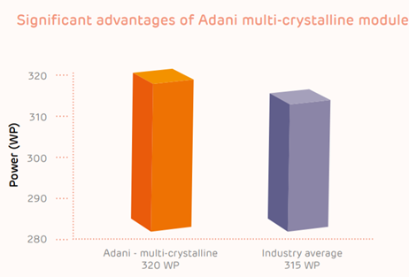
Components:
PV module = ASP-7-AAA (AAA=300-330) | 72 Cells | 300-330 Wp.
Inverter
Converter
Charge controller
Average carbon foot print per year needs to below under 2 tonnes by 2050 to avoid 2 degree rise in global temperature.

Slide 15
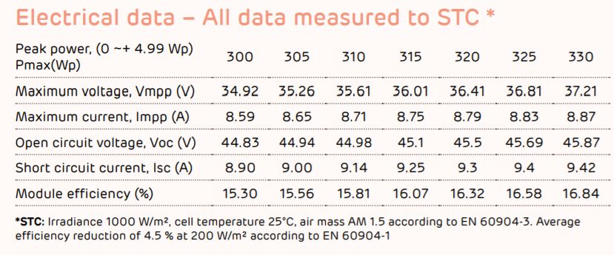

Product specification
Product warranty
25 years warranty

Slide 16
COST TO CUSTOMER
Coal = Rs 6.98 per kWh
Solar PV module Without tracking cost = Rs 2.30 per kWh
Solar PV module With tracking cost = Rs 1.90 per kWh
Considering the additional costs required to balance the variability of renewables, a grid with 30 per cent RE generation is cost-effective as compared to a moderate RE system and would not raise costs for Indian consumers.

Slide 17
Total passenger traffic – 50,750 EV vehicle estimation – 2% of total traffic + 50 airport authority vehicle = 1015 + 50 = 1065 Total Solar charging cost with tracking = 1.9(tariff using solar power) x 30 x 1065 = Rs. 60,705 Total charging cost using power from grid = 6.98(tariff using coal) x 30 x 1065 = Rs. 223011 Saving for customer = 223011 – 60705 = Rs. 162306 Profit percentage per customer = 72.779 %
NAVI MUMBAI PARKING REVENUE MODEL
 | General Parking | Rate (Rs) | Premium parking | Rate (Rs)
30 mins | 30,000 | @ 160 | 20,000 | @ 250
8 – 24 hrs | 500 | @ 1000 | 250 | @ 1200

Slide 18
 | Per unit cost (Rs) | Range Per unit (Km) | Maximum capacity (units) | Full charge price (Rs) | Per km price (If car travel is 200 km) Rs.
EV (with MPPT) | 1.9 | 10 | 30 | 57 | 0.29
EV (without MPPT) | 3.2 | 10 | 30 | 96 | 0.5
 | Per unit cost (Rs) | Range per litre (km) | Full tank price (Rs) | Per km price (If car travel 200 km) Rs.
Petrol | 100 | 13 | 1538 | 7.8
Diesel | 90 | 16 | 1125 | 5.7

Slide 19

RFID CARD
After the subsidy, The owners can use the RFID card (like a credit card) that’s handed to them in order to fast-charge at the workshop. Just install respective digital mobile app, load money into it using a listed payment gateway, and, you’re good to go. s

Slide 20

MARKET SCOPE
4th most attractive renewable energy market in the world.
Recent analysis signifies that 4 lakh charging stations needed to accommodate the demand for 20 lakh EVs on the roads by 2026.
There were also 106 proposal from public and private companies for the deployment of 7000 EV stations across various cities.
Companies has already set up charging stations for EV’s.
Airports could power 100,000 homes if we covered them in solar panels

Slide 21
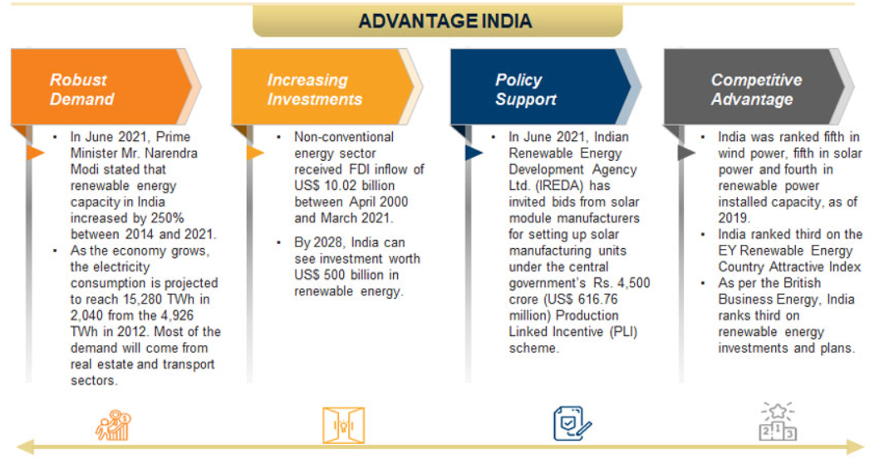
FUTURE SCOPE

Slide 22
References
“A New VSAS approach for Maximum Power Tracking for Renewable Energy Sources (RES)” Nacer K. M’Sirdi , Abdelhamid Rabhi , Mouna Abarkan
"PV Power System Using Maximum Power Point Tracking (Increment Conductance Algorithm)” Vol. 3, Issue 5, May 2014 @IJIRSET, Mohammed Ali Khalifa, Kamal Mohamed Saied,Sami Salem Bitro, Miftahul Anwar, Muhammad Nizam
“New perturb and observe mppt algorithm and its validation using data from pv module” @IJAET, Bikram Das ,Anindita Jamatia, Abanishwar Chakraborti Prabir Rn.Kasari& Manik Bhowmik
“Analysis of Different MPPT Techniques” Vol. 5, Issue 3, March 2
016 @IJAREEIE, Athira B,. Greeshma V,. Jeena Johnson
“A New Maximum Power Point Tracking for Photovoltaic Systems” Mohamed Azab, International Journal of Electrical, Computer, Energetic, Electronic and Communication Engineering Vol:2, No:8, 2008.
“Enhancement of Solar Photovoltaic Cell by Using Short-Circuit Current Mppt Method” Burri Ankaiah, Jalakanuru Nageswararao @ www.ijesi.org Volume 2 Issue 2 ǁ February. 2013 ǁ PP.45-50

