Slide 1

Jack The Hack Hackathon
THEME - Airport
SUB-THEME : Revenue generation models

Slide 2
MPPT INTEGRATED SOLAR POWERED GRID CONNECTED SYSTEM FOR AIRPORT ENERGY DEMAND AND ELECTRIC VEHICLE CHRARGING SYSTEM
MEMBERS - Ayush Negi
Rishabh Raj Prasad
COLLEGE - VELLORE INSTITUTE OF TECHNOLOGY

Slide 3

PROBLEM STATEMENT
Statement –
To develop a Grid connected MPPT Integrated solar PV System for electric vehicle charging and Airport Energy Demand Management.
Using Solar Powered Fast Charging System to Charge Electric Tow Tugs / Luggage Cart/ Passenger Vehicles.
Creating online dashboard using IOT for 24/7 monitoring of System to avoid physical contact adhering to the new norms.

Slide 4
SOLUTION
There is no denying the industry has made progress but its infrastructure is neither scalable nor sustainable and profitable.
The main idea of our project is divided into two major parts :
The first part majorly focuses on drawing maximum power from solar PV array . Instead of fully depending on Grid to supply the Energy to the airport , we can shift to Solar Powered system to meet the energy demand of the airport.
After extensively going through various research paper we have decide to choose Incremental Conductance method for our application.

Slide 5
Apart from this we can directly integrate Solar Powered Fast EV Charging system to charge Electric Tow Tugs / Electric Luggage Cart/ Electric Passenger Vehicles to be used inside the Airport premises.
In order to avoid human Interaction and easy to manage , we have created an online Dashboard using ThingSpeak to integrate and remotely monitor the entire system.
This could be the best Revenue generation model as the efficiency of controller can be upto 99% .Although the initial cost of investment is high but the cost of maintenance is low since the new Panels and Inverter are Technologically advanced and long lasting . This could also help us in realizing the aim of making the infrastructure is scalable and profitable. Thus achieving the dream of sustainable society.

Slide 6
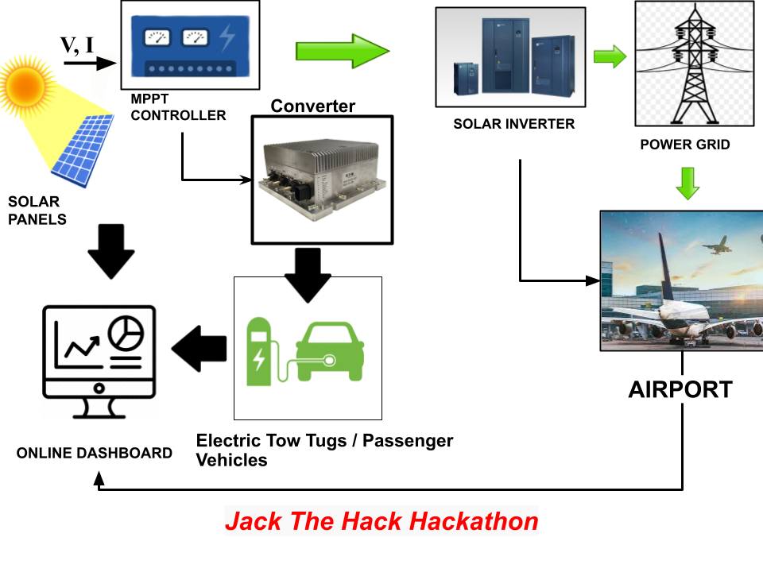
Block Diagram of the Model:

Slide 7
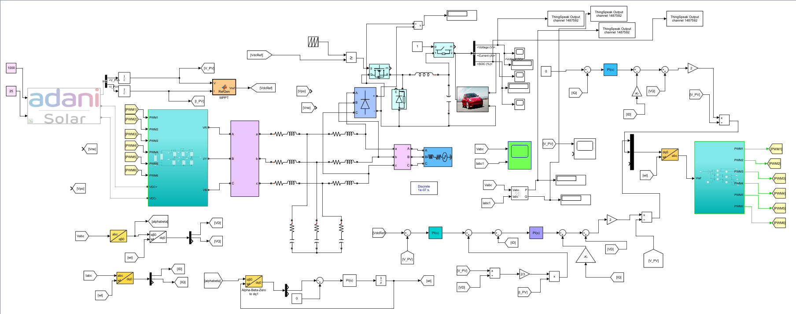
DEMO MATLAB SIMULINK MODEL

Slide 8
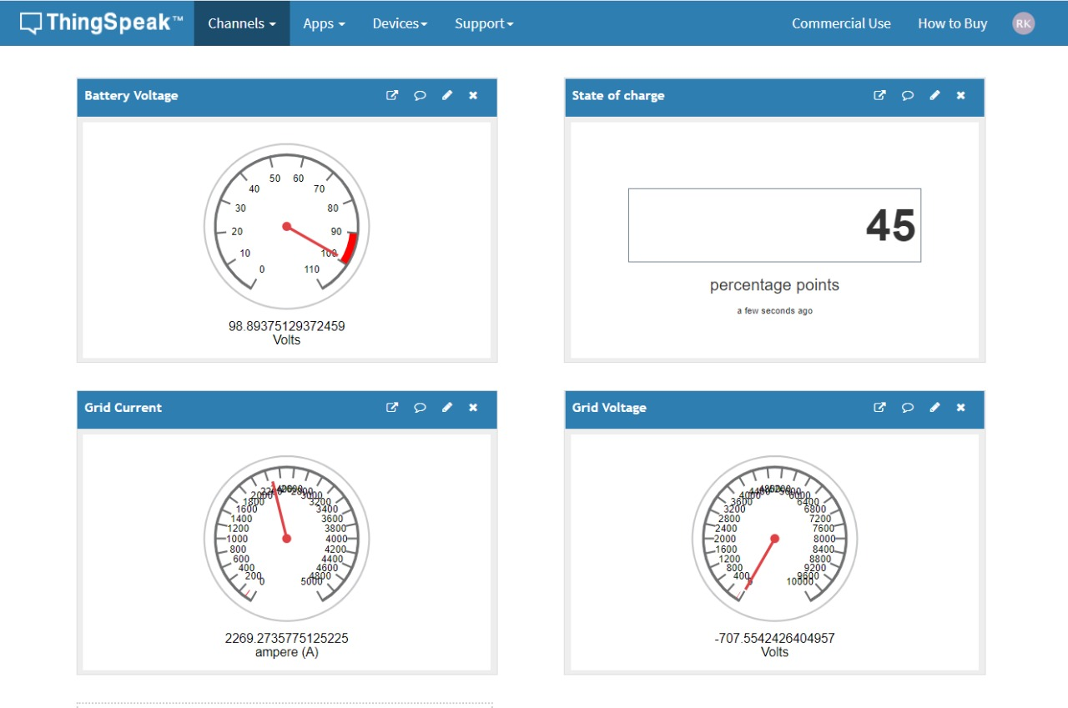
ONLINE DASHBOARD

Slide 9
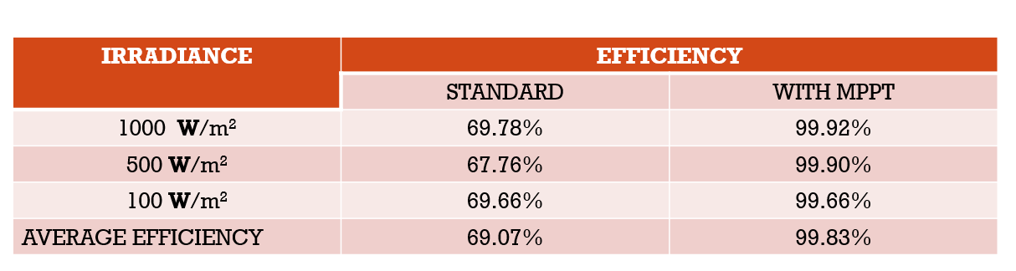
Tracking EFFICIENCY OF SYSTEM

Slide 10
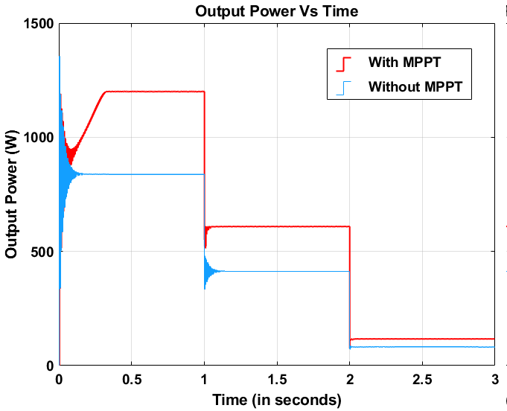
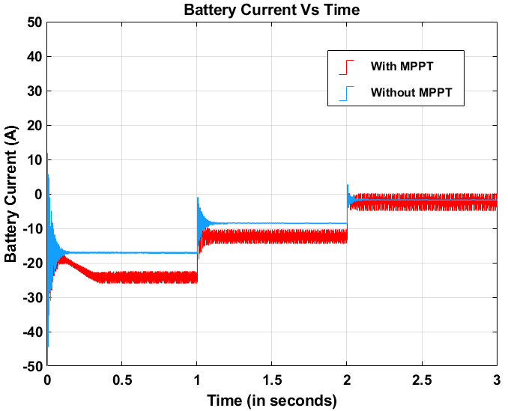
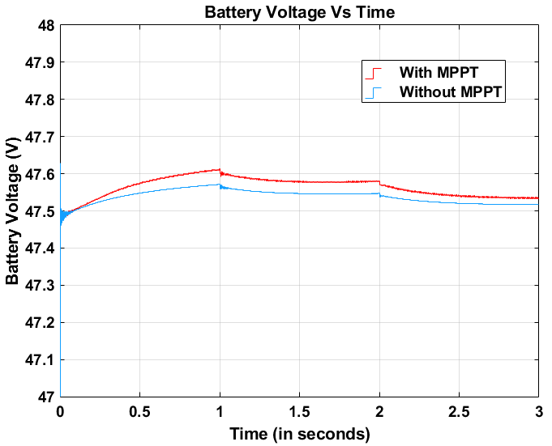
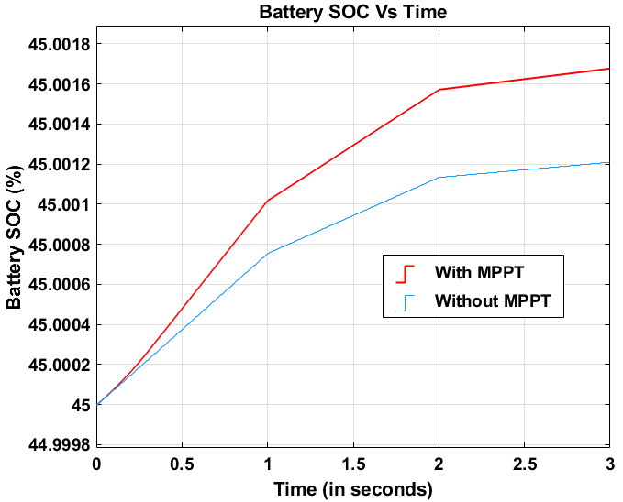
COMPARISION OF OUTPUT POWER , VOLTAGE ,CURRENT AND BATTERY SOC WITH AND WITHOUT MPPT INTEGRATED SYSTEM.

Slide 11
IMPACT TO SOCIETY
The biggest advantage of an electric vehicle is its green credential. Electric cars are 100 percent eco-friendly as they run on electrically powered engines.
Since electricity will be produced by solar so cost of charging will further reduced in compare to normal charging stations.
Use of EV and solar power will support environment as they are clean and green energy resources
This will promote the concept of reuse , reduce and recycle

Slide 12
Solar and EV charging increases property value and demand , Such data has been found in recent studies and surveys.
EV and solar also help in creation of resilient local grid.
India has potential to implement such initiatives all over country for better management and consumption of energy.
Most industry analysts agree that upgrades are needed to the transmission grid to handle the increased load from EVs.
Ultimately it will help to create awareness among public and will promote mass adoption of such ideas.

Slide 13

MARKET SCOPE
Indian renewable energy sector is the fourth most attractive renewable energy market in the world.
The government is aiming to achieve 227 GW of renewable energy by 2022, more than its 175 GW target as per the Paris Agreement.
As per a Market Watch report, India would need around 4 lakh charging stations to accommodate the demand for 20 lakh EVs on the roads by 2026.

Slide 14
States like are ready to set up their solar EV charging stations at parking area of T-3 at IGI Airport.
Under second phase of FAME scheme of India 317 such charging sections will be framed across various airports in different cities of India.
There were also 106 proposal from public and private companies for the deployment of 7000 EV stations across various cities.
Companies like Mahindra Reva has already set up charging stations for EV’s at Bangalore airports.
Airports could power 100,000 homes if we covered them in solar panels.

Slide 15

FUTURE SCOPE
EV market has a great scope in future and is growing exponentially in India.
This also promotes concept of Renewable energy resources use and reduce pollution.
The Government of India targeted to install renewable energy capacity of 175 GW by the end of 2022.
At the United Nations Climate Action Summit, Prime Minister of India Narendra Modi announced the renewable energy target to 450 GW by 2030 from 175 GW by 2022.
Airports could power 100,000 homes if we covered them in solar panels

Slide 16
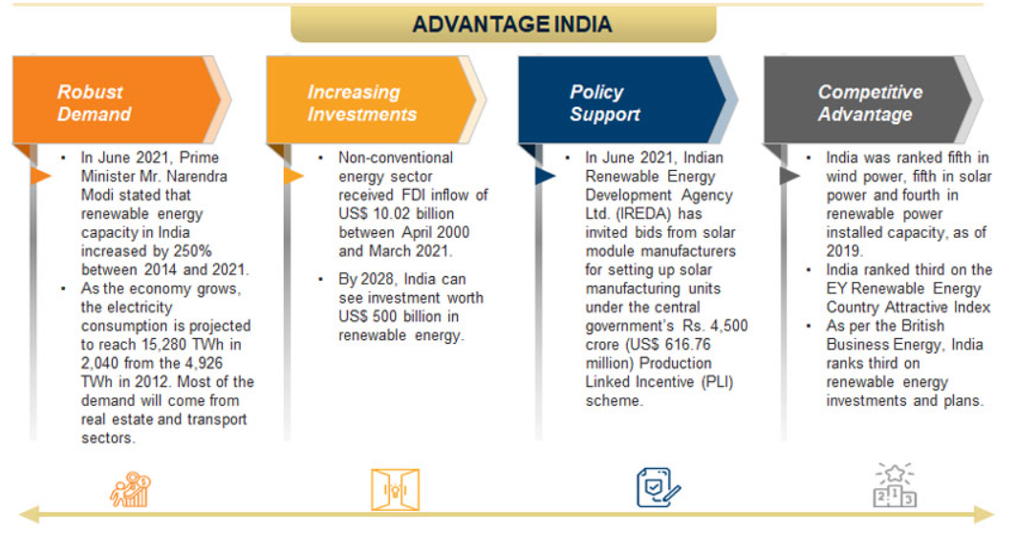
In India, for example, Airports have solar power on their roofs and all possible areas.
The Puducherry airport has become the first airport of the Airports Authority of India (AAI) which is entirely solar-powered.

Slide 17
References
“A New VSAS approach for Maximum Power Tracking for Renewable Energy Sources (RES)” Nacer K. M’Sirdi , Abdelhamid Rabhi , Mouna Abarkan
"PV Power System Using Maximum Power Point Tracking (Increment Conductance Algorithm)” Vol. 3, Issue 5, May 2014 @IJIRSET, Mohammed Ali Khalifa, Kamal Mohamed Saied,Sami Salem Bitro, Miftahul Anwar, Muhammad Nizam
“New perturb and observe mppt algorithm and its validation using data from pv module” @IJAET, Bikram Das ,Anindita Jamatia, Abanishwar Chakraborti Prabir Rn.Kasari& Manik Bhowmik
“Analysis of Different MPPT Techniques” Vol. 5, Issue 3, March 2
016 @IJAREEIE, Athira B,. Greeshma V,. Jeena Johnson
“A New Maximum Power Point Tracking for Photovoltaic Systems” Mohamed Azab, International Journal of Electrical, Computer, Energetic, Electronic and Communication Engineering Vol:2, No:8, 2008.
“Enhancement of Solar Photovoltaic Cell by Using Short-Circuit Current Mppt Method” Burri Ankaiah, Jalakanuru Nageswararao @ www.ijesi.org Volume 2 Issue 2 ǁ February. 2013 ǁ PP.45-50

