Slide 1
AI Virtual Shopping Assistant
Project Submission & Explanation By: [Your Name]

Slide 2
Problem & Solution
Problem: Shoppers face too many choices and generic listings.
Solution: An AI-powered shopping assistant that understands taste, budget, and intent.
→ Fetches live products via Shopify API
→ Provides recommendations with Google Gemini AI
→ Conversational shopping experience

Slide 3
System Architecture
• User → React + TypeScript frontend
• Shopify Storefront API → Product data
• Gemini AI → Recommendations & chat
• Contexts → Cart & user preferences
• Secure proxy → Protects Gemini API key

Slide 4
Tech Stack
⚛ React 18 + TypeScript
🎨 Tailwind CSS & Framer Motion
🛒 Shopify Storefront API (GraphQL)
🤖 Google Gemini AI
🗂 React Router v6 + Context

Slide 5
Key Features
✨ Personalized product recommendations
💬 Conversational shopping with AI
🔎 Product browsing & filters
🛍 Smart cart summary
⚡ Modern UI with animations
🔐 Secure Shopify integration

Slide 6
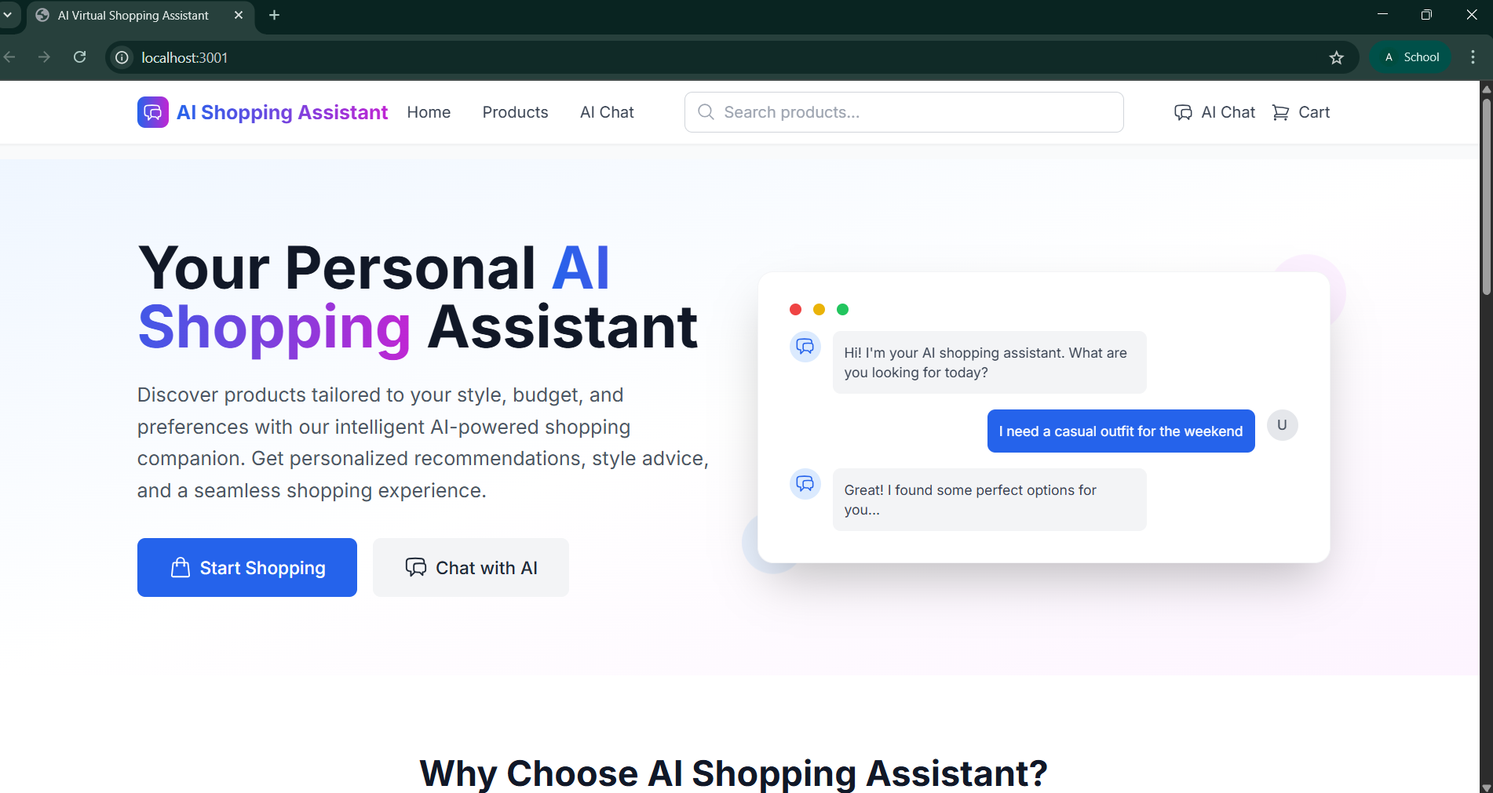
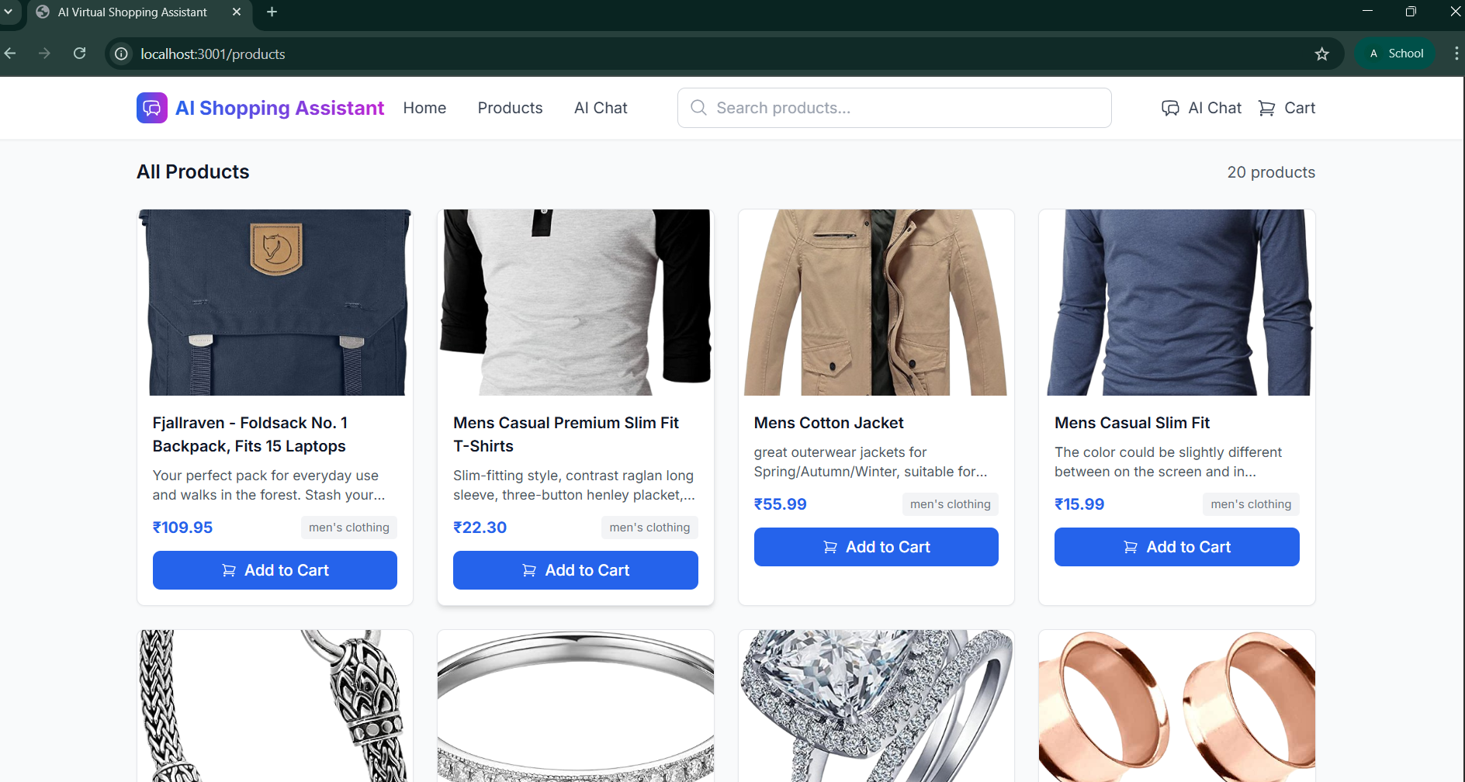
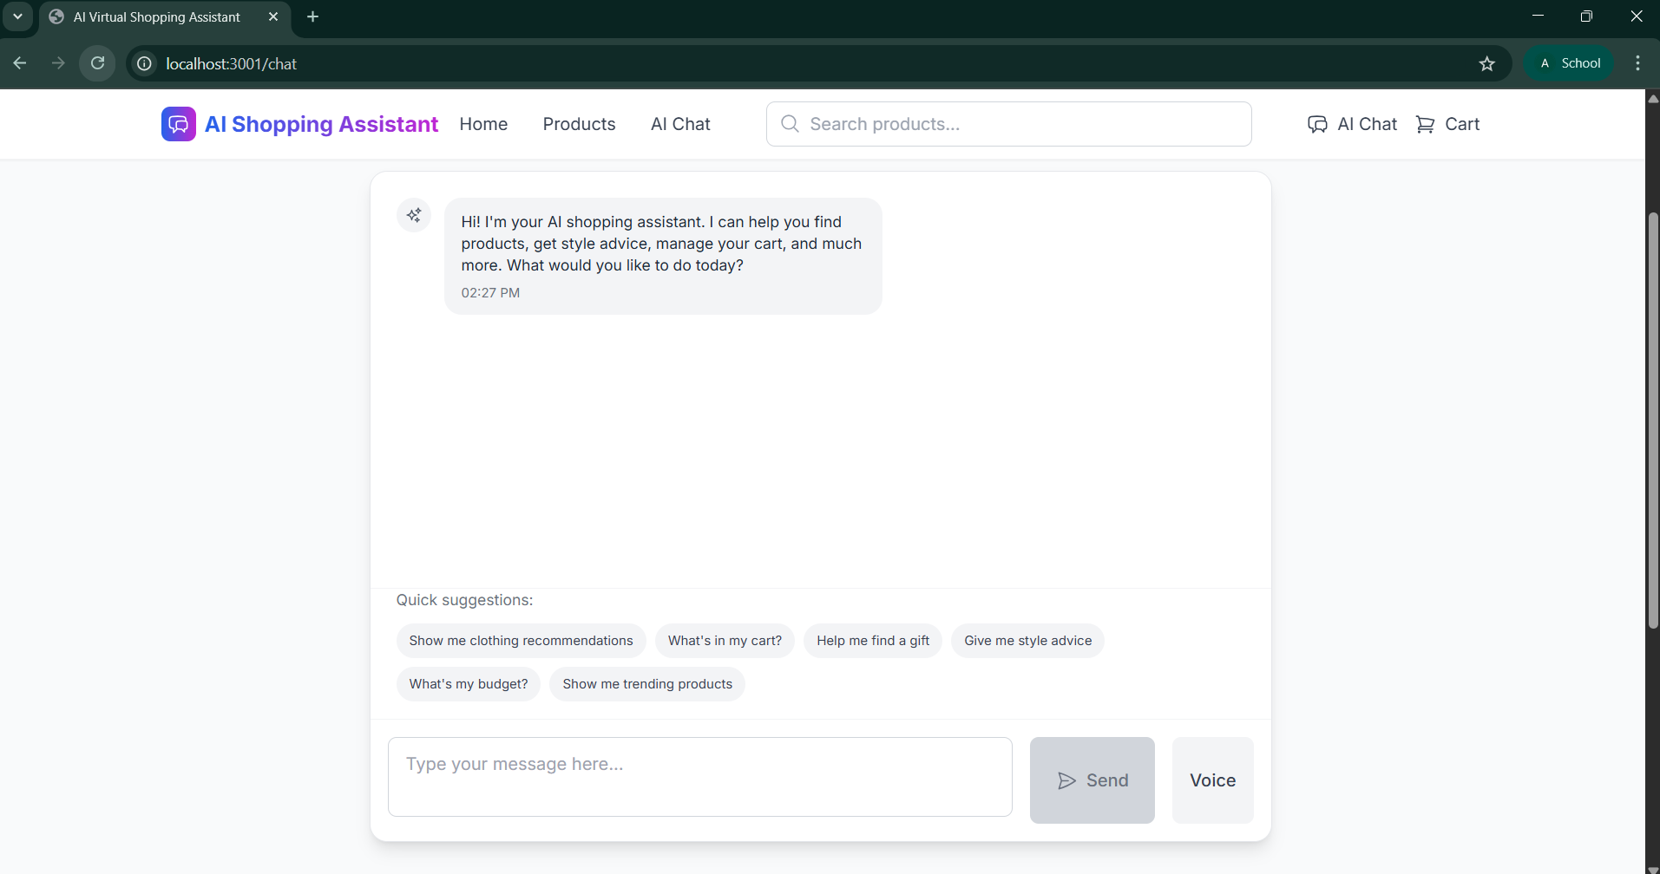
Project Demo - Screenshots

Slide 7
Results & Impact
🚀 Faster product discovery
📈 Higher customer engagement
😊 Improved shopping experience
🏗 Scalable & secure foundation

Slide 8
Conclusion & Future Scope
Conclusion: AI + Shopify = Smarter shopping experience.
Future Scope:
• Payments & checkout integration
• User authentication & profiles
• Multilingual support
• Analytics & feedback loop

Slide 9
THANK YOU!
Any Questions?

