Slide 1
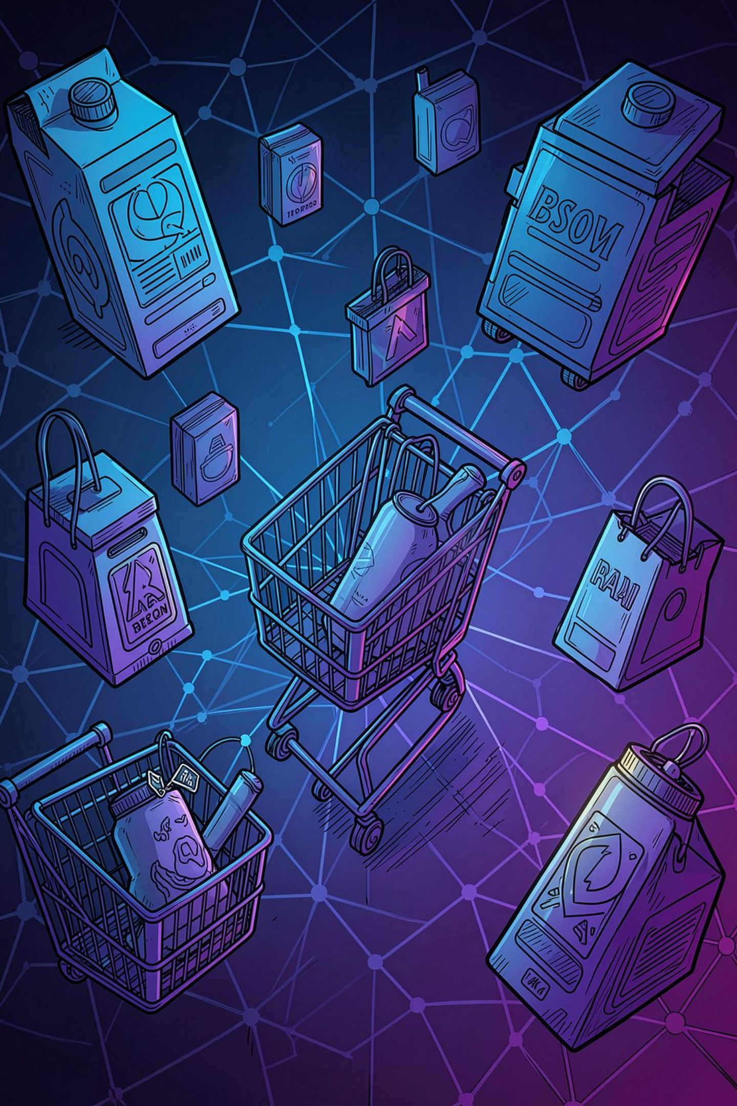
AI Product Recommendation Engine
Intelligent Personalized Shopping Assistant
Ayush Prajapati - MPOnline - Advanced Software Engineering & Development Internship
Date: 5 - August -2026

Slide 2




Problem Statement
Customers struggle to find relevant products among overwhelming choice.
Traditional systems favor popularity, not individual fit.
Information overload leads to abandoned sessions and lost revenue.
Businesses miss conversions when discovery fails.
Shopping Friction
High browse-to-purchase drop-offs from poor discovery
User Frustration
Difficulty locating relevant items reduces trust and retention
E‑commerce Growth
Rapid market growth increases need for precise personalization

Slide 3
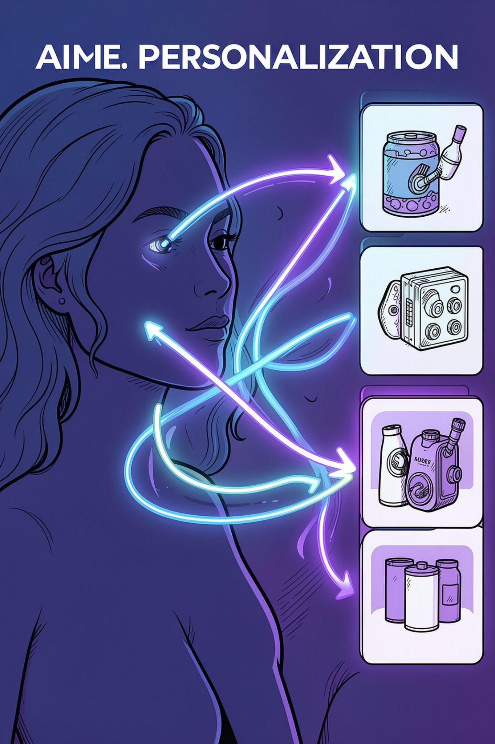
Objectives
Deliver personalized product recommendations per user.
Model and understand user behavior across signals.
Increase engagement, CTR, and conversions.
Solve cold-start for new users & products.
Provide explainable, auditable recommendations.
Support real-time recommendations at scale.

Slide 4
Existing System vs Proposed AI System
Existing System
Proposed AI System
Popularity-based suggestions
Collaborative Filtering (user-item interactions)
Rule-based logic, manual tuning
Content-based & hybrid models with learned features
Limited personalization, static lists
Deep learning embeddings and real-time ranking
Slow to adapt to trends
NLP for reviews, session-aware recommendations, fast updates

Slide 5


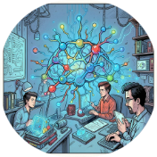
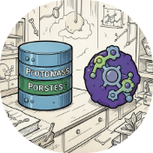
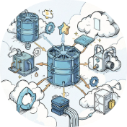

Technologies — Full Stack
Frontend
Backend
ML Frameworks
Data & Storage
React · TypeScript · Tailwind CSS
FastAPI · Python
Scikit-Learn · TensorFlow · PyTorch
PostgreSQL · MongoDB
Deployment
Visualization
Docker · AWS / Render / Railway · GitHub CI
Matplotlib · Plotly

Slide 6

System Architecture
User
Frontend
FastAPI
Recommend
Layered, modular design for scalability: decouple frontend, API, model serving, and data storage. Supports batch + streaming pipelines.

Slide 7
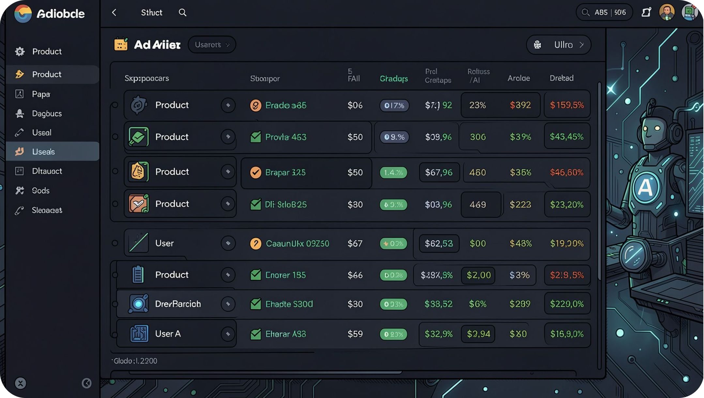
Dataset
Core fields collected and engineered for modeling:
Product: ProductID, Category, Brand, Price, Images, Description
User: UserID, Demographics, Browsing & Purchase History
Signals: Ratings, Reviews, Session Events, Timestamps
Example sources: Amazon dataset, Flipkart dumps, curated Kaggle datasets for prototyping.

Slide 8
Data Pipeline
Cleaning
Feature Eng
Preprocessing
Training & Deploy
Pipeline handles missing values, textual embedding (NLP), categorical encoding, and scalable preprocessing for batch and streaming inputs.

Slide 9
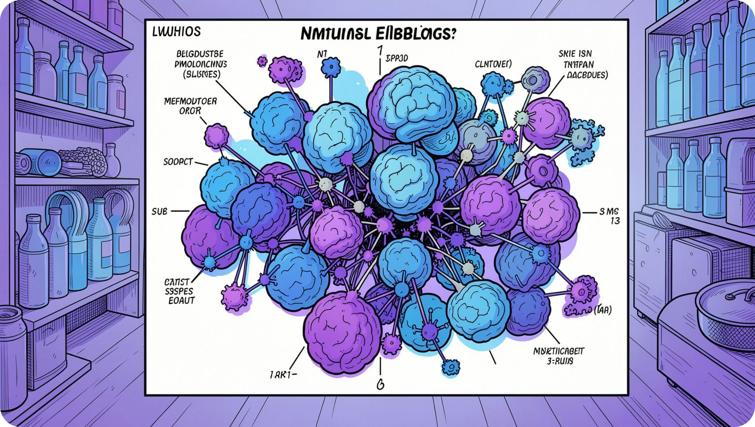
Recommendation Algorithms
Collaborative Filtering
User-user and item-item similarity, matrix factorization for latent factors.
Content-Based
TF‑IDF / BERT for product text, attribute matching, cosine similarity.
Hybrid
Weighted blend or meta-learner combining CF + content signals.
Deep Learning
Embeddings, Neural Collaborative Filtering, Autoencoders for denoising.

Slide 10
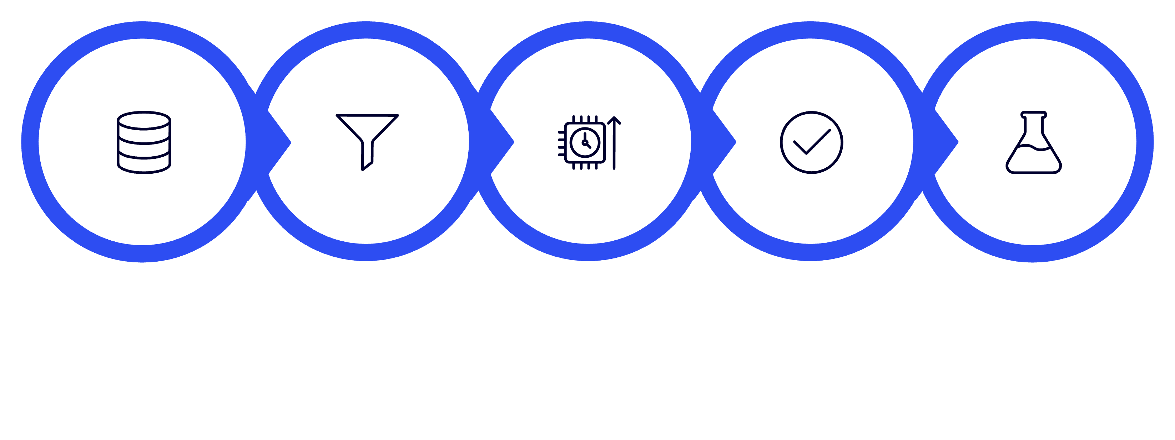
Machine Learning Workflow
Collect
Preprocess
Train
Validate
Test
Emphasize versioning (models & data), CI for training pipelines, monitoring for data drift and model performance in production.

