Slide 2
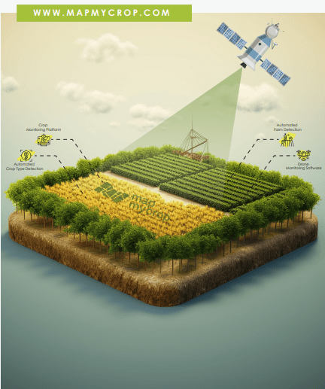
SmartHarvest AI: A data-driven platform to accurately predict crop yields across India.
Proposed Solution & Innovation :
Proposed Solution: A predictive AI system that fuses soil properties, historical weather, and live satellite imagery to forecast crop yields with unparalleled accuracy.
Innovation: 360° Data Fusion: Our model's key innovation is its ability to learn from the complete agricultural picture:
1. Soil Health (ISRIC SoilGrids API)
2. Climate Patterns (NASA POWER API)
3. Real-Time Crop Growth (Satellite Imagery)
Uniqueness: Actionable Intelligence:We don't just provide data. we deliver actionable yield forecasts and optimization strategies through an interactive dashboard.
Problem Fit: Addresses unpredictability in farming by delivering accurate, data-driven insights that reduce risks and increase productivity.
Notes:
Our idea—**AI-Powered Crop Yield Prediction and Optimization**—goes beyond traditional methods by integrating diverse datasets into a single intelligent platform. By combining soil properties, historical weather, and government agricultural data, our system generates yield predictions with remarkable accuracy.
The **innovation** lies in the fusion of cutting-edge machine learning techniques with real-world datasets, ensuring practical applicability for farmers. Unlike generic tools, our platform delivers **personalized recommendations** tailored to each crop and region, helping farmers make smarter choices.
This solution directly tackles the core problem: unpredictability in farming. By offering actionable insights, it not only improves productivity but also enhances food security and sustainability across agricultural communities.

Slide 3
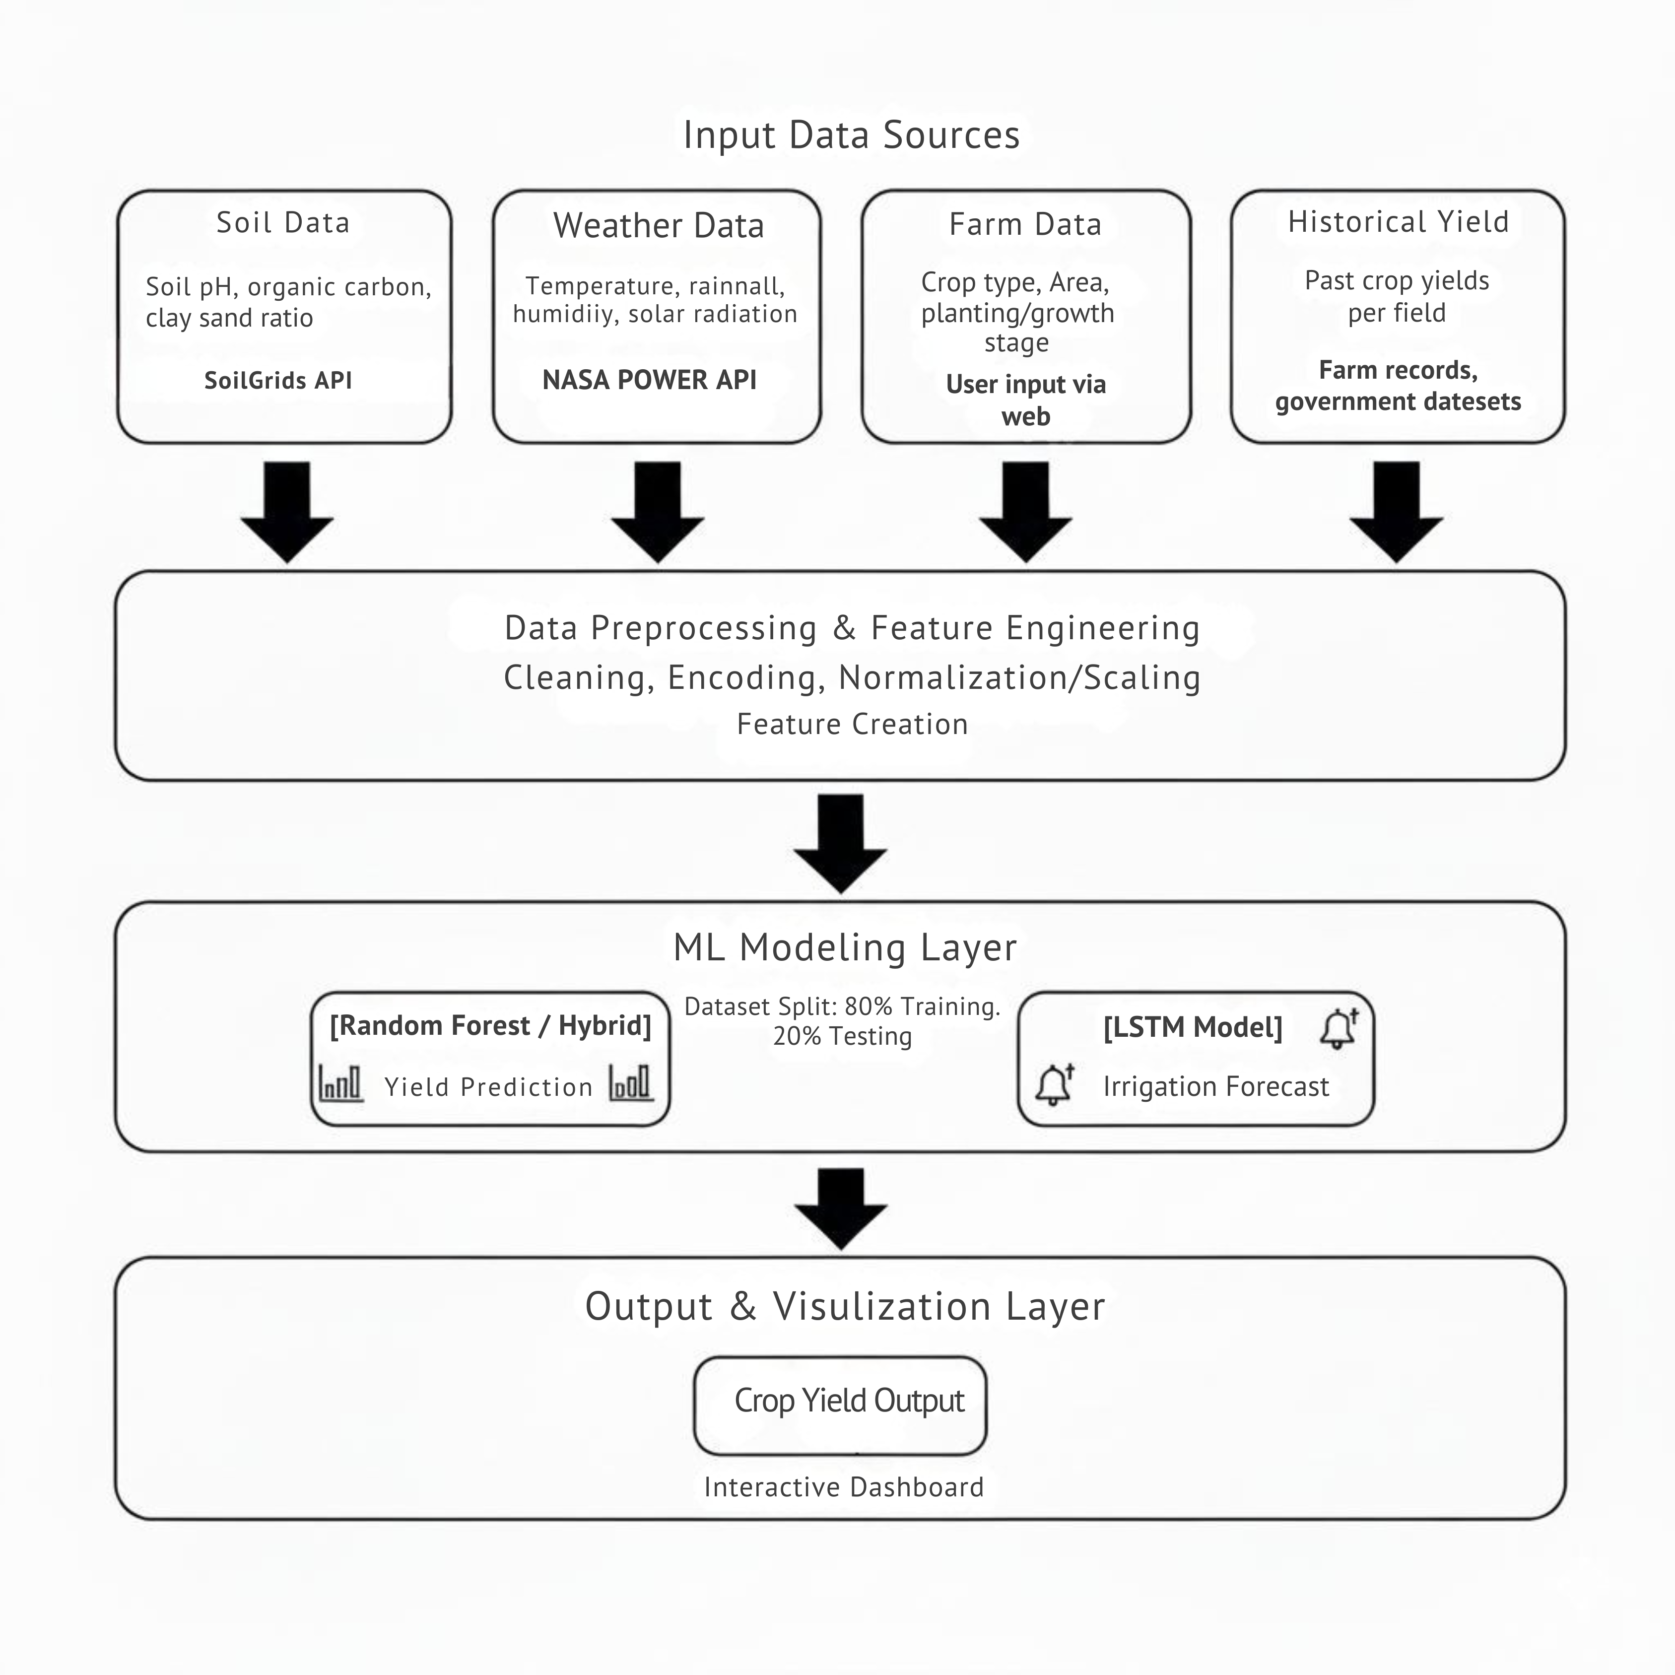
Technical Approach
Tech Stack, Workflow & Prototype
Tech Stack: Frontend: HTML, CSS, JS | Backend: Python 3 | | Database:MongoDB|Core Libraries: Pandas, GeoPandas, Scikit-learn | APIs: NASA POWER, ISRIC SoilGrids | Data: Govt. Crop Production (APY.csv).
Workflow: Data collection → Preprocessing → Machine Learning model training → Prediction → Dashboard visualization with interactive UI.
Prototype: Live Dashboard with secure user login.Real-time prediction form & prediction history log.
Integration: APIs seamlessly connect real-time weather, soil, and government datasets to ensure accurate, scalable predictions across regions.
Notes:
Our **technical backbone** combines simplicity for farmers with the power of advanced data science. On the frontend, we rely on HTML, CSS, and JavaScript for a clean, mobile-optimized experience. The backend is powered by Python 3, leveraging Pandas and GeoPandas for data handling, and Scikit-learn for predictive modeling.
The **workflow** is straightforward yet powerful: we ingest data from government crop production datasets, NASA POWER for weather, and ISRIC SoilGrids for soil properties. After preprocessing, the machine learning models generate predictions which are visualized in our interactive dashboard.
The **prototype**—CropAI—provides farmers with personalized insights. They can enter parameters such as soil type, crop type, season, and area to instantly receive yield predictions and optimization tips. The integration of APIs ensures our system scales across regions, delivering real-time, data-driven intelligence.

Slide 4




Feasibility and Viability
Challenges, Risks & Strategies
Feasibility
Leverages open government crop data, global soil and weather APIs, and scalable machine learning frameworks for sustainable deployment.
Key Challenges
Data quality inconsistencies, rural internet limitations, and farmer training gaps may affect adoption and accuracy.
Risks
Scalability across diverse regions, trust in AI predictions, and integration with traditional farming practices.
Mitigation Strategies
Offline-ready features, community training workshops, multilingual support, and continuous model retraining to enhance accuracy.
Notes:
Feasibility is a central concern for any innovation, and our solution addresses it head-on. By combining government agricultural data with global weather and soil datasets, we ensure that our system is **scalable, reliable, and sustainable**.
However, challenges remain. Data quality can vary significantly, rural connectivity may limit access, and farmers may require capacity building to fully leverage the system. Trust in AI predictions is another crucial factor.
To mitigate these risks, we propose **offline-ready features**, robust **multilingual support**, and active **training workshops** for farmers. Our models will undergo continuous retraining as new data becomes available, ensuring high accuracy across regions. This comprehensive approach makes our solution both **feasible and viable** in real-world agricultural ecosystems.

Slide 5
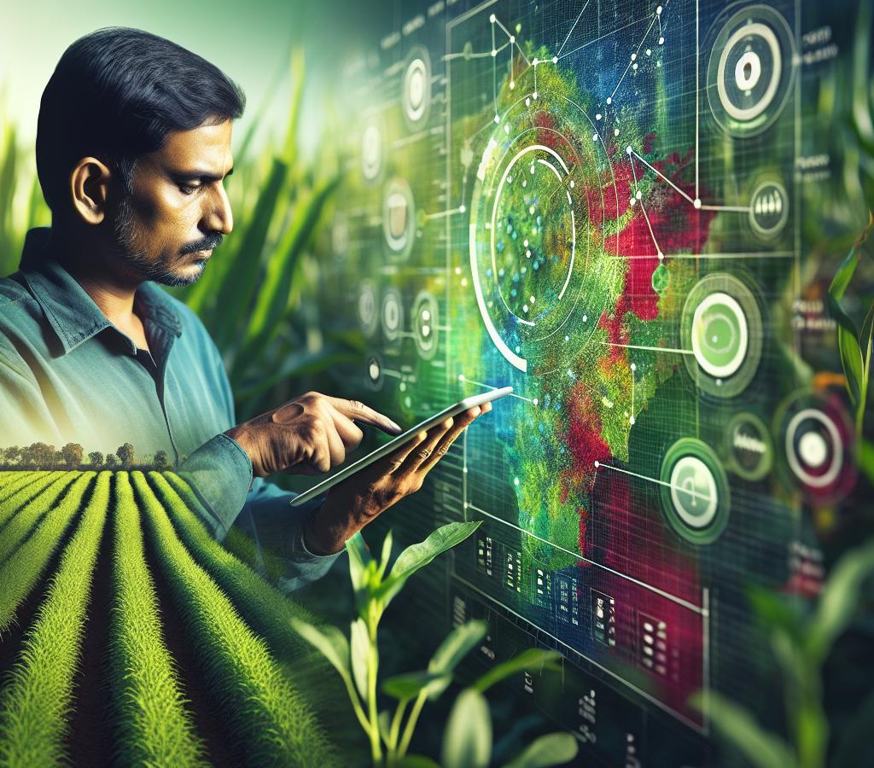
Impact and Benefits
Empowering Farmers & Driving Sustainability
Impact
Farmers: Empowers them with data-driven insights to reduce risk and increase profitability at least 10% .
Government: Enables accurate national food supply forecasting and the design of effective, targeted agricultural policies.
Agribusiness: Improves risk models for crop insurance and enhances overall market efficiency for traders and logistics.
Benefits
Economic: Boosts agricultural GDP, increases productivity, and helps stabilize food prices for the nation.
Social: Strengthens food security and improves the livelihoods of millions of farmers and their families.
Photo by Shaun Coward on Unsplash
Notes:
The impact of our solution extends far beyond immediate crop yield predictions. By providing farmers with accurate, real-time insights, we empower them to make better decisions, reducing uncertainty and building confidence in adopting modern agricultural practices.
From an **economic perspective**, the optimization of inputs like seeds, fertilizers, and irrigation ensures higher productivity at lower costs. This directly translates to increased farmer incomes and greater market stability.
Equally important are the **environmental benefits**. With efficient resource utilization, our platform encourages sustainable farming practices and reduces the ecological footprint of agriculture. In the long term, this solution contributes to **food security, rural prosperity, and sustainable development**, aligning perfectly with India’s Smart Agriculture vision.

Slide 6
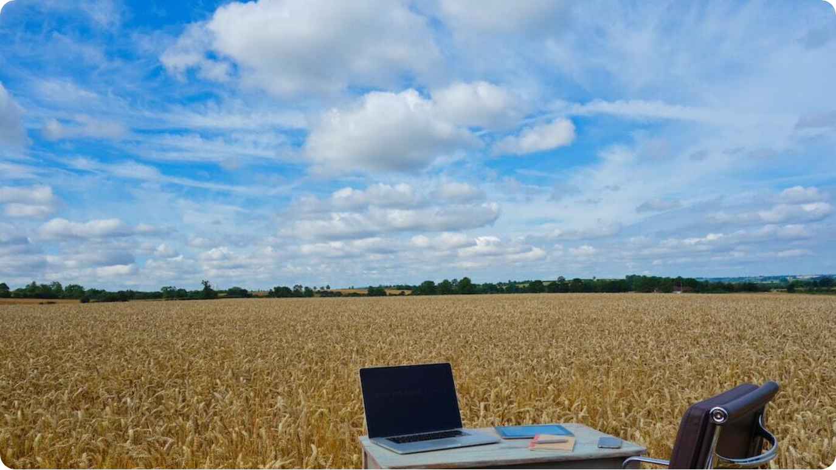
Research and References
Data Sources & Supporting Work
Government Crop Data: APY.csv dataset from Indian Government portals providing district-level crop production statistics.
NASA POWER API: Global climate and weather data used for accurate historical and real-time agricultural analysis.
ISRIC SoilGrids: Geospatial soil property datasets integrated for precision agriculture applications.
Supporting Research: Studies on AI in agriculture, geospatial analytics, and sustainable farming practices.
Research Foundation
Our methodology is based on the proven data science principle of multi-modal data fusion (combining weather, soil, and satellite data) for agricultural forecasting.
Notes:
Every robust solution stands on a foundation of credible research and reliable data. Our project relies heavily on **open government datasets** like APY.csv, which provides accurate crop production data at district levels. This ensures that our model predictions are grounded in authentic national statistics.
To account for environmental factors, we use the **NASA POWER API**, which provides detailed weather and climate datasets, while the **ISRIC SoilGrids API** supplies vital geospatial soil information. Together, these datasets enable high-accuracy yield predictions tailored to local conditions.
In addition, our approach is informed by **global research** on AI in agriculture, machine learning for yield prediction, and sustainable farming. These references not only validate our methodology but also highlight the novelty and relevance of our solution in the global agricultural landscape.

