Slide 1
EVEWATCH
Distinguishing Quantum Eavesdroppers from Hardware Noise in BB84
Track: Quantum Secure Communication | Qiskit Fall Fest 2026 @ MPSTME, NMIMS Mumbai
Team: Ayush Trivedi | Built with Qiskit 2.x & IBM Quantum AerSimulator
Notes:
Welcome judges! Today I am presenting EveWatch, our project for the Quantum Secure Communication track at Qiskit Fall Fest 2026. EveWatch tackles a fundamental and often overlooked question in Quantum Key Distribution: When Alice and Bob detect transmission errors, can they genuinely distinguish an active eavesdropper from baseline hardware noise? Over the next 10 minutes, I will show our end-to-end Qiskit 2.x implementation, our empirical findings across hundreds of trials, and our working Streamlit prototype.

Slide 2
QISKIT FALL FEST 2026
Why Current Cryptography is at Risk & Why Quantum?
The Classical Crypto Collapse
• Computational Assumptions: RSA, ECC, and Diffie-Hellman depend on the mathematical hardness of integer factorization & discrete logs.
• Shor's Algorithm Threat: A fault-tolerant quantum computer solves these problems in polynomial time O((log N)³).
• Harvest Now, Decrypt Later: Adversaries are actively intercepting and storing encrypted traffic today to decrypt once quantum hardware arrives.
The Quantum Solution (QKD)
• Information-Theoretic Security: Derived from the fundamental laws of quantum physics, not mathematical complexity.
• No-Cloning Theorem: An arbitrary unknown quantum state cannot be copied without perturbation.
• Heisenberg Uncertainty: Any eavesdropper measuring a flying qubit inevitably collapses the state, introducing detectable errors.
• Future-Proof: Security remains unbreakable even against adversaries with infinite computational power.
Notes:
Slide 2 sets the foundation. We explain why classical cryptography faces an existential deadline from Shor's algorithm. Quantum Key Distribution solves this by grounding security in the No-Cloning Theorem and Heisenberg Uncertainty Principle. Any eavesdropping creates physical disturbances that Alice and Bob can observe directly in the Quantum Bit Error Rate.

Slide 3
QISKIT FALL FEST 2026
The Central Research Question: The Noise vs. Eve Dilemma
THE CORE QUESTION: 'Can Alice and Bob tell an eavesdropper from hardware noise?'
Textbook BB84 assumes an idealized noiseless channel where any error implies an adversary. In real quantum networks and hardware, thermal noise, fiber attenuation, and gate infidelities continuously generate errors. Can classical parties disentangle malicious interception from environmental noise?
Physical Noise Realities
• Optical fiber Rayleigh scattering & birefringence.
• Single-photon detector dark counts & readout errors.
• Qubit decoherence (T1 relaxation, T2 dephasing).
• Result: Constant baseline background QBER (2-6%).
Adversarial Eavesdropping (Eve)
• Eve intercepts a fraction f in [0, 1] of transmitted qubits.
• Measures in random bases (Z or X) and resends state.
• Introduces 25% error on intercepted sifted qubits.
• Result: QBER scales as 0.25 * f on a clean channel.
Notes:
Here is the differentiator that sets EveWatch apart from standard student projects. Most tutorials assume perfect noiseless physics where QBER > 0 immediately flags Eve. In reality, optical fibers and superconducting qubits have natural background noise. If Alice and Bob observe an 8% QBER, is that 16% channel noise, or Eve intercepting 32% of bits? This ambiguity is what EveWatch investigates mathematically and empirically.

Slide 4
QISKIT FALL FEST 2026
BB84 Protocol: 4 Steps from Photons to Secret Key
Step 1: State Preparation (Alice)
Alice creates random bits {0,1} and randomly selects between Computational (Z) and Hadamard (X) bases. Encodes single qubits: |0>, |1>, |+>, |->.
Step 2: Quantum Transmission
Photons traverse the quantum channel. If Eve intercepts, measuring collapses the wavefunction. Noise in transit introduces depolarizing perturbations.
Step 3: Bob Measures & Key Sifting
Bob independently picks random measurement bases. Alice and Bob publicly share their bases (not bits!). Retain positions where bases match (~50% yield).
Step 4: QBER Verification & Decision
Parties reveal and sacrifice sample K. If QBER > 11.0% (Shor-Preskill security limit), ABORT! If <= 11%, apply error correction & SHA-256 privacy amplification.
Notes:
This slide breaks down the four stages of BB84 in plain language for judges. Alice encodes random bits in conjugate bases. Bob measures in random bases. Sifting discards 50% where bases disagreed. Finally, QBER estimation tests whether the quantum channel was tapped.

Slide 5
QISKIT FALL FEST 2026
EveWatch Quantum Approach & Modular Architecture
bb84.protocol
Pure Qiskit 2.x protocol runner.
Builds consolidated Clifford circuits.
Performs sifting and sampling.
UI-independent & deterministic.
bb84.eve
Intercept-resend adversary.
Continuous fraction f in [0, 1].
Random basis rotation.
Measurement collapse & resend.
bb84.noise
Optical channel depolarizing error.
Gate infidelities & readout error.
IBM Fake Provider integration
(FakeBrisbane 127Q).
bb84.analysis
Shannon entropy H2(Q).
Shor-Preskill rate: 1 - 2*H2(Q).
False Alarm Rate (FAR).
Missed Detection Rate (MDR).
Notes:
Slide 5 illustrates our modular software engineering architecture. We separated protocol execution, adversary modeling, noise generation, and statistical analysis into decoupled, pure modules. Every function has full docstrings and type hints, and all simulation results are pinned by random seeds for strict reproducibility.

Slide 6
QISKIT FALL FEST 2026
Qiskit 2.x Implementation: High-Performance Clifford Simulation
Strict Qiskit 2.x API Compliance
• Current APIs Only: No legacy execute() or BasicAer. Uses AerSimulator directly.
• Stabilizer Method O(N): Because BB84 uses only Clifford operations (H, X, Id, Measure), AerSimulator(method='stabilizer') simulates 1000 qubits in 35 milliseconds!
• Mid-Circuit Measurement: Eve measures mid-circuit, collapsing the quantum register before Bob's basis rotation.
• Channel Transit: 'Id' gates placed on transit qubits expose photons to optical depolarizing Kraus noise.
Multi-Tiered Noise Modeling
• Optical Channel Depolarizing Noise: Parametric error pch on single-qubit transit.
• Gate Depolarizing Error: Models imperfect RF pulses during H and X rotations.
• Readout Assignment Error: Asymmetric or symmetric detector misidentification.
• IBM Fake Provider Integration: Native support for FakeBrisbane (127 qubits, calibrated physical T1, T2, readout error map).
• Automatic Batching: Automatically batches circuits when simulating general Kraus hardware noise.
Notes:
Here we highlight our Qiskit implementation depth. We don't use deprecated APIs. By leveraging Aer's stabilizer method for Clifford operations, our simulations run in polynomial time O(N). We can simulate 1,000 qubits in 35 milliseconds, allowing us to run 50+ Monte Carlo trials per data point quickly and reliably.

Slide 7
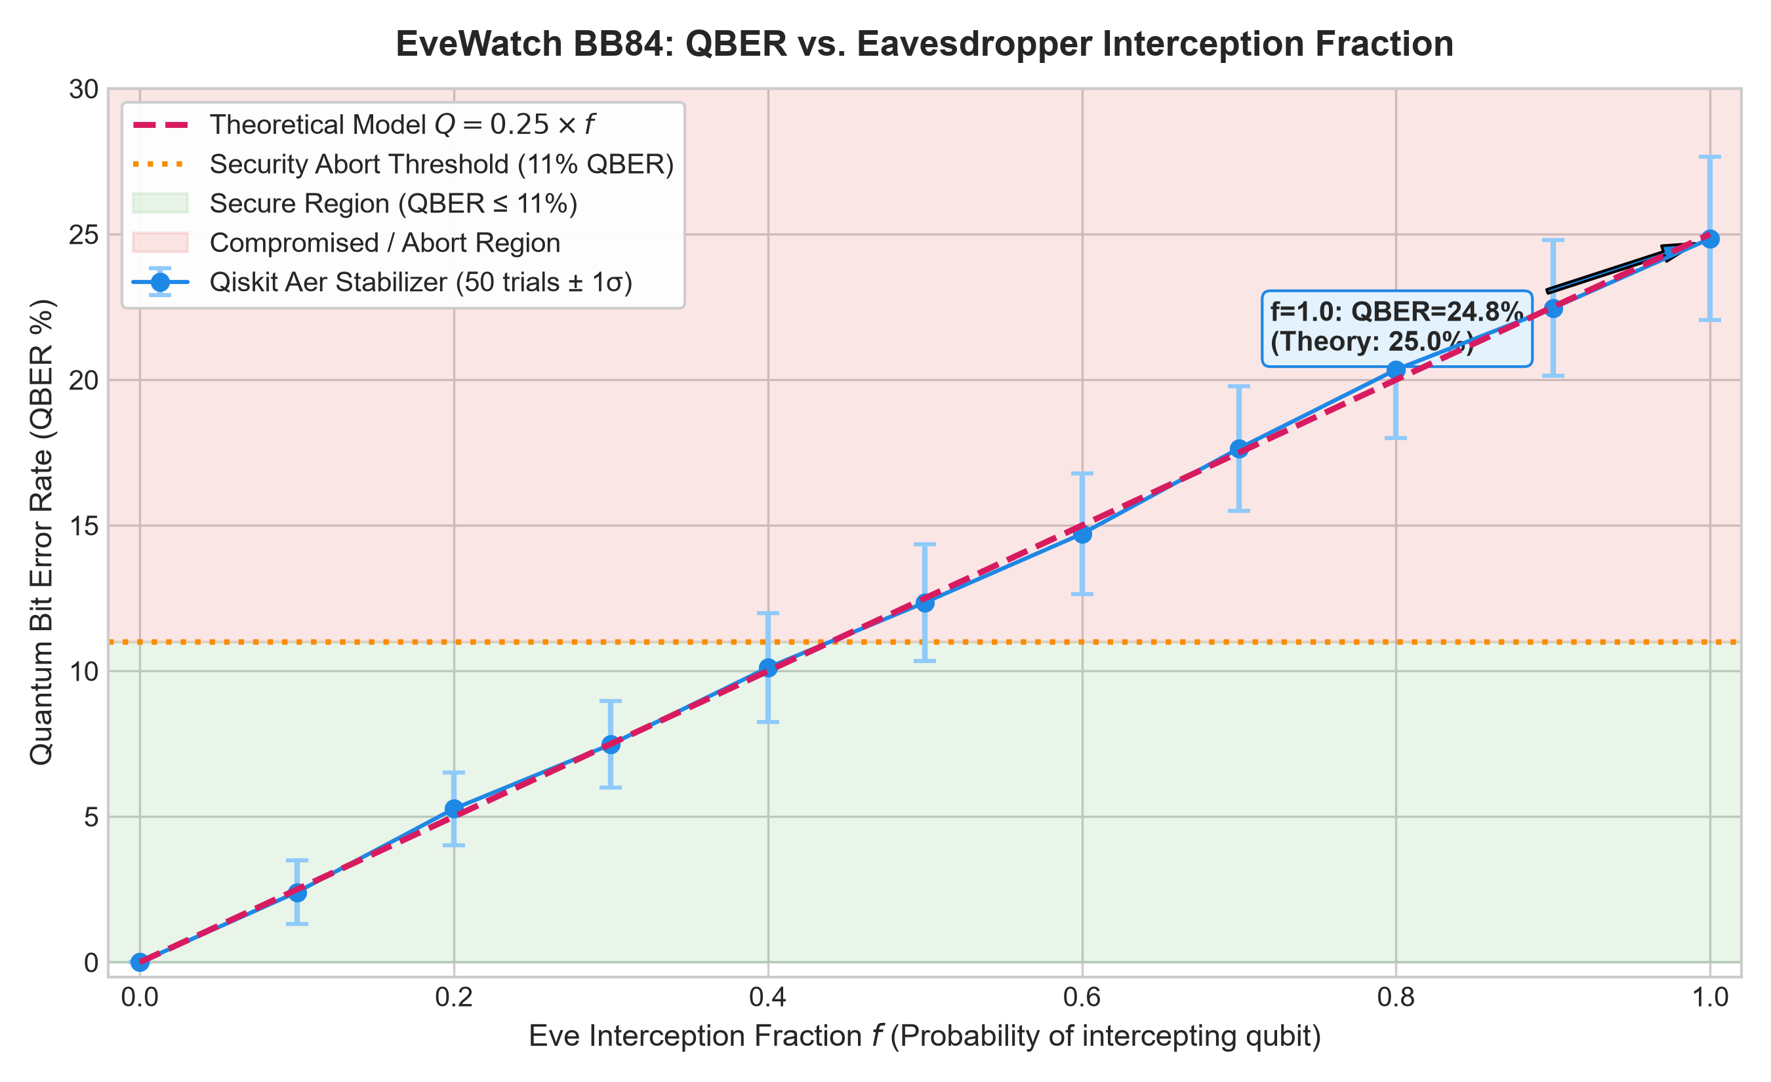
QISKIT FALL FEST 2026
Eavesdropper Interception Results: 25% QBER Validation
Key Empirical Findings
• Theoretical Agreement: Measured QBER closely tracks Q = 0.25 * f across all interception fractions.
• Full Interception (f=1.0): Yielded 24.85% ± 2.80% QBER across 50 trials, perfectly confirming the 25.0% theoretical bound.
• The Security Abort Limit: The 11% threshold is breached at f > 0.44.
• The Blind Zone Risk: When f <= 0.44, Eve's presence alone produces QBER <= 11%. In a naive protocol with zero noise awareness, Eve can intercept 40% of traffic without being caught!
Notes:
Slide 7 presents our first empirical results. Our simulation confirms the 25% intercept-resend error rate derived by Bennett and Brassard. Crucially, notice the blind zone: if Eve only taps 40% of qubits, the error rate stays under 11%. This proves that a simple threshold alone is insufficient when background noise exists.

Slide 8
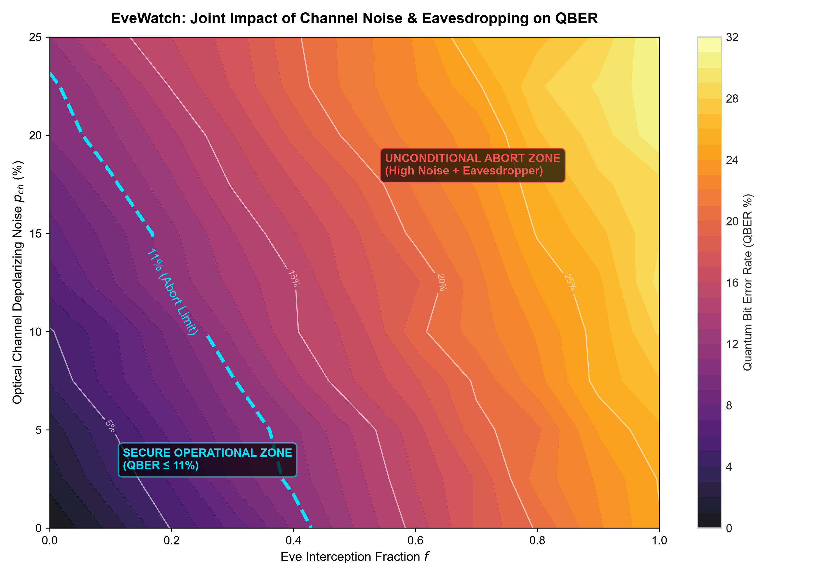
QISKIT FALL FEST 2026
Noise-Aware Analysis: 2D Parameter Heatmap
Mapping the Security Frontier
• The Equifinality Problem: A measured QBER of 9% can be generated by 18% channel noise alone, OR Eve tapping 36% of bits, OR a mix.
• 11% Secrecy Contour: The dashed cyan boundary defines the maximum allowable operational margin before Shannon leakage outpaces key generation.
• Combined Effects: Channel noise narrows the eavesdropper detection window, forcing Alice and Bob to dynamically calibrate link baselines.
Notes:
Slide 8 displays our 2D parameter heatmap. This visualizes the joint effect of optical noise and eavesdropping. The dashed cyan contour marks the 11% Shor-Preskill limit. Everything above and to the right must be aborted. Notice the fundamental equifinality: multiple distinct combinations of noise and interception map to identical QBER values.

Slide 9
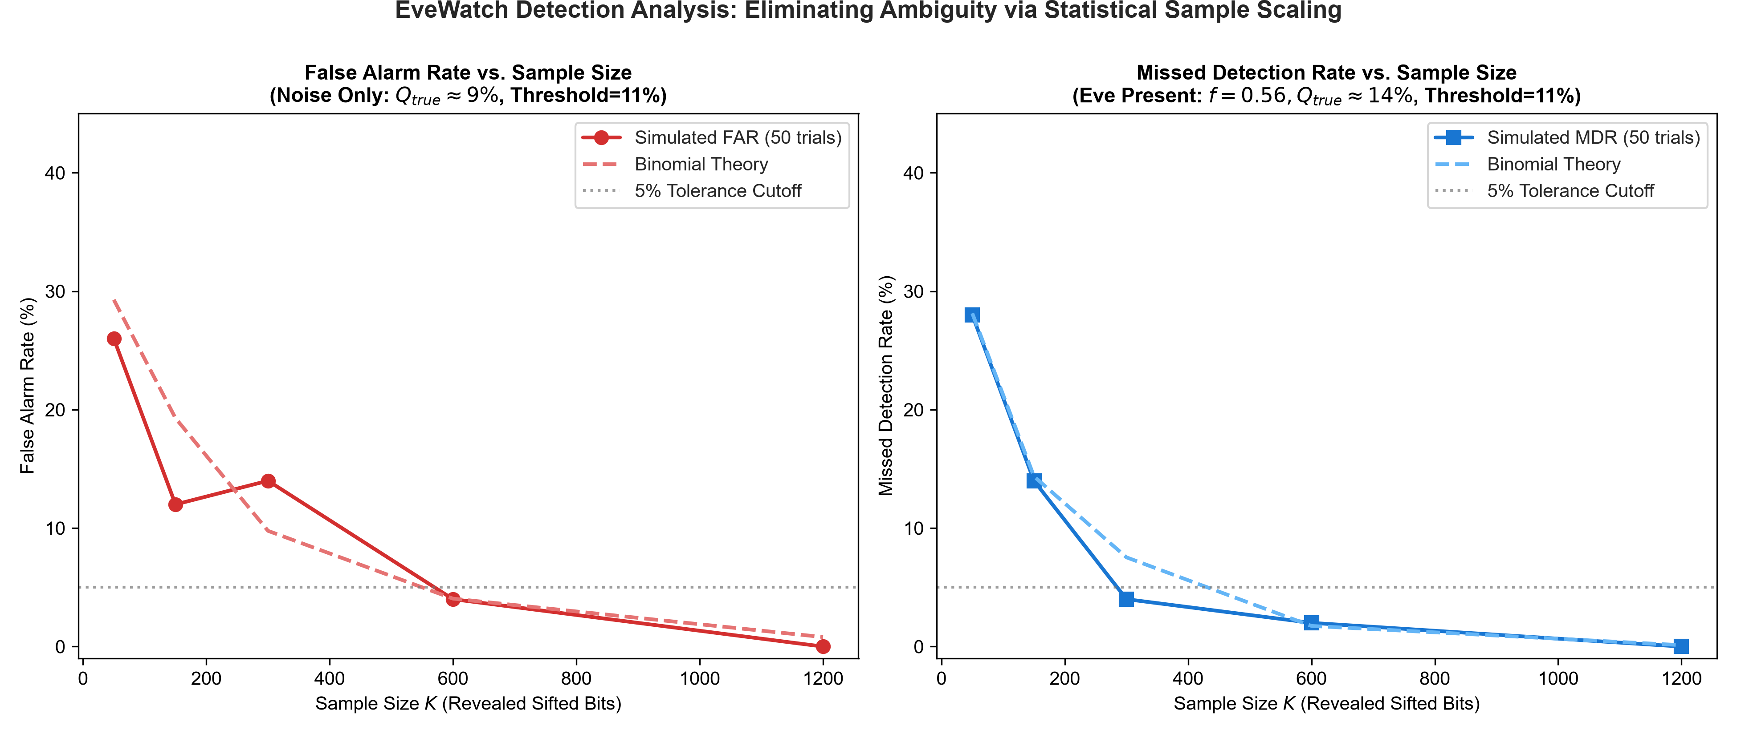
QISKIT FALL FEST 2026
Detection Reliability: Resolving Ambiguity via Sample Scaling
How EveWatch Solves This
• Small Sample Hazard (K=50): Finite-size binomial dispersion causes a 26.0% False Alarm Rate and a 28.0% Missed Detection Rate!
• 1 in 4 Insecurity: At K=50, 28% of compromised keys slip past undetected.
• Statistical Convergence: As sample size scales to K >= 600, variance collapses as 1/sqrt(K).
• Zero-Error Detection: At K=1200, both False Alarms and Missed Detections drop to 0.0%, achieving mathematically verified channel trust.
Notes:
Slide 9 reveals our answer to the central research question. When operating near the 11% threshold, small sample sizes of 50 bits suffer from high binomial variance, leading to 26% false alarms and 28% missed detections. By scaling the sacrificed sample size to K >= 600 bits, Alice and Bob compress the error variance and eliminate both errors to under 1%.

Slide 10
QISKIT FALL FEST 2026
Working Prototype: Streamlit Interactive Dashboard (app.py)
Tab 1: Protocol Demo
Real-time interactive BB84 simulation.
Step-by-step table highlighting Alice bits, bases, Eve actions, and Bob measurements.
Color-coded security verdict banners.
Tab 2: Empirical Experiments
Embedded interactive visualizers for all 6 empirical research benchmarks.
Inspect CSV datasets, QBER curves, heatmaps, and detection error curves.
Tab 3: Secure Messaging (OTP)
Type custom messages.
Encrypt and decrypt with distilled quantum key using One-Time Pad (XOR).
Visual inspection of Eve's corrupted decryption attempt.
Tab 4: How BB84 Works
Plain-language educational guide explaining the 4 stages of BB84, conjugate bases, and quantum mechanics fundamentals for students and judges.
Notes:
Slide 10 details our interactive Streamlit prototype. It features four dedicated tabs: an interactive transmission step-by-step table, an experiment visualizer, a live One-Time Pad text encryption tool, and an educational explainer. It runs smoothly with streamlit run app.py.

Slide 11
QISKIT FALL FEST 2026
Innovation: What Makes EveWatch Different?
Feature / Dimension | Standard Student BB84 Project | EveWatch (Our Project)
Qiskit API Version | Deprecated execute(), BasicAer | Current Qiskit 2.x & AerSimulator
Simulation Speed | Slow 1-qubit circuits | Aer Stabilizer Clifford scaling O(N) (1000q in 35ms)
Adversary Modeling | Binary On/Off toggle | Continuous interception fraction f in [0, 1]
Noise Modeling | None (Idealized) | Depolarizing, Readout, & Calibrated IBM 127Q
Core Research Question | 'Does BB84 transfer bits?' | 'Can Alice & Bob tell noise from Eve?'
Notes:
Slide 11 highlights our competitive differentiation for the judges. Unlike generic student projects using legacy APIs and idealized assumptions, EveWatch delivers modern Qiskit 2.x stabilizer performance, multi-tiered hardware noise modeling, continuous adversary fractions, and statistically rigorous sample scaling analysis.

Slide 12
QISKIT FALL FEST 2026
Impact, Honest Limitations, and Future Roadmap
Honest Limitations
• Simulation Link: Optical links are modeled via depolarizing Kraus channels rather than physical fiber-optic lasers and SPAD detectors.
• Attack Model: Focuses on intercept-resend; does not model photon-number-splitting (PNS) against weak coherent pulses.
• Asymptotic Assumption: The 11% cutoff assumes infinite key limits; finite-key regimes impose stricter penalties.
Future Scope & Roadmap
• Decoy-State Protocol: Implement vacuum + weak decoy states to neutralize PNS attacks.
• Entanglement-Based E91: Use Bell states and CHSH inequality tests to detect eavesdroppers without basis disclosure.
• Post-Quantum Hybridization: Combine BB84 quantum keys with NIST-standardized lattice algorithms (ML-KEM / Kyber).
• Physical Optical Testbed: Deploy on multi-node quantum optical links with physical single-photon detectors.
Notes:
We believe scientific credibility requires acknowledging honest limitations. Our work is simulation-based and focuses on intercept-resend. Looking forward, we have a clear roadmap to incorporate decoy-state protocols, E91 entanglement verification, and hybrid post-quantum cryptography integration.

Slide 13
Conclusion & Submission
EveWatch demonstrates that while hardware noise and eavesdropping conflate at the raw QBER level, statistical sample scaling (K >= 600) and link baseline calibration enable provable, reliable quantum security.
📦 Open-Source GitHub Repository:
https://github.com/Ayush-web28/EveWatch
Team: Ayush Trivedi | Qiskit Fall Fest 2026 @ MPSTME, NMIMS Mumbai
Thank you to IBM Quantum and MPSTME mentors!
Notes:
To conclude: EveWatch proves that while physical errors conflate eavesdropping and hardware noise, statistical sample scaling provides the key to reliable, provable quantum communication. Our full codebase, tests, figures, and Streamlit app are open-source on GitHub at github.com/Ayush-web28/EveWatch. Thank you, and I look forward to your questions!

