Slide 1

Presented by-
Ayush Agrawal
Sarthak Lav

Slide 2
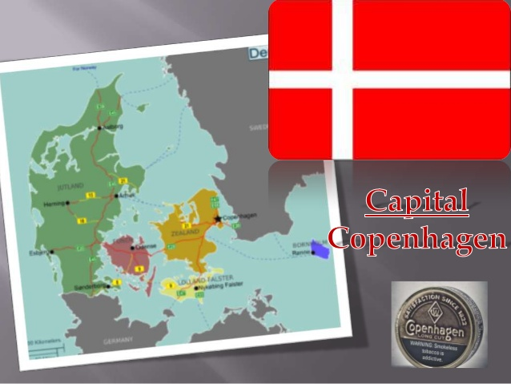

Slide 3
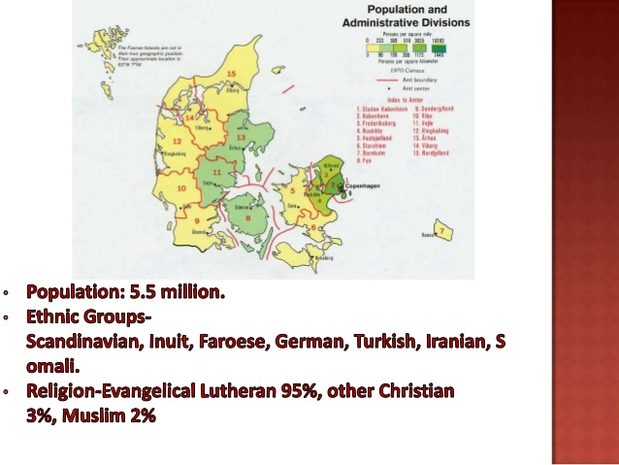

Slide 4
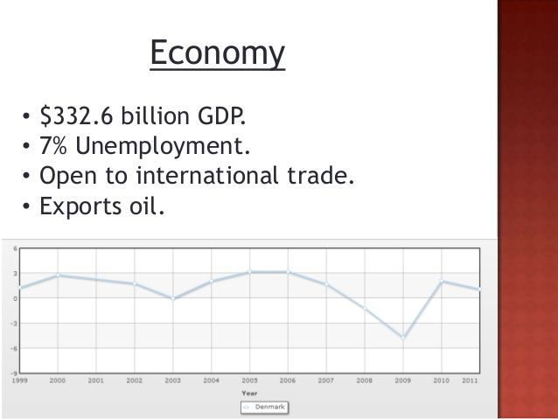

Slide 5
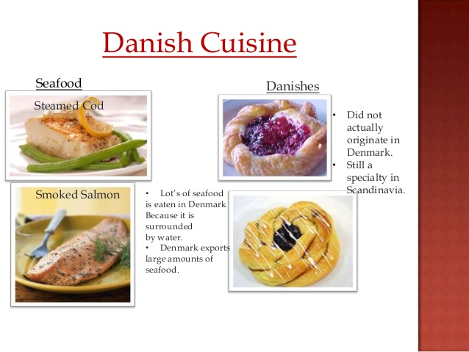
The concept was brought to Denmark by Austrian bakers

Slide 6
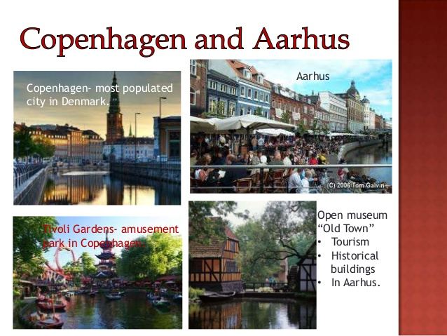

Slide 7


Slide 8
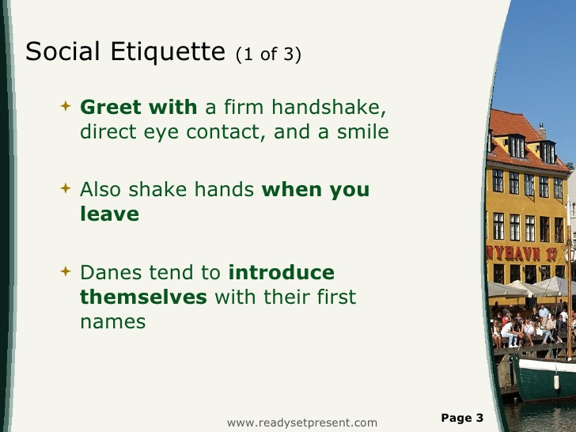

Slide 9


Slide 10
