Slide 1
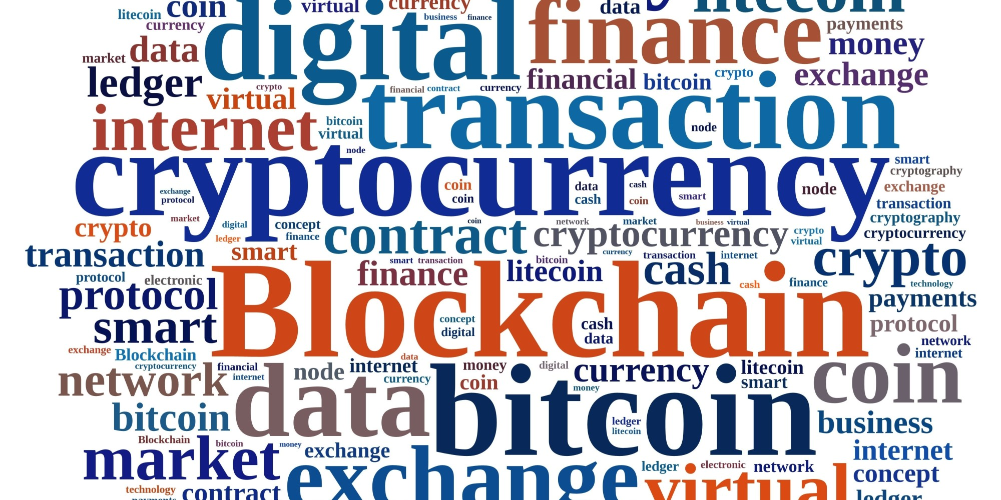
Crypto Currency
Presented by : Pushpraj Kaushik

Slide 2
What is crypto currency?
Crypto currency is a digital currency and a medium of exchange like other currencies.
It is designed for purpose of exchanging digital information through a process made possible by principles of cryptography.
Cryptography is used to secure transactions and generation of new coins.

Slide 3
Why crypto currency is used?
Easy to carry
Simple, fast, safe & cheap.
Low inflation and collapse risk
Untraceable
Access to Everyone(Open Source)
Decentralized nature

Slide 4
Where it is used ?
It is Explicitly banned in few countries and in few countries it is implicitly banned.
In USA and Canada, it is used like any other currency or investment options.
In some countries, regulations are still being made to launch crypto currency for its smooth functioning.
It is similar to reward points which has its own value and can be used for exchange.

Slide 5
Who?
Invention
The concept of bit coin was first proposed by Satoshi Nakamoto.
Operation
Group of developers from different parts of the world work on it and take bit coins as salary or reward.
Usage
Any one can generate their own address and can start using it.

Slide 6
When?
Bitcoin was first proposed in 2008.
Its demand increased after 2014.
Price of bit coin in 2010 was less than a rupee
1 bit coin is currently equal to 5,84,000 Indian Rupees.
By the time I present the indices may fluctuate
Price of bit coin change according to demand and supply.

Slide 7
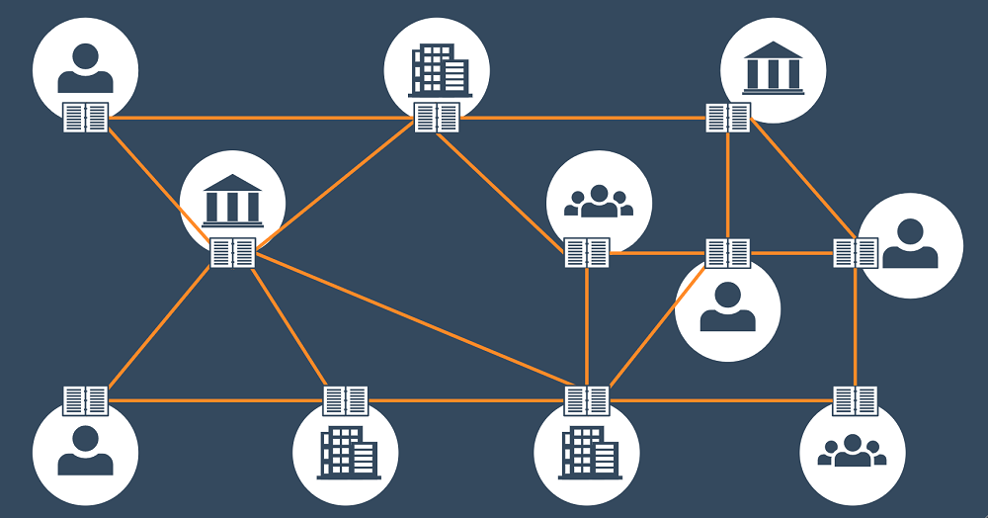
Distributed ledger technology

Slide 8
How it works?
BITCOIN TECHNOLOGY
Distributed ledger technology
Data Mining
Computing devices
Encryption Decryption
Blockchain
Bitcoin wallets

Slide 9
etvx
ENTRY
Started investing in crypto currency
TASK
Exchange of crypto currency from one address to another address
VALIDATION
Safe transaction with the help of blockchain which uses SHA 256 for encryption and decryption
EXIT
Book your profit/loss.

Slide 10
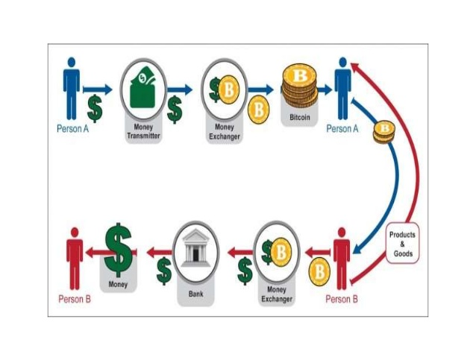
ETVX

