Slide 1
Machine Learning
Final Report
Team - 1
Sarthak Daksh - 2020403
Singh Ayush Kumar Satish - 2020133
Atyant Sony - 2020039
Aishwary Sharma - 2020490

Slide 2
Motivation
A car depreciates in value form the moment you buy it, and depreciation progresses over time. The make and model of the car, total kilometers driven, overall condition of the vehicle, and various other factors further affect a car’s resale value. This project aligns with our goal of creating a transparent sales process by providing the best resale value estimate for a car that one should expect to shell out, thus preventing any kind of dissatisfaction from either the buyer’s side or the seller’s side and deploying Machine Learning Models to solve real world problems.

Slide 3
Literature review
Paper 1 - N. Sun, H. Bai, Y. Geng, and H. Shi, “Price evaluation model in second-hand car systems based on BP neural network theory,” in 2017 18th IEEE Conference.
The study provides a model based on Big Data Analysis using the optimized BP neural network algorithm used to select the optimal number of hidden neurons in the BP neural network to establish a second-hand car price evaluation model to get the price that best matches the car.
Paper 2 - P. Boteju and L. Munasinghe, “Vehicle Recommendation System using Hybrid Recommender Algorithm and Natural Language Processing Approach,” in 2020 2nd International Conference on Advancements in Computing (ICAC).
A neural network model was trained using data from vehicle users and sellers to best predict cars suitable to the user. Besides the neural network, the model uses natural language processing (NLP) to produce more personalized recommendations.

Slide 4
Dataset Description
Initial Dataset Size: 9379 Rows & 32 Columns
Final Dataset Size: 7452 rows & 29 Columns
Features in the final dataset: Year, Brand Value, Ratings, Drivetrain, MPG, Fuel, Transmission, Mileage, Color
Label Encoding & One-Hot Encoding: Converting Object type features to Int type
Undersampling & Oversampling: Not applicable as the Target value is continuous.
Feature Reduction using PCA is not viable as most features are weakly correlated.

Slide 5
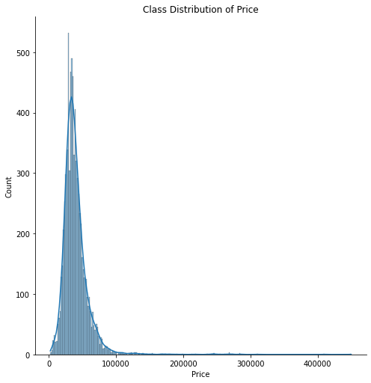
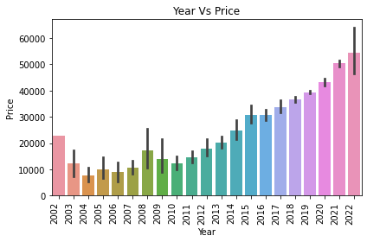
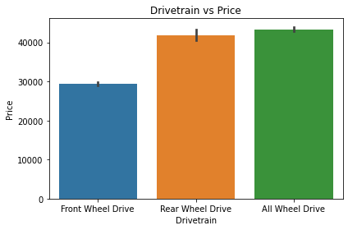
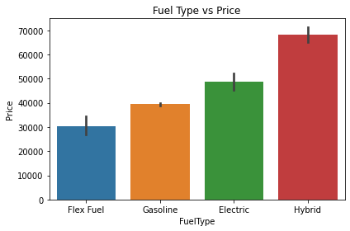
Class Distribution of Price

Slide 6
Models
We implemented several supervised Machine learning models namely:-
Linear Regression
Lasso Regression
Ridge Regression
Decision Trees
Decision Trees Regressor with ADA boosting
K-Nearest Neighbor
SVR
Random Forest

Slide 7
Best Parameter
Model | Best Parameter
Linear Regression | No parameters
Lasso Regression | Alpha : 19.138276553106213
Ridge Regression | Alpha : 16.032064128256515
Decision Tree | criterion : absolute_error, max_depth : 10
ADA boosting on Decision Tree | Loss : linear, n_estimators : 250
KNN | N_neighbors: 5, weights: distance
Random Forest | Criterion: absolute_error, max_depth: 22
SVR (epsilon) | C: 10.0, epsilon: 0.01, kernel: linear, gamma: scale
SVR(Linear) | Loss: squared_epsilon_insensitive, C: 0.1

Slide 8
Result
Model | R2 Score | Absolute Error | Mean Squared Error | Root mean Square error
Linear Regression | 0.5047594243059601 | 7290.192246735668 | 207909323.58681455 | 14419.061120156699
Lasso Regression | 0.5054769923199474 | 7253.694773104404 | 207608077.914029 | 14408.611241685612
Ridge Regression | 0.5037237249531942 | 7272.58715567909 | 208344125.50418794 | 14434.130576664045
Decision Tree | 0.6893352176712266 | 4725.2585513078475 | 130421673.6799128 | 11420.230894334527
ADA boosting | 0.8694658482918944 | 3336.0020780494415 | 61609962.13168386 | 7849.201369036462
KNN | 0.8408103557102092 | 4423.421056245784 | 78582295.88930534 | 8864.665582485632
SVR (linear) | 0.4542500669934886 | 8137.461254055149 | 242839659.8852381 | 15583.313507891642
SVR (epsilon) | 0.43779440403628467 | 8137.461254055149 | 242839659.8852381 | 15583.313507891642
Random Forest | 0.8724321201275056 | 3515.0942320590207 | 52371376.24132079 | 7236.807047401553

Slide 9
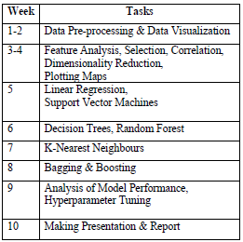
Timeline

Slide 10
Contribution
Data Pre-Processing and Visualization - Atyant Sony, Aishwary Sharma
Model Implementation and Training and Testing - Sarthak Daksh, Singh Ayush Kumar Satish
Rest was equally contributed by all the members

Slide 11
Thank you for listening!

