Slide 1

Using CNN to Predict business attribute labels for Yelp restaurants using user-submitted photos
Joseph Vele
Ayush Bhandari
Ruoxi Pan
Khoury College of Computer Sciences
Northeastern University

Slide 2


Introduction
Background: At Yelp, there are lots of photos being updated by the users. These photos provide rich local business information and user opinions across categories.
Goal: We want to teach the computer to predict the business attributes given the photos.

Slide 3
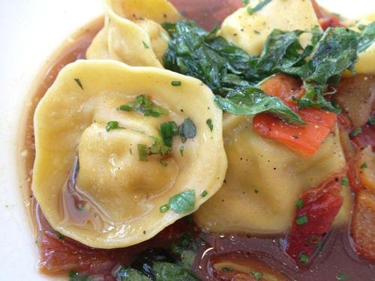
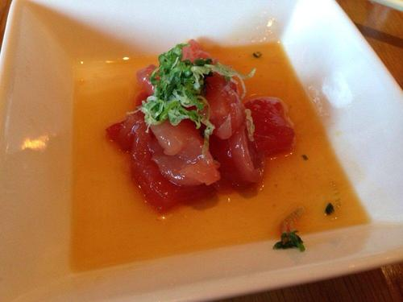
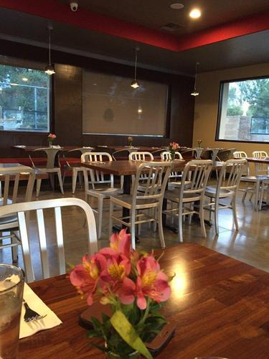
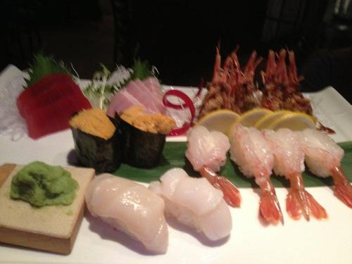
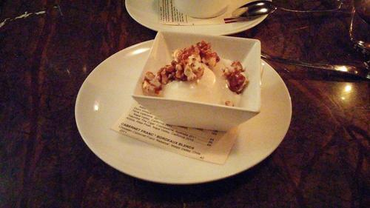
OUR DATA
Attributes:
0: good_for_lunch 1: good_for_dinner 2: takes_reservations 3: outdoor_seating 4: restaurant_is_expensive 5: has_alcohol 6: has_table_service 7: ambience_is_classy 8: good_for_kids
Photo Examples:

Slide 4
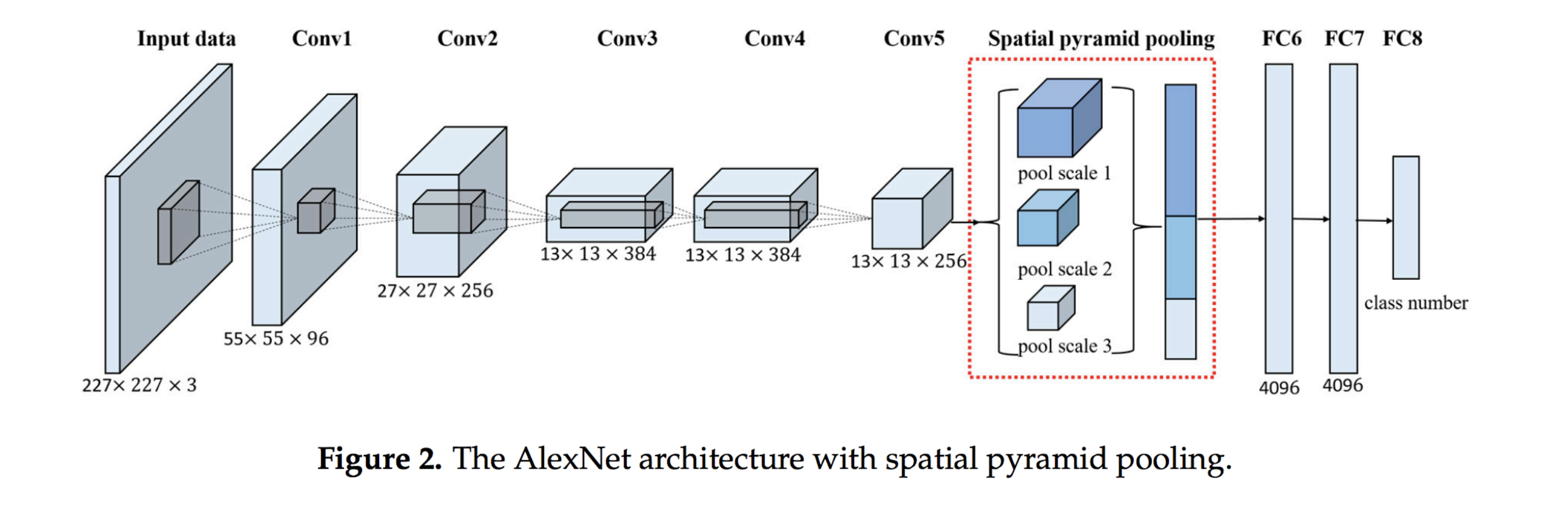
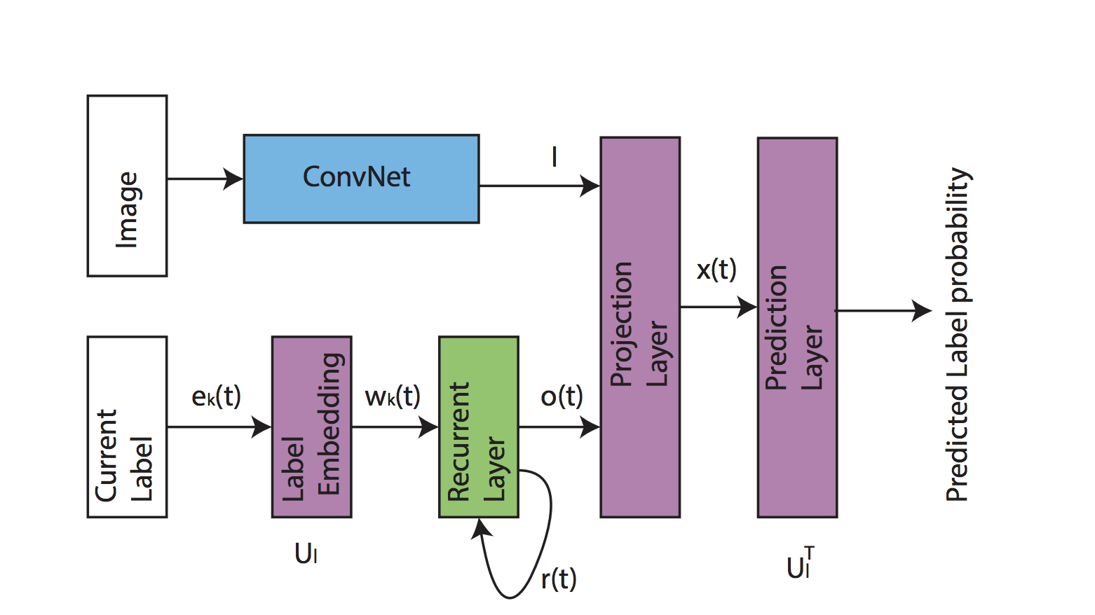
Methodology
CNN Multi-Label with Spatial Pyramid Pooling (SPP)
VGGNET
ALEXNET
CNN-RNN

Slide 5
related WORK
J. Wang, Y. Yang, J. Mao, Z. Huang, C. Huang, and W. Xu, “CNN-RNN: A Unified Framework for Multi-label Image Classification,” 2016 IEEE Conference on Computer Vision and Pattern Recognition (CVPR), 2016.
X. Han, Y. Zhong, L. Cao, and L. Zhang, “Pre-Trained AlexNet Architecture with Pyramid Pooling and Supervision for High Spatial Resolution Remote Sensing Image Scene Classification,” Remote Sensing, vol. 9, no. 8, p. 848, 2017.
K. He, X. Zhang, S. Ren, and J. Sun, “Spatial Pyramid Pooling in Deep Convolutional Networks for Visual Recognition,” Computer Vision – ECCV 2014 Lecture Notes in Computer Science, pp. 346–361, 2014.

