Slide 1







MASS TRANSFER II PROJECT
AI-Assisted Optimization of Liquid– Liquid Extraction Process

Kaushal

Grishma

Ayush
Machine Learning & Optimization
Crosscurrent & Countercurrent Simulation
GUI Development & Equilibrium Modeling
Instructor: Lopamudra Giri
Course: Mass Transfer II
IIT Hyderabad
Indian Institute of Technology Hyderabad

Slide 2



Problem Statement & Objective
Context and Goals of the Mass Transfer II Project

Background

Project Objective
Liquid–liquid extraction is a critical separation technique where a solute is transferred from one liquid phase to another immiscible solvent.
To develop a computational software tool that modernizes the design process by integrating physics-based modeling with AI.
KEY APPLICATIONS:
●
Pharmaceutical purification
●
Petroleum refining
●
Food processing
●
Wastewater treatment
Model liquid-liquid equilibrium accurately
Simulate multi-stage extraction processes
⚠
Limitations of Conventional Methods
Analyze process performance metrics
Optimize operating parameters automatically
Traditional design relies on ternary diagrams and manual calculations, which are:
Visualize results interactively in real-time
×Time consuming and prone to human error
×Difficult to scale for complex systems
×Inefficient for exploring large parameter spaces
GOAL: EFFICIENCY & ACCURACY

Slide 3











System Architecture & Member Responsibilities
Modular Framework Integration & Development Roles
Slide 4
DATA & INTERFACE
CORE SIMULATION
ML & OPTIMIZATION

Ayush

Grishma

Kaushal
RESPONSIBILITIES
RESPONSIBILITIES
RESPONSIBILITIES
•

Equilibrium data processing & cleaning
•

Crosscurrent extraction modeling
•

Synthetic dataset generation
•

Regression fitting of tie-line data
•

Countercurrent extraction modeling
•

Neural Network architecture design
•

Graphical User Interface (GUI) dev
•

Stagewise mass balance algorithms
•

Model training & validation cycles
•

Result visualization framework
•

Multi-stage separation logic
•

Parameter optimization algorithms
→
→
COMPONENTS
  
equilibrium_model.py gui_interface.py
visualization.py
COMPONENTS
COMPONENTS
 
crosscurrent_sim.py countercurrent_sim.py
 
dataset_generator.py ml_model.py

Slide 4
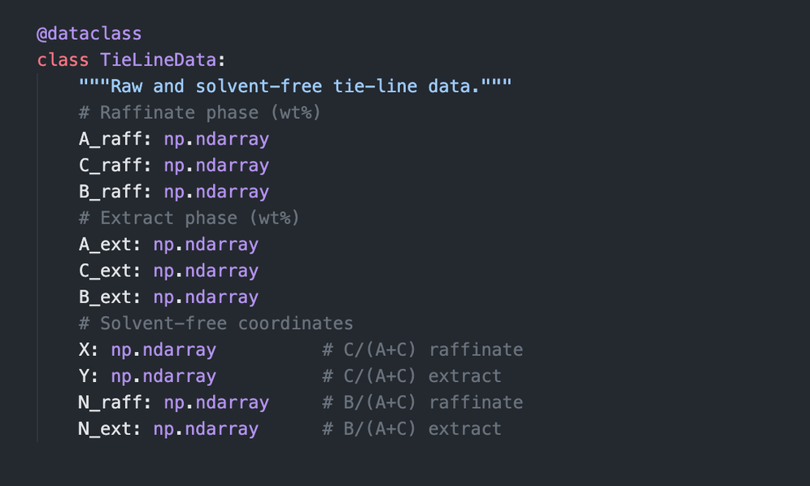
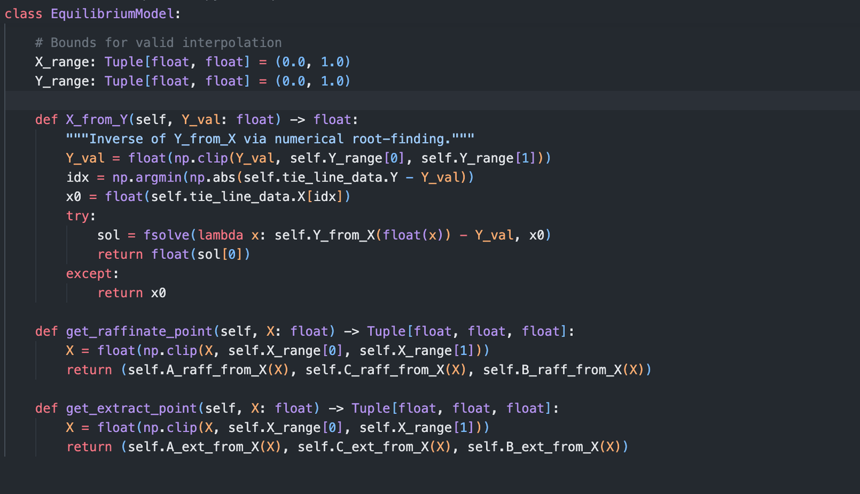
Code: Equilibrium Data Fitting
Mass Transfer II

Slide 5
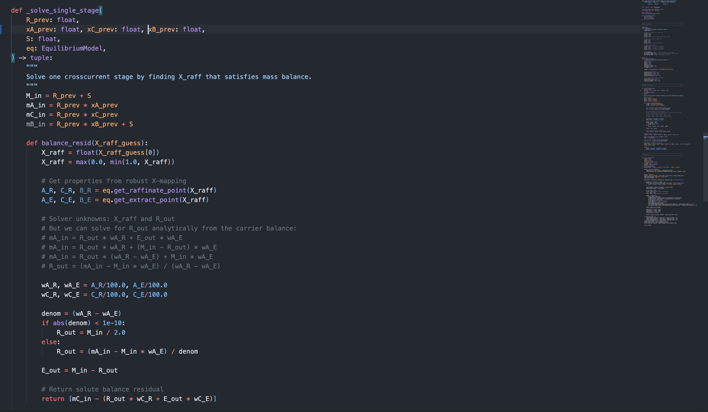

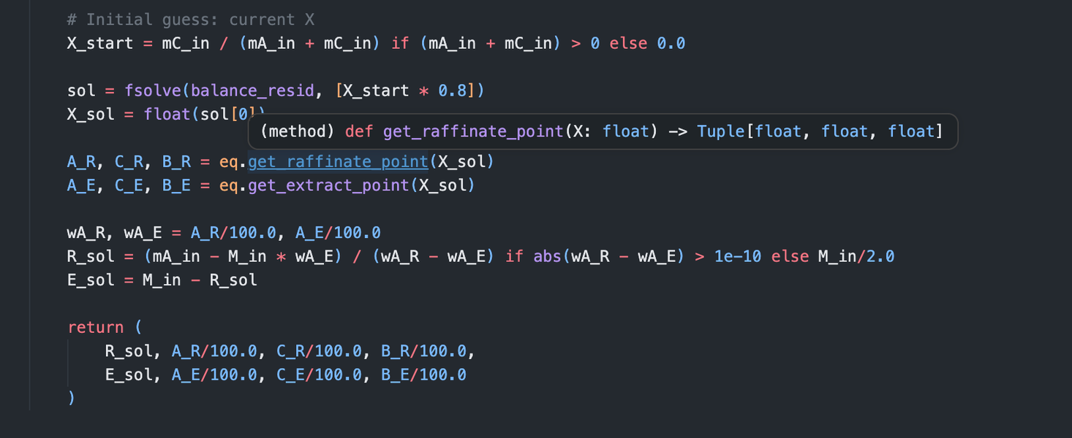

Code: Crosscurrent Extraction
Mass Transfer II

Slide 6
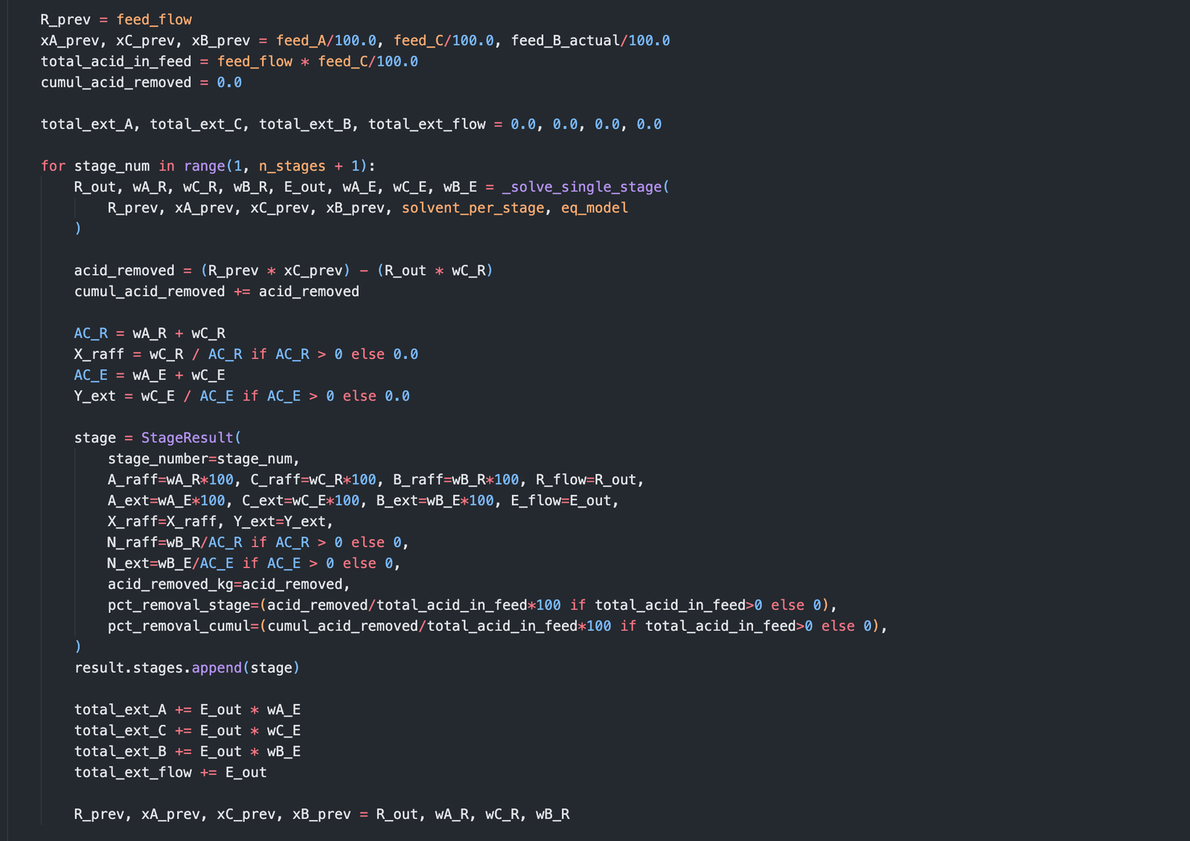

Code: Crosscurrent Extraction
Mass Transfer II

Slide 7
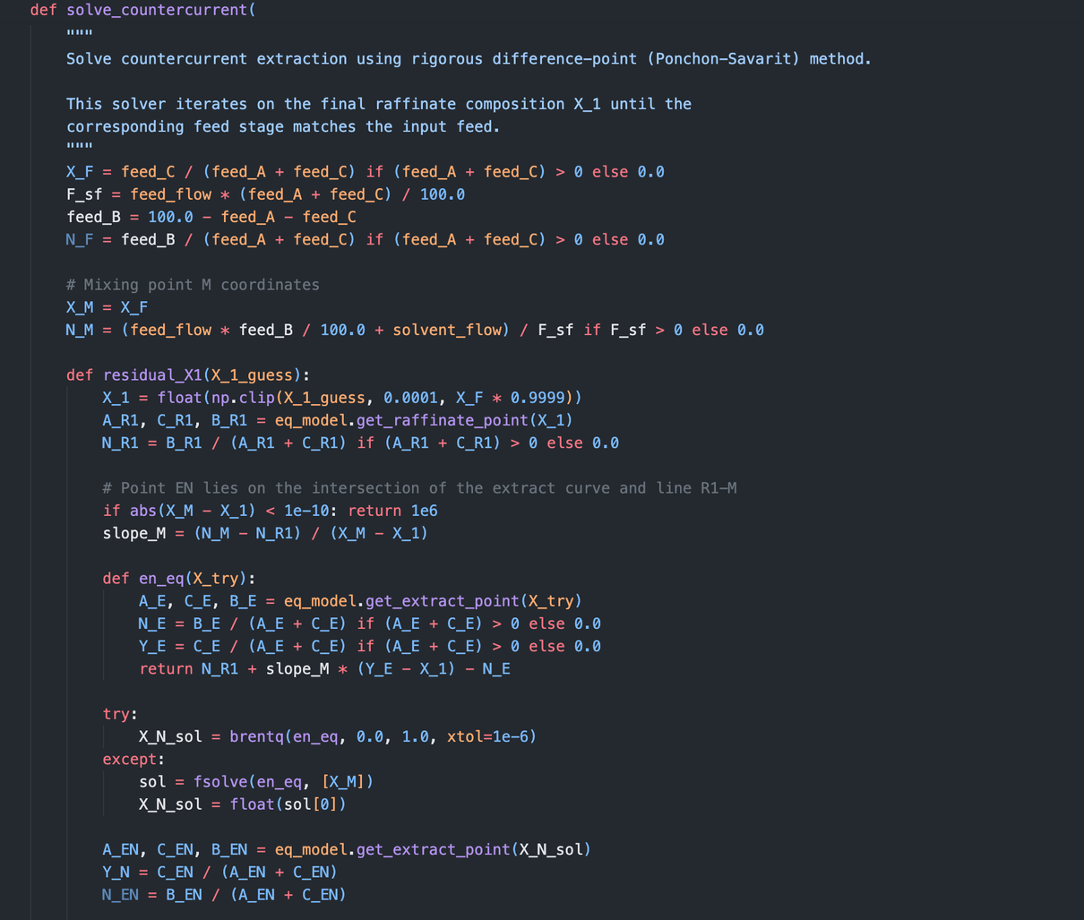
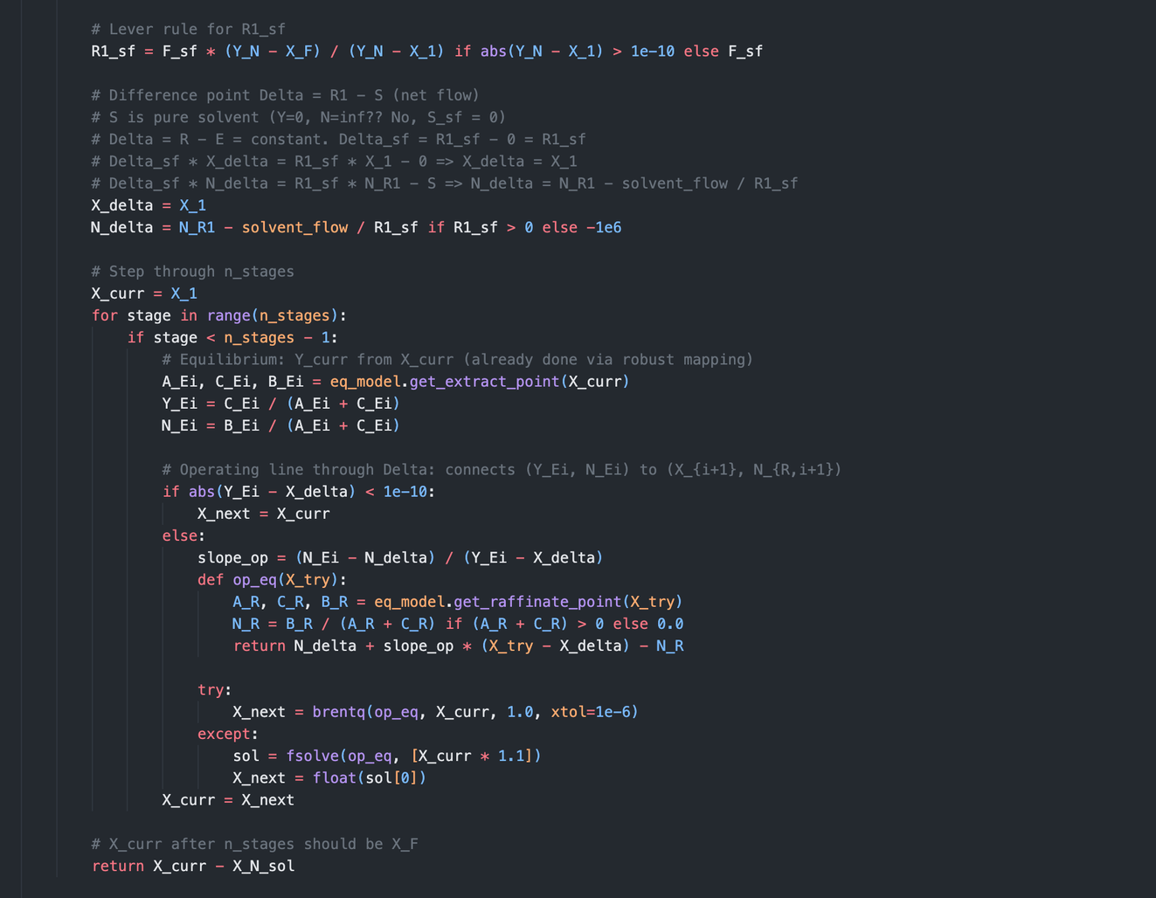
Code: Countercurrent Extraction
Mass Transfer II

Slide 8
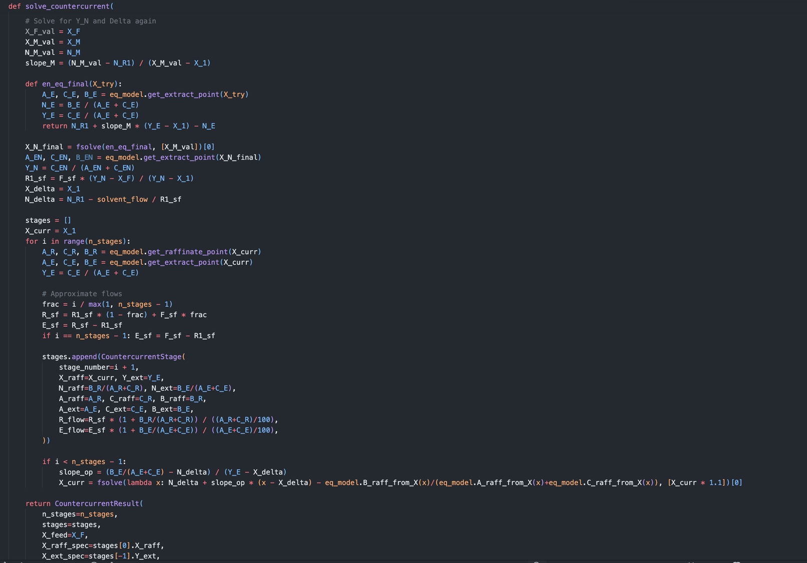
Code: Countercurrent Extraction
Mass Transfer II

Slide 9
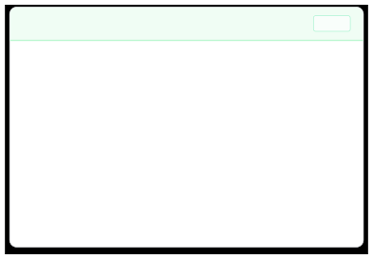
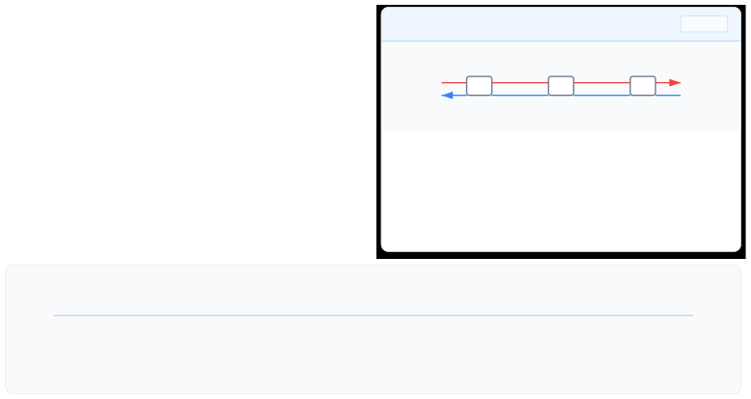


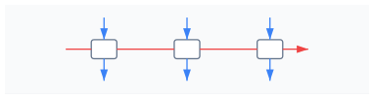




Extraction Simulation Model
COMPARISON OF METHODOLOGIES & ALGORITHMS

Grishma
⧫
Crosscurrent Extraction
SIMPLE

Countercurrent Extraction
EFFICIENT
Solvent
Feed
Feed
Raffinate
S1
S2
S3
S1
S2
S3
Extract
Solvent
Fresh solvent is added at each stage independently.
Phases flow in opposite directions through the system.
→ → →
→
Design: Simple equipment setup. Operation: Easy to control individual stages. Drawback: High solvent consumption.
Efficiency: Lower driving force per stage.
→ → →
→
Design: Widely used in industry. Operation: Continuous steady-state flow. Benefit: Significantly reduced solvent usage.
Efficiency: Maximum average driving force.

Stagewise Calculation Algorithm
1
2
3
4
Equilibrium
Mass Balance
Update
Iterate
Determine phase equilibrium based on current concentrations
Apply component mass conservation equations
Calculate new raffinate/extract compositions
Repeat for N stages or until convergence

Slide 10
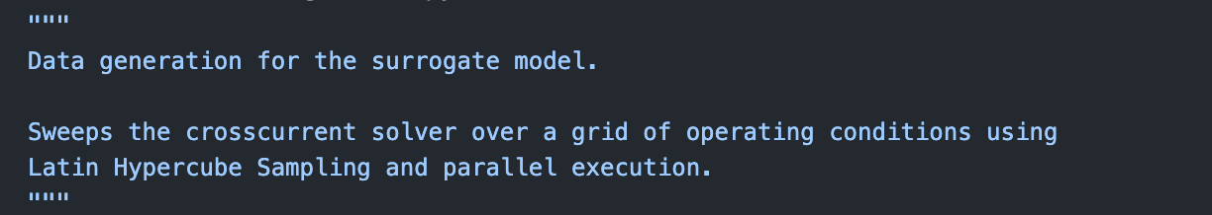
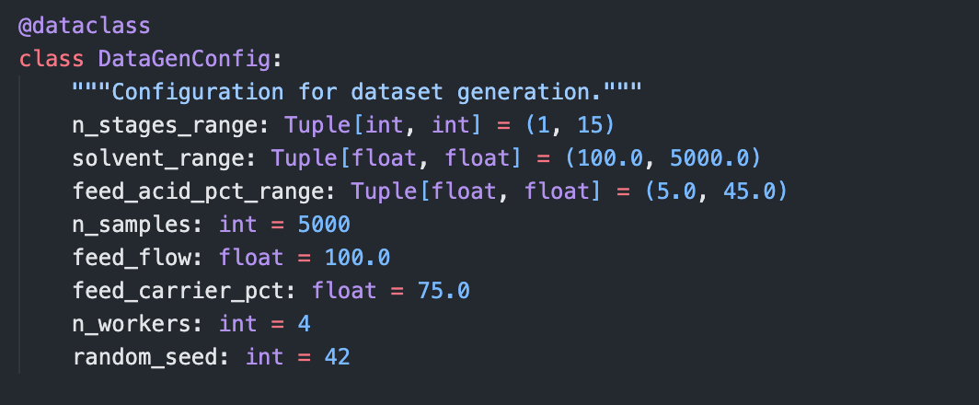
Code: Data Generation
Mass Transfer II

Slide 11
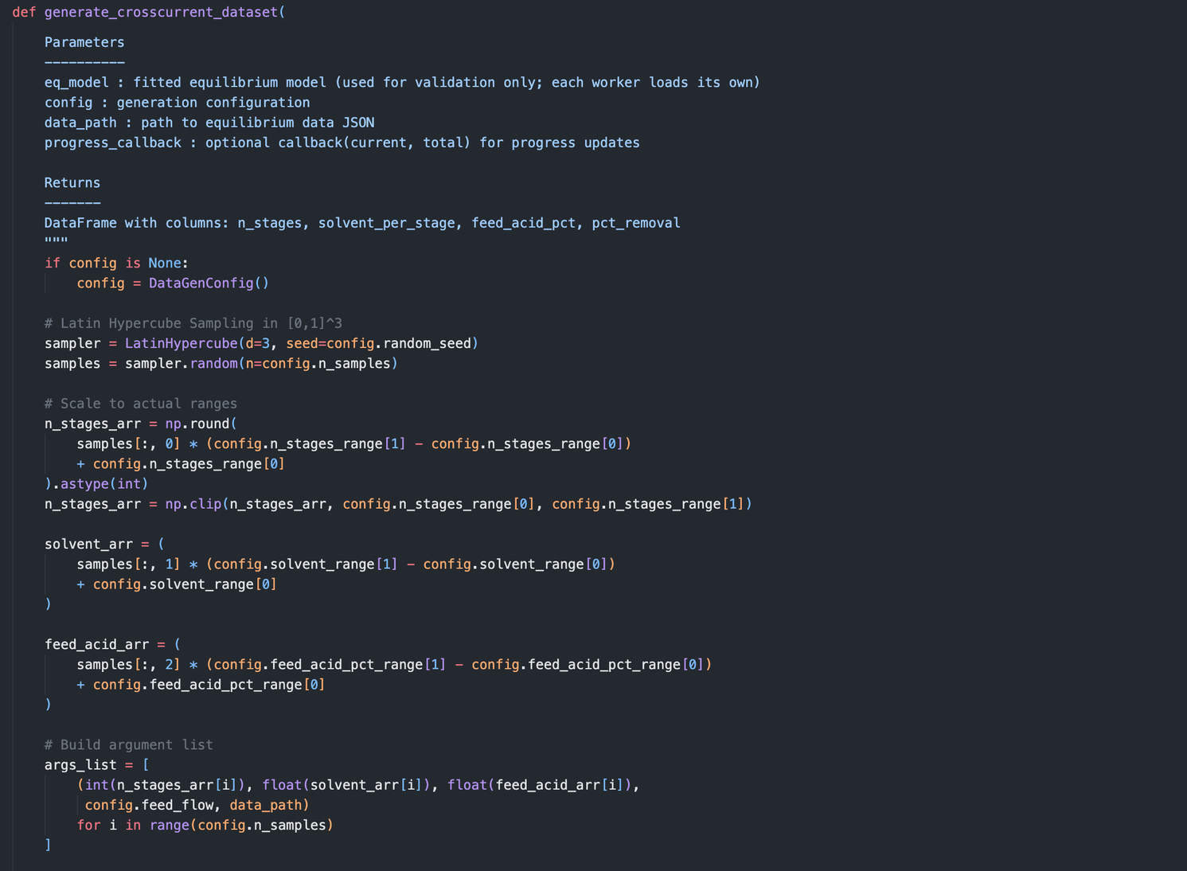
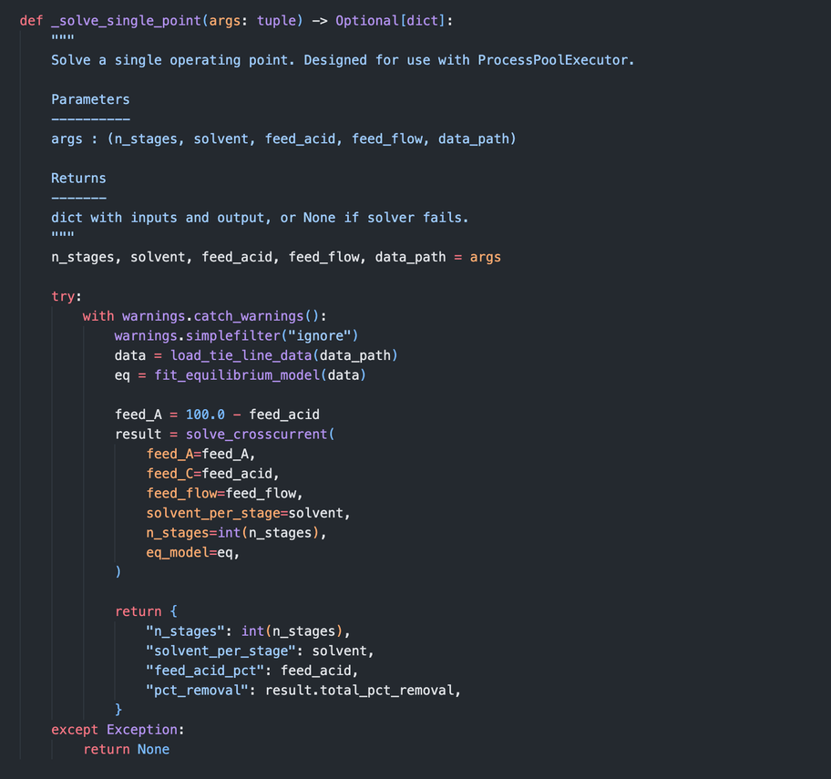
Code: Data Generation
Mass Transfer II

Slide 12
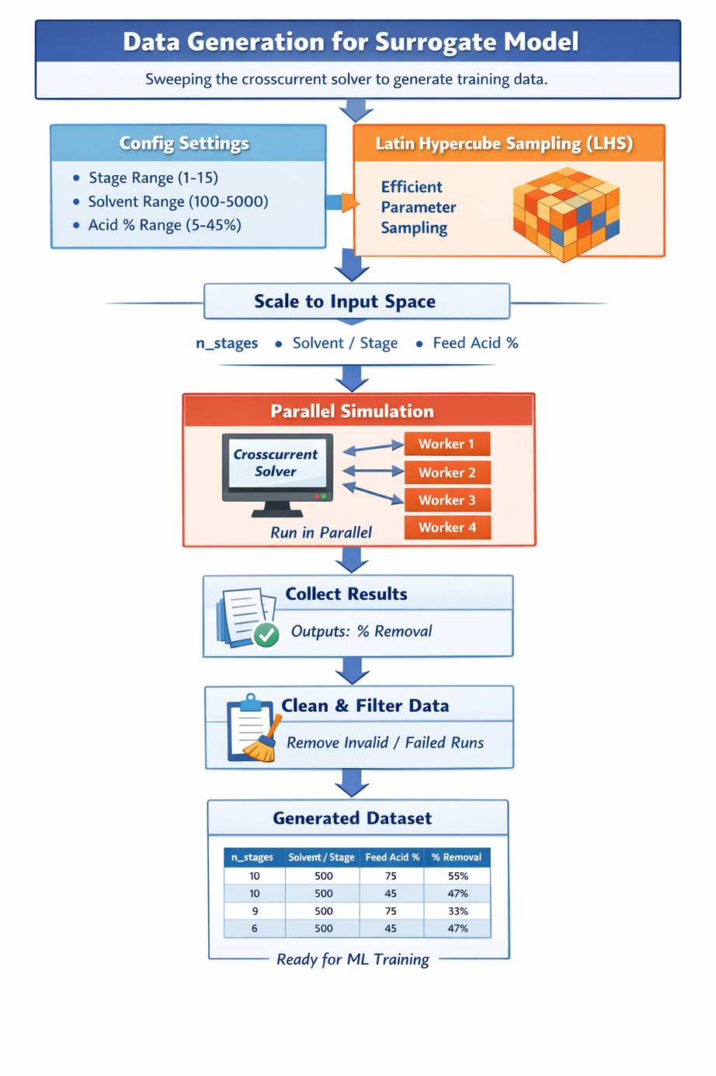

Slide 13
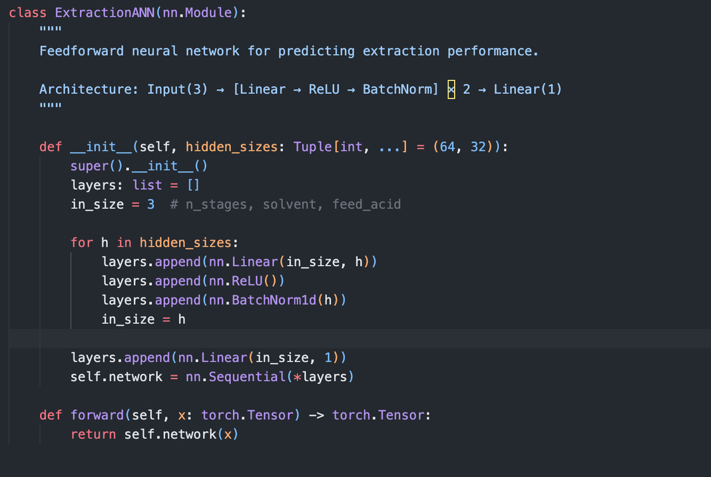
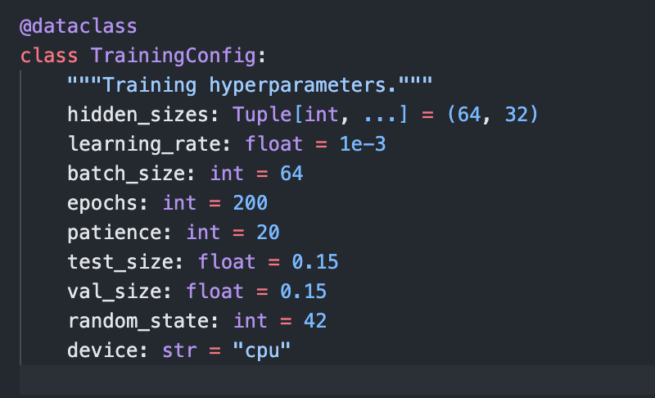
Code: ANN Model
Mass Transfer II

Slide 14
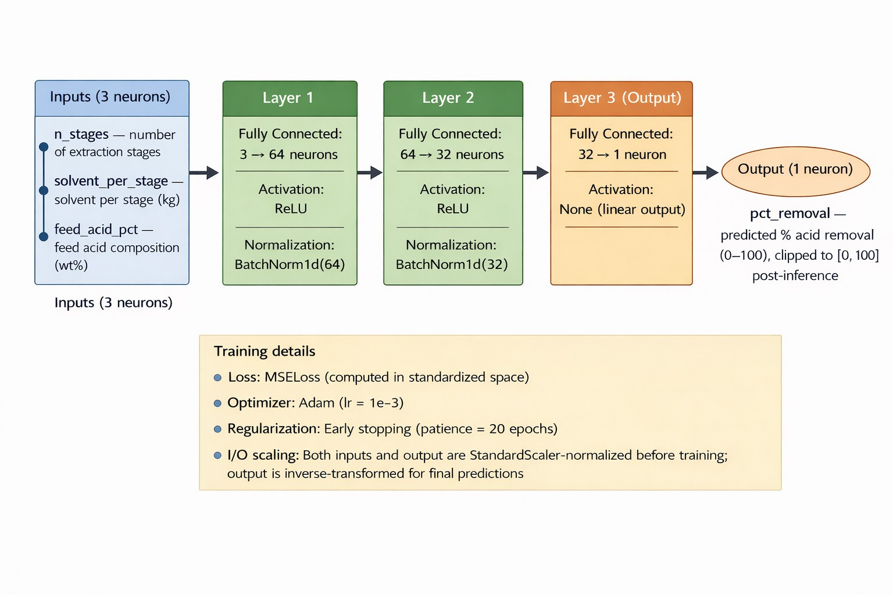

Slide 15

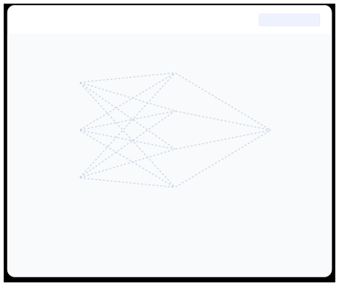


























Machine Learning Model
NEURAL NETWORK ARCHITECTURE & TRAINING STRATEGY

Kaushal

Network Topology
Feed-Forward ANN

Training Workflow

STEP 01
Generate Dataset
INPUT LAYER
HIDDEN LAYER
OUTPUT LAYER

⧫
STEP 02
Split Data (Train/Test)



STEP 03
Train Model (Gradient Descent)
Solvent Ratio (S/F)
No. of Stages (N)


Extraction Efficiency (%)
Feed Comp. (xF)

Why Machine Learning?
Enables instant prediction of extraction efficiency across the entire parameter space without running computationally expensive simulations for every point.
⚡
ReLU Activation

Slide 16
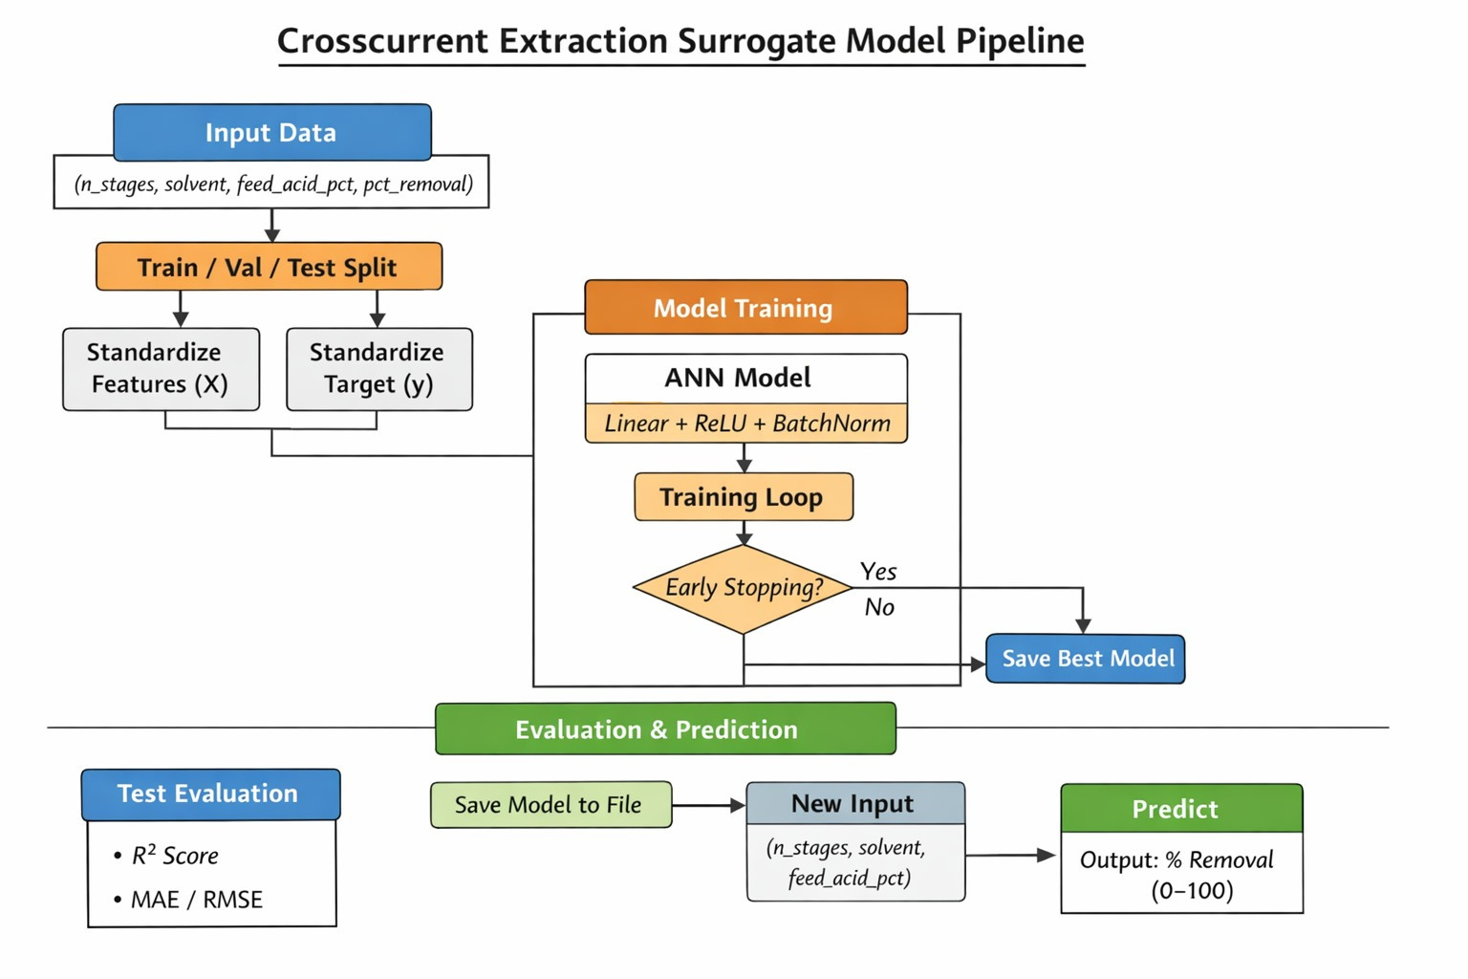

Slide 17
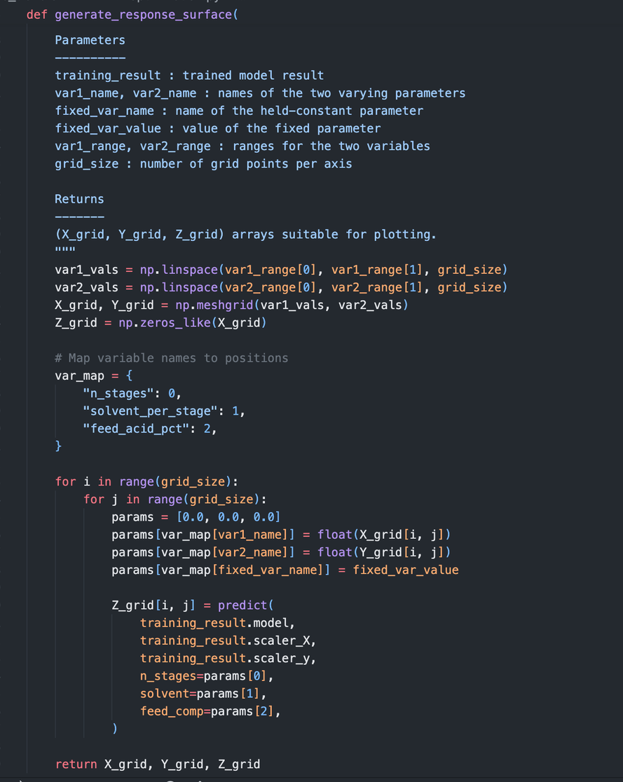
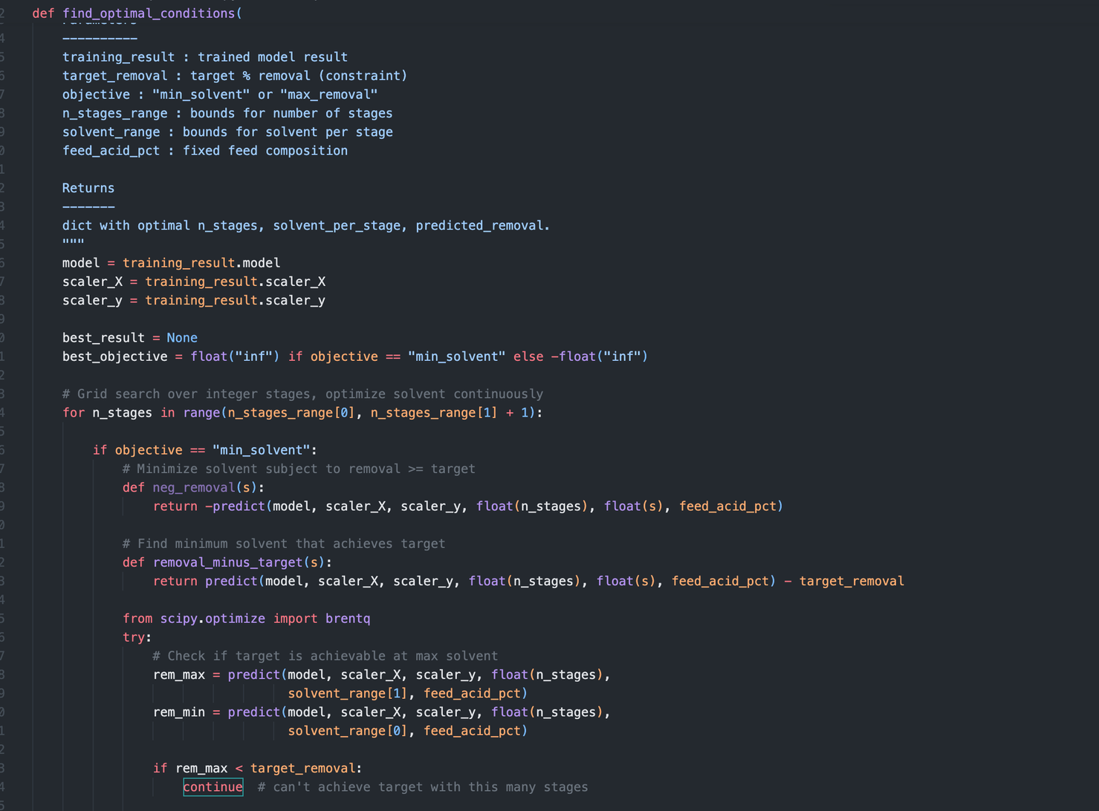
Code: Respomse Surface and Optimization
Mass Transfer II

Slide 18
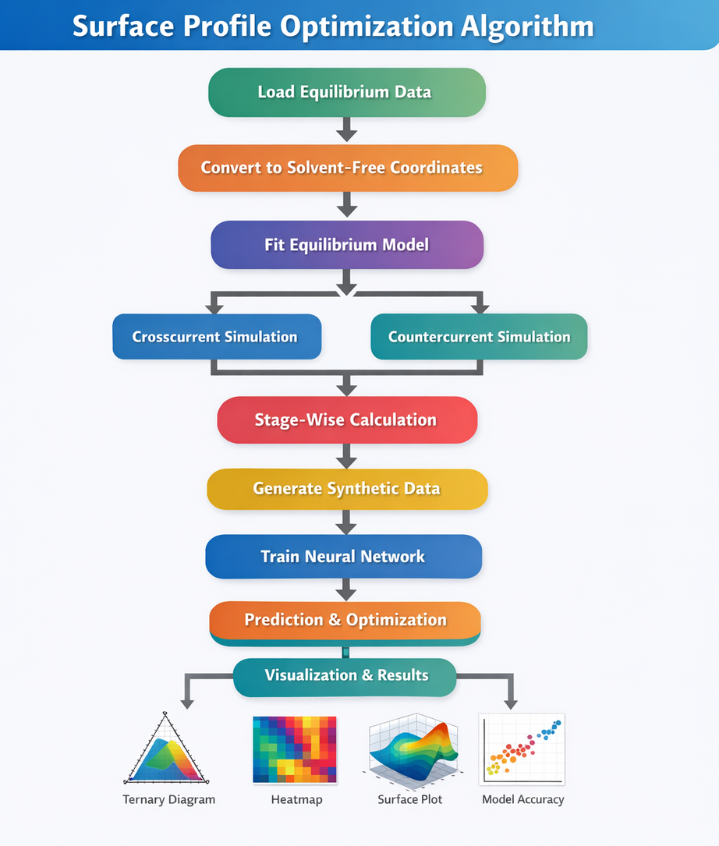
Algorithm Flowchart
Mass Transfer II

Slide 19
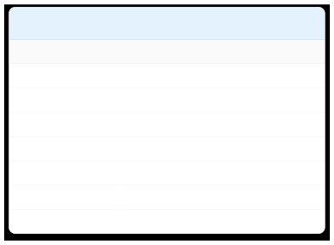
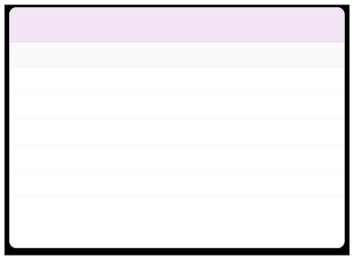



Code Analysis
Key Variables & Program Structure
Slide 5

Process Simulation Variables

Machine Learning Variables
VARIABLE
DESCRIPTION
VARIABLE
DESCRIPTION
F
Feed flow rate (kg/hr)
X_train
Training input parameters (Features)
S
Solvent flow rate (kg/hr)
y_train
Target extraction efficiency (Labels)
xR
Raffinate phase solute composition
(updated each stage)
model
Neural network instance (ANN)
yE
Extract phase solute composition
(from equilibrium model)
loss
Mean Squared Error (MSE) during training
N_stages
Number of extraction stages
optimizer
Gradient descent algorithm (Adam)
solvent_ratio
Solvent-to-feed ratio (S/F)
epochs
Number of training iterations
efficiency
Calculated extraction efficiency (%)
The code is designed using a modular architecture separating: Thermodynamic modeling (equilibrium), Process simulation (stage calculations), Data-driven prediction (ML model) This ensures: independent development, easier debugging, scalability for industrial use.

Slide 20


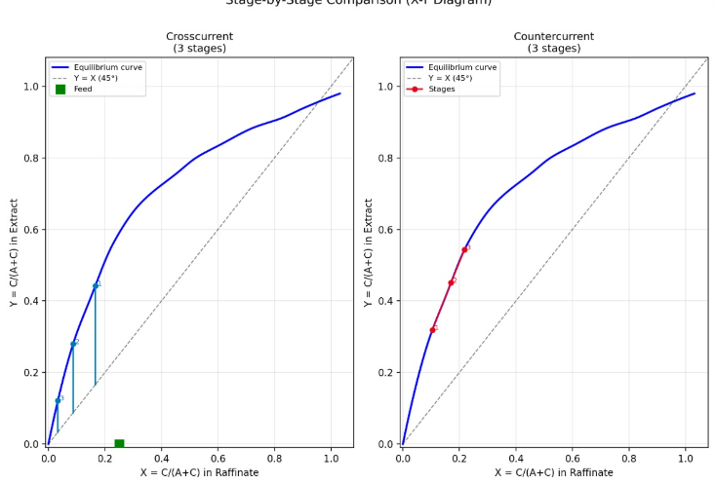
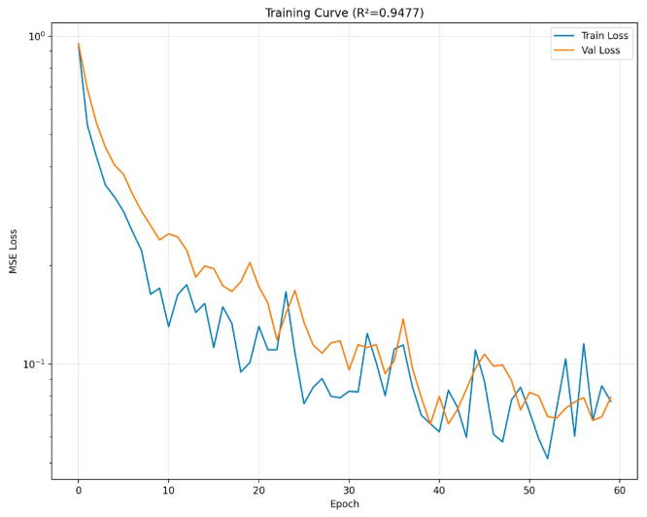


Results Analysis

Performance Metrics
HEATMAP VISUALIZATION & PREDICTION ACCURACY

Parameter Efficiency Map
Stages vs. Solvent Ratio

Prediction Accuracy
R² = 0.952

Key Observations
Optimal Region Identified
High efficiency achieved at S/F > 2 and stages ≥ 4.
Further increase shows diminishing returns.
Model Validation
Predictions closely match simulation results.
Low loss and tight fit indicate reliable ML model.

Slide 21
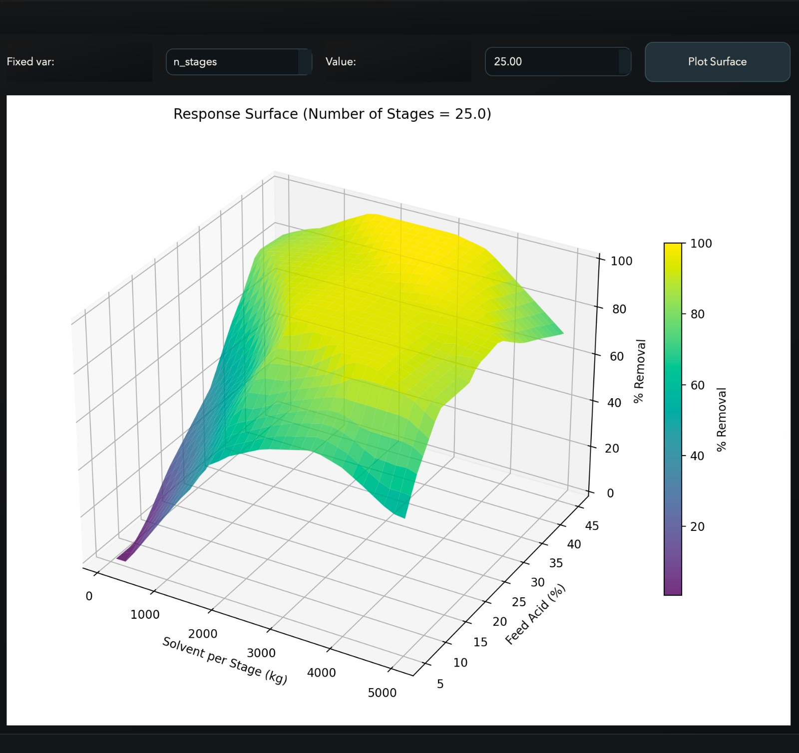







Surface Optimization
3D RESPONSE SURFACE & OPTIMAL OPERATING POINT

3D ANALYSIS
Peak
Base
⭐
Global Optimum
RECOMMENDED SETTINGS
2.2
Solvent Ratio (S/F)
5
No. of Stages
96.8%
Predicted Efficiency

Design Insight
The response surface reveals a plateau region where increasing solvent beyond ratio 2.5 yields negligible efficiency gains.
Conclusion: Operating at the identified
optimum minimizes solvent cost while
maximizing recovery.
PARAMETER SENSITIVITY
Low Sensitivity
High

Slide 22








Innovation & Team Expertise
PROJECT CONCLUSIONS & CONTRIBUTIONS

Project Completed

Key Innovations


Team Contributions

AI-Assisted Optimization
Implemented machine learning to predict extraction efficiency instantly, bypassing computationally expensive iterative simulations.
Final Outcome
The developed framework provides a powerful computational tool for the rapid analysis, design, and optimization of liquid–liquid extraction processes.
Kaushal
KA
MachineLearning & Optimization

Hybrid Modeling Framework
Seamlessly integrated rigorous physics-based mass transfer models with data-driven neural networks for robust accuracy.
Grishma
SimulationAlgorithms (Cross/Counter)
GR
AY
Ayush
Equilibrium Modeling & GUI Dev

Interactive Digital Twin
Developed a GUI tool allowing real-time parameter adjustment, visualization of equilibria, and dynamic process analysis.

Ready for Deployment
COURSE: MASS TRANSFER II

Slide 23
