Slide 1

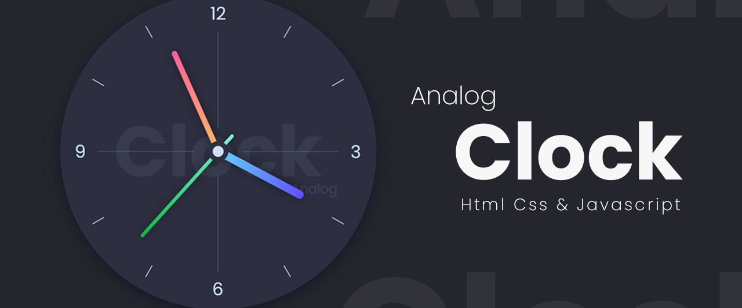
ANALOG CLOCK

Slide 2
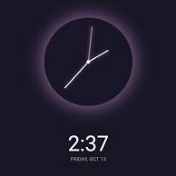
ANALOG CLOCK
This project is an interactive Analog Clock developed using HTML, CSS, and JavaScript. It demonstrates how to create a real-time clock with dynamic movement of hour, minute, and second hands.

Slide 3
Objectives
The aim of this project is to design and develop a functional and visually appealing analog clock using HTML, CSS, and JavaScript, demonstrating real-time updates and smooth animations.
1
Create a Functional Analog Clock
Develop a real-time clock that accurately displays the current time.
2
Implement Smooth Animations
Use CSS transitions and JavaScript to ensure smooth movement of clock hands.
3
Enhance User Experience
Design an aesthetically pleasing and responsive clock layout for various screen sizes.
4
Apply Core Web Technologies
Utilize HTML for structure, CSS for styling, and JavaScript for functionality.
5
Improve JavaScript Skills
Strengthen understanding of Date objects, DOM manipulation, and CSS transformations.

Slide 4



Methodology
This project will leverage a structured methodology to develop and deploy a machine learning model for automated loan eligibility assessment.
CREATING STRUCTURE OF THE CLOCK
STYLING AND ANIMATION OF CLOCK
FUNCTIONALITY AND INTERACTIVITY OF CLOCK
Creates the basic structure of the clock using <div> elements.
Defines clock face and hands (hour, minute, second).
Styles the clock face with colors, borders, and circular shape.
Positions the clock hands correctly and adds smooth animations.
Fetches the current time using the date object and calculates rotation angles for each hand based on time.
Continuously updates the clock hands to ensure real-time movement

Slide 5
FUTURE SCOPE
1
Customization Options
Users can choose different clock themes, colors, and styles dynamically.
2
Digital Clock Integration
Combine analog and digital displays for enhanced functionality.
3
Alarm Feature
Implement an alarm system to notify users at a set time.
4
Time Zone Support
Allow users to select different time zones and display multiple clocks.
5
Mobile App Integration
Convert the web-based clock into a mobile-friendly application using frameworks like React Native.

Slide 6

Aarti
Lata Kumari

