Slide 1
Health and Development: The Case of Japan
Exploring the Interdependence of Health and Socio-Economic Development

Slide 2
Introduction
Health and development are deeply interconnected. A healthy population contributes to economic productivity, while economic development provides resources for healthcare. Japan, a high-income country, exemplifies how investments in health fuel long-term growth.

Slide 3
Japan Overview
• GDP per capita (2023): ~$34,000
• Population: ~124 million
• Life expectancy: 84 years (highest globally)
• Health expenditure: 11.4% of GDP (2022)
• Population aged 65+: 29.3% (2024)
Japan's development has gone hand-in-hand with advances in public health.

Slide 4
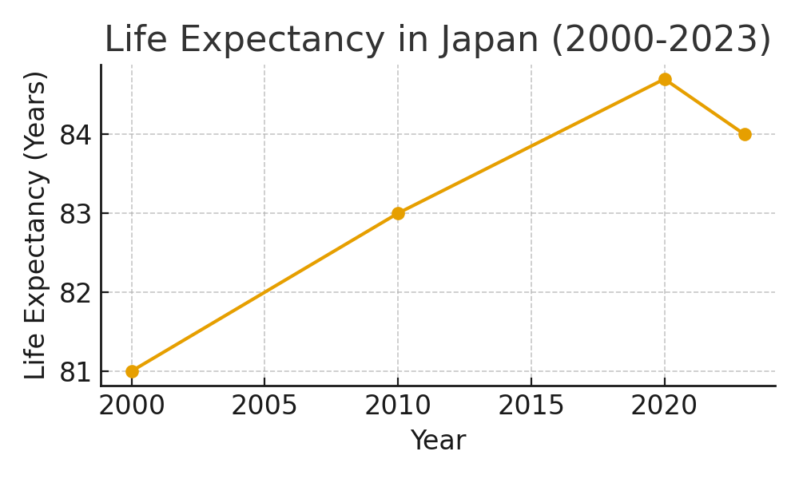
Life Expectancy Trends
Japan's life expectancy has consistently been among the highest in the world, reflecting the impact of healthcare access, diet, and social systems.

Slide 5
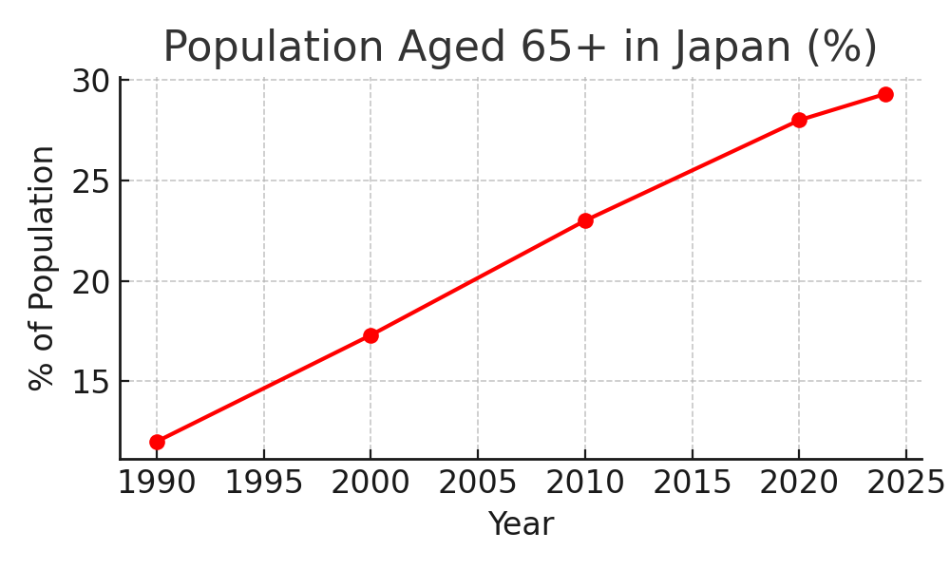
Aging Population
Japan has the world's oldest population, with nearly 30% aged 65 or older. This demographic transition affects labor supply, healthcare demand, and social security systems.

Slide 6
Health System Policies
• Universal Health Coverage (1961): Ensured access to healthcare for all.
• Long-Term Care Insurance (2000): Addressed needs of the elderly.
• Emphasis on preventive care: Early detection and regular checkups.
These policies balanced health equity with economic sustainability.

Slide 7
Health and Development Link
• Healthier populations increase productivity and economic growth.
• Japan's educated, healthy workforce powered post-WWII economic miracle.
• Low infant mortality and high life expectancy reinforce human capital.
• Investments in sanitation, education, and public health supported GDP growth.

Slide 8
Challenges Ahead
• Aging population strains healthcare and pension systems.
• Rising healthcare costs (11.4% of GDP).
• Workforce shrinking due to demographic decline.
• Need for immigration and technological innovation in eldercare.

Slide 9
Lessons for Other Countries
• Universal health coverage strengthens human development.
• Preventive care reduces long-term healthcare costs.
• Aligning health and social policies sustains economic growth.
• Preparing for demographic changes early is critical.

Slide 10
Conclusion
Japan demonstrates that health and development are mutually reinforcing. Strong health policies created a productive workforce, while economic growth funded universal healthcare. Today, Japan faces challenges of aging, but its model offers valuable lessons for balancing health and development in other nations.

