Slide 1
INDIAN INSTITUTE OF INFORMATION TECHNOLOGY VADODARA
Project Presentation on
SmartCart: Distributed E-Commerce Platform
A Polyglot Microservices Web Application with Razorpay Payment Gateway Integration
Presented by:
Ayush Dubey (Group 03 Lead, TeamID 03, Enrollment ID: 202351000)
Guide: Course Faculty & Lab Coordinator
Department: Department of Computer Science & Engineering
CS 545 Software Engineering • MCA Second Year • Autumn 2026-27

Slide 2
SMARTCART / PROJECT SCOPE
Problem and objectives
CURRENT PROBLEM
• Single Point of Failure in Monoliths: Traditional e-commerce backends couple cart, catalog, and billing into a single database; high traffic during flash sales creates severe bottlenecks and system-wide outages.
• Vulnerabilities in Cart & Payments: Client-side price calculations allow cart tampering, while unverified third-party payment callbacks cause fraudulent orders and inventory loss.
• Slow, Error-Prone Order Operations: Tracking orders across disparate legacy modules, uncoordinated stock deductions, and manual return evaluations lead to stock discrepancies and customer dissatisfaction.
PROJECT OBJECTIVES
• Polyglot Microservices Architecture: Deconstruct e-commerce capabilities into 8 autonomous microservices (Auth, Product, Cart, Wishlist, Order, Payment, Notification, API Gateway) with isolated databases.
• Atomic Checkout Saga with Rollbacks: Implement an atomic checkout workflow (placeOrder) that reserves warehouse stock, verifies coupons, and triggers compensatory stock rollbacks if payments fail.
• Cryptographic Payments & Edge Resilience: Integrate Razorpay Orders (UPI/Cards in Paise) with HMAC-SHA256 signature verification, durable MySQL idempotency to block duplicate orders, and dynamic ETag caching.

Slide 3
END-TO-END SHOPPING & FULFILLMENT FLOW
Proposed solution
A customer discovers products, manages cart items, and completes verified checkout in a responsive web application.
01
Sign in & Discover
Authenticate customer / staff
JWT session tokens securely stored in HttpOnly SameSite=Lax cookies; browses catalog with full-text search, category filters, and dynamic 304 ETag caching.
02
Manage Cart & Checkout
Choose items and apply coupons
Server-authoritative cart subtotal computation preventing client price tampering; validates stock availability and evaluates promotional discount codes.
03
Pay & Track Order
Validate payment & track shipment
Multi-channel Razorpay checkout (UPI/Cards) in Indian Paise; validates HMAC-SHA256 signatures; advances order state (Confirmed -> Shipped -> Delivered).
Output: An itemized order confirmation receipt, transactional email notifications via Resend API, real-time shipment milestone tracking, and a 30-day return policy evaluation workflow.

Slide 4
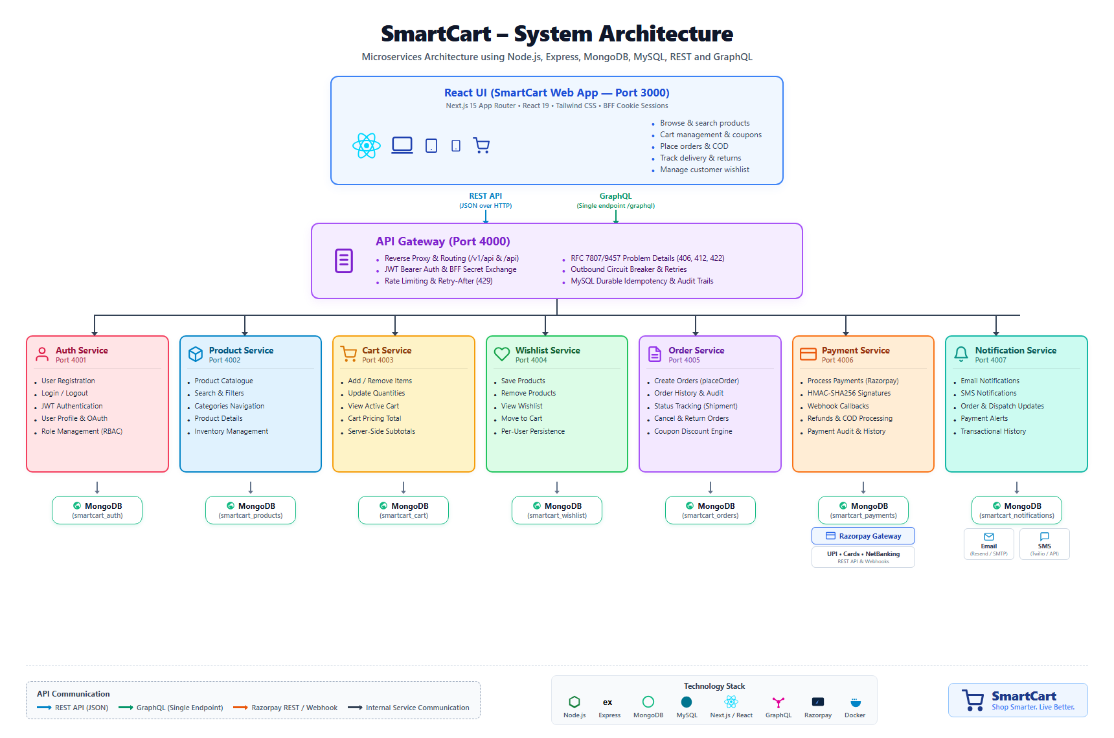
POLYGLOT MICROSERVICES TOPOLOGY
System architecture
A decoupled architecture that isolates business domains and scales horizontally
Storefront / Client (Port 3000)
Next.js 15, React 19, Tailwind CSS
Customer storefront, cart drawer, checkout portal, and role-based staff admin panels with HttpOnly session cookies.
Central API Gateway (Port 4000)
Reverse Proxy, Helmet & AJV Guard
Sliding-window rate limiting (120 req/60s), durable MySQL idempotency key checks, and uniform RFC 7807 error standardization.
Microservices & DBs (Ports 4001–4007)
Express.js & Independent MongoDB Stores
Auth (4001), Product (4002), Cart (4003), Wishlist (4004), Order (4005), Payment (4006), and Notification (4007).
Request Journey: Gateway → Order Saga → Stock Hold → Razorpay → Resend Email

Slide 5
FULL STACK SPECIFICATIONS
Technology and implementation
LAYER | SAMPLE CHOICE | PURPOSE
Frontend (BFF) | Next.js 15, React 19, Tailwind CSS | Server-Side Rendering (SSR), App Router, responsive storefront, and HttpOnly session cookies.
API Gateway Edge | Node.js, Express, Helmet, AJV | Centralized routing, sliding-window rate limiting (120 req/60s), schema guard, and circuit breaking.
Domain Microservices | Express.js REST & GraphQL | 7 autonomous microservices (Auth, Catalog, Cart, Wishlist, Order Saga, Payment, Notification).
Persistence Stores | MongoDB Community 7.0 & MySQL 8.4 | Zero-shared databases: MongoDB collections per service + MySQL for durable edge idempotency.
Partner Integrations | Razorpay REST API & Resend Mailer | UPI/Card digital checkouts in Indian Paise, HMAC-SHA256 signature verification, and transactional emails.
One technical point to discuss: Durable Idempotency & Distributed Rollback
1. Duplicate Order Prevention: Clients pass an Idempotency-Key header on checkout. The API Gateway computes a SHA-256 hash of the payload and queries the MySQL api_idempotency table. Repeated requests return cached responses with Idempotency-Replayed: true, completely preventing double-billing on network retries.
2. Compensatory Stock Rollback: During order placement, Product Service inventory is locked atomically. If Razorpay payment fails or signature validation mismatches, the Order Service executes a compensatory REST call to release the reserved stock immediately.

Slide 6
OPERATIONAL APPLICATION WALKTHROUGH
Screenshots and demonstration
Live validation of core storefront and administrative fulfillment workflows
01 Storefront Catalog & Razorpay Checkout
Demonstrates instant catalog filtering, dynamic ETag validation (304), persistent carts, and Razorpay modal checkout.
02 Order Tracking & Staff Inventory Workbench
Demonstrates immutable inventory stockHistory[], courier tracking updates, and 30-day return claims.
[ Storefront UI / Next.js 15 Web Application ]
• Dynamic product grid with rating badges & stock status
• Slide-over interactive cart drawer with live subtotal
• Razorpay Standard Checkout popup supporting UPI & Cards
• Server-validated coupon promotional discounts
[ Customer Tracking & Admin Workbench ]
• Delivery timeline stepper (Confirmed → Shipped → Delivered)
• Staff stock management table with mandatory reason prompt
• Automated return policy verification (30-day window check)
• Refund authorization dashboard triggering Razorpay API
Demo sequence: Login & Authenticate → Search Products → Add to Cart → Razorpay Payment (UPI) → Verify Order Tracking

Slide 7
VERIFICATION EVIDENCE
Testing and results
Verification evidence that core distributed microservice functions work reliably
TEST CASE | EXPECTED BEHAVIOR | OBSERVED RESULT
User Authentication & RBAC Session Security | Bcrypt credentials checked; issue JWT strictly in HttpOnly SameSite=Lax cookie. Reject unauthenticated/unauthorized access with RFC 7807 problem details (HTTP 401 / 403). | PASSED (100%) Token successfully set in HttpOnly cookie; unprivileged role access returns HTTP 403 Forbidden with uniform problem details payload.
Checkout Saga & Stock Rollback on Payment Failure | Atomically reserve warehouse stock during order placement; if Razorpay payment is declined or aborted, trigger compensatory REST call to release reserved stock back. | PASSED (100%) Stock decremented upon checkout; intentional payment failure successfully invoked compensatory rollback, restoring warehouse stock count.
Razorpay Payment Signature Verification (HMAC) | Compute HMAC-SHA256(order_id + '|' + payment_id, SECRET). Match signature string to confirm payment. Tampered signatures must immediately set payment status to FAILED. | PASSED (100%) Valid signatures transition order to CONFIRMED. Altered signatures reject with HTTP 400 Bad Request (urn:smartcart:error:payment-declined).

Slide 8
MILESTONES & FUTURE SCOPE
Conclusion and next steps
WHAT THE TEAM COMPLETED
• Autonomous Microservices Architecture: Built and deployed 8 standalone services (Auth, Catalog, Cart, Wishlist, Order Saga, Payment, Notification, API Gateway) with isolated database schemas.
• End-to-End E-Commerce Workflows: Full product catalog with dynamic ETag caching (304), server-authoritative cart calculation, coupon promotion engine, and 30-day return workflows.
• Production Payment & Edge Hardening: Completed Razorpay standard checkout integration in Paise, HMAC-SHA256 signature verification, durable MySQL idempotency, rate limiting, and RFC 7807 errors.
WHAT COMES NEXT
• Asynchronous Message Broker Integration: Transition cross-service communication from synchronous HTTP/REST to an event-driven pub/sub architecture using RabbitMQ or Apache Kafka.
• Multi-Channel Logistics Webhooks: Integrate third-party carrier APIs (Shiprocket / Bluedart) for automated live GPS parcel tracking webhooks instead of manual status advancement.
• Multi-Channel SMS Alerts & Search AI: Add SMS dispatch via Twilio alongside email alerts, and integrate vector-based AI search for natural language product discovery.

Slide 9
Thank you
Questions & Answers / Technical Discussion
SmartCart Project Deliverables & Repository:
• GitHub: https://github.com/Ayush17314/SmartCart
• Engineering Team: Group 03 (TeamID 03) — Ayush Dubey
• IIIT Vadodara | CS 545 Software Engineering | Autumn 2026-27

