Slide 1
Autonomous Production Choke Controller
for a Single Naturally Flowing Oil Well
Brute-force Model Predictive Control · control interval Ts = 1 hour
Maximises safe production; refuses targets that cannot be met safely
0 constraint violations across 300 closed-loop runs | targets tracked to <1 % | 98.6 % of max safe rate when target infeasible

Slide 2
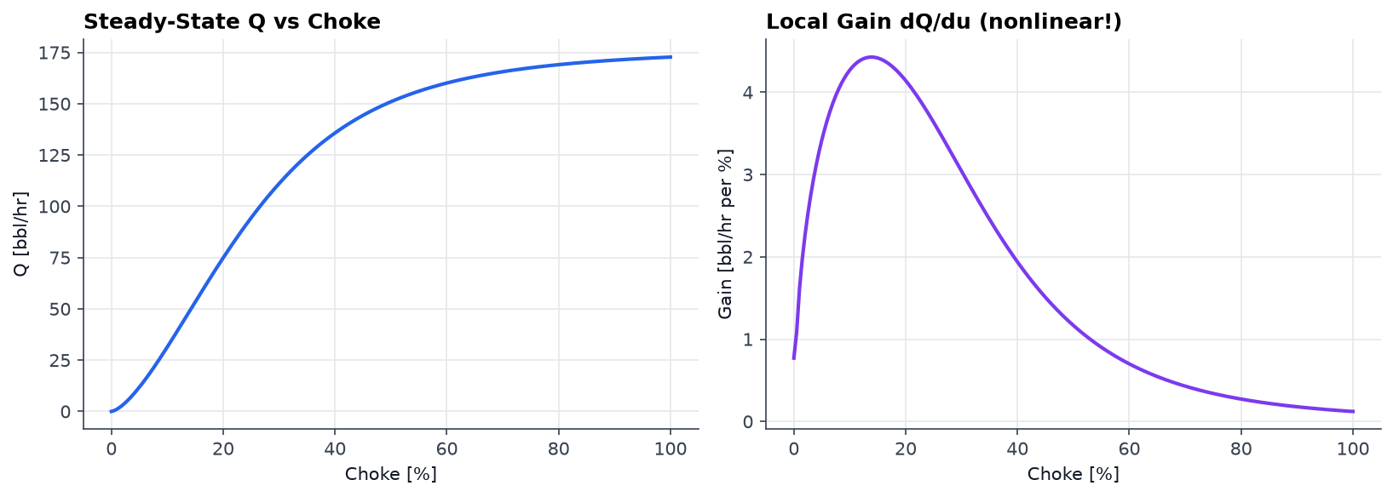
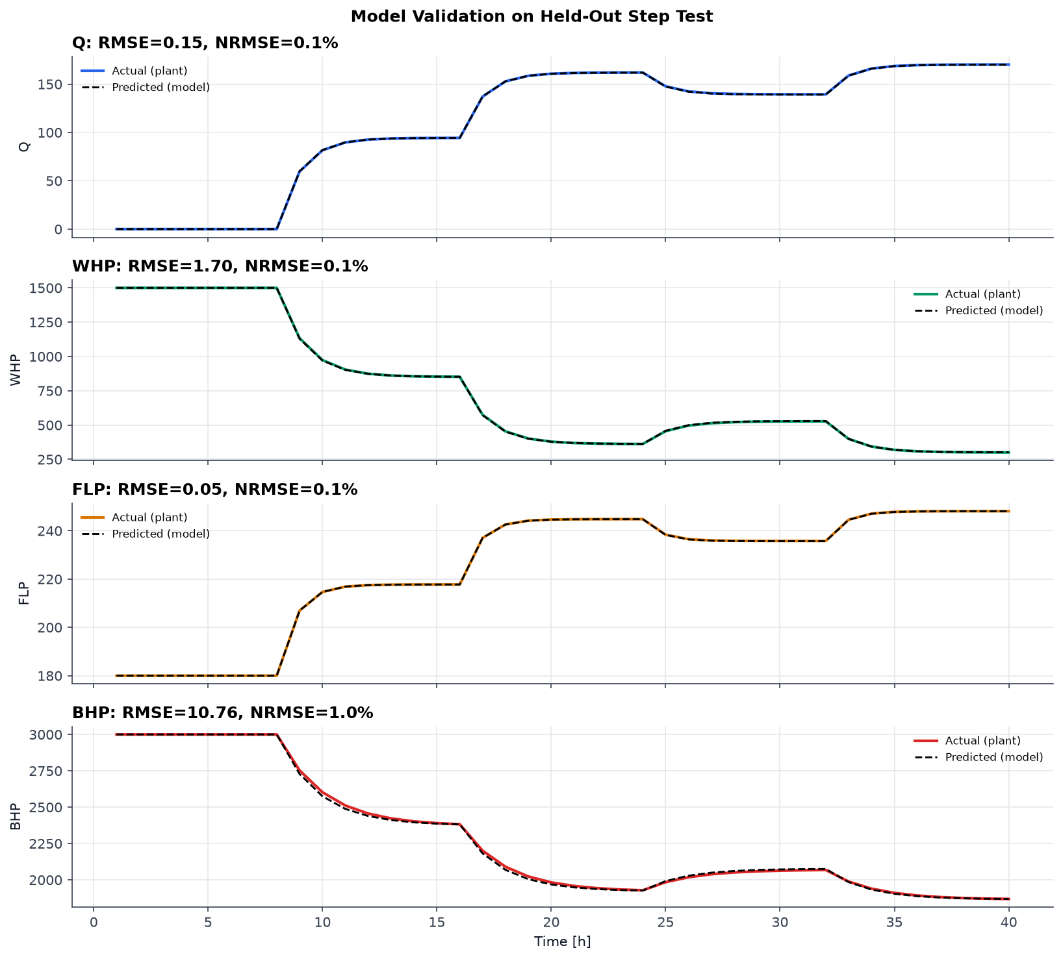
PROCESS UNDERSTANDING & MODEL
Step-test results (our own experiments)
15 choke steps, up and down, 5–20 % magnitude, each held 8 h (≈4× slowest τ) to reach true steady state
Opening the choke raises Q and FLP, lowers WHP and BHP — one input, four strongly coupled outputs
Gain dQ/du collapses 3.91 → 0.15 bbl/hr per % across the range (~26×) → the process is strongly nonlinear
Provided reference dataset used for illustration only — never for fitting, per the problem statement
Model assumptions
Linear IPR (constant productivity index); turbulent tubing friction ∝ Q²; choke orifice Q = Cv·f(u)·√(WHP−FLP)
One first-order lag per output; dead time negligible (θ ≤ 0.09 h)
WHT and AP monitored and logged, but not active constraints
Dynamic model developed
y(k+1) = y(k) + α·( y_ss(u) + d − y(k) ), α = 1 − e^(−Ts/τ)
Nonlinearity captured as a piecewise-linear steady-state curve y_ss(u); dynamics stay linear → simple and explainable
Fitted τ: Q 0.99 h · WHP 1.18 h · FLP 0.80 h · BHP 1.75 h
Validated on HELD-OUT steps: NRMSE 0.09 % (Q), 0.95 % (BHP)

Slide 3
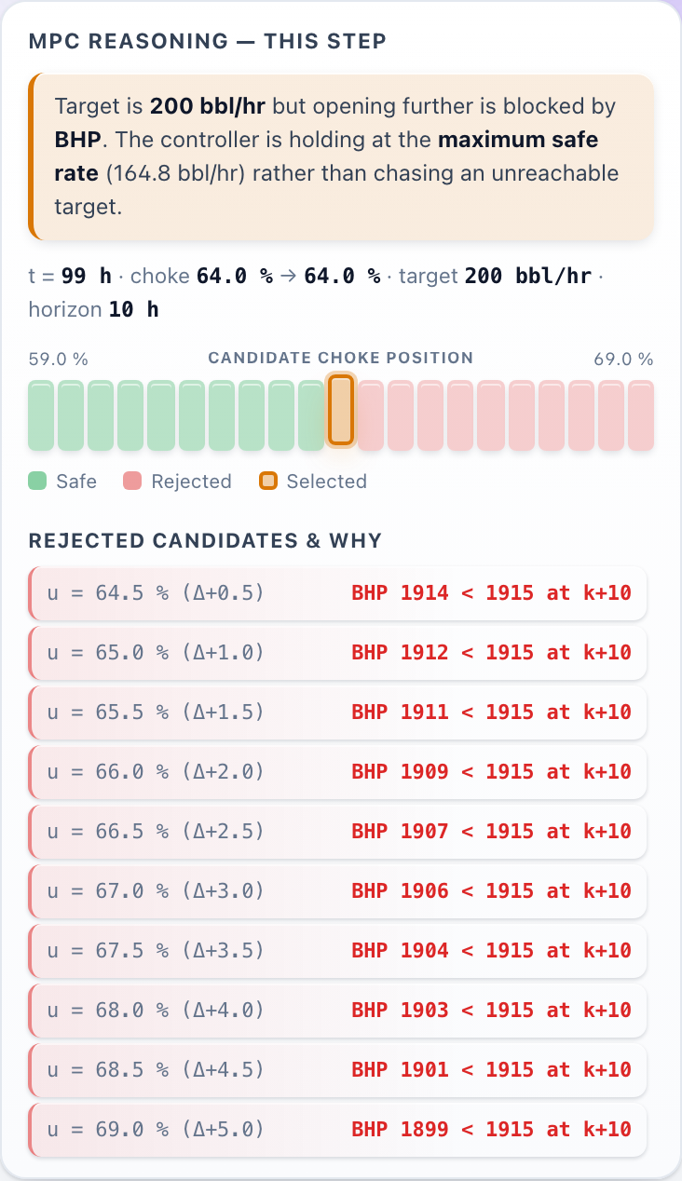
TECHNICAL APPROACH — CONTROL STRATEGY
Prediction methodology
Enumerate ALL candidate moves within the ramp limit: u ± 5 % on a 0.5 % grid → 21 candidates
Roll each forward 10 h through the identified model (move-blocked: apply, then hold)
Horizon must outrun the slowest lag: BHP τ = 1.75 h, so 10 h ≈ 5.7 τ
Every prediction restarts from the current measurement → model error never compounds
Measurement filter + bias correction remove hunting and steady-state offset
Choke move selection logic
J = (Q_pred_end − Q_target)² + 0.05·(Δu)² → closest to target, penalise large moves
Deterministic tie-breaks: lowest cost → smallest |Δu| → lower choke (conservative)
Deadband: move only if it buys ≥ 2 (bbl/hr)² improvement → zero valve chatter
Constraint handling
Reject any candidate whose predicted WHP/FLP/BHP breaches limits at ANY point in the horizon
Safety margins inside each hard limit (10/8/15 psi) cover sensor noise + model error + filter lag
If ALL candidates unsafe → pick the least-bad (smallest predicted violation), never lurch
Infeasible target needs no special case: 'open further' is filtered out every step → the controller pins itself at the safe boundary
Live MPC reasoning: every candidate, why each was rejected

Slide 4
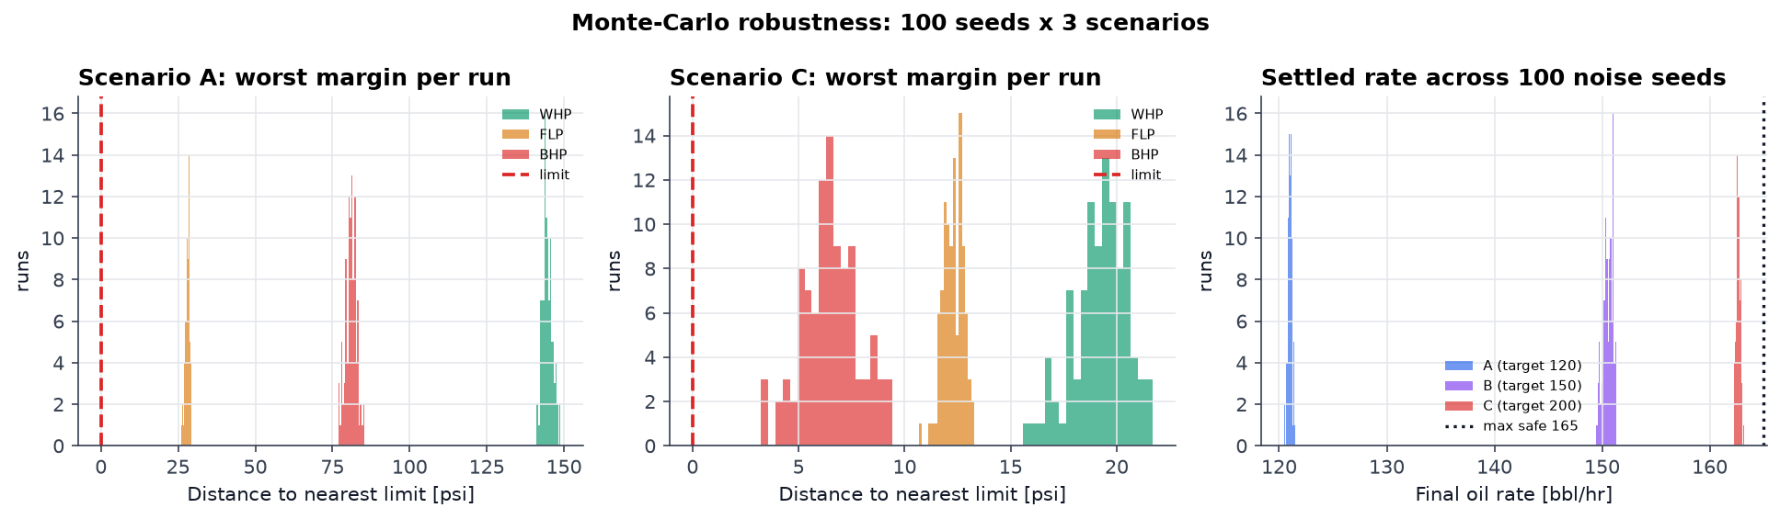
FEASIBILITY AND VIABILITY
300
closed-loop runs
0
constraint violations
98.6 %
of max safe rate
19/19
tests passing
Feasibility — proven, not asserted
Monte-Carlo: 100 independent noise seeds × 3 scenarios; envelope checked on every sample
Worst margin to any limit: A +26 psi · B +16 psi · C +3.2 psi
Runs end-to-end in ~2 min; no GPU, no internet, no solver library
Challenges found — and fixed
Horizon shorter than the slowest lag → BHP kept falling after the horizon (11/100 runs breached)
Coarse step-test knots → chord across a convex curve over-estimated BHP by 8 psi (unsafe direction)
Both passed single-run testing; only the Monte-Carlo exposed them
Risk strategy
Margins sized for noise + model error + filter lag, and re-verified over 300 runs
Cost of safety quantified, not hidden: 2.3 bbl/hr (1.4 %) below the theoretical max
Controller reads ONLY step() outputs → official simulator drops in with zero changes (proven by a test against a different plant)

Slide 5
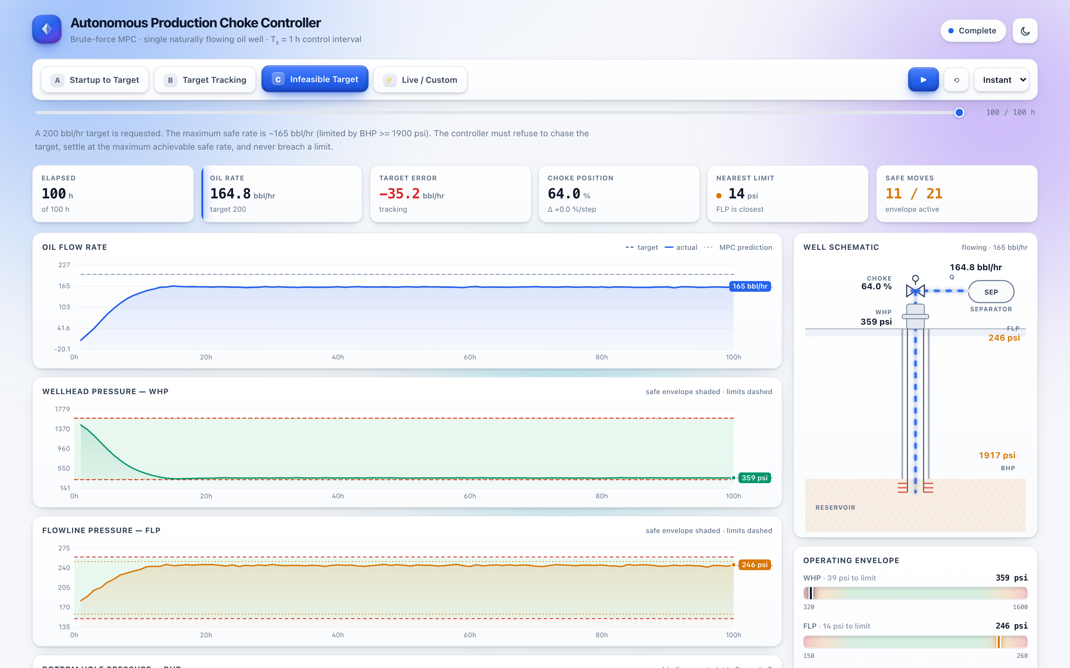
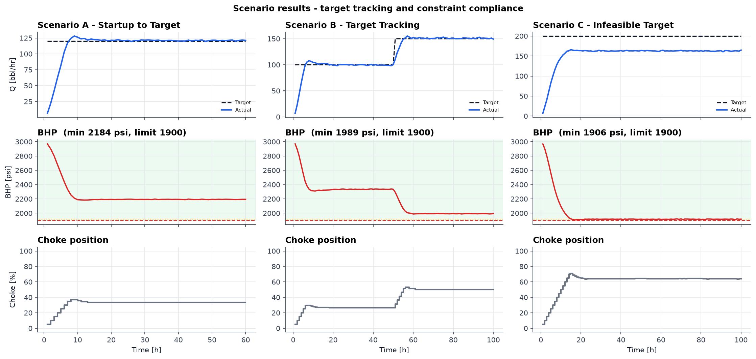
ARTIFACTS — RESULTS
Scenario outcomes & tracking performance
A — Startup to target: settled 121.0 ± 0.6 bbl/hr (target 120) · choke 33.5 % · min BHP 2184 psi · 0.8 % error
B — Target tracking 100→150: settled 150.8 ± 0.8 bbl/hr (target 150) · choke 50.0 % · min BHP 1989 psi · 0.5 % error
C — Infeasible target 200: settled 162.7 ± 0.9 bbl/hr (target 200) · choke 64.0 % · min BHP 1906 psi · capped at max safe rate
Safety performance
WHP ≥ 320, FLP ≤ 260, BHP ≥ 1900 psi, |Δu| ≤ 5 %/step — held on EVERY sample
Automated PASS/FAIL audit in the pipeline; non-zero exit if any check fails
Deliverables
Simulator · step tests · model ID · MPC · 3 scenarios · Monte-Carlo · 19 tests · dashboard · report
One command reproduces everything: python run_all.py
All three scenarios: target tracked when feasible (A, B); refused and capped at the safe maximum when not (C) — BHP rests on its limit without ever crossing it.

Slide 6
RESEARCH AND REFERENCES
Lessons learned
Where you place step-test knots is a SAFETY decision — linear interpolation across a convex curve is optimistic exactly where the constraint binds
A horizon shorter than the slowest time constant is not conservative, it is unsafe
One good run is not evidence; a safety claim about a stochastic system needs a distribution
Margins must cover estimator lag and model error, not just sensor noise
Every filter is a trade: ours removed constraint hunting but cost response lag that had to be paid for in margin
Infeasibility needs no special-case code — it falls out of predict → filter → select
Engineering references
Inflow performance / linear IPR (constant productivity index) — standard above bubble point
Choke orifice / valve-sizing relation Q = Cv·f(u)·√ΔP
Dynamic Matrix Control: move blocking, output disturbance (bias) estimation, constraint back-off
Open-loop step testing and FOPDT identification for control-oriented models
Provided material used
Autonomous_Choke_Control_Simulated_Dataset.csv — reference only, as the problem statement directs; never used to fit the model
Compared against our physics stand-in and the differences reported openly (reference is near-linear; its FLP falls with rate)
Project artifacts
src/ well_simulator · model · controller · simulator_interface
scripts/ reference EDA · step tests · model ID · scenarios · robustness · capture · PDF
tests/ 19 tests incl. a swap-in proof against a different plant
dashboard/ self-contained HTML/JS demo (no build, no server needed)
report/ENGINEERING_REPORT.md → submission/ENGINEERING_REPORT.pdf
Note on the simulator
The simulator module itself was not supplied, so we built a documented physics-based stand-in from the process description. The controller touches only step()/reset(), so the official simulator substitutes with zero changes.

