Slide 1
UNet++ Semantic Segmentation on UAVScenes — Setup
• Dataset: UAVScenes aerial camera imagery, native resolution 2448×2048
• Split by flight sequence (no frame overlap between splits):
Train 11,825 images | Val 4,207 images | Test 3,285 images
• Model: UNet++ (segmentation_models_pytorch), ResNet-34 encoder, ImageNet-pretrained
• Training config: 352×288 resolution, batch size 32, 50 epochs, all images cached in RAM
• Loss: 0.5 × Dice + 0.5 × class-weighted Cross-Entropy (median-frequency balancing)
• Optimizer: AdamW, lr 3e-4 with warmup + cosine decay
• Class merging: 19 originally annotated classes → 10 training classes
ID | Class | Merged From (raw UAVScenes classes)
0 | Background | background, unused/reserved raw ids, solar_board (removed), umbrella (removed)
1 | Building | roof, transparent_roof
2 | Road | dirt_motor_road, paved_motor_road, paved_walk, car_park
3 | Airstrip | airstrip
4 | Water | river, pool
5 | Bridge | bridge
6 | Container | container
7 | Traffic_Barrier | traffic_barrier
8 | Vegetation | green_field, wild_field
9 | Vehicle | sedan, truck (merged dynamic class)

Slide 2
Test Set Results — UNet++
• Overall metrics (3,285 test images)
Test Loss | Pixel Accuracy | Mean IoU (mIoU) | Mean Precision | Mean Recall | Mean F1
0.2727 | 95.36% | 82.80% | 88.62% | 91.81% | 90.11%
• Per-class results, sorted best → worst by IoU
Class | IoU | Precision | Recall | F1
Airstrip | 96.8% | 98.1% | 98.6% | 98.4%
Vegetation | 95.7% | 97.8% | 97.7% | 97.8%
Water | 91.9% | 94.0% | 97.6% | 95.8%
Building | 87.4% | 90.7% | 96.1% | 93.3%
Container | 87.1% | 89.5% | 97.0% | 93.1%
Road | 85.0% | 89.9% | 94.0% | 91.9%
Bridge | 82.9% | 92.5% | 88.8% | 90.6%
Background | 75.4% | 87.8% | 84.2% | 85.9%
Vehicle | 68.1% | 78.6% | 83.5% | 81.0%
Traffic Barrier | 57.8% | 67.2% | 80.5% | 73.3%
• Best: Airstrip (96.8%), Vegetation (95.7%), Water (91.9%). Weakest: Traffic_Barrier (57.8%), Vehicle (68.1%) — both rare, small-object classes (well under 0.5% of all pixels).

Slide 3
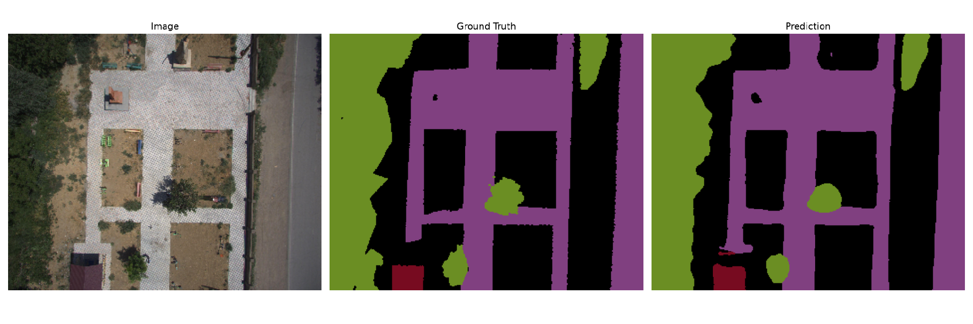
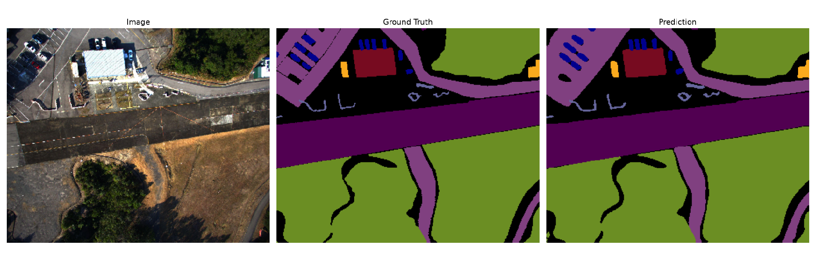
Sample Predictions (Test Set)
Sample 1: paved schoolyard / courtyard — Building, Road, Vegetation
Sample 2: airstrip with parking, building, container, vehicles, traffic barriers — all classes recovered closely

Slide 4
Future Work & Improvement Plan
• Train the full-resolution config (960×800) for the final “ideal” model — resolution helps small/rare classes (Traffic_Barrier, Vehicle) the most, since they shrink to near-invisibility at 352×288.
• Try a stronger encoder (ResNet-50 or EfficientNet-B3/B4) once the pipeline and hyperparameters are validated on the current fast config.
• Apply light post-processing (morphological cleanup / CRF) to reduce the boundary noise visible along class edges in the predictions.

