Slide 1

IE 643 COURSE PROJECT · PREP PRESENTATION · MID-PROJECT STATUS
Unsupervised Domain Adaptation for Forecasting Multivariate Time-Series Data
Progress so far: problem, datasets, a first LiteTCN + CARE-DA campaign, and an interface prototype. The second half locks the method, the report and the final demo.
Team: [Team Name]
[Member 1 Name] — [Roll No.]
[Member 2 Name] — [Roll No.]
[Member 3 Name] — [Roll No.]
[Member 4 Name] — [Roll No.]
September 2026
DOMAIN 1 · source
DOMAIN 2 · target
Notes:
This is a prep / mid-project talk, not the final. First cycle: data, LiteTCN, first CARE-DA table. Second half is still open. Then the hook: a model trained in the hills does not know the plains.

Slide 2

ROADMAP OF THIS TALK
Outline
01
Problem understanding
05
CARE-DA strategy & loss
What changes between domains and why forecasts break
v1 design; v2 is a first follow-up, not locked
02
Background reading
06
Metrics & protocol
Forecasting models, domain-adaptation theory and methods
Forecast accuracy and adaptation-efficiency metrics
03
Datasets & preparation
07
First experiments
Three source → target pairs; extraction and curation steps
3-seed v1 campaign + seed-0 v2 probe
04
Lightweight forecaster
08
Prototype & remaining work
LiteTCN: RevIN + dilated convolutions + linear path
Interface v1, open questions, second-half plan
IE 643 Course Project · [Team Name]
Notes:
One breath per item. Frame as a first cycle plus a plan: we have data, a model and a first table, but the method is not locked and the report/demo are still mid-way.

Slide 3




01 · PROBLEM UNDERSTANDING
Train on one domain, forecast well in another
Domain 1 — source
Domain 2 — target
Same pattern elsewhere
Hilly region (Shimla)
Plain region (Delhi)
IT stock → Pharma stock
Past window x and future y both available
Train forecaster f_θ : x → ŷ
Years of labeled history
Only input windows x available
Different level, cycles, correlations
Goal: adapted f_θ' with low target error
adapt
(no target labels)
Transformer A → Transformer B
Formal setting — unsupervised domain adaptation (UDA) for forecasting
Source D_S = {(x_i, y_i)}: look-back x ∈ ℝ^(L×C) and horizon y ∈ ℝ^(H×C) (multivariate, C variables).
Target D_T = {x_j}: input windows only, and P_T(x, y) ≠ P_S(x, y).
Goal find f minimising the target risk E_(x,y)~P_T ‖f(x) − y‖², starting from the source model, with no target future values used for training or model selection.
IE 643 Course Project · [Team Name]
Notes:
Explain with the temperature story from the project brief. Stress the constraint: in the target domain we observe inputs but do not use future values for training — that is what makes it UDA. Mention the finance and energy analogues briefly.

Slide 4
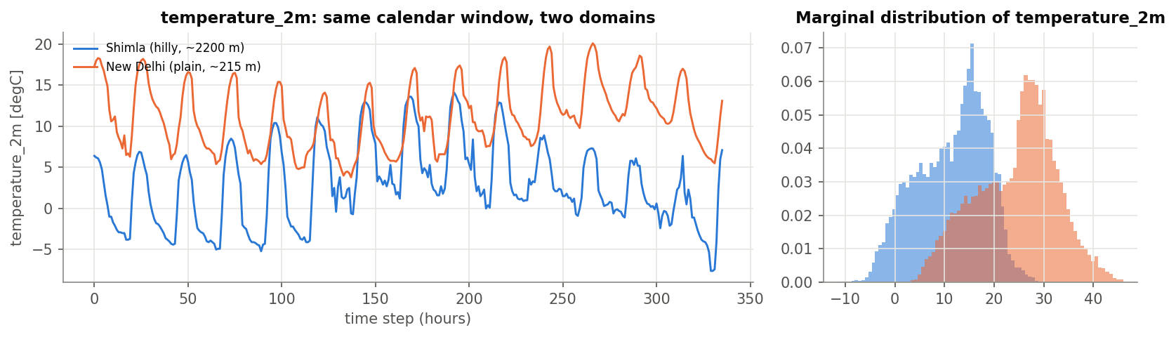



01 · PROBLEM UNDERSTANDING
What actually shifts between hills and plains?
Marginal / level shift
Dynamics (covariate) shift
Conditional shift
Mean temperature 11.4 °C vs 24.6 °C; surface pressure 783 vs 984 hPa. Handled by per-domain scaling + RevIN.
Different diurnal amplitude, humidity regimes and cross-variable correlations: the encoder sees unfamiliar patterns.
The same recent history can lead to a different future (terrain, urban heat, monsoon). Needs adaptation, not rescaling.
IE 643 Course Project · [Team Name]
Notes:
Point at the histogram: the two domains barely overlap. Then separate three kinds of shift. The first one is easy (normalisation); the second and third are why we need an adaptation strategy.

Slide 5




02 · BACKGROUND READING
Lightweight forecasting models we studied
DLinear
TCN
PatchTST
RevIN
Zeng et al., AAAI 2023
Bai et al., 2018
Nie et al., ICLR 2023
Kim et al., ICLR 2022
A single linear map from look-back to horizon (after trend/seasonal split) rivals Transformers on long-horizon benchmarks.
Stacked dilated 1-D convolutions: large receptive field, parallel training, few parameters.
Patches of the series as tokens + channel independence; state of the art but heavier.
Normalise each input window by its own mean/std, then de-normalise the output: removes per-window level/scale shift.
→ Linear temporal path in our model
→ Strided, dilated conv encoder
→ Candidate encoder for later stages
→ Built in: handles marginal shift
Design decision: combine a TCN encoder, a DLinear-style linear path and RevIN in one small model (381,606 parameters), so adaptation stays cheap enough to run on a laptop CPU.
IE 643 Course Project · [Team Name]
Notes:
Why lightweight: the brief asks for it, and adaptation is repeated per domain, so it must be cheap. DLinear shows simple models are strong; TCN gives a compact nonlinear encoder whose features we can align; RevIN deals with level shift for free.

Slide 6
02 · BACKGROUND READING
Why aligning features can work: the domain-adaptation bound
ε_{T}(h) ≤ ε_{S}(h) + ½ d_{HΔH}(D_{S}, D_{T}) + λ*
Ben-David et al., Machine Learning 2010: target error is bounded by source error + domain divergence + the error of the best joint hypothesis.
Source error
Domain divergence
Joint error λ*
Keep minimising the supervised forecasting loss on Domain 1 during adaptation.
Make source and target feature distributions look alike: MMD, CORAL, adversarial (DANN).
Cannot be measured without target labels. Alignment alone can destroy forecast-relevant information; keep features meaningful with self-supervision and stay close to the source weights.
→ L_fcst
→ L_MMD + L_CORAL
→ L_SSL + L_anchor
IE 643 Course Project · [Team Name]
Notes:
This one equation motivates every term of our loss. Walk left to right: source error, divergence, joint error. The third term is the trap: aligning at any cost can make forecasting impossible, so we add self-supervision and anchoring.

Slide 7
02 · BACKGROUND READING
The domain-adaptation toolbox and what we take from it
Family | Core idea | Representative methods | Role in our project
Discrepancy-based | Minimise a statistical distance between source and target features | MMD / DAN (Long et al. 2015), Deep CORAL (Sun & Saenko 2016) | Alignment terms of CARE-DA; also stand-alone baselines
Adversarial | A domain classifier is fooled through a gradient-reversal layer | DANN (Ganin et al. 2016), CoDATS (Wilson et al. 2020) | Baseline
Self-supervised / test-time training | Auxiliary label-free task on target data keeps features informative | TTT (Sun et al. 2020), masked reconstruction | SSL term: masked reconstruction of target windows
Parameter regularisation | Penalise drifting away from the pre-trained (source) solution | L2-SP (Li et al. 2018) | Elastic anchor: prevents forgetting and over-alignment
Normalisation-based | Remove per-instance or per-domain statistics | RevIN (Kim et al. 2022), AdaBN | RevIN inside the model + per-domain z-scoring
Insight from reading: no single family is sufficient for regression on time series. Our strategy combines the four complementary ideas in a single loss.
IE 643 Course Project · [Team Name]
Notes:
This is our map of the literature. Emphasise we did not invent a family; we composed complementary pieces and justify each one with the bound on the previous slide.

Slide 8
02 · BACKGROUND READING
Domain adaptation for time series: prior work
CoDATS
Adversarial 1-D CNN adaptation for multi-source sensor classification.
The gap we target
KDD 2020
Most time-series UDA work is for classification, not forecasting.
Forecasting DA (e.g. DAF) usually assumes some labeled target data.
Heavy backbones are costly to adapt for every new domain.
Our aim: label-free adaptation of a lightweight multivariate forecaster, measured by how much of the supervised gap it closes.
SASA
Aligns sparse associative structure between variables (inter-channel dependencies).
AAAI 2021
DAF
Attention-sharing Transformer for forecasting; needs some labeled target data.
ICML 2022
CLUDA
Contrastive learning + nearest-neighbour alignment for time-series UDA.
ICLR 2023
RAINCOAT
Aligns time- and frequency-domain features under feature and label shift.
ICML 2023
IE 643 Course Project · [Team Name]
Notes:
Name one takeaway per paper: CoDATS = adversarial; SASA = variable relationships; DAF = forecasting but with labels; CLUDA = contrastive; RAINCOAT = frequency. Then state our niche.

Slide 9
03 · DATASETS
Three benchmarks, each with two distinct domains
Benchmark | Domain 1 (source) | Domain 2 (target) | Variables | Frequency & span | L → H | Why it is a real domain shift
Climate (Open-Meteo ERA5) | Shimla, 2195 m (hilly) | New Delhi, 214 m (plain) | 7 vars: temperature_2m, relative_humidity_2m, dew_point_2m, surface_pressure, wind_speed_10m, cloud_cover, shortwave_radiation | Hourly 2021-01-01 → 2024-12-31 | 168 → 24 | Elevation, pressure, diurnal cycle and monsoon response differ
Finance (Yahoo Finance, NSE) | IT basket: TCS, INFY, WIPRO, HCLTECH, TECHM | Pharma basket: SUNPHARMA, DRREDDY, CIPLA, DIVISLAB, LUPIN | 4 vars: log_return, hl_range, gap, log_volume | Daily (trading) 2012-01-03 → 2025-06-27 | 60 → 5 | Sector-specific volatility, news and regulation
Energy (ETT benchmark) | ETTh1: transformer, county 1 | ETTh2: transformer, county 2 | 7 vars: HUFL, HULL, MUFL, MULL, LUFL, LULL, OT | Hourly 2016-07-01 → 2018-06-26 | 168 → 24 | Different load profiles and oil-temperature dynamics
35.1k
hourly records per climate site (4 years)
3322
trading days per stock (5 stocks per sector)
17.4k
hourly records per transformer (2 years)
IE 643 Course Project · [Team Name]
Notes:
All three are public and reproducible with one script. The climate pair maps directly to the brief (hilly -> plain). Finance maps to the IT -> pharma example. ETT is a standard forecasting benchmark with two stations. Datasets to be confirmed with TAs.

Slide 10





03 · DATA EXTRACTION & CURATION
From raw APIs to leakage-free training windows
1. Extract
2. Clean
3. Engineer
4. Split
5. Scale
6. Window
Open-Meteo archive API (7 hourly vars, IST); yfinance OHLCV; ETT CSVs from GitHub
Linear interpolation of gaps; drop zero-volume / invalid trading days
Finance: log-return, high-low range, overnight gap, log-volume (stationary)
Chronological 70/10/20 per series (ETT 60/20/20); test windows keep L steps of context
z-score per domain; target statistics from unlabeled target inputs only
Sliding windows: L look-back → H horizon, all variables in and out
Leakage guards
Reproduce in one command
Strictly chronological splits; no shuffling across time
Target future values never used for UDA training or for choosing checkpoints
Adaptation runs for a fixed number of epochs (no peeking at target validation)
python -m src.data_download
Raw pulls saved in data/raw, curated CSVs in data/processed/<benchmark>/<domain>.csv
IE 643 Course Project · [Team Name]
Notes:
Walk the pipeline left to right. The important design choice is step 5: each domain gets its own scaler, and for the target that only needs unlabeled inputs — legitimate under UDA. Then the leakage guards.

Slide 11
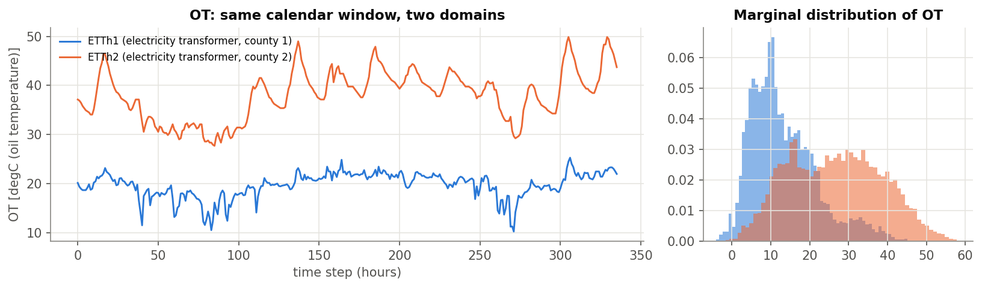
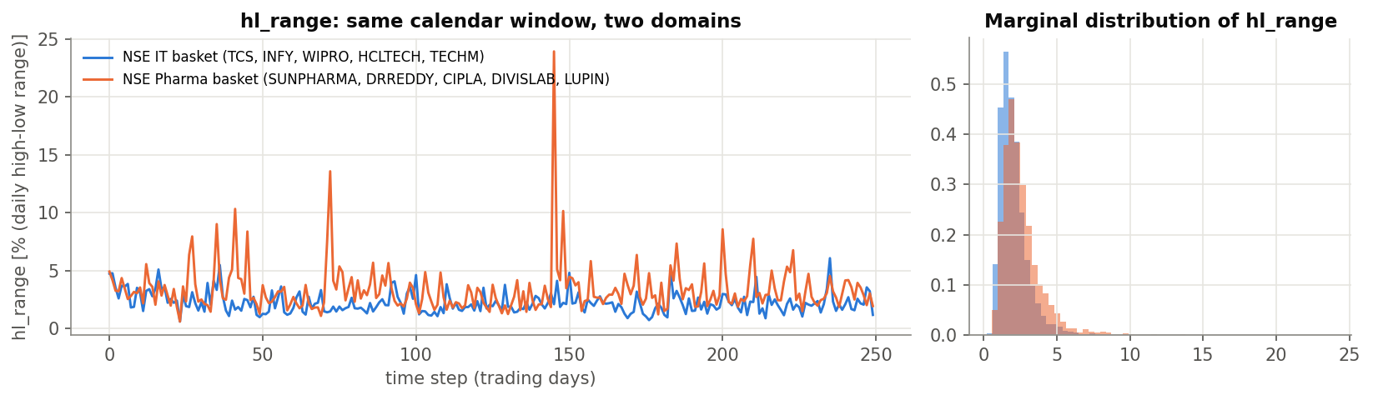
03 · DATASETS
Domain shift in the energy and finance benchmarks
ETTh1 → ETTh2
Oil temperature mean 13.3 vs 26.6 °C; load channels have different scales and daily/weekly structure.
IT → Pharma
Daily high-low range 2.33% vs 2.57%. Returns are near-unpredictable, while volatility and volume are persistent and forecastable.
IE 643 Course Project · [Team Name]
Notes:
Energy has a strong shift; finance has a subtler one. That contrast becomes important when we interpret results later.

Slide 12
04 · LIGHTWEIGHT FORECASTER
LiteTCN-Forecaster: small, and built to be adapted
Input x
RevIN
Conv encoder
Latent z
Forecast head
ŷ
L × C window
(all variables)
normalise per window
(stats kept)
3 × Conv1d, stride 2
dilation 1-2-2, GELU
Flatten → Linear
128-d features
+
Linear 128 → H·C
RevIN⁻¹
H × C
↑ z is aligned across domains
Recon head
Linear 128 → L·C
(self-supervision)
Linear temporal path
DLinear-style L → H, shared across channels
381,606
parameters (L=168, C=7)
< 1 min
per epoch on a laptop CPU
3
outputs: forecast, latent, reconstruction
IE 643 Course Project · [Team Name]
Notes:
Trace one window through the model. Two ideas: (1) the latent z is where we align domains; (2) the reconstruction head gives us a label-free task in the target domain. The linear path keeps a strong DLinear-like baseline inside the model.

Slide 13
05 · ADAPTATION STRATEGY
CARE-DA: our label-free adaptation strategy
Correlation-Aligned, Reconstruction-regularised, Elastic-anchored Domain Adaptation
L_fcst
MSE(ŷ_s, y_s)
One training step
Source batch
keeps source skill
(x_s, y_s) labeled
Sample a source and a target batch
Forward both through the shared model
Compute the loss terms (v1 or v2)
One AdamW update of θ
Log each term, feature MMD and source error per epoch
Shared LiteTCN
L_align
MMD² + CORAL on (z_s, z_t)
weights θ, initialised
from source model θ_S
closes domain gap
L_SSL / L_inner
v1 mask-recon · v2 inner-forecast
Target batch
forecast-consistent pretext
x_t only — no labels
L_anchor
‖θ − θ_S‖²
no forgetting / collapse
v1 is the designed objective we ran first. Ablations already suggest replacing L_SSL; a seed-0 v2 probe is in progress (second half will lock this).
IE 643 Course Project · [Team Name]
Notes:
Explain the name. Be honest that v1 SSL hurt. Do not say the project is finished: v2 is a follow-up experiment we will confirm over 3 seeds.

Slide 14
05 · LOSS FUNCTION DESIGN
The adaptation objective, term by term
L_CARE = L_fcst(S) + λ_M · MMD²_k(z_s, z_t) + λ_C · CORAL(z_s, z_t) + λ_R · L_mask(x_t) + λ_A · ‖θ − θ_S‖²
Term | Definition | Why it is needed | λ
L_fcst | (1/HC)‖f_θ(x_s) − y_s‖² on the source batch | Bound term ε_S; prevents the model from forgetting how to forecast | 1
MMD²_k | Multi-kernel RBF MMD between latent batches, bandwidth from median heuristic × {¼ … 4} | Matches the whole feature distribution (all moments) | 1
CORAL | ‖Cov(z_s) − Cov(z_t)‖²_F / 4d² | Matches cross-feature correlation, i.e. inter-variable structure | 1
L_mask | Mask 30% of target time steps; MSE of reconstructing them from z | Label-free target signal; stops alignment from collapsing features | 1
Anchor | L2-SP: squared distance to source weights θ_S | Elastic memory of Domain 1; limits negative transfer | 0.01
v1 weights were fixed a priori (fair vs baselines). Ablations say λ_R = 0 is better. Second-half plan: replace L_mask with a forecast-consistent pretext and confirm over 3 seeds.
IE 643 Course Project · [Team Name]
Notes:
This is deliverable 5, the designed loss. Connect each row to the bound. Mention the weights were fixed, not tuned per dataset, which makes the comparison fair.

Slide 15
06 · PERFORMANCE METRICS
Measuring forecast quality and adaptation efficiency
Forecast accuracy (per domain)
Adaptation efficiency (our additions)
MSE / MAE
Gap-Closure Ratio
on z-scored values, averaged over all H steps and C variables (comparable across variables)
GCR = (E_source-only − E_method) / (E_source-only − E_oracle)
Share of the gap to a fully supervised fine-tuned model that is closed without labels. 1 = oracle level; < 0 = negative transfer.
MASE
MAE ÷ in-sample seasonal-naive MAE: < 1 beats the naive forecast; scale-free across domains
Feature discrepancy
MMD² between source and target latents: did alignment happen?
Key-variable RMSE
Forgetting %
in physical units: °C temperature, % range, °C oil temperature (interpretable for users)
change in Domain 1 test MSE after adapting to Domain 2
Stability
mean ± std over 3 random seeds
IE 643 Course Project · [Team Name]
Notes:
Deliverable 6. Accuracy metrics are standard; GCR is what tells us whether adaptation is worth it relative to simply collecting labels. Forgetting tells us whether Domain 1 still works.

Slide 16
07 · EXPERIMENTS
Experimental protocol
Methods compared (same source checkpoint)
Source training
20 epochs, AdamW, lr 1e-3, cosine schedule, best source-validation checkpoint
Seasonal naive
repeat last season (no learning)
Source-only
Domain 1 model applied as-is (lower bound)
Adaptation
10 epochs, lr 3e-4; v1 = last epoch; v2 picks min(source-val MSE + feature MMD) — still no target labels
DANN / Deep CORAL / MMD
classic single-principle UDA baselines
CARE-DA v1 / v2 (ours)
v1 + ablations (3 seeds); v2 is a seed-0 probe only
Self-supervision
mask ratio 0.3; also used during source training so the head is ready
Target-only*
trained from scratch on labeled Domain 2
Fine-tune oracle*
source model fine-tuned with Domain 2 labels (upper bound)
Seeds / hardware
3 seeds (0, 1, 2); PyTorch on a laptop CPU
* uses target labels: reference only, not UDA
IE 643 Course Project · [Team Name]
Notes:
Emphasise fairness: every method starts from the same source checkpoint and gets the same budget; checkpoints for UDA are never chosen using target labels.

Slide 17
07 · FIRST EXPERIMENTAL CAMPAIGN
Preliminary Domain-2 results — not the final table
Method | Climate MSE | Energy MSE | Finance MSE | Climate Δ vs src-only | Energy Δ vs src-only | Finance Δ vs src-only
Seasonal naive | 0.351 | 0.225 | 1.024 | +38.5% | +30.0% | +82.5%
Source-only | 0.254 ± 0.004 | 0.173 ± 0.004 | 0.561 ± 0.001 | — | — | —
DANN | 0.268 ± 0.017 | 0.217 ± 0.020 | 0.572 ± 0.003 | +5.5% | +25.7% | +2.0%
Deep CORAL | 0.272 ± 0.007 | 0.192 ± 0.006 | 0.573 ± 0.002 | +7.1% | +11.4% | +2.0%
MMD | 0.234 ± 0.003 | 0.165 ± 0.004 | 0.558 ± 0.002 | -7.9% | -4.4% | -0.5%
CARE-DA v1 (3 seeds) | 0.245 ± 0.002 | 0.167 ± 0.004 | 0.562 ± 0.002 | -3.6% | -3.3% | +0.1%
CARE-DA − SSL (ablation) | 0.234 ± 0.003 | 0.162 ± 0.004 | 0.558 ± 0.002 | -7.8% | -6.4% | -0.6%
CARE-DA v2 (seed 0 probe) | 0.236 | 0.156 | 0.552 | -6.2% | -7.8% | -1.8%
Target-only* | 0.240 ± 0.003 | 0.177 ± 0.005 | 0.551 ± 0.001 | -5.3% | +2.6% | -1.9%
Fine-tune oracle* | 0.232 ± 0.004 | 0.168 ± 0.001 | 0.548 ± 0.000 | -8.5% | -3.0% | -2.4%
First campaign: v1 is mean ± std over 3 seeds. v2 is a seed-0 probe only — we will re-run it over 3 seeds before locking the method. Bold teal = best 3-seed label-free so far. * uses Domain 2 labels.
IE 643 Course Project · [Team Name]
Notes:
Call this a first campaign. Be honest: full v1 is not the best; −SSL is stronger. v2 looks promising on seed 0 but is not confirmed. That is the work of the second half.

Slide 18
07 · FIRST EXPERIMENTAL CAMPAIGN
Where the first campaign helped — and where it did not
Best so far (still provisional)
-7.9%
Climate · MMD (oracle* -8.5%)
-7.8%
Energy · CARE v2* (oracle* -3.0%)
-1.8%
Finance · CARE v2* (oracle* -2.4%)
Bars clipped at −12%: DANN on energy is −26%.
IE 643 Course Project · [Team Name]
Notes:
First-campaign reading: alignment helps, DANN/CORAL hurt. Climate's best 3-seed method is still MMD. Energy/finance v2 numbers are seed 0 only — say we will confirm them. Finance has little headroom even for the oracle.

Slide 19
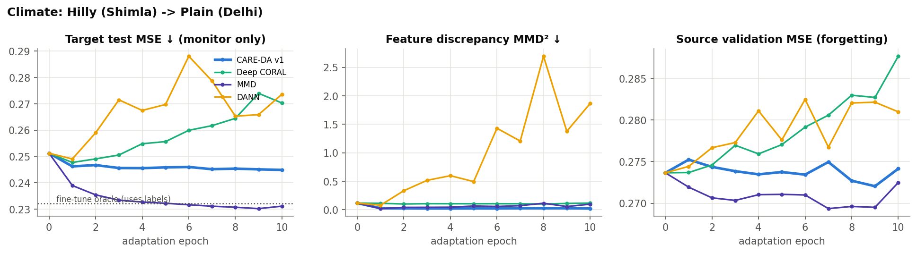
07 · ADAPTATION BEHAVIOUR
Logged adaptation dynamics (climate, seed 0)
Alignment happens
Lower gap ≠ lower error
No forgetting
CARE-DA cuts latent MMD² between domains from 0.078 to 0.016 (climate, mean of 3 seeds).
CARE-DA reaches the smallest discrepancy, yet MMD-only forecasts better; DANN is unstable (MMD² 1.9) and its target error drifts upward.
Label-free variants keep Domain 1 error flat (CARE-DA -1.3%), while supervised fine-tuning degrades Domain 1 by +14%.
IE 643 Course Project · [Team Name]
Notes:
These are the adaptation logs (deliverable 4). Target MSE is plotted for monitoring only, never used to pick checkpoints. Three messages: alignment works as intended, a smaller feature distance does not guarantee better forecasts, and label-free adaptation does not destroy Domain 1 performance.

Slide 20
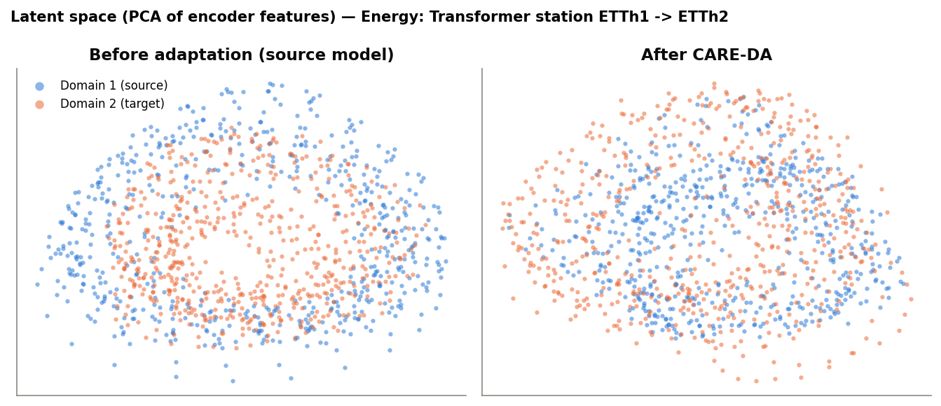
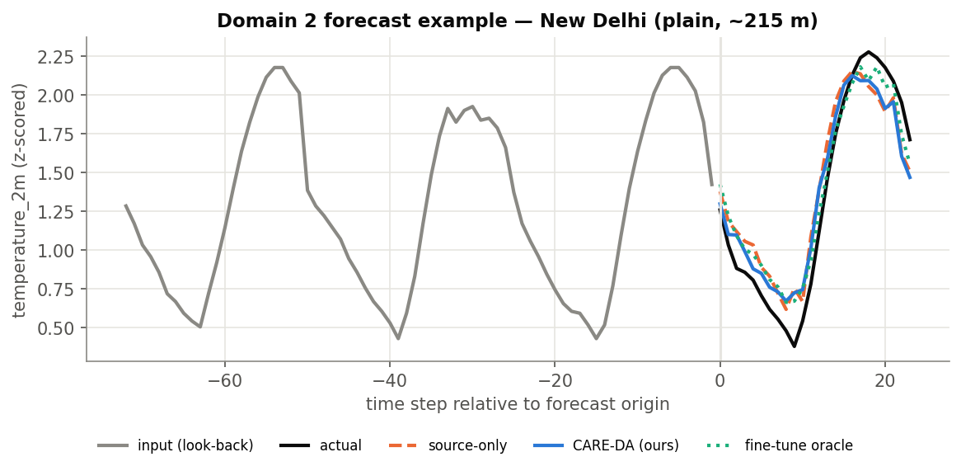
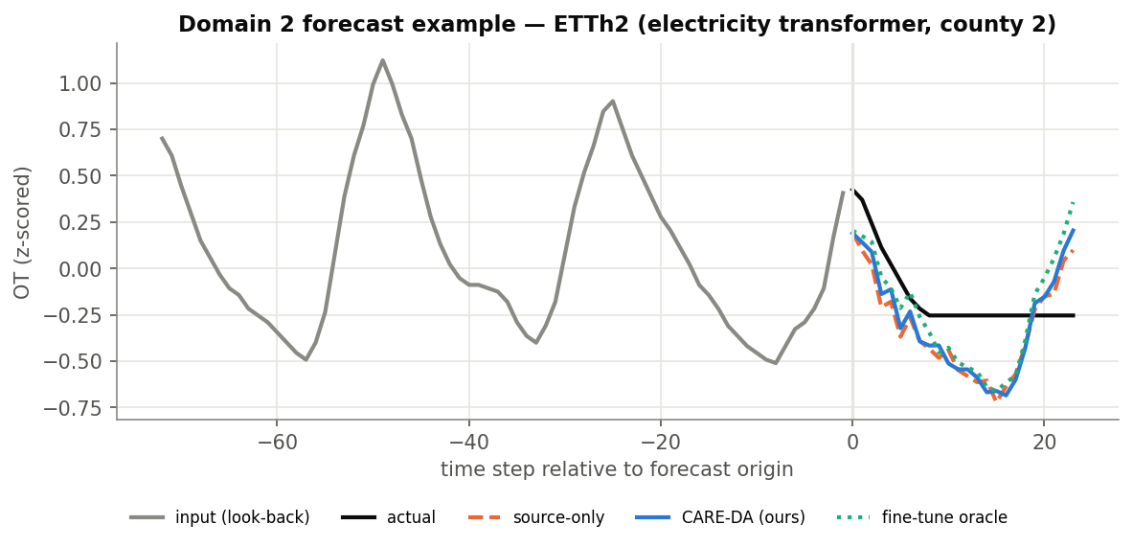
07 · QUALITATIVE RESULTS
What adaptation does to features and forecasts
Reading the plots
Left: PCA of encoder features on ETT (blue = Domain 1, orange = Domain 2). After CARE-DA the two clouds mix more evenly; latent MMD² falls from 0.18 to 0.04.
Right: Domain 2 test windows. Grey = input, black = actual, orange dashed = source-only, blue = CARE-DA, green dotted = supervised oracle.
IE 643 Course Project · [Team Name]
Notes:
Qualitative evidence. Pick one forecast window and explain where the source-only model is biased and how the adapted one moves towards the actual values.

Slide 21

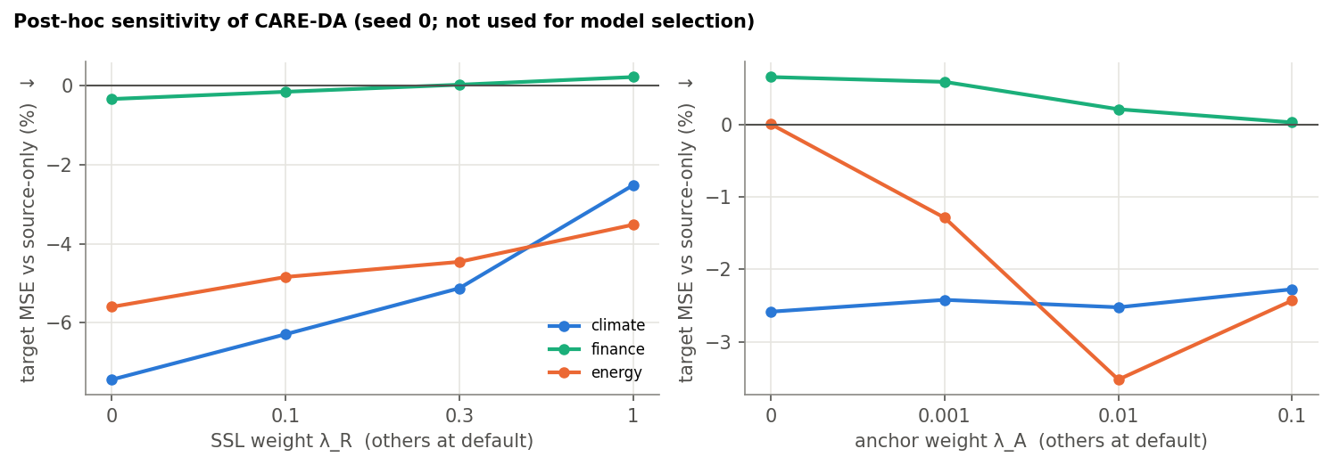

07 · INSIGHTS SO FAR
What the first campaign taught us — open for the second half
Variant (Δ MSE vs src-only) | Climate | Energy | Finance
CARE-DA v1 | -3.6% | -3.3% | +0.1%
− alignment | +5.8% | +4.5% | +0.6%
− SSL | -7.8% | -6.4% | -0.6%
− anchor | -3.8% | -0.1% | +0.5%
CARE-DA v2 (probe) | -6.2% | -7.8% | -1.8%
Alignment is the working core
Removing the MMD + CORAL terms turns every gain into negative transfer. Matching feature distributions is what adapts the model.
SSL hurt; v2 is the next experiment
Mask-recon raised error as λ_R grew. A seed-0 v2 probe looks better (climate −6.2%, energy −7.8%, finance −1.8%) but is not locked until we run 3 seeds.
Anchor helps where the shift is strong
On energy the anchor turns −0.1% into −3.3%; DANN or CORAL alone cause negative transfer. Finance has little to gain (oracle only −2.4%).
IE 643 Course Project · [Team Name]
Notes:
This is the pivot slide. First campaign taught us SSL hurts and alignment is the core. v2 is a probe, not the locked method. End with: that is why the second half exists.

Slide 22
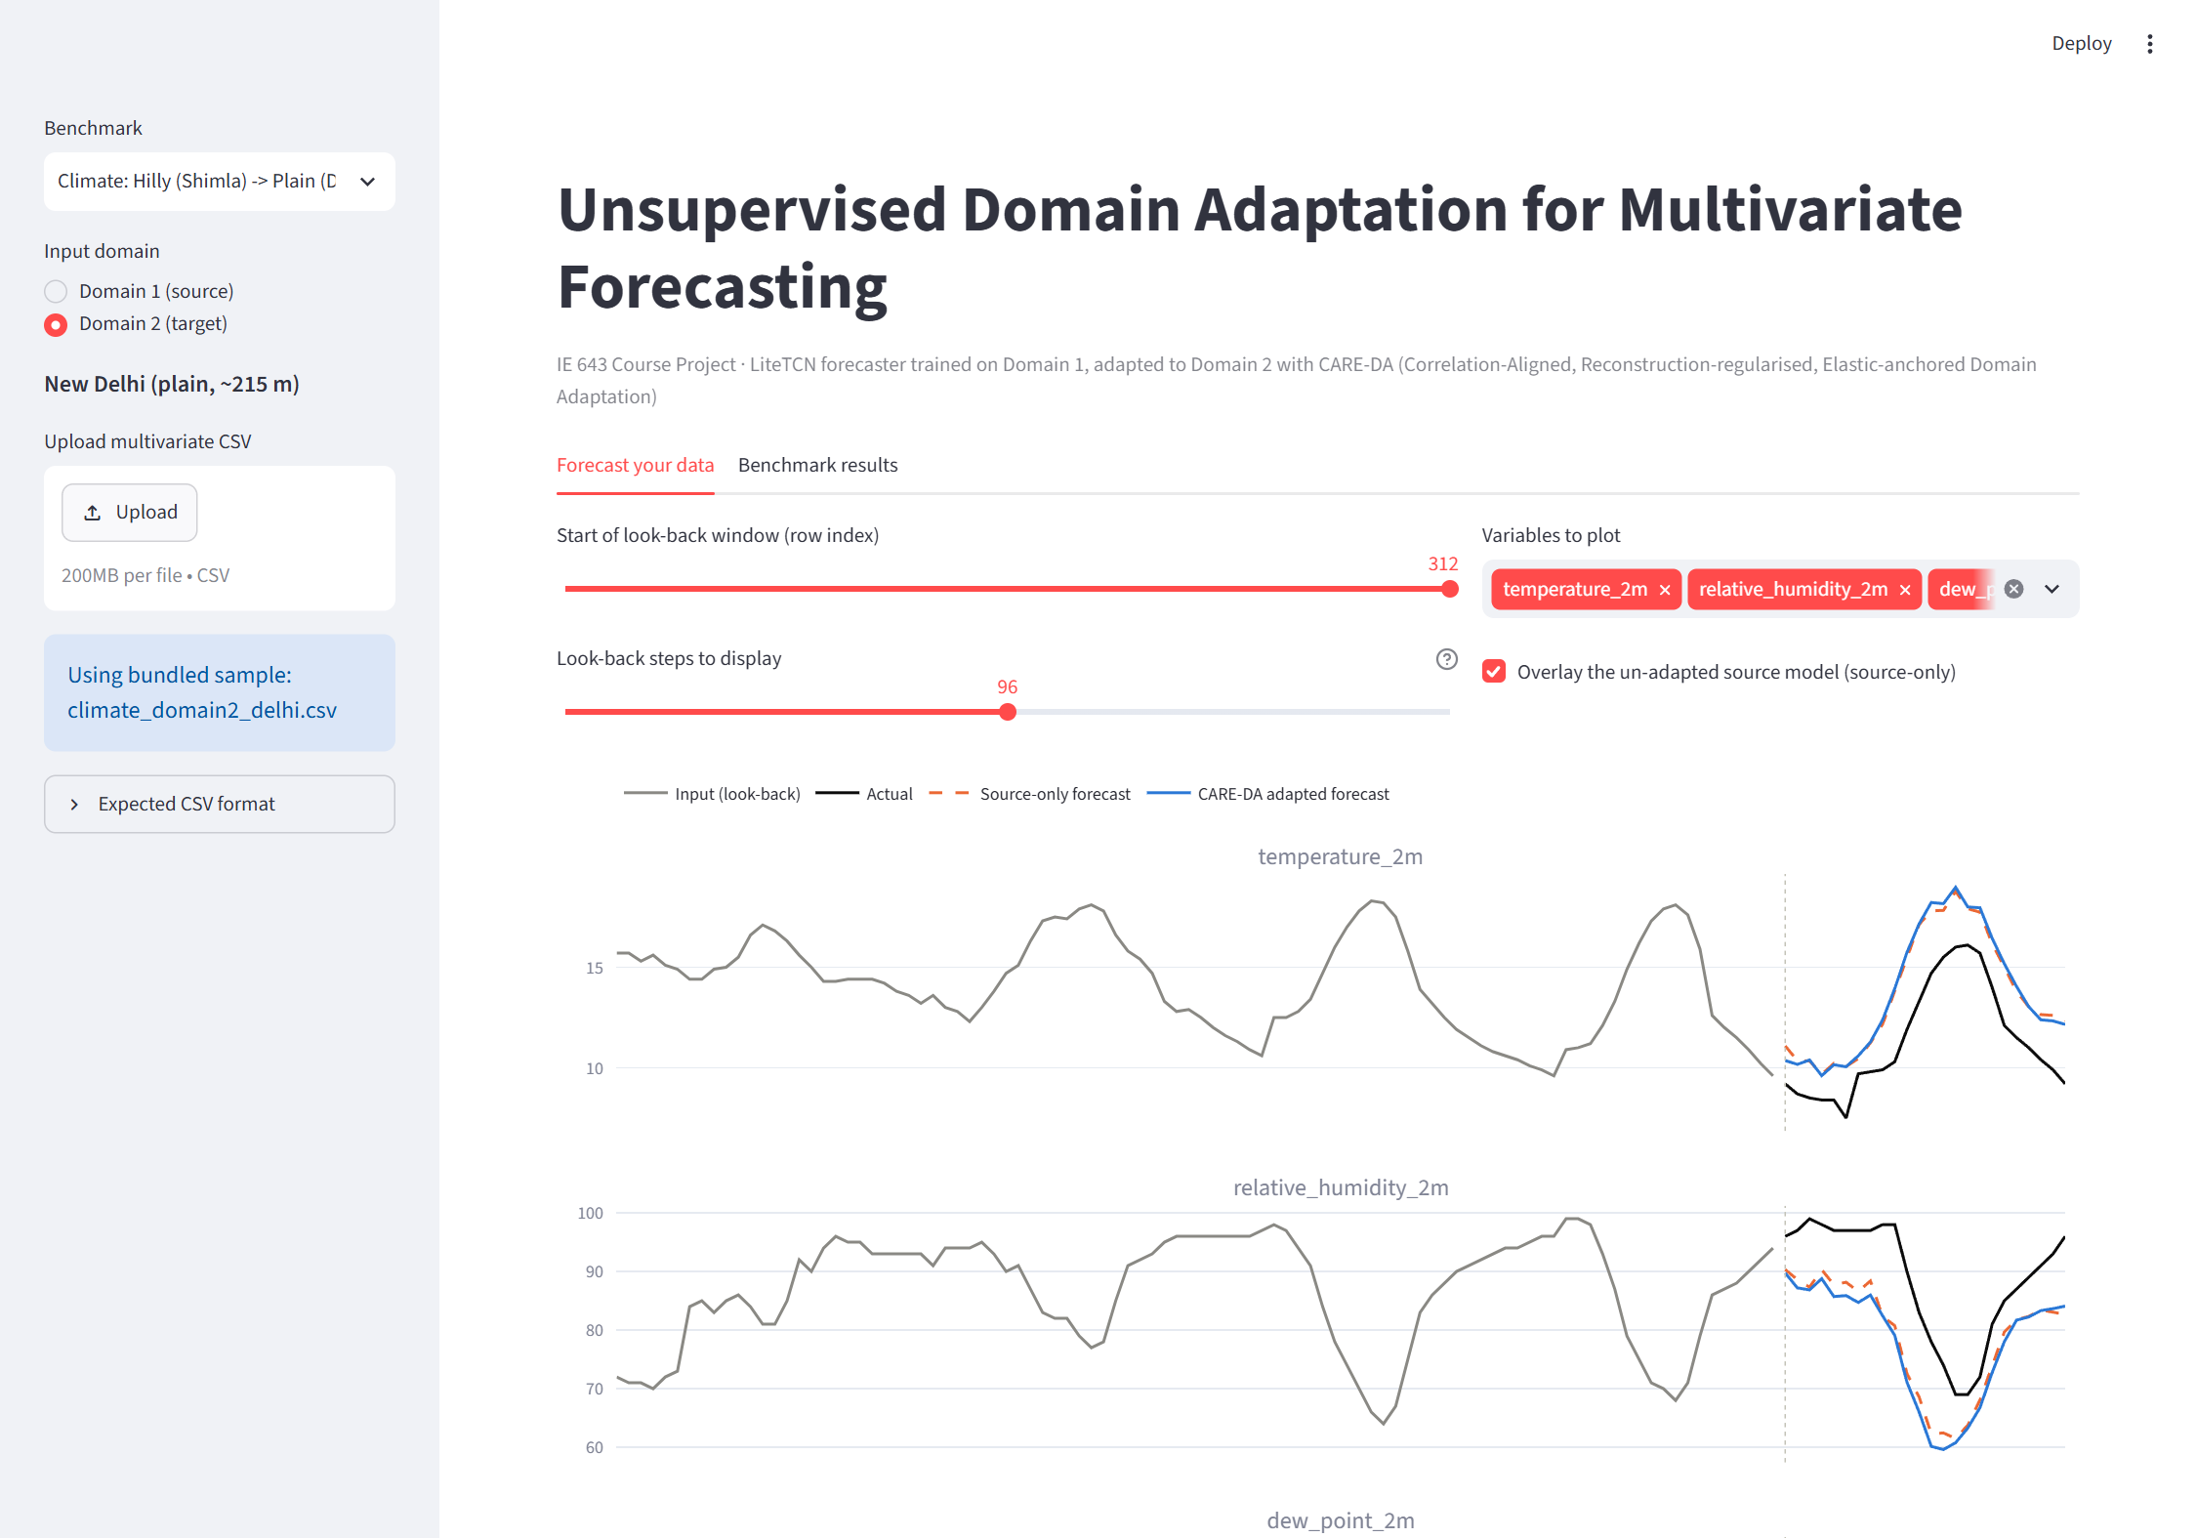


08 · INTERFACE PROTOTYPE
Working demo — still to polish before the intensive assessment
Pick benchmark and domain, then upload a multivariate CSV (or use the bundled samples). Raw OHLCV is converted to features automatically.
Per-variable plots of input, actual and forecast. Domain 2 can overlay the un-adapted source model (prototype comparison).
Window-level MSE, MAE, MASE and key-variable RMSE, plus a whole-file rolling evaluation against baselines.
Still to add: batch upload, per-variable metric cards, uncertainty bands, and a cleaner Domain-2 comparison.
streamlit run app/app.py
IE 643 Course Project · [Team Name]
Notes:
Show the prototype, then say what is still missing. Do not present this as the final interface.

Slide 23



08 · PLAN AHEAD
Roadmap: sub-tasks, status and next steps
First half (done)
Second half (next)
Before intensive assessment
Problem study and literature review
3 domain-pair datasets curated (pending TA)
LiteTCN + CARE-DA v1 first campaign (3 seeds)
Metrics, logs, plots defined
Interface prototype (both domains)
Get the 3 datasets signed off by the TAs
Lock CARE-DA v2 over 3 seeds + ablations
Unsupervised λ / checkpoint selection
Polish the interface and write the full report
Stage-wise report (final version)
Few-shot / extra-domain extras if time
Recorded demo + live walkthrough
Final presentation of locked results
Course deliverables status
◐ first version
Domain 1 + adapted models
◐ first version
Interface: Domain 1
◐ first version
Interface: Domain 2
◐ first version
Performance metrics
◐ first version
Stage-wise report
○ not started
Intensive assessment
IE 643 Course Project · [Team Name]
Notes:
Close as mid-project: first cycle is real, nothing is locked. Ask the TAs to verify the datasets. Second half = lock v2, write the report, polish the demo.

Slide 24
REFERENCES
Research papers (1/2)
[1] Shai Ben-David, John Blitzer, Koby Crammer, Alex Kulesza, Fernando Pereira and Jennifer Wortman Vaughan. A theory of learning from different domains, Machine Learning, 2010. https://doi.org/10.1007/s10994-009-5152-4
[2] Yaroslav Ganin, Evgeniya Ustinova, Hana Ajakan, Pascal Germain, Hugo Larochelle, François Laviolette, Mario Marchand and Victor Lempitsky. Domain-Adversarial Training of Neural Networks, Journal of Machine Learning Research, 2016. https://arxiv.org/abs/1505.07818
[3] Baochen Sun and Kate Saenko. Deep CORAL: Correlation Alignment for Deep Domain Adaptation, ECCV Workshops, 2016. https://arxiv.org/abs/1607.01719
[4] Mingsheng Long, Yue Cao, Jianmin Wang and Michael I. Jordan. Learning Transferable Features with Deep Adaptation Networks, ICML, 2015. https://arxiv.org/abs/1502.02791
[5] Arthur Gretton, Karsten M. Borgwardt, Malte J. Rasch, Bernhard Schölkopf and Alexander Smola. A Kernel Two-Sample Test, Journal of Machine Learning Research, 2012. https://jmlr.org/papers/v13/gretton12a.html
[6] Xuhong Li, Yves Grandvalet and Franck Davoine. Explicit Inductive Bias for Transfer Learning with Convolutional Networks, ICML, 2018. https://arxiv.org/abs/1802.01483
[7] Yu Sun, Xiaolong Wang, Zhuang Liu, John Miller, Alexei A. Efros and Moritz Hardt. Test-Time Training with Self-Supervision for Generalization under Distribution Shifts, ICML, 2020. https://arxiv.org/abs/1909.13231
[8] Xiaoyong Jin, Youngsuk Park, Danielle C. Maddix, Hao Wang and Yuyang Wang. Domain Adaptation for Time Series Forecasting via Attention Sharing, ICML, 2022. https://arxiv.org/abs/2102.06828
[9] Garrett Wilson, Janardhan Rao Doppa and Diane J. Cook. Multi-Source Deep Domain Adaptation with Weak Supervision for Time-Series Sensor Data, KDD, 2020. https://arxiv.org/abs/2005.10996
[10] Ruichu Cai, Jiawei Chen, Zijian Li, Wei Chen, Keli Zhang, Junjian Ye, Zhuozhang Li, Xiaoyan Yang and Zhenjie Zhang. Time Series Domain Adaptation via Sparse Associative Structure Alignment, AAAI, 2021. https://arxiv.org/abs/2012.11797
IE 643 Course Project · [Team Name]
Notes:
References follow the course-prescribed format.

Slide 25
REFERENCES
Research papers (2/2) and web resources
[11] Yilmazcan Ozyurt, Stefan Feuerriegel and Ce Zhang. Contrastive Learning for Unsupervised Domain Adaptation of Time Series, ICLR, 2023. https://arxiv.org/abs/2206.06243
[12] Huan He, Owen Queen, Teddy Koker, Consuelo Cuevas, Theodoros Tsiligkaridis and Marinka Zitnik. Domain Adaptation for Time Series Under Feature and Label Shifts, ICML, 2023. https://arxiv.org/abs/2302.03133
[13] Taesung Kim, Jinhee Kim, Yunwon Tae, Cheonbok Park, Jang-Ho Choi and Jaegul Choo. Reversible Instance Normalization for Accurate Time-Series Forecasting against Distribution Shift, ICLR, 2022. https://openreview.net/forum?id=cGDAkQo1C0p
[14] Ailing Zeng, Muxi Chen, Lei Zhang and Qiang Xu. Are Transformers Effective for Time Series Forecasting?, AAAI, 2023. https://arxiv.org/abs/2205.13504
[15] Yuqi Nie, Nam H. Nguyen, Phanwadee Sinthong and Jayant Kalagnanam. A Time Series is Worth 64 Words: Long-term Forecasting with Transformers, ICLR, 2023. https://arxiv.org/abs/2211.14730
[16] Shaojie Bai, J. Zico Kolter and Vladlen Koltun. An Empirical Evaluation of Generic Convolutional and Recurrent Networks for Sequence Modeling, arXiv preprint, 2018. https://arxiv.org/abs/1803.01271
[17] Haoyi Zhou, Shanghang Zhang, Jieqi Peng, Shuai Zhang, Jianxin Li, Hui Xiong and Wancai Zhang. Informer: Beyond Efficient Transformer for Long Sequence Time-Series Forecasting (ETT dataset), AAAI, 2021. https://arxiv.org/abs/2012.07436
[18] Rob J. Hyndman and Anne B. Koehler. Another look at measures of forecast accuracy, International Journal of Forecasting, 2006. https://doi.org/10.1016/j.ijforecast.2006.03.001
Websites
Thank you
[19] Open-Meteo. https://open-meteo.com/en/docs/historical-weather-api. Accessed on: 18th September, 2026.
[20] Ran Aroussi. https://github.com/ranaroussi/yfinance. Accessed on: 18th September, 2026.
[21] Haoyi Zhou. https://github.com/zhouhaoyi/ETDataset. Accessed on: 18th September, 2026.
Questions welcome
IE 643 Course Project · [Team Name]
Notes:
Wrap up in one sentence: lightweight forecaster + principled label-free adaptation + honest metrics. Thank the audience.

