Slide 1

#HumseFarakPadtaHai www.road-safety.co.in
IIT DELHI
THE REVOLUTIONARIES

Slide 2
Android App for Speed-Distance Danger Alarm
#HumseFarakPadtaHai www.road-safety.co.in
App’s Location Manager
Device’s GPS
Current Location Info.
Calculate instant. speed
S > €
ALARM
YOLO,
OpenCV (etc.)
Obstacle Detection
t < €
ALARM

Slide 3
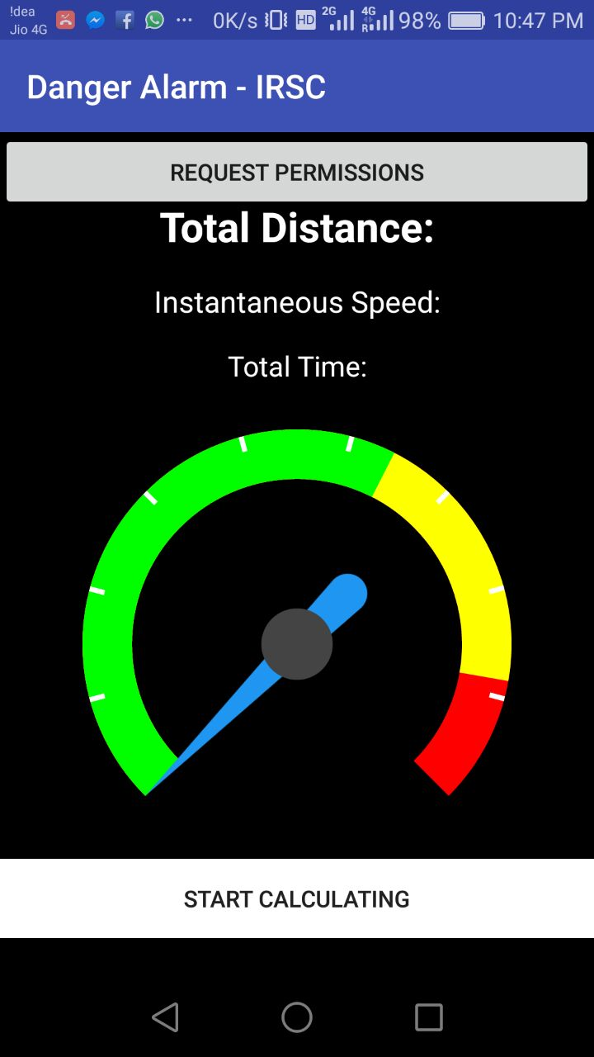
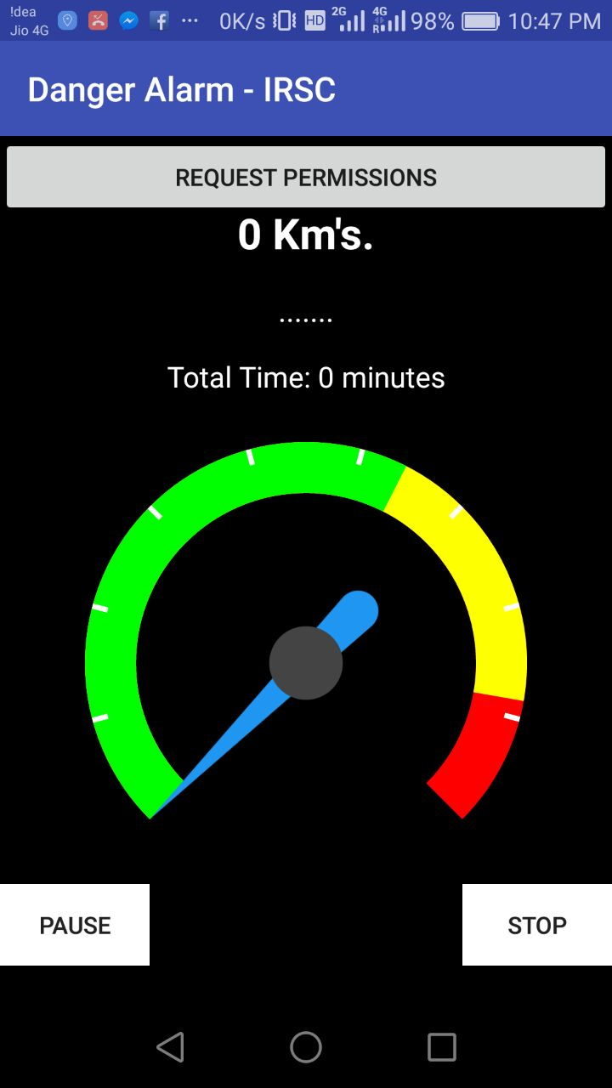

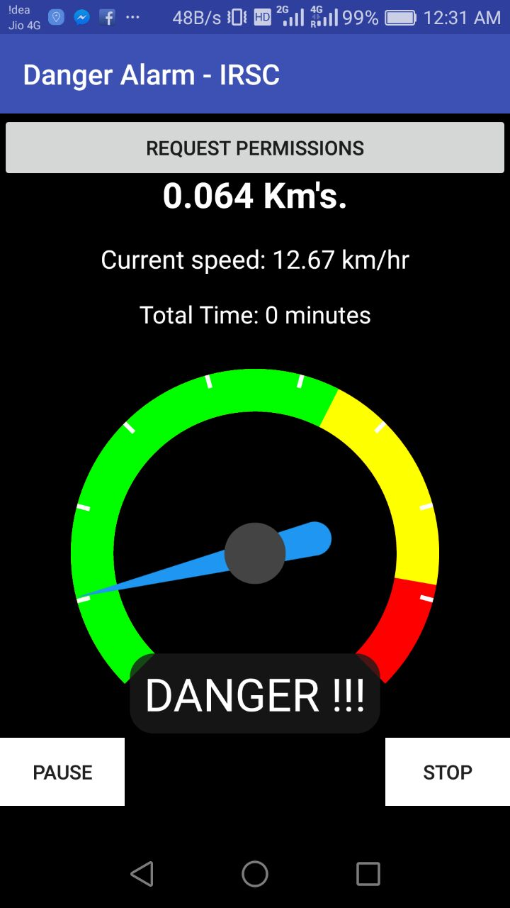
Android App for Speed-Distance Danger Alarm
#HumseFarakPadtaHai www.road-safety.co.in

Slide 4
Object Detection and Recognition
#HumseFarakPadtaHai www.road-safety.co.in
App’s Location Manager
Device’s GPS
Current Location Info.
Calculate instant. speed
S > €
ALARM
OpenCV (etc.)
Obstacle Detection
t < €
ALARM

Slide 5
Object Detection and Recognition
#HumseFarakPadtaHai www.road-safety.co.in
OpenCV (Open Source Computer Vision Library)
- C++, C, Python and Java interfaces .
- Supports Windows, Linux, Mac OS, iOS and Android .
- Need to be trained on different objects (Time Consuming) .
Tensorflow
- Multi Language and platform supported (Libraries available for transition) .
- Plugins available such as Yolo which have been already trained .
- Trained on US standards ! Different from Indian Standards .

Slide 6
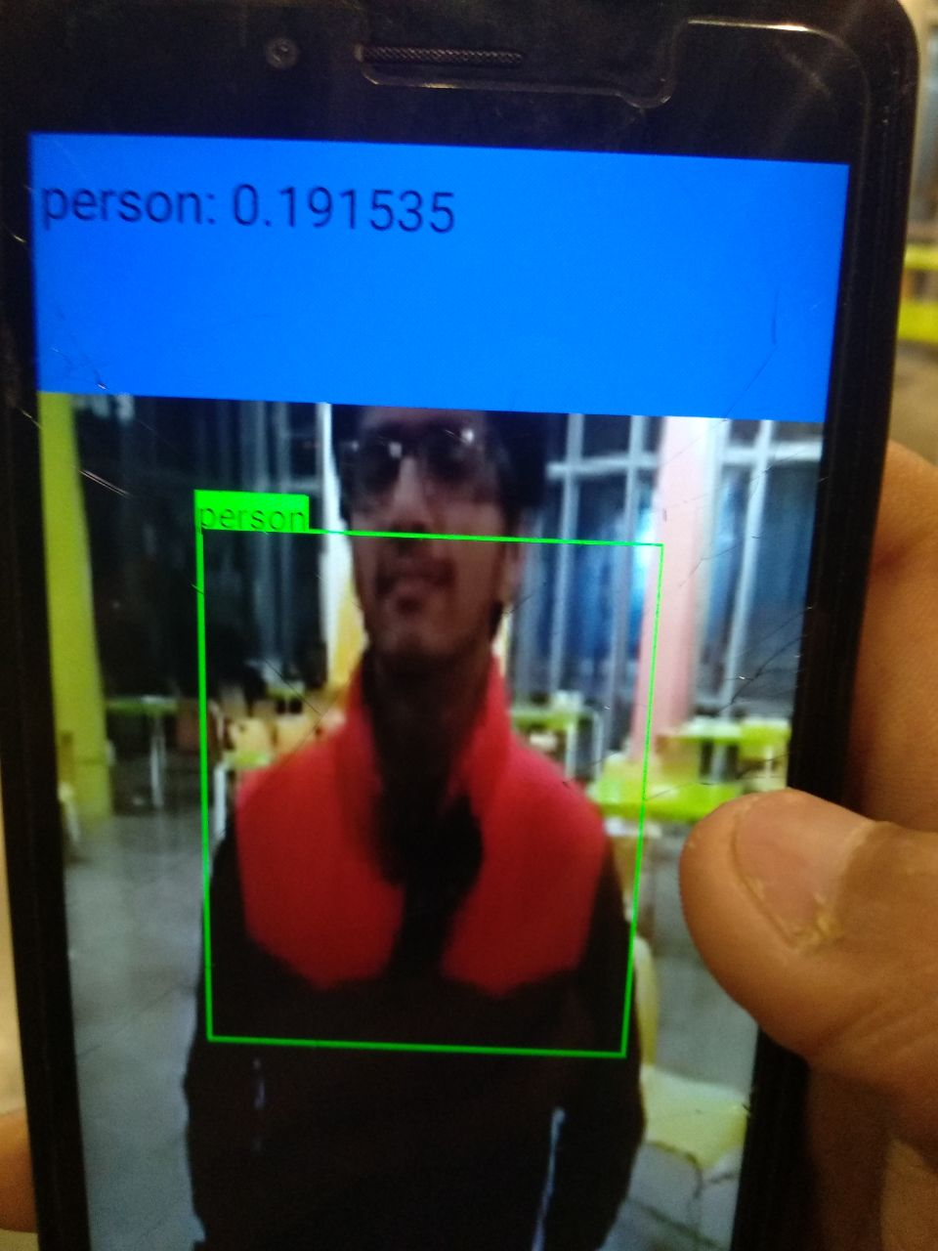
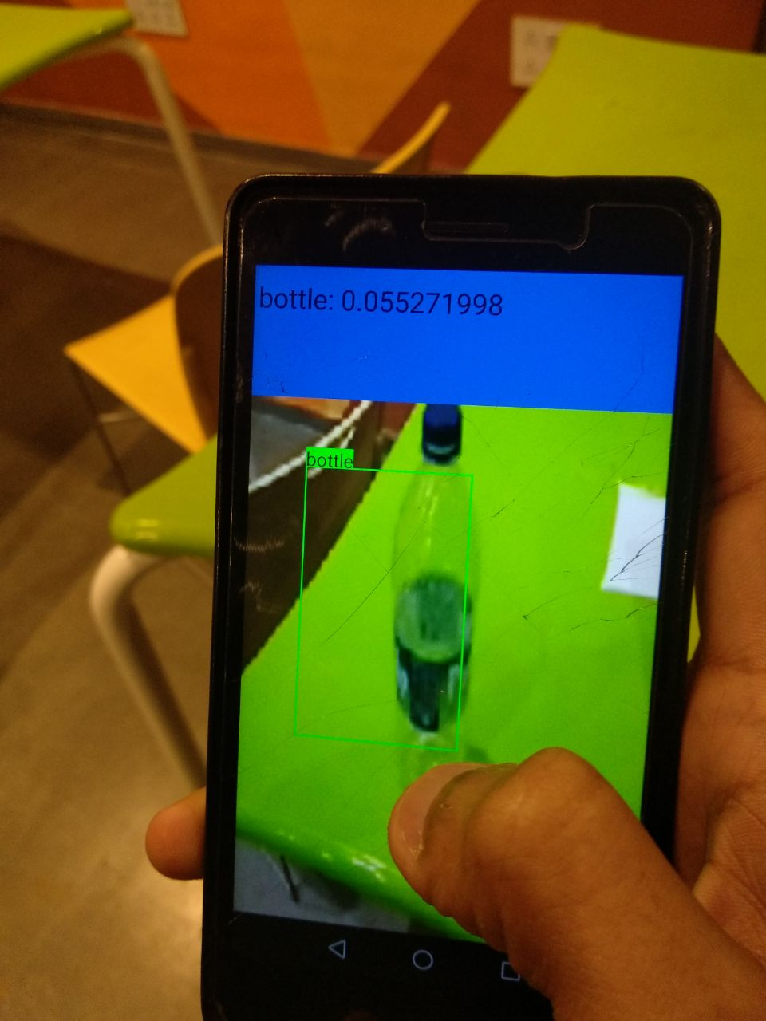
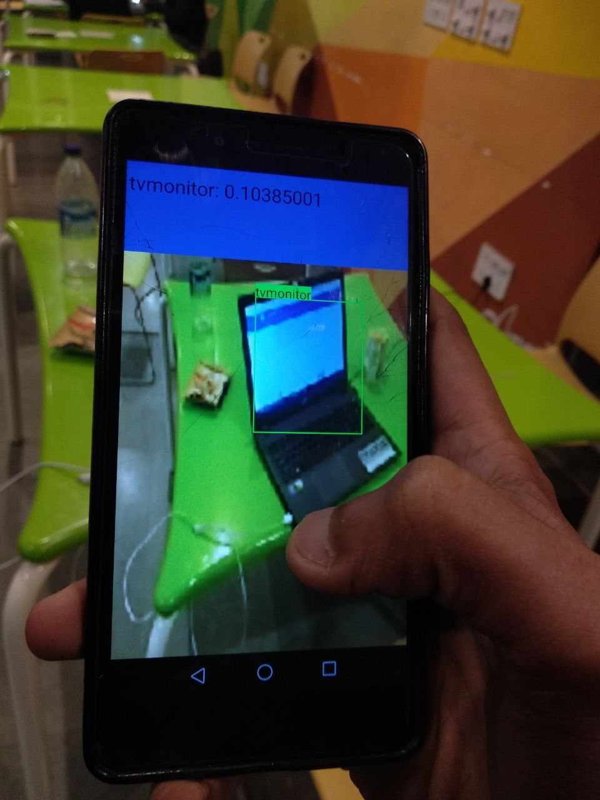
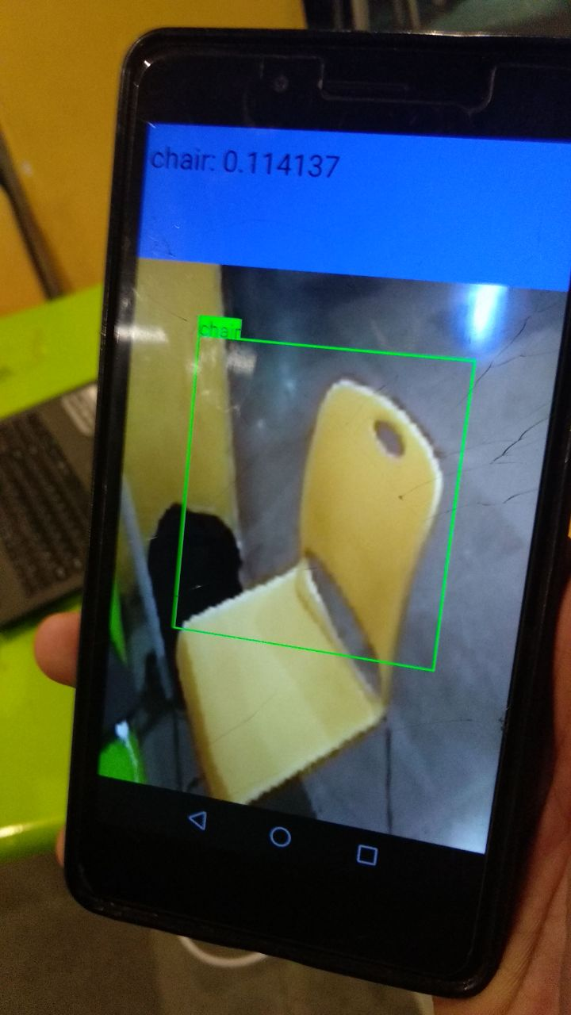
Object Detection and Recognition Working with Android-Yolo Plugin
#HumseFarakPadtaHai www.road-safety.co.in

Slide 7
Activities Remaining For Future
#HumseFarakPadtaHai www.road-safety.co.in
Building and Testing of best suited ML / DL algorithms.
Collecting data of Indian Roadway Standards.
Training on a Data Set for Obstacles on Indian Roadways.
Integration of Speedometer and Obstacle Detection System.
Field testing with the help of volunteers ( or IRSC ) .

Slide 8
References
#HumseFarakPadtaHai www.road-safety.co.in
https://opencv.org/
https://www.tensorflow.org/
https://github.com/bdjukic/CarND-Vehicle-Detection
https://developer.android.com
https://stackoverflow.com/ …. And the List GOES ONN !!!

Slide 9
#HumseFarakPadtaHai www.road-safety.co.in
THANK YOU
http://www.cse.iitd.ac.in/~cs1160396/
https://github.com/Ayush21298/Danger_Alarm_App_IRSC
Email : patel.ayush08@gmail.com

