Slide 1


WELCOME TO
WATER RESOURCES
SECTION
CIVIL ENGINEERING DEPARTMENT
INDIAN INSTITUTE OF TECHNOLOGY, DELHI

Slide 2












FACULTIES | Prof. B. R. Chahar Interest: Seepage, Drainage, Canal Design.
Prof. A. K. Gosain Interest: Integrated Watershed Modelling, GIS, Hydrological Modelling. | Prof. A.K. Keshari Interest: Hydrological and Environmental Modelling, Remote Sensing and GIS
Prof. Shashi Mathur Interest: Groundwater Contamination, Bioremediation of Soils, Flow through Porous Media | Prof. Rakesh Khosa Interest: Water Resources Systems, Stochastic Processes, Conflict Resolution and Hydrologic Modeling
Prof. N. K. Garg Interest: Water Resources Systems, Finite Element Watershed Modelling | Prof. D. R. Kaushal Interest: Hydraulic and Water Resources Engineering, Fluid Mechanics, Sediment Transport
Prof. C. T. Dhanya Interest: Hydro-climatological Modelling, Nonlinear Dynamics and Chaos Theory, Stochastic Hydrology. | Prof. Sumedha Chakma Interest: Contaminant Hydrology, Bioreactor Landfill, Watershed Management.

Slide 3

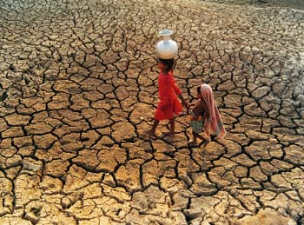
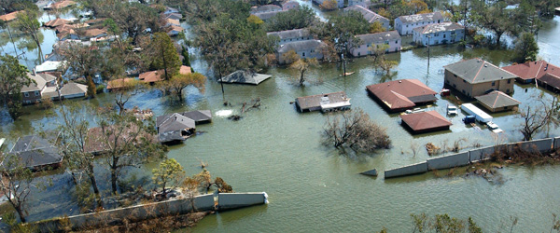
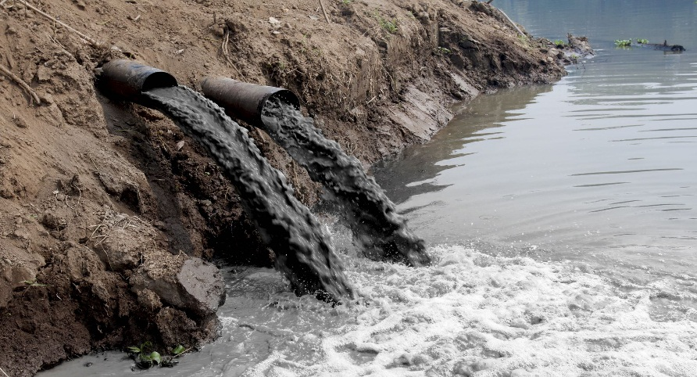

CHALLANGES
DROUGHT
FLOOD
WATER POLUTION
CLIMATE CHANGE

Slide 4
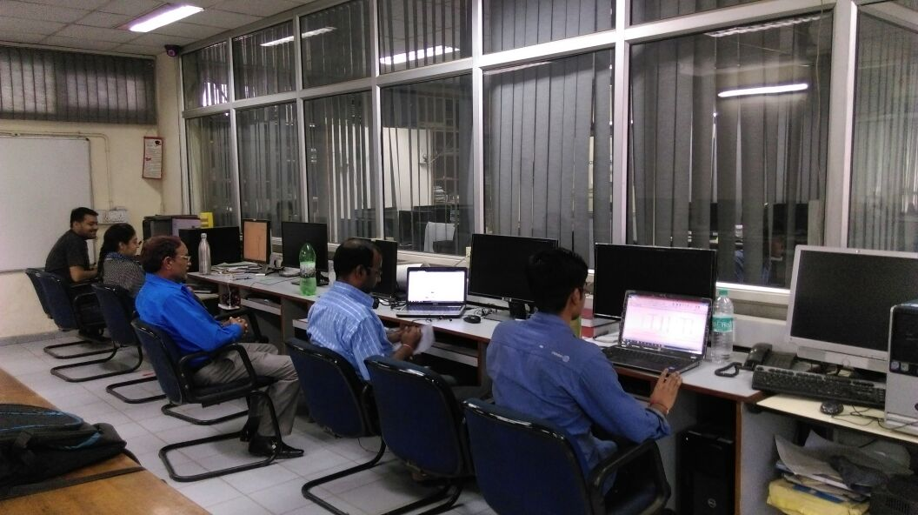
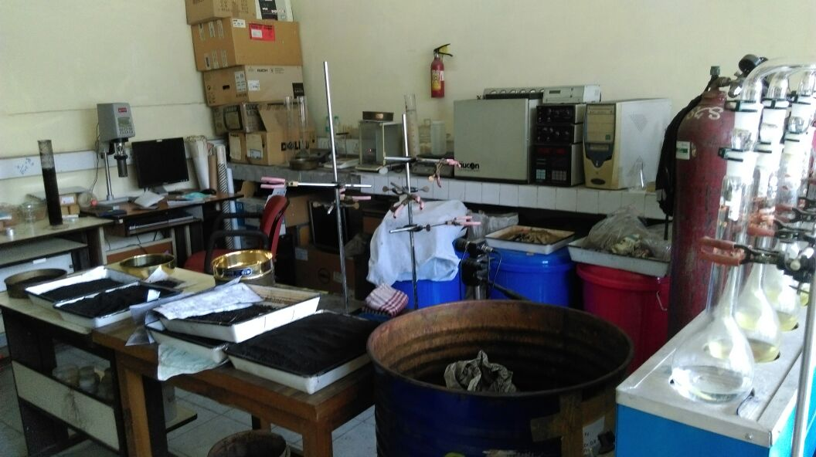
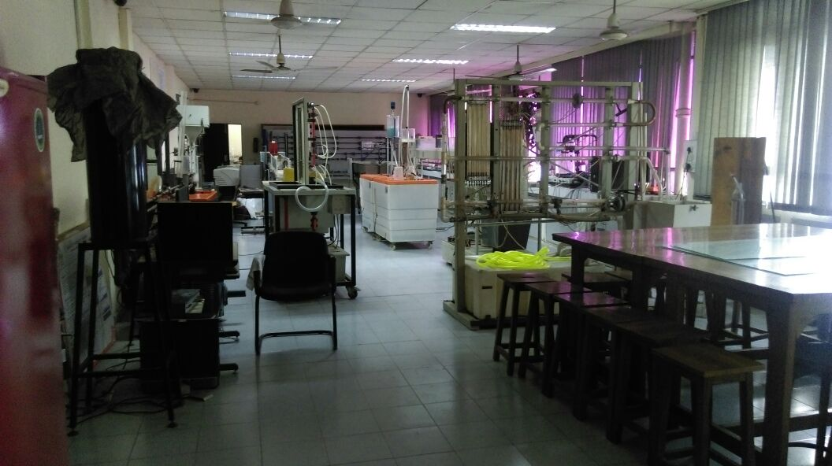
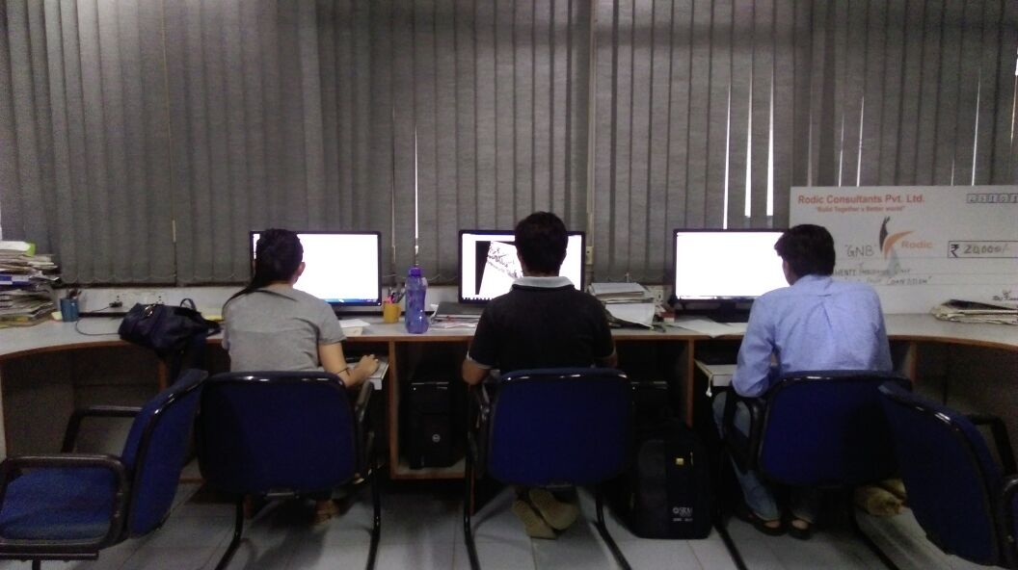
LABORATORIES

Slide 5
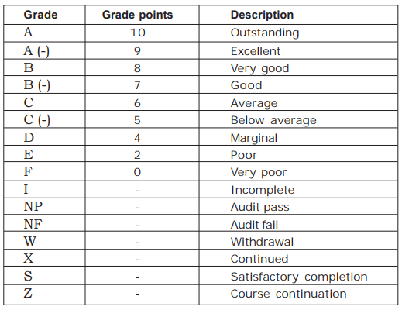
CREDIT SYSTEM @ IIT Delhi

Slide 6
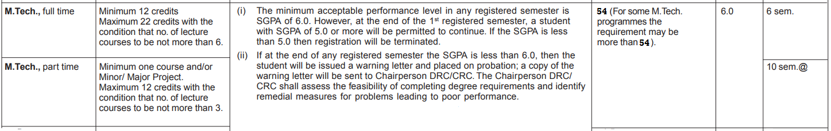
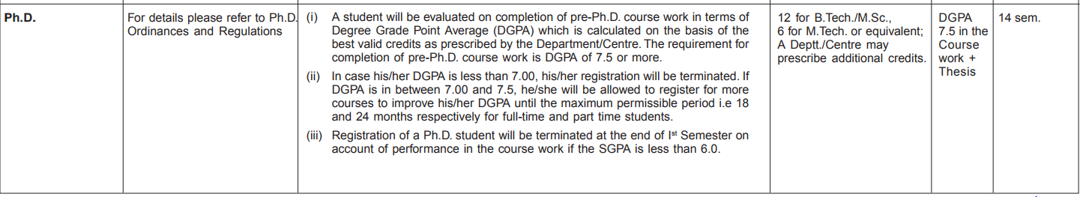
Continuation of Registration and Graduation Requirements for Postgraduate Programmes

Slide 7






Master of Technology in Water Resources Engineering
Category | PC |  | PE | OC | Total
Credits | 39 |  | 15 | 0 | 54
 | Major Project | Others
 | 18 | 21

Slide 8
PG Courses
Course No. | Course Title | Category | Slot | Coordinator
CVL 730 | Hydrological Processes and Modeling | PC | A | Rakesh Khosa
CVL 731 | Optimization Techniques in Water Resources | PC | B | A. K. Keshari
CVL 732 | Groundwater Hydrology | PC | E | B. R. Chahar
CVL 733 | Stochastic Hydrology | PC | M | C. T. Dhanya
CVL 831 | Surface Water Quality Modeling and Control | PE | F | Shashi Mathur
CVL 839 | Hydrologic Applications in Remote Sensing Technology | PE | H | A. K. Keshari
CVL 738 | Economic Aspects of Water Resources Development | PE |  | Sumedha Chakma
CVD 831 | Major Project Part I (CEW) | PC | - | Sumedha Chakma

Slide 9
With best wishes for the Upcoming Journey
Stay Happy, Healthy and Enjoy learning at IIT Delhi

