Slide 1


Slide 2

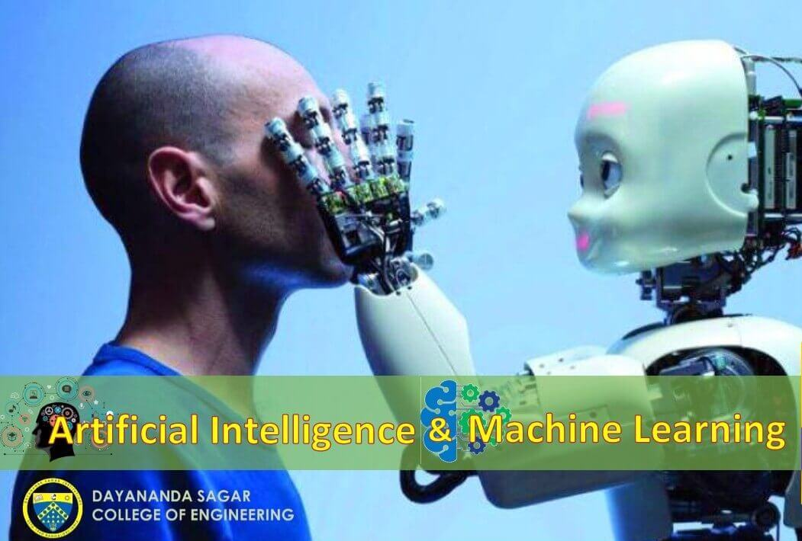
DAYANANDA SAGAR COLLEGE OF ENGINEERING
PROJECT NAME = Real time recognition of underwater image using deep learning technique
Pro. RAMYA
(Guide Name)
Dr . VINDHAYA
(Head of the Department)
Notes:
YAYASHVINI MAM

Slide 3
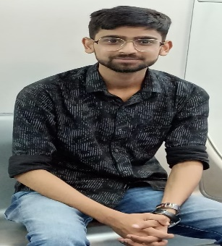



Team Members
Ayush Aditya (1DS20AI015)
Praveen Yadav
(1DS20AI042)
Yash Rathi
(1DS20AI057)
Om Prakash Kumar
(1DS21AI401)

Slide 4
PROJECT INTRODUCTION
This project is regarding the Real time recognition of underwater image using deep learning technique. The underwater environment is characterized by dynamic and unpredictable conditions, making traditional computer vision techniques inadequate for image recognition tasks. Deep learning, a subset of machine learning, has proven to be effective in handling complex visual data. This introduction explores the motivation behind employing deep learning techniques for underwater image recognition and highlights the potential benefits of real-time recognition.

Slide 5
PROBLEM STATEMENT
Given a set of underwater images with varying degrees of noise, distortion, and lighting conditions, the task is to develop an accurate and efficient image recognition system using artificial neural networks. The system should be able to classify the images into predefined categories such as different species of marine organisms, underwater objects, or environmental conditions

Slide 6
Literature Survey Table
TITLE | DESCRIPTION | PROBLEM WITH TECHNIQUE | AUTHOR
SWIPENET: Object detection in noisy underwater images | Feature Pyramid Networks | SWIPENET is still sensitive to noise in underwater images. This is because the model is trained on a dataset of noisy images, and it may not be able to generalize well to images with less noise. | LongChen, Feixiang Zhou, Shengke Wang.
Underwater Fish Detection using Deep Learning for Water Power Applications | Histogram of Oriented Gradients | But human analysis of video takes time, so some level of automation is needed to process large video data sets in a timely, efficient manner in order to provide information needed for permitting and adaptive management decisions | Wenwei Xu, Shari Matzner

Slide 7
Methodology
SVC stands for Support Vector Classification, which is a machine learning algorithm used for classification tasks. It belongs to a class of algorithms known as Support Vector Machines (SVMs).
In SVC, the algorithm creates a hyperplane or a set of hyperplanes in a high-dimensional space to separate different classes of data points. The goal is to find the hyperplane that maximizes the margin between the classes, effectively creating a decision boundary.
It classifies data by finding the optimal hyperplane that separates different classes. It aims to maximize the margin between data points and the decision boundary.
It can handle both linear and non-linear classification tasks through the use of different kernel functions.

Slide 8
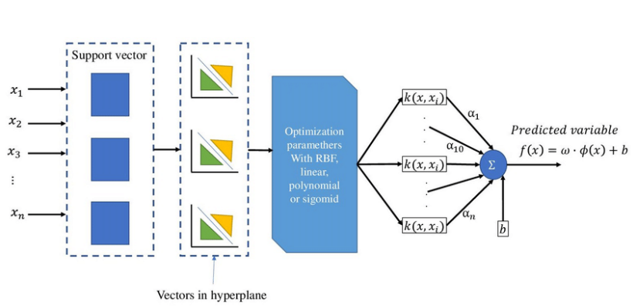
Methodology
Fig: SVC Architecture

Slide 9
Dataset Details
Kaggle- Underwater datasets of human and fish.
Kaggle is a data science competition platform and online community of data scientists and machine learning practitioners under Google LLC. Kaggle allows users to find datasets they want to use in building AI models, publish datasets, work with other data scientists and machine learning engineers, and enter competitions to solve data science challenges.
Roboflow-Label images datasets of human and fish.
Roboflow provides a free people detection API that, given an image, will return coordinates that represent the location of all of the people in an image. This API is hosted on Universe, home to over 110,000 datasets useful in training computer vision models, as well as 11,000 pre-trained models ready to useRoboflow empowers developers to build their own computer vision applications, no matter their skillset or experience.

Slide 10
DATASET LINKS
Roboflow:- https://public.roboflow.com/object-detection/fish
Roboflow: - https://universe.roboflow.com/search?q=underwater%20human
Kaggle:-https://www.kaggle.com/datasets/aungpyaeap/fish-market

Slide 11
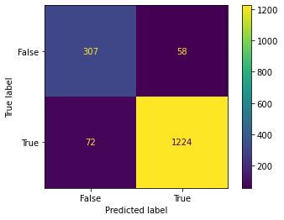
Result and Performance Metrics

Slide 12
CONCLUSION
In conclusion, underwater detection can be challenging due to various factors such as low visibility, poor lighting conditions, and color distortion. However, there are several approaches that can be used to improve the accuracy of image recognition for underwater images, such as data augmentation, preprocessing, transfer learning, object detection, ensemble learning, domain-specific datasets, and sensor fusion. A combination of these approaches can be used to develop a robust image recognition system that can accurately recognize objects in underwater environments. It is important to note that the specific approach used will depend on the specific requirements of the application, and further research and development are needed to improve the accuracy and reliability of image recognition for underwater images.

Slide 13
References
[1] SWIPENET: Object detection in noisy underwater images 19 Oct 2020 · Long Chen, Feixiang Zhou, Shengke Wang, Junyu Dong, Ning li, Haiping Ma, Xin Wang, Huiyu Zhou ·
[2]Underwater object detection using Invert Multi-Class Adaboost with deep learning 23 May 2020 · Long Chen, Zhihua Liu, Lei Tong, Zheheng Jiang, Shengke Wang, Junyu Dong, Huiyu Zhou
[3]Underwater Fish Detection using Deep Learning for Water Power Applications 5 Nov 2018 · Wenwei Xu, Shari Matzner ·
[4]. Chen, Z., Zhang, Z., Dai, F., Bu, Y., Wang, H.: Monocular vision-based underwater object detection. Sensors 17(8), 1784 (2017)
[5]. Cong, Y., Fan, B., Hou, D., Fan, H., Liu, K., Luo, J.: Novel event analysis for human-machine collaborative underwater exploration. Pattern Recognition 96, 106967 (2019) novel method of training a multi-species seagrass classifier using a dataset of single species photos, the emphasis is on classifying seagrass into key morphological super-classes, together with background.

Slide 14
INDIVIDUAL CONTRIBUTION
Common =Survey Paper , Report , Ppts
Ayush Aditya & Om Prakash =Testing and Real Time Integration.
Yash Rathi , Praveen Yadav =Dataset Collection and Model Classification.
.

Slide 15


