Slide 1


Slide 2


DAYANANDA SAGAR COLLEGE OF ENGINEERING
PROJECT NAME =PAYMENT GATEWAY SITE
TEAM MEMBERS=AYUSH ADITYA
Dr. PREETI SATISH
Professor & HEAD of the Department
GUIDE NAME=YAYASHVINI MAM
SANJANA MAM
Notes:
YAYASHVINI MAM

Slide 3
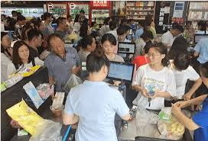

DEFINE PHASE
Write the Problem Statement what you have identified along with the Objectives?
PROBLEM STATEMENTS
The problem I have identified is about the people faces many PROBLEMS REGARDING PAYMENTS ESPECIALLY WHEN IT COMES TO OFFLINE. This is common problems in remote areas when banks are not set up people have to travel away from their hometown.
OBJECTIVE STATEMENTS
The objective of this problem is to make the payment in simplified way. Consumers the hassle-free experience they want at no cost .THEY DON’T NEED TO TRAVEL AWAY FROM THEIR HOMETOWN.

Slide 4



IDEATE PHASE
Write the solution strategy that you have come up with and feasibility of the project and also mention the hardware/software requirements for your project?
SOLUTION
The solution strategy that I have come with the why not I prepare an ONLINE PAYMENT SITE so that it would be very comfortable of the people especially living in the remote areas.
FEASIBILITY
The feasibility of this project is that is user friendly , simple and easy to implement. Their is extra charges will be applied on any amount of money as it is their in case of other payments sites.
REQUIREMENS
BANK DETAILS
HTML CSS FIGMA BOOTSTRAP

Slide 5


