Slide 1

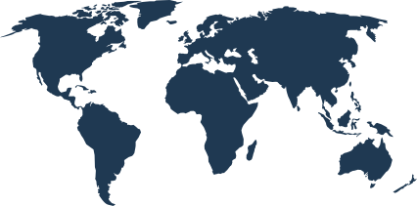

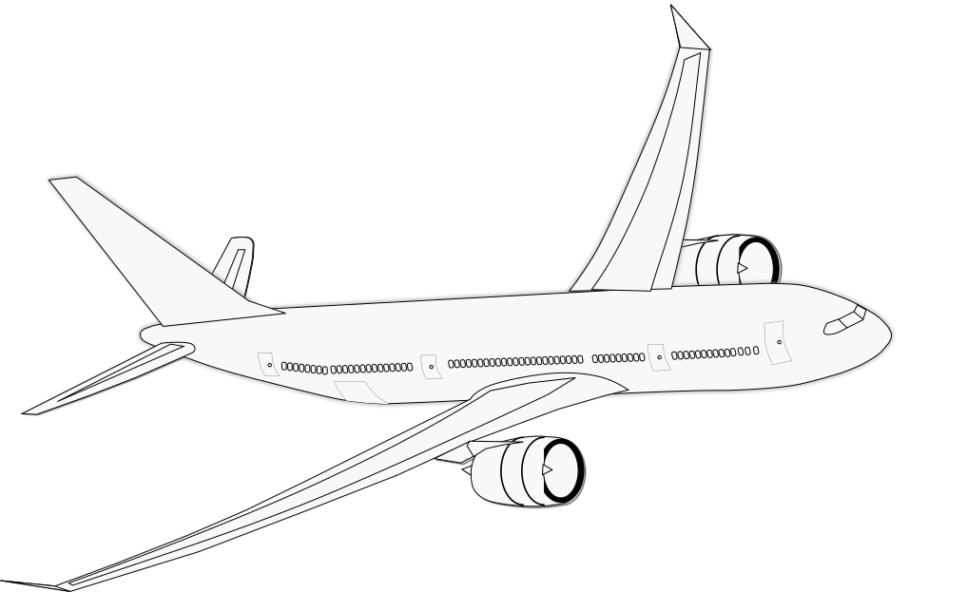


Plan • Protect • Save • Discover
Travel
Sphere
A Community Driven Travel & Safety Platform
Niharika Chawla
Ayush Gupta
Sarwar Singh Dhillon
Presented By
1024030762
1024030781
1024030862

Slide 2
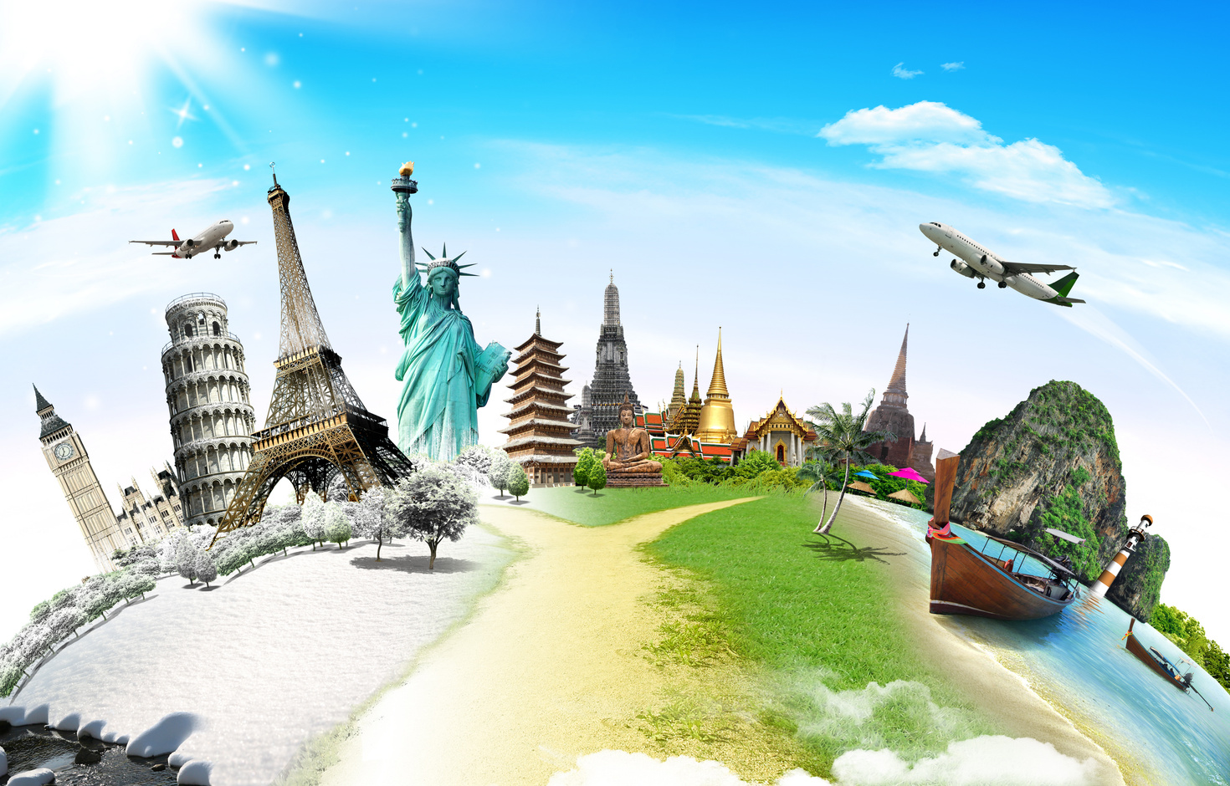

INTRODUCTION
TravelSphere is a smart, community driven travel platform designed to make traveling easier, safer, and more organized. It brings important travel needs such as trip planning, safety updates, budgeting, travel information, and connecting with other travelers together in one place.

Slide 3


MOTIVATION
Simplify Travel Planning
Make Travel Smarter & Safer
Bring trip planning, itineraries, navigation, weather, and travel information into one platform.
Help users make informed decisions, manage their budget, avoid potential risks, and enjoy better travel experiences.
Build a Travel Community
Provide Real-Time Information
Enable travelers to share experiences, recommendations, alerts, and connect with people visiting the same destination.
Help travelers stay updated about weather, road conditions, safety concerns, and local situations.

Slide 4
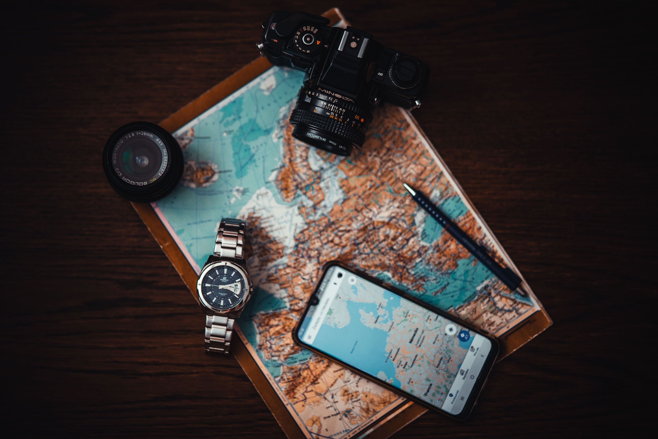
PROBLEM STATEMENT
Currently, travel information is spread across many different platforms. Navigation apps, social media, travel blogs, safety services, and budgeting apps each solve only part of the problem. This makes it difficult for travelers to find updated and trustworthy information, manage their trip efficiently, stay aware of safety concerns, and connect with other travelers in one place.

Slide 5

OUR SOLUTION
TravelSphere brings these different travel needs into a single platform. Users can plan their trips, create itineraries, track expenses, receive location-based safety and community alerts, connect with fellow travelers, and discover new places through shared experiences. The platform aims to help travelers Plan smarter, Protect themselves, Save time and money, and Discover with confidence.

