Slide 1
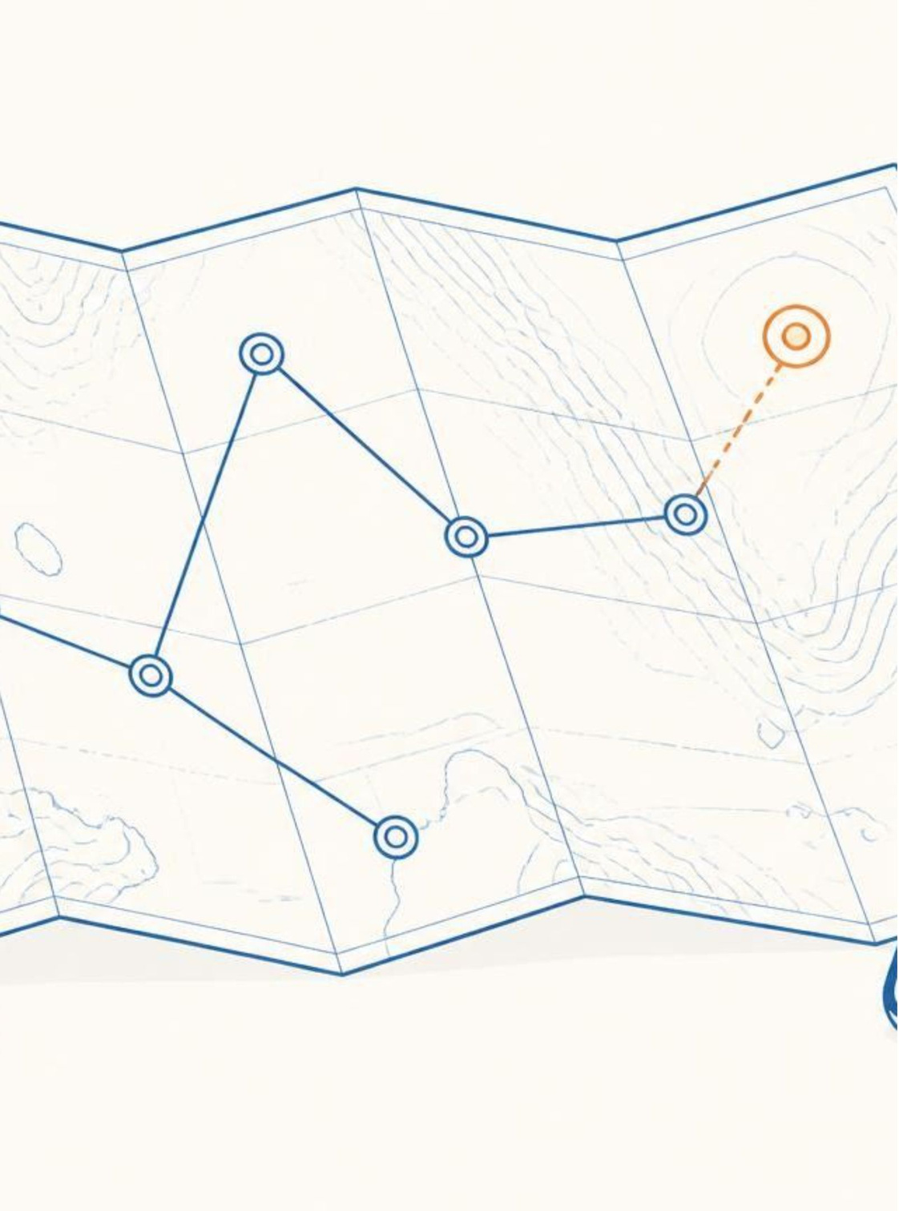

TRAVEL SPHERE
PROTOTYPE
Plan • Protect • Save • Discover
  A unified platform for discovering destinations, planning trips, and sharing travel experiences.
  Designed to make travel planning personalized and convenient.
  Core prototype areas: Explore, Trip Planning, Posts, User Profiles.
  Current status: Frontend and backend integration in progress.
Notes:
1

Slide 2






WHAT OUR PROTOTYPE OFFERS
User Authentication — Registration and Login
Explore — Discover destinations and travel content
Trip Planning — Create and manage travel plans
Posts — Share travel experiences
Interactions — Like and engage with posts
Profile — View user information and activity
FLOW
Discover → Plan → Experience → Share
Notes:
2

Slide 3
HOW TRAVEL SPHERE WORKS
01
02
03
04
Login / Signup
Explore Destinations & Posts
Select / Plan a Trip
Manage Trip Details
05
06
07
Travel & Experience
Share Experience
Interact with the Travel Community
Frontend → Backend → Database
Frontend
Backend
Database
Frontend handles user interaction and UI.
Backend processes requests and application logic.
Database stores users, trips, posts, and related data.
Notes:
3

Slide 4
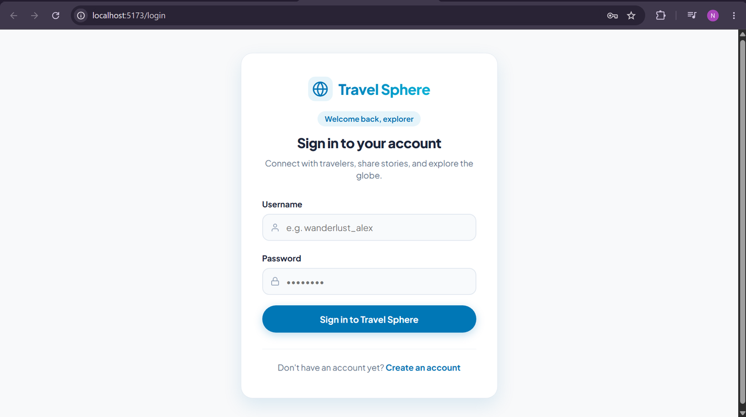
PROTOTYPE DEMO
ROADMAP
Current Prototype
Next Steps
  Functional UI for major screens
  Frontend-backend communication
  User and travel content management
  Core navigation and interaction flows
  Complete remaining backend functionality
  Improve personalization/recommendations
  Testing and bug fixing
  UI/UX refinement
  Final integration and deployment
Building a complete end-to-end travel experience with Travel Sphere.
Notes:
4

