Slide 1
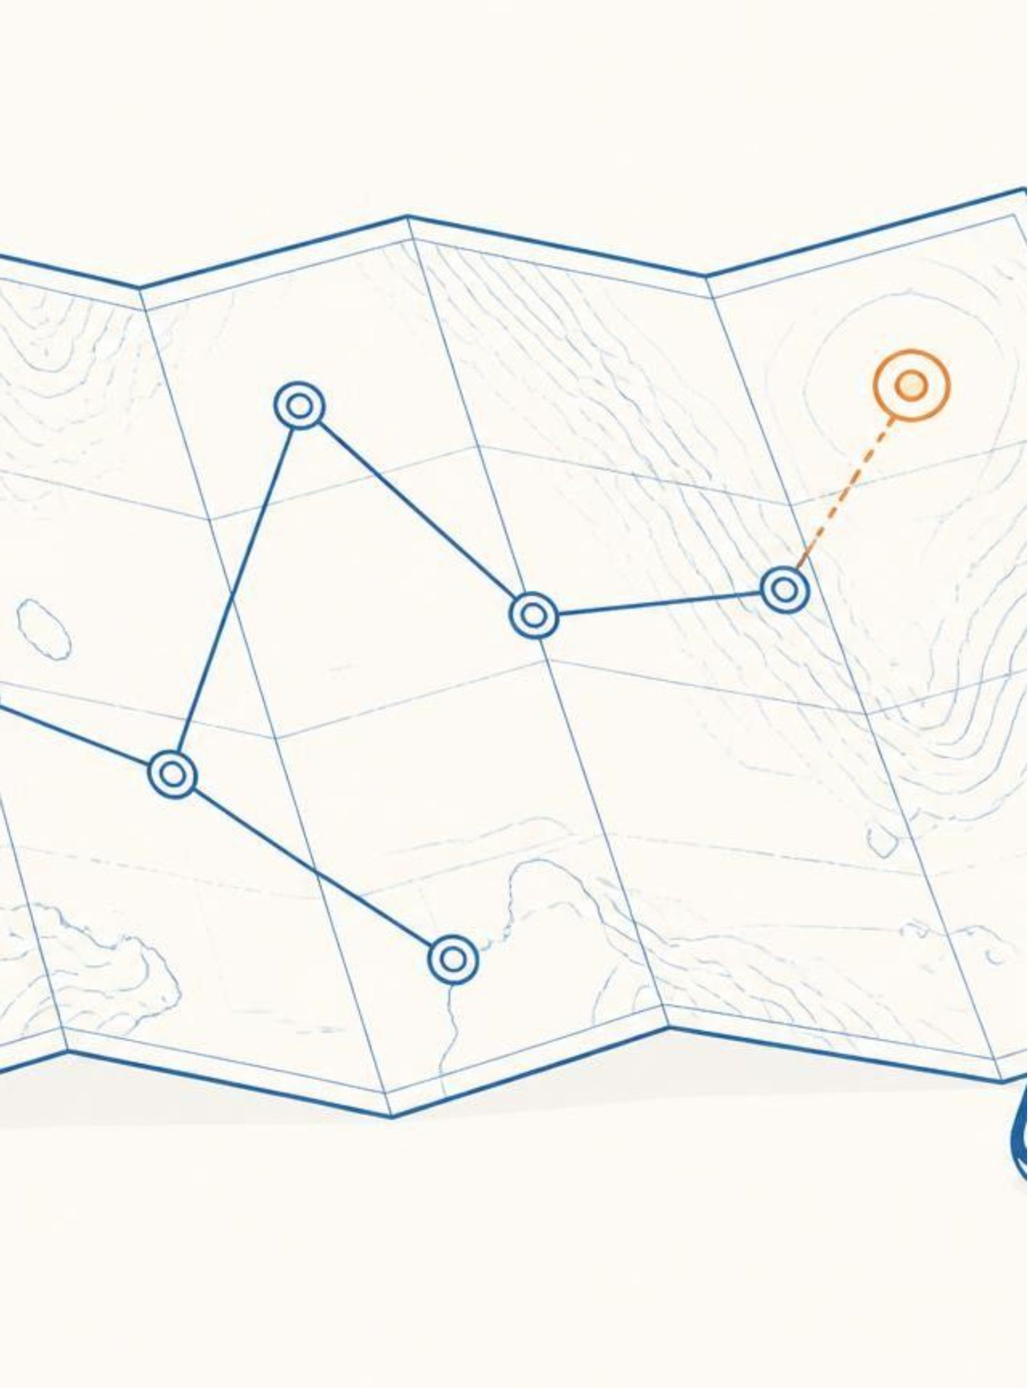
TRAVEL SPHERE
PROTOTYPE
Plan • Protect • Save • Discover
A unified platform for discovering destinations, planning trips, and sharing travel experiences.
Designed to make travel planning personalized and convenient.
Core prototype areas: Explore, Trip Planning, Posts, User Profiles.
Current status: Frontend and backend integration in progress.

Slide 2





WHAT OUR PROTOTYPE OFFERS
User Authentication — Registration and Login
Explore — Discover destinations and travel content
Trip Planning — Create and manage travel plans
Posts — Share travel experiences
Interactions — Like and engage with posts
Profile — View user information and activity
FLOW
Discover → Plan → Experience → Share

Slide 3
HOW TRAVEL SPHERE WORKS
01
02
03
04
Login / Signup
Explore Destinations & Posts
Select / Plan a Trip
Manage Trip Details
05
06
07
Travel & Experience
Share Experience
Interact with the Travel Community
Frontend → Backend → Database
Frontend
Backend
Database
Frontend handles user interaction and UI.
Backend processes requests and application logic.
Database stores users, trips, posts, and related data.

Slide 4
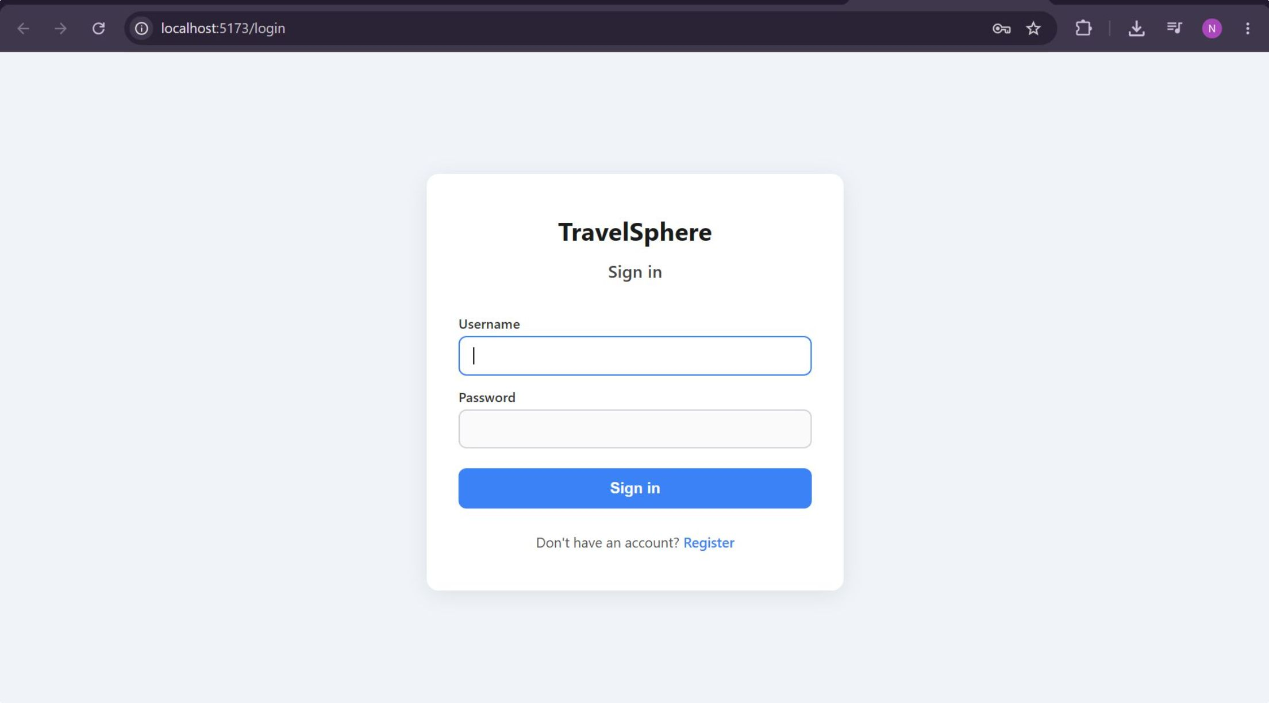
PROTOTYPE DEMO
ROADMAP
Current Prototype
Next Steps
Functional UI for major screens
Frontend-backend communication
User and travel content management
Core navigation and interaction flows
Complete remaining backend functionality
Improve personalization/recommendations
Testing and bug fixing
UI/UX refinement
Final integration and deployment
Building a complete end-to-end travel experience with Travel Sphere.

