Slide 1
EduTek
01
02
Introduction
Description
REACT
NODE
03
04
Presented By : Anik Roy (2115800003)
Ayush Tiwari (2115800008)
Luvkush Sharma (2115800015)
Submitted to : Mr. Sanjay Madan
Security Measure
Future Goals

Slide 2
01
Introduction

Slide 3
Technologies
02
Next.Js
Express.Js
Node.js
MongoDB Atlas
Redis
Cloudinary
RTK Query
Description

Slide 4
02
Feature

Slide 5
Features
User Dashboard:
Personalized user interface for learners.
Access to enrolled courses
Secure video playback with DRM encryption.
Interactive features such as Q&A and course reviews.
Admin Dashboard:
Comprehensive control panel for course administrators.
Course creation and management.
User management, including enrollment and permissions.
Real-time analytics for course performance and user engagement.
Live Classes:
Real-time Interaction: EduTek offers live video classes, allowing students and instructors to engage in real-time, enhancing the learning experience with immediate feedback and interaction.

Slide 6
Features
Security Measures:
Video Cipher technology to prevent unauthorized access, recording, or downloading of course videos.
DRM encryption to protect course content from piracy and unauthorized distribution.
Payment Gateway Integration:
Seamless integration with Stripe for secure and convenient payment processing.
Multiple payment options for users' convenience.
Notification System:
Real-time notifications for course administrators about user activities, course enrollments, and purchases.
Alerts for new questions, reviews, and interactions from users.
Question & Answer Feature:
Interactive platform for users to ask questions and receive responses from course instructors or administrators.
Encourages engagement and fosters a collaborative learning environment.

Slide 7
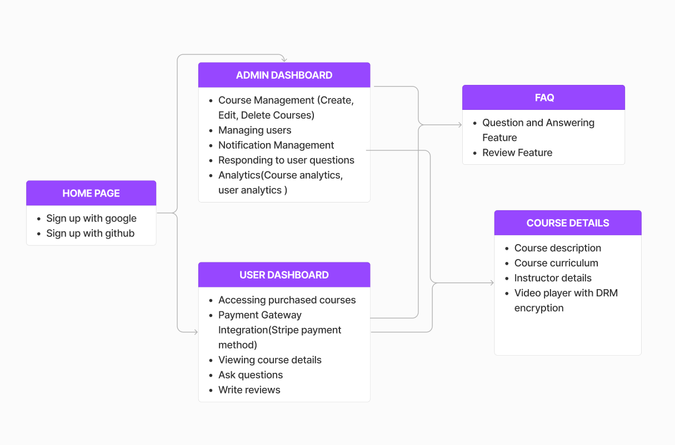

Slide 8
03
Competitors

Slide 9
Competitors
Coursera
A leading online learning platform offering a wide range of courses from top universities and institutions worldwide. Coursera provides certification upon course completion and features interactive learning experiences.
Udemy:
Known for its vast library of courses taught by industry experts, Udemy offers both free and paid courses across diverse subjects. It emphasizes self-paced learning and allows instructors to create and monetize their courses.

Slide 10
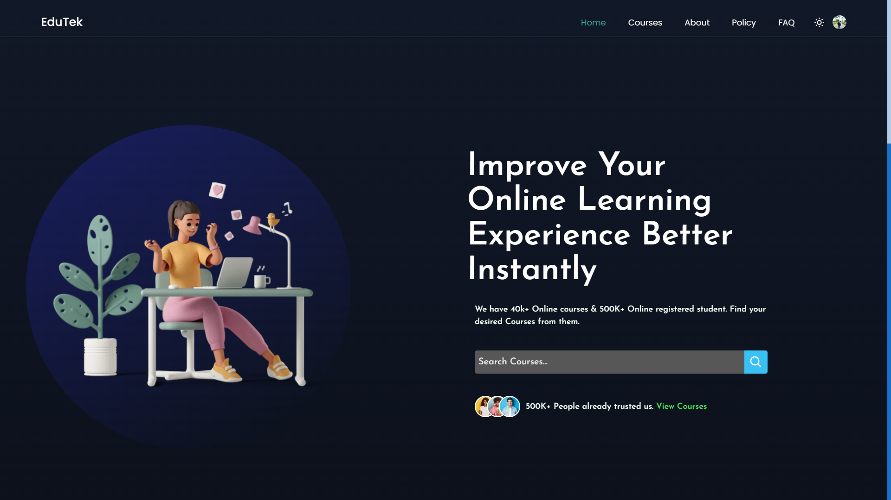

Slide 11
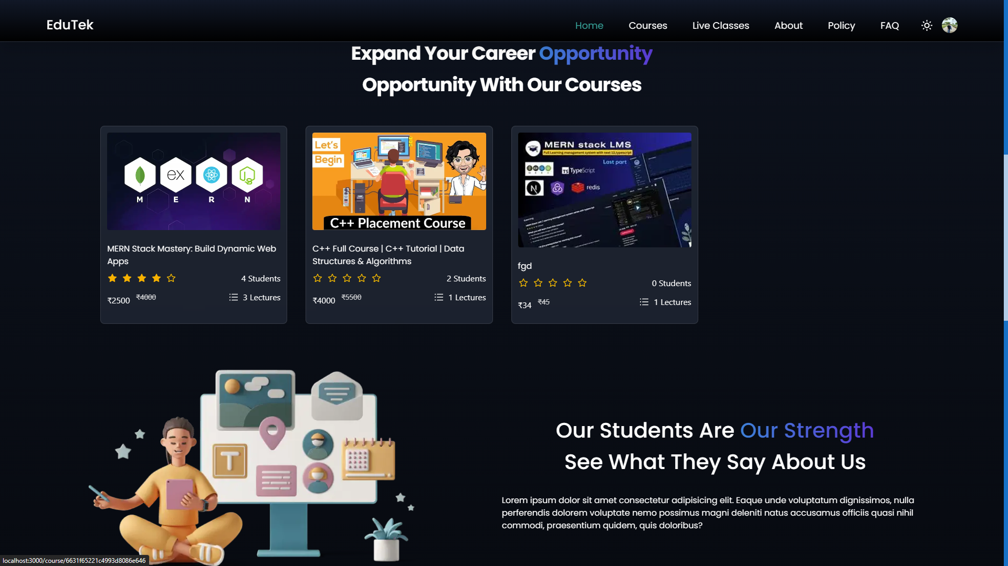

Slide 12
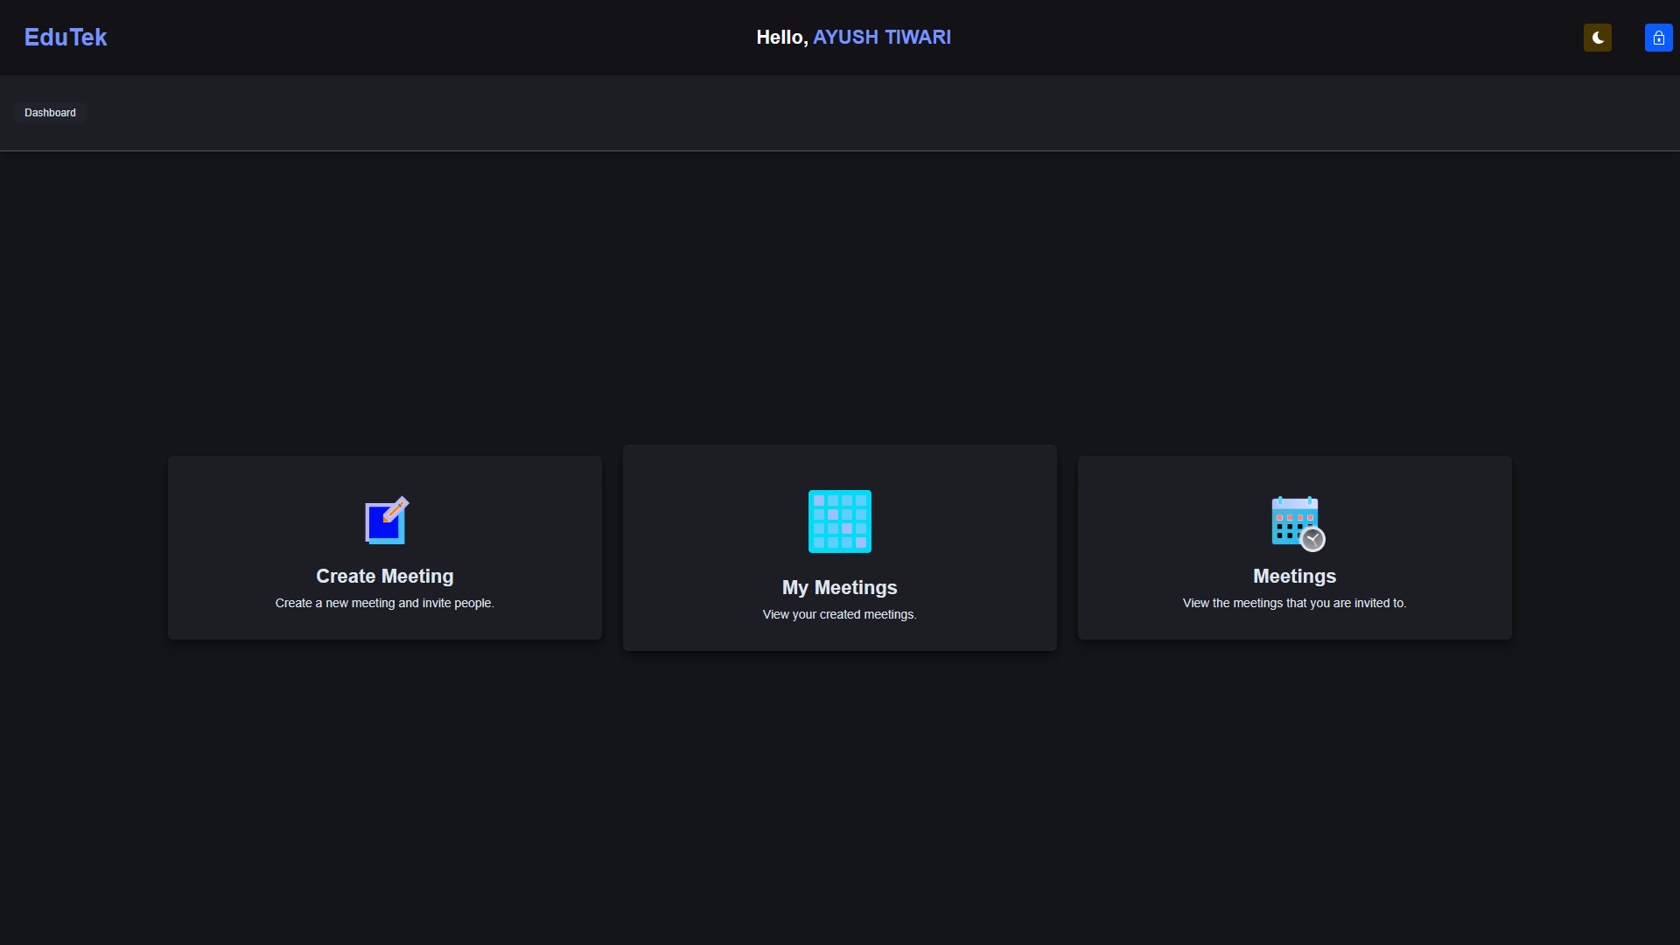

Slide 13
Thanks!

