Slide 1

A Project Presentation on
MOVIE REVIEW ANALYSIS AND RECOMMENDATION SYSTEM
Department of Information Technology
United Institute Of Technology, Naini, Prayagraj(284)
Under the Guidance: Submited By:
Mr.Shobit Kumar Ayush Srivastava(Roll No.:1628413008)
(Assistant professor) Akhilesh kumar Pal(Roll No.:1628413003)
Anubhav Srivastava(Roll No.1628413005)

Slide 2
TABLE OF CONTENT
Introduction
About the project
Requirements
Module Description
Zero level DFD
LEVEL 1 DFD
Er diagram
Flow Chart
Snap shots
Future Scope

Slide 3
INRODUCTION
Now day’s number of movie released in a particular day and different person has different choices to watch them but it is really difficult for a user to choose which movie is best for them to invest money and time to watch it. So the people are required a genuine opinion and reaction of people who already know about the movie after the release which helps them to decide which one is better to watch it.

Slide 4
ABOUT THE PROJECT
Reason for implementation of our system:
The scenario where movie is average, star ratings prove bit confuse for any user. They don’t get clear views of what the other users think of that movie.
Idea behind the system:
our system is a movie review system which will generate polarity graph related to the movies which are released. The system will generate better polarity after analyzing the user review. Also our system will provide star ratings too.

Slide 5
HARDWARE AND SOFTWARE REQUIREMENTS
FRONT-END
HTML
Django
BACK-END
Python
Machine learning
HARDWARE REQUIREMENT
Processor-i3
Hard disk-5GB
Memory-1GB

Slide 6
MODULE DESCRIPTION
Admin: This module contain specific task to manage the activity perform by different user, and to ensure the proper working of system.
User: This module will authenticate the users. It makes every user unique. Simply the user has to give input as the movie name and the review analysis in the form of rating and graph will provide as output.
Login: login modules contains the login id and password which will authenticate the user as well as admin .

Slide 7
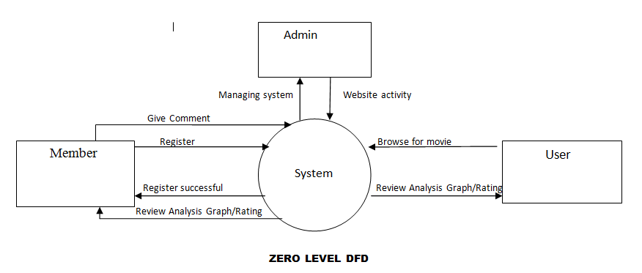
DATA FLOW DIAGRAM

Slide 8
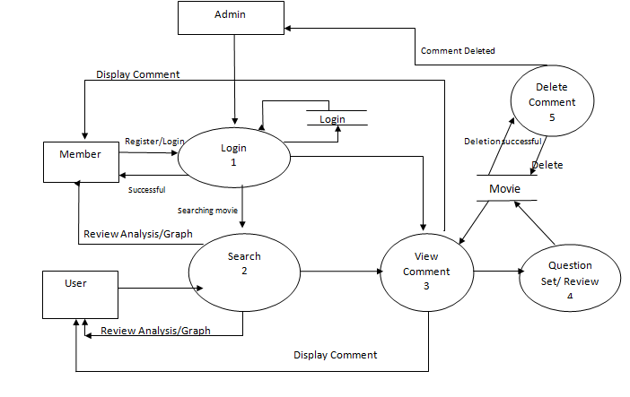
level 1 DFD

Slide 9
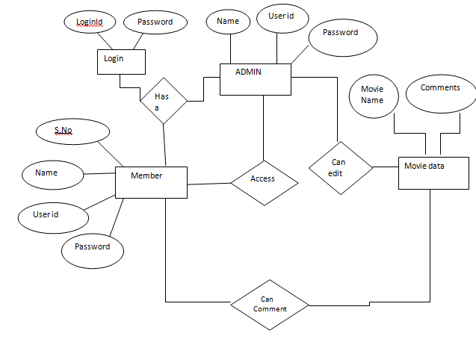
ER DIAGRAM

Slide 10
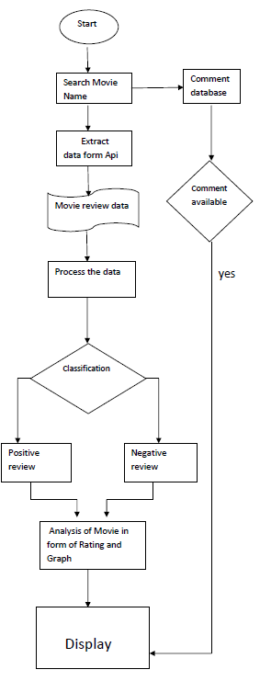
FLOW CHART:
neutral

Slide 11
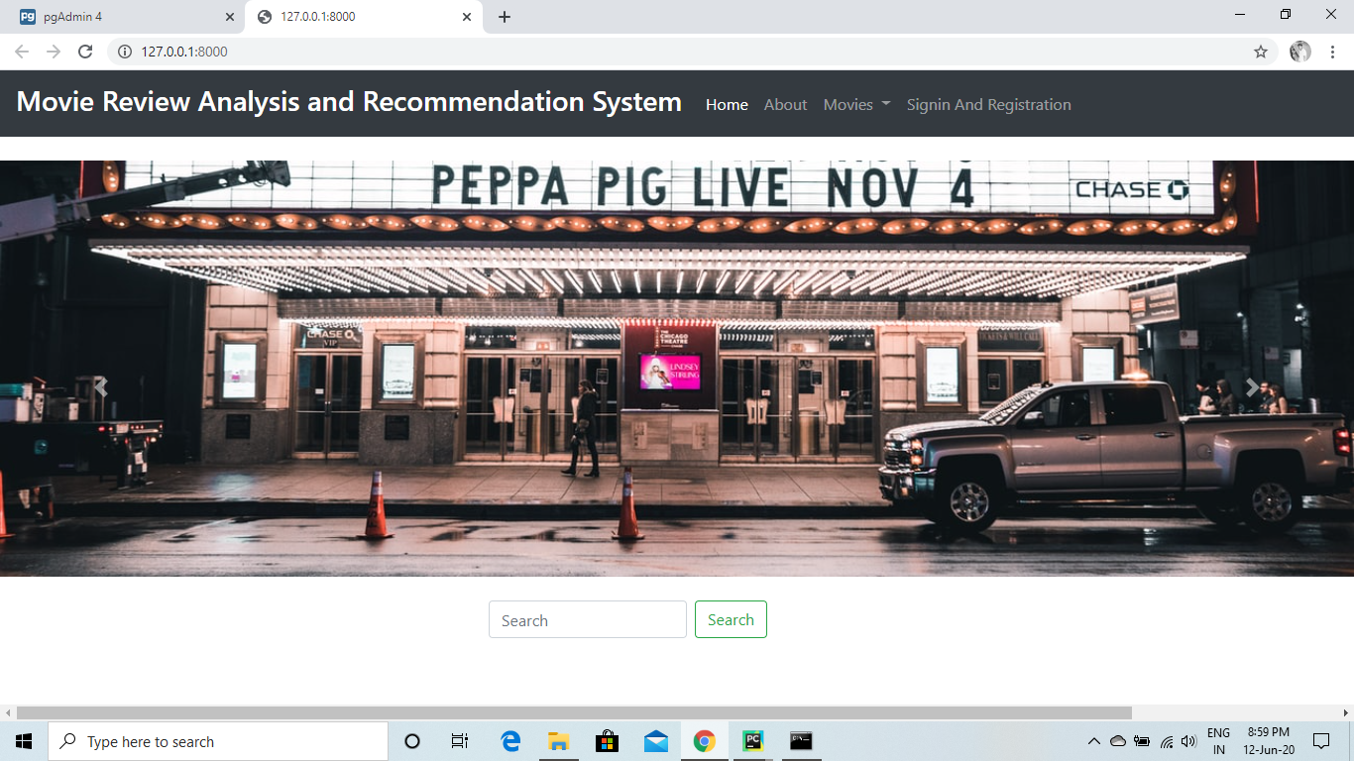
SCREENSHOTS

Slide 12
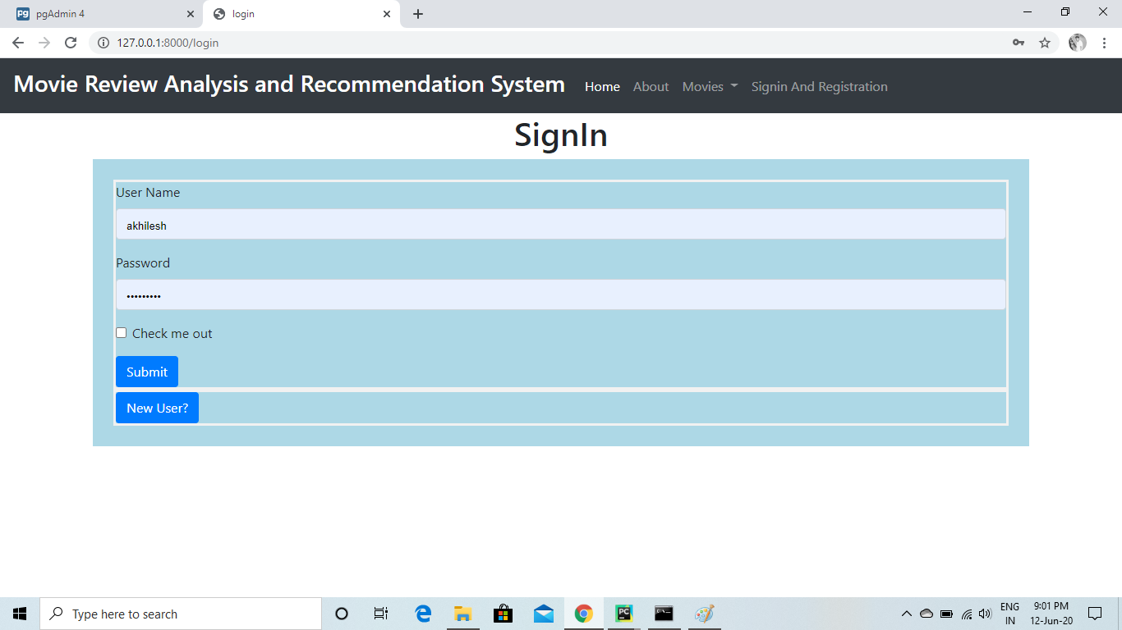
SIGN IN PAGE

Slide 13
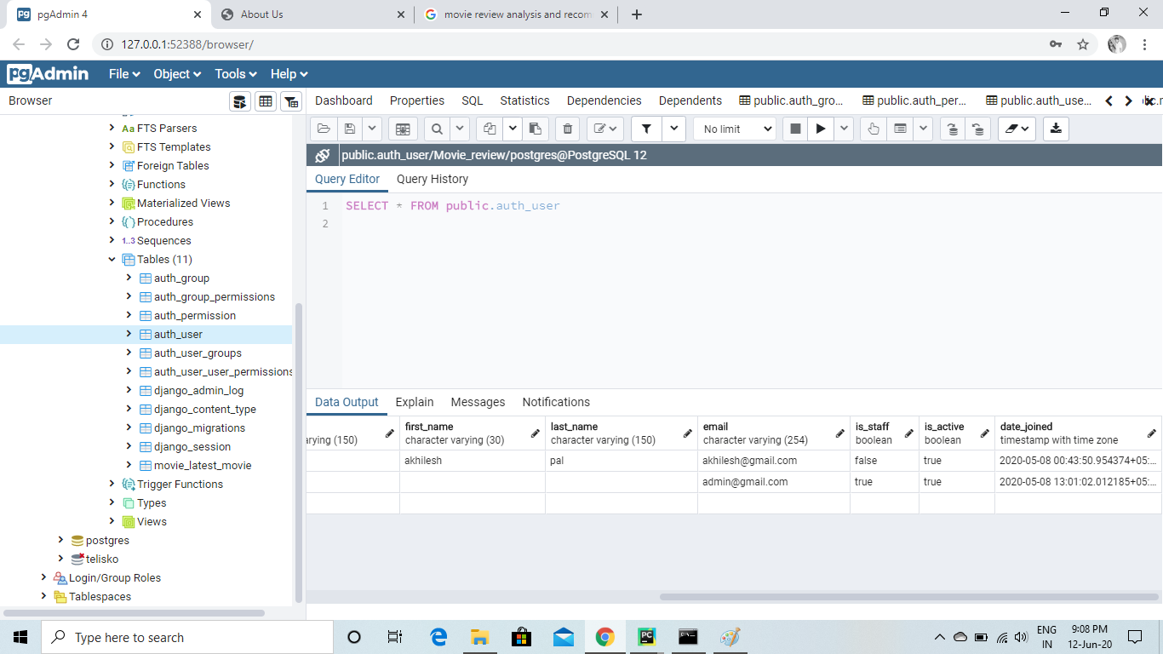
DATABASE

Slide 14
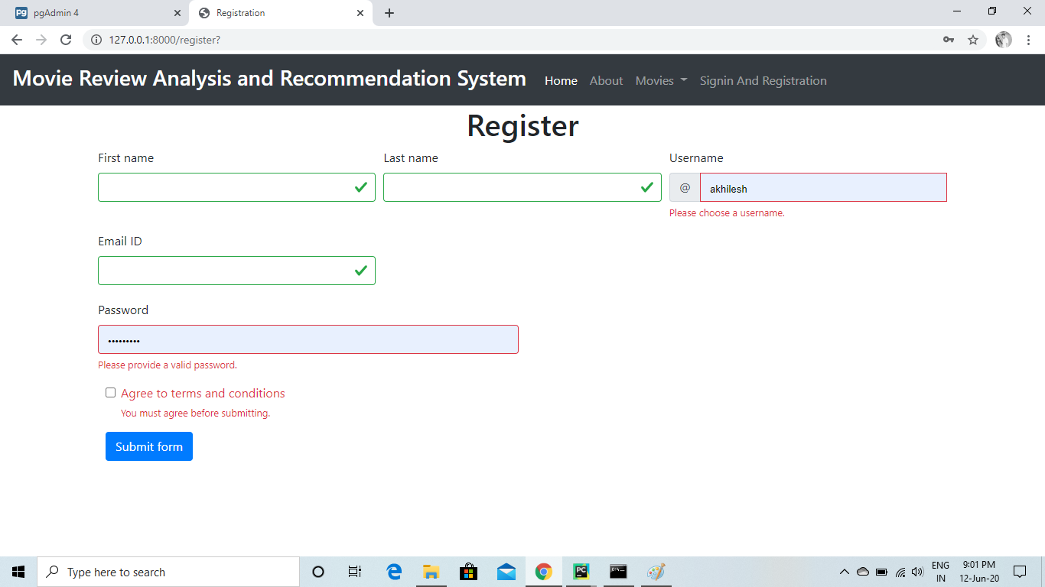
REGISTER PAGE

Slide 15
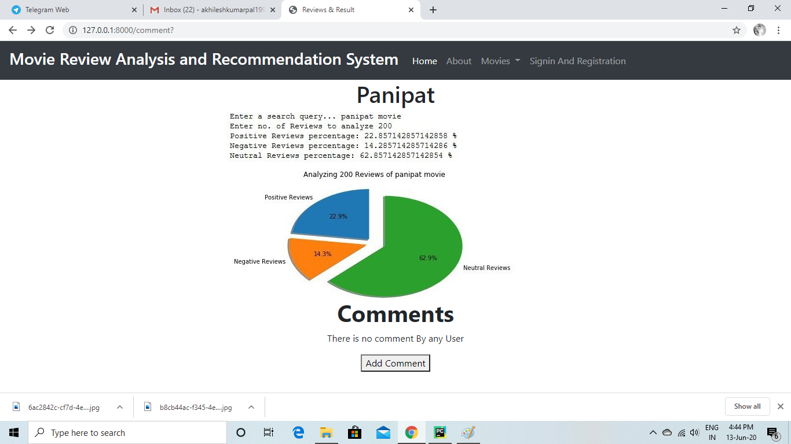
Output page

Slide 16
Future scope
This project will give clear view about the movie how the movie is and what the people think about that particular movie the whole analysis will be provided to the user which will be beneficial for them to choose a good movie to watch.
In this system a person can search all categories of movies.
In future we are able to provide booking of movie tickets.
We also provide the reward points to our member for the reviews.

