Slide 1
RetinaAI
Predicting Student Dropout Risk with Multimodal Machine Learning
[Tabular Academic Data + Attendance Time-Series + Counsellor Notes (NLP)]
Ayush Saini
B.Tech, Computer Science & Engineering (AI & ML)

Slide 2
Problem Statement
Student dropout is a major challenge for educational institutions. Early indicators are often scattered across separate systems, which delays timely intervention.
Why it matters
Enable proactive academic & financial support
Improve retention and graduation rates
Give counsellors a unified, data-driven signal
Replace single-indicator guesswork with a holistic, multimodal view
Goal: classify each student into a dropout risk category
Low Risk
Medium Risk
High Risk
2

Slide 3
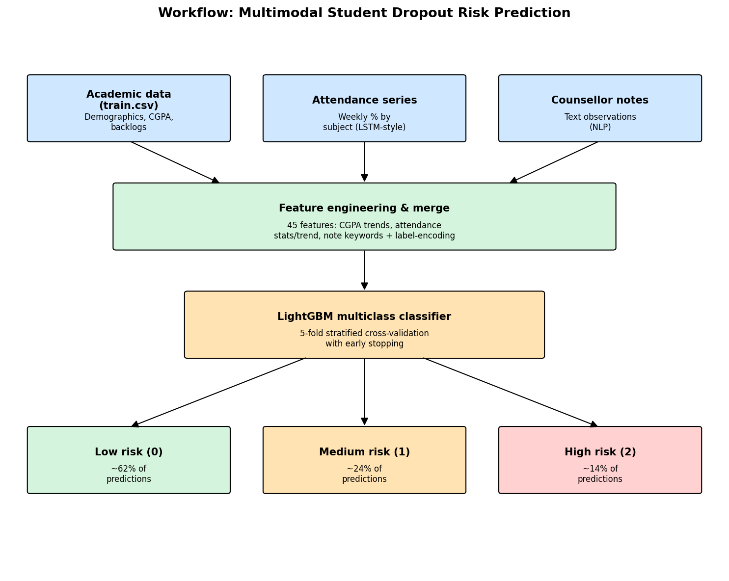
Project Workflow
3

Slide 4
Multimodal Data Sources
1
2
3
Tabular Academic Data
Attendance Time-Series
Counsellor Notes (NLP)
Branch, gender, hostel, family income, parent education, scholarship, part-time job, CGPA (sem 1-4), backlogs
Weekly attendance % per subject and semester — trend & consistency signals
Short text observations from counsellors — keyword and category signals
4

Slide 5
Feature Engineering
Academic
Backlogs
CGPA mean / std / min, CGPA trend (sem4 - sem1)
Total backlogs, backlog trend across semesters
Attendance
Counsellor Notes
Mean/std/min/max, per-semester & per-subject means, trend slope (vectorized regression), recent-semester attendance
Label-encoded note category, 10 binary keyword flags (stress, backlog, demotivated, financial, etc.)
5

Slide 6
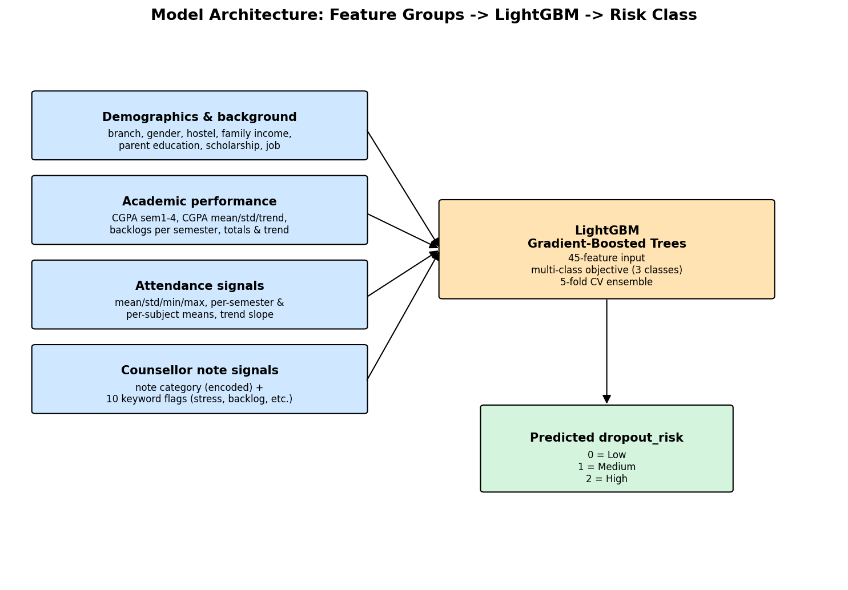
Model Architecture
6

Slide 7
Training & Evaluation Methodology
Model
Why Macro F1?
LightGBM multiclass classifier
45 engineered features as input
Objective: 3-class softmax (multi_logloss)
The target classes are imbalanced (~60% Low, ~25% Medium, ~15% High). Accuracy alone can look good while ignoring the minority classes. Macro F1 weights all three classes equally, giving a fairer view of how well the model identifies Medium and High risk students.
Validation Strategy
Stratified 5-Fold Cross-Validation
Avoids data leakage; preserves class balance per fold
Early stopping on held-out fold each round
Class Distribution (Train)
Low: 60% Medium: 25% High: 15%
7

Slide 8
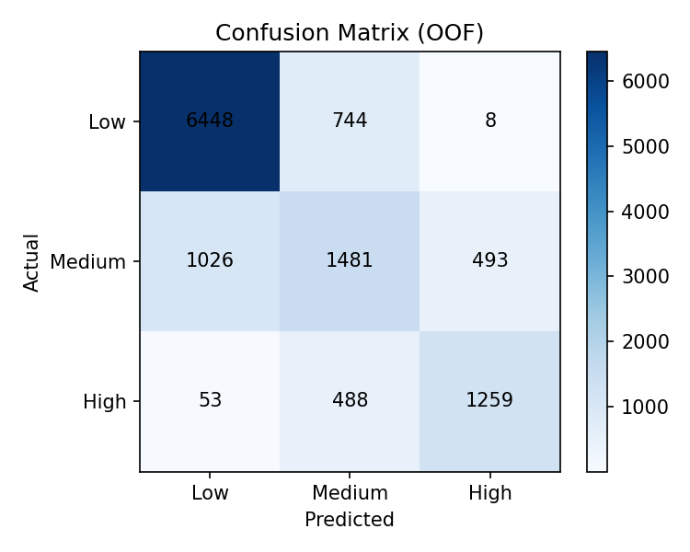
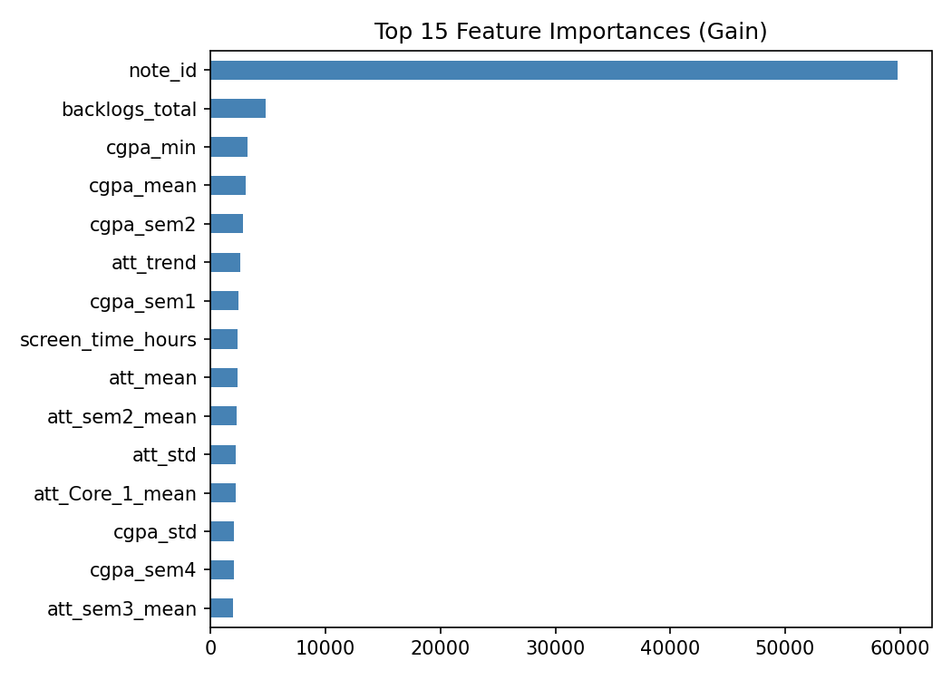
Model Performance
76.53%
0.7005
5
5-Fold CV Accuracy
Macro F1 Score
Stratified Folds
8

Slide 9
Key Insights & Challenges
Top Predictors
Challenges Faced
CGPA trend and mean
Attendance trend & recent-semester attendance
Total backlogs
Counsellor note keywords (stress, dropout mention)
Family income & parent education
Vectorizing attendance trend computation across ~15,000 students for speed
Extracting signal from a small set of repetitive counsellor note phrases
Balancing performance across all three imbalanced risk classes
Building & validating the full pipeline within a strict one-hour deadline
9

Slide 10
Conclusion & Future Scope
Conclusion
Future Scope
RetinaAI demonstrates that combining tabular academic data, attendance trends, and counsellor-note signals into a single LightGBM model produces a reliable, fast, and reproducible dropout risk classifier - achieving 76.5% accuracy and 0.70 macro F1 under a strict hackathon time constraint.
Transformer-based embeddings for counsellor notes
LSTM/GRU sequence modeling on raw attendance series
Ensembling with CatBoost / XGBoost
Real-time faculty/counsellor dashboard
LMS integration for institutional deployment
Thank you
10

