Slide 1

Analysis of Unemployment Trends
In India during 2020
Guided By:-
Dr. Mridu Sahu (Asst. Prof. NIT Raipur)
Dr. Govind Gupta (Asst. Prof. NIT Raipur)
Project By:-
Ayush Singh - CEC_131
Abhishek Kumar - CEC_132
Aditya S Sarkar – CEC_134
Chokkapu Gowriswara Rao – CEC_136

Slide 2
Overview
This presentation provides a comprehensive analysis of unemployment trends across various regions in India up to November 2020. The data includes estimated unemployment rates, employment numbers, and labor participation rates. Below is a detailed outline of the content covered in this presentation:
Dataset Description:
The dataset includes monthly unemployment statistics for different states and regions in India.
Key metrics include the Estimated Unemployment Rate (%), Estimated Employed, and Estimated Labour Participation Rate (%).
The data spans from the beginning of 2020 up to November 2020, capturing the impact of the COVID-19 pandemic.
Objectives of the Analysis:
To identify trends in unemployment rates over time, particularly before and during the COVID-19 pandemic.
To compare unemployment rates across different regions and states in India.
To assess the impact of the COVID-19 pandemic on employment and labor participation rates.
To provide insights that can help policymakers address unemployment issues effectively.
Tools used – Python Libraries for Data Preprocessing & Visualization, MS Power BI for Report Making

Slide 3
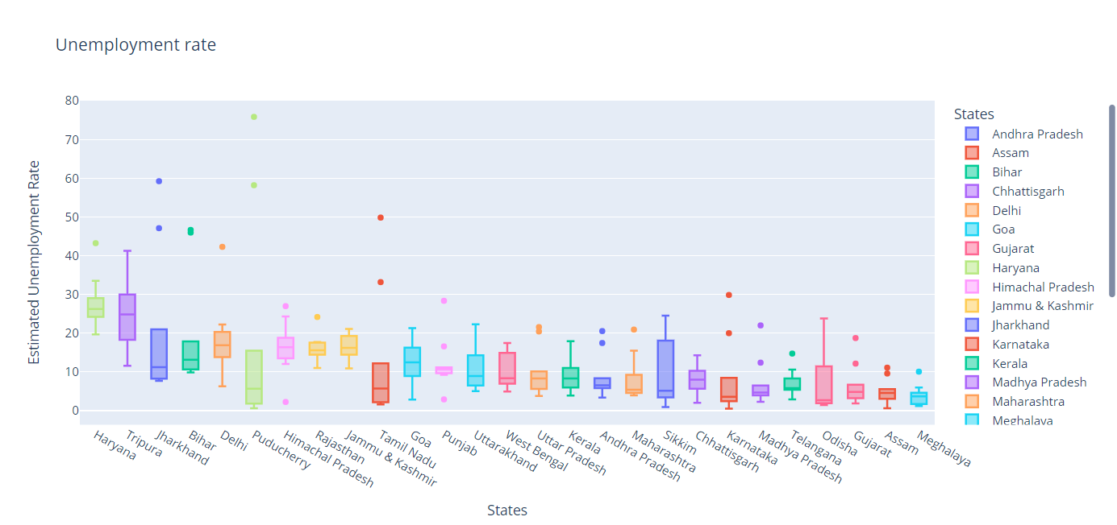

Slide 4
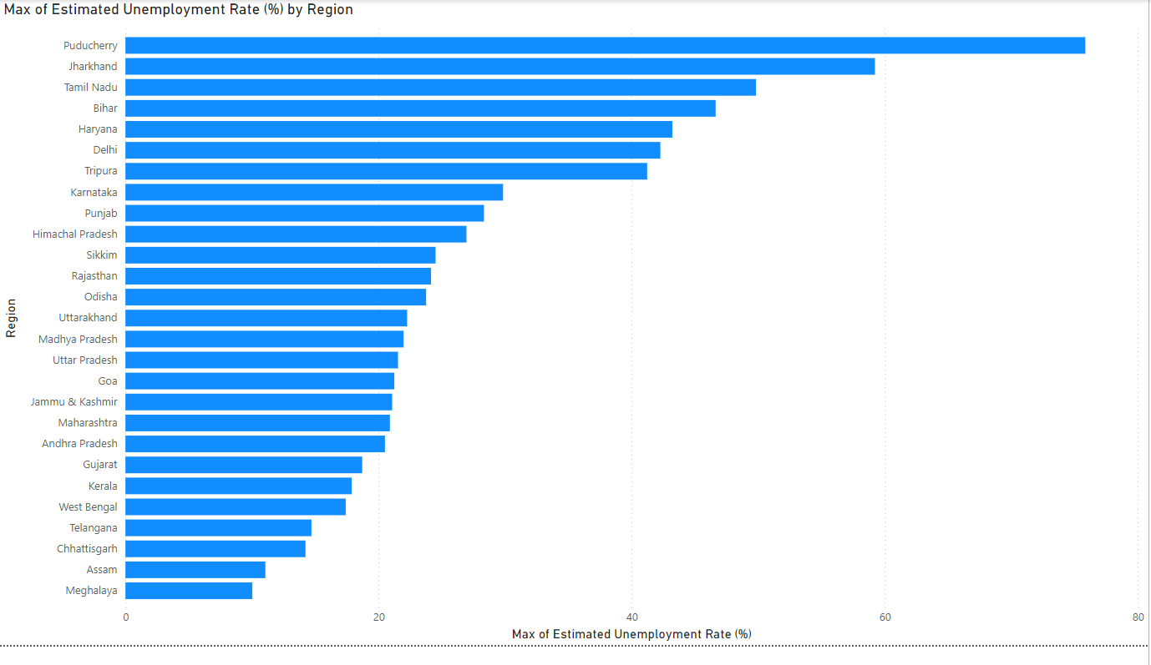

Slide 5
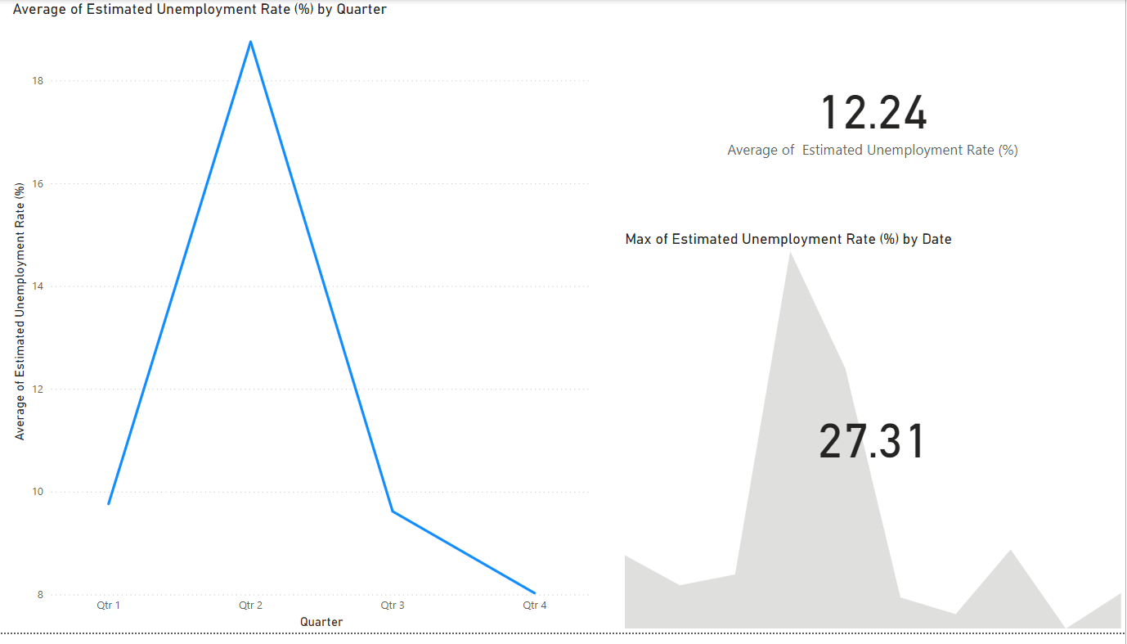

Slide 6
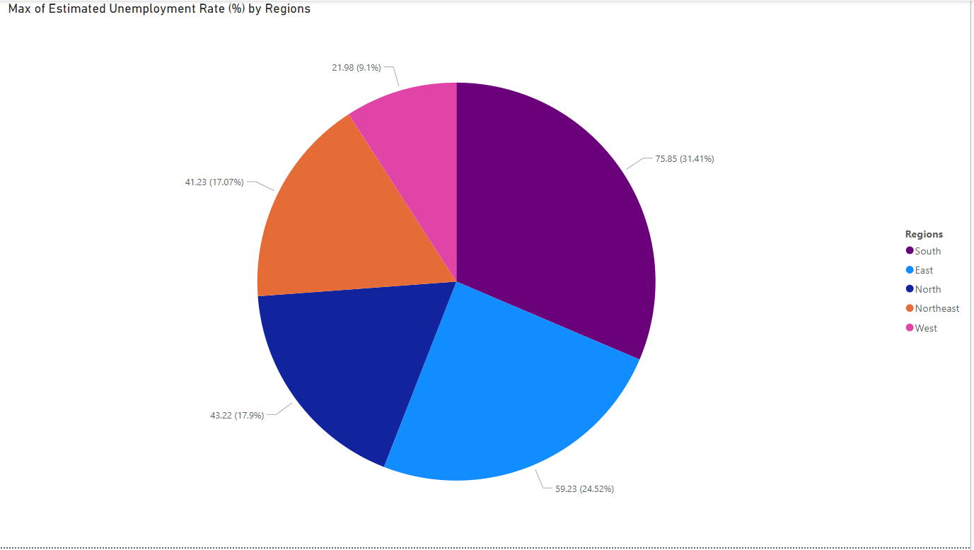

Slide 7
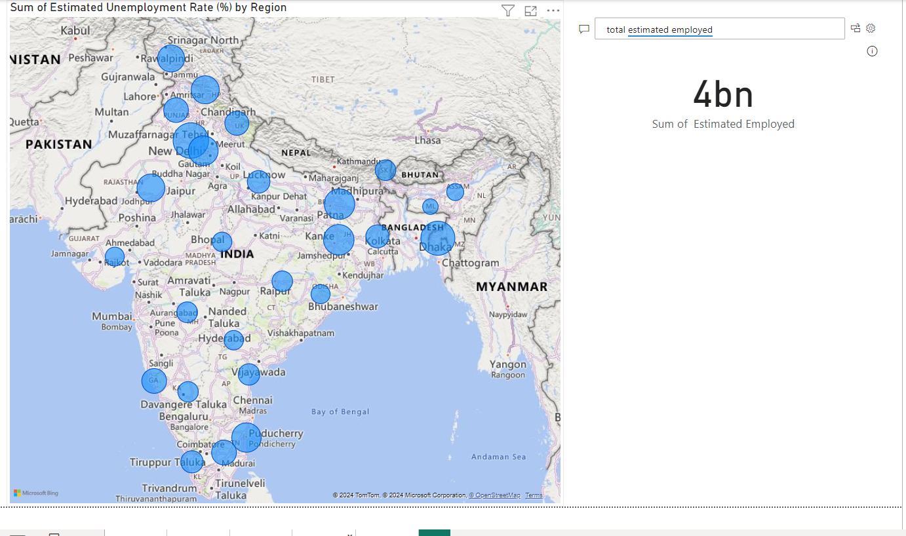

Slide 8
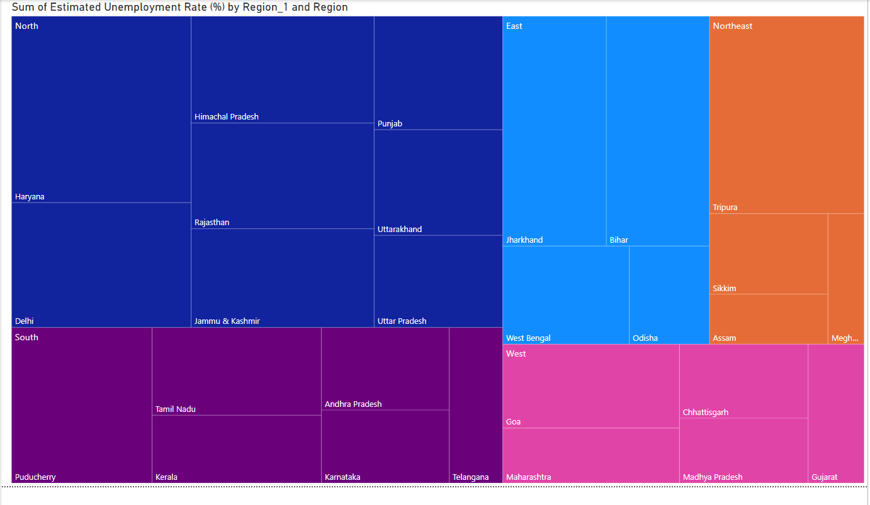

Slide 9
Key INSIGHTS
Haryana & Tripura have the highest Average Unemployment Rate in 2020
The NORTH Region was the most affected due to COVID-19 crisis, Delhi & Haryana being the largest contributors
Most impacted States/Union Territories :-
Puducherry
Jharkhand
Bihar
Haryana
Tripura

Slide 10
References
Dataset used - https://www.kaggle.com/datasets/gokulrajkmv/unemployment-in-india
Python Code - https://colab.research.google.com/drive/1Synq8BD1q0PRZ0UgYyh-F_EzxJscND29

Slide 11
THANK YOU

