Slide 1


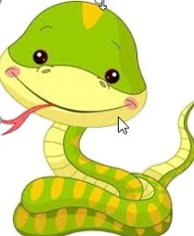
www.Shyamsir.com 78 74 39 11 91
www.Shyamsir.com

Slide 2

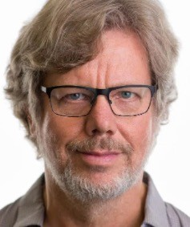
Remember that
Python is a programming language
Guido van Rossum
www.Shyamsir.com

Slide 3
Characteristics
Python is General purpose , High Level , Interpreted Language.
It’s Open Source - Free
Rich Libraries
Portable
Easy to learn
Supports Object Oriented concept
Many types of Applications we can create with the help of python
www.Shyamsir.com

Slide 4
Extension
.Py
www.Shyamsir.com

Slide 5
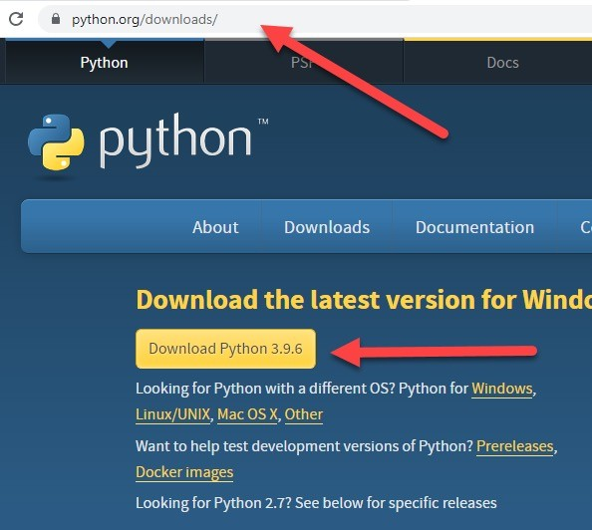
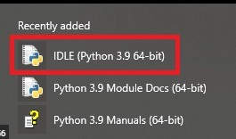
Editor - IDLE
https://www.python.org/downloads/
www.Shyamsir.com

Slide 6
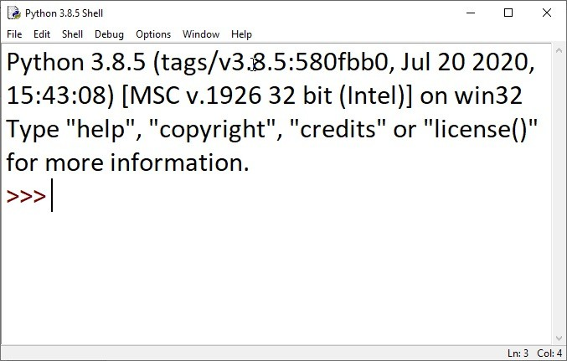
Editor - IDLE
www.Shyamsir.com

Slide 7
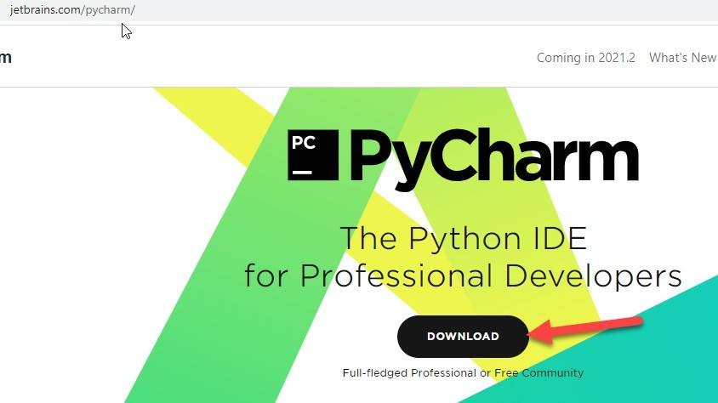
Editor - PyCharm
https://www.jetbrains.com/pycharm
www.Shyamsir.com

Slide 8
www.Shyamsir.com

Slide 9
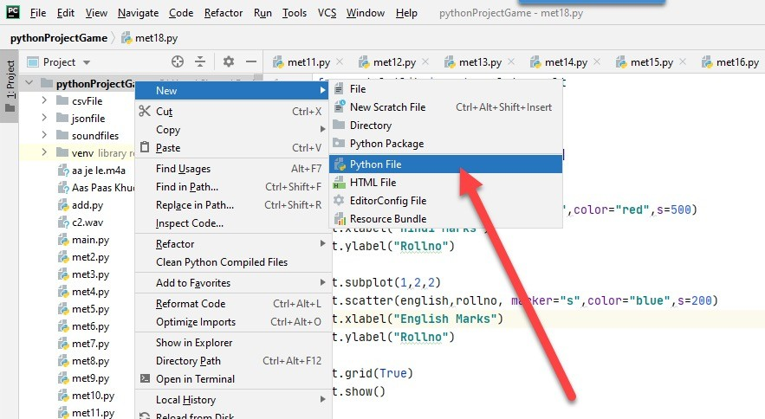
Editor – PyCharm – Install and Open
www.Shyamsir.com

Slide 10
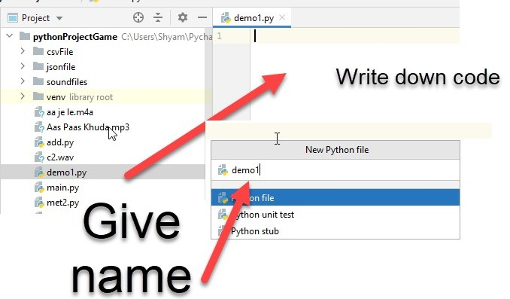
Editor – PyCharm – Install and Open
www.Shyamsir.com

Slide 11
Any Question?
www.Shyamsir.com 78 74 39 11 91
www.Shyamsir.com

