Slide 1


Customer Behavior Analysis Report
Comprehensive SQL-Driven Insights from Customer Shopping Behavior Dataset
Notes:
1

Slide 2
Executive Summary
$136,620
3,900
$59.64
61.1%
Total Revenue
Total Customers
Avg Purchase
Subscribed
+8.2% growth
+2.1% increase
+4% growth
Female customers drive 52.2% of revenue ($71,280). Subscribers spend 9% more and generate 61% of total revenue. The 26-45 age group contributes 45% of revenue.
Notes:
2

Slide 3
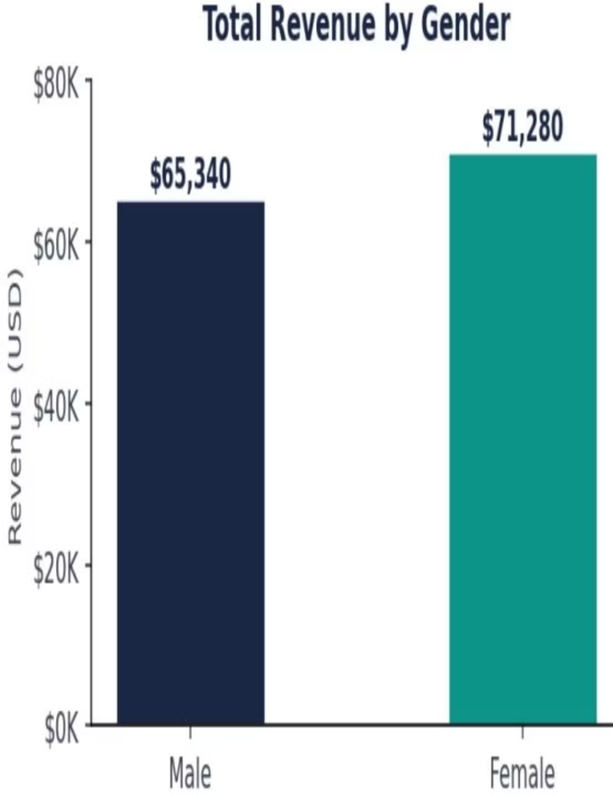
Revenue by Gender
Key Findings
Female: $71,280 (52.2%)
Male: $65,340 (47.8%)
Female customers contribute ~$6K more
Insight: Targeted promotions toward female shoppers could amplify this gap.
Notes:
3

Slide 4



High-Value Discount Users
45%
50.8%
$74.20
Customers with Discount
Spending ≥ Average
Avg Purchase
1,755 customers applied discounts
892 high-value discount users
Among discount users above average
Insight: Over half of discount users spend above average ($59.64), generating $66,186 in revenue. Discounts successfully attract high-value buyers without hurting margins.
Notes:
4

Slide 5
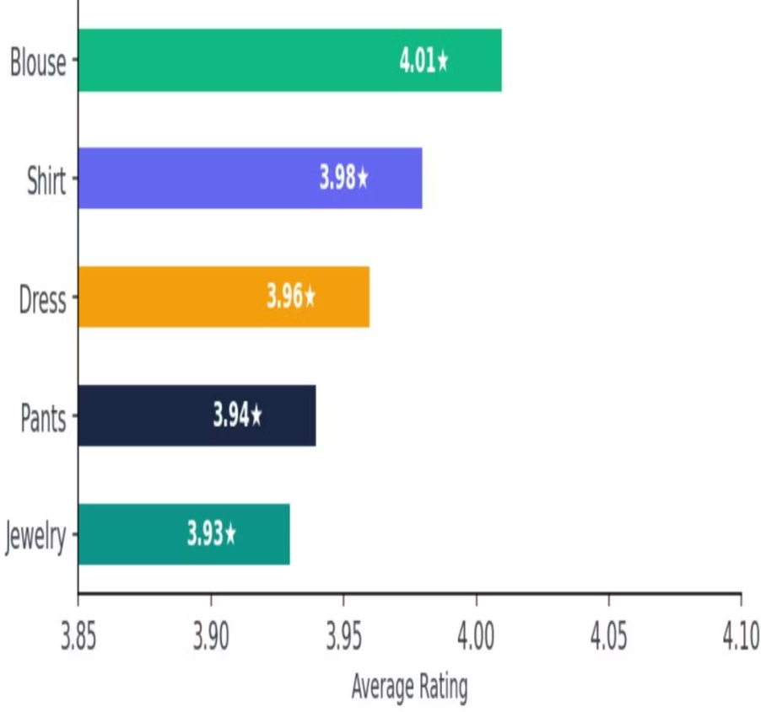
Top 5 Products by Rating
1
2
3
Blouse
Shirt
Dress
4.01★
3.98★
3.96★
4
5
Pants
Jewelry
3.94★
3.93★
Insight: Clothing items dominate top ratings. Invest in quality for these categories and use them in marketing to build brand trust.
Notes:
5

Slide 6
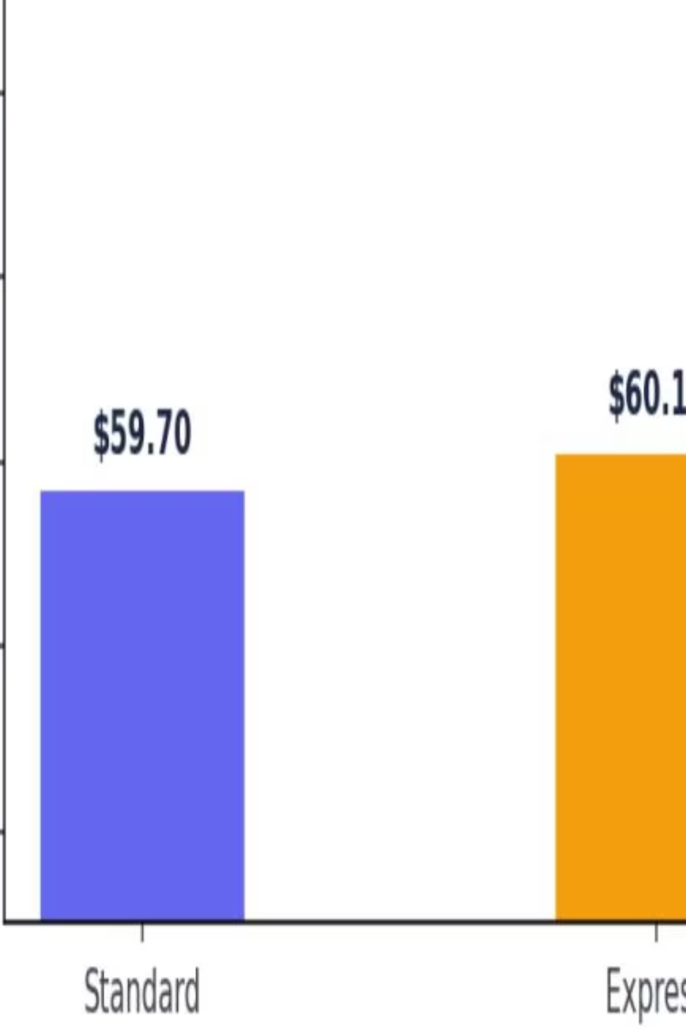

Shipping Type vs Spend
Standard Shipping
Express Shipping
Avg: $59.70
2,010 customers
$119,997 total
Avg: $60.12
890 customers
$53,507 total
Insight: Express shipping customers spend marginally more ($0.42), suggesting speed-focused shoppers are slightly higher-value. Consider upselling express at checkout.
Notes:
6

Slide 7
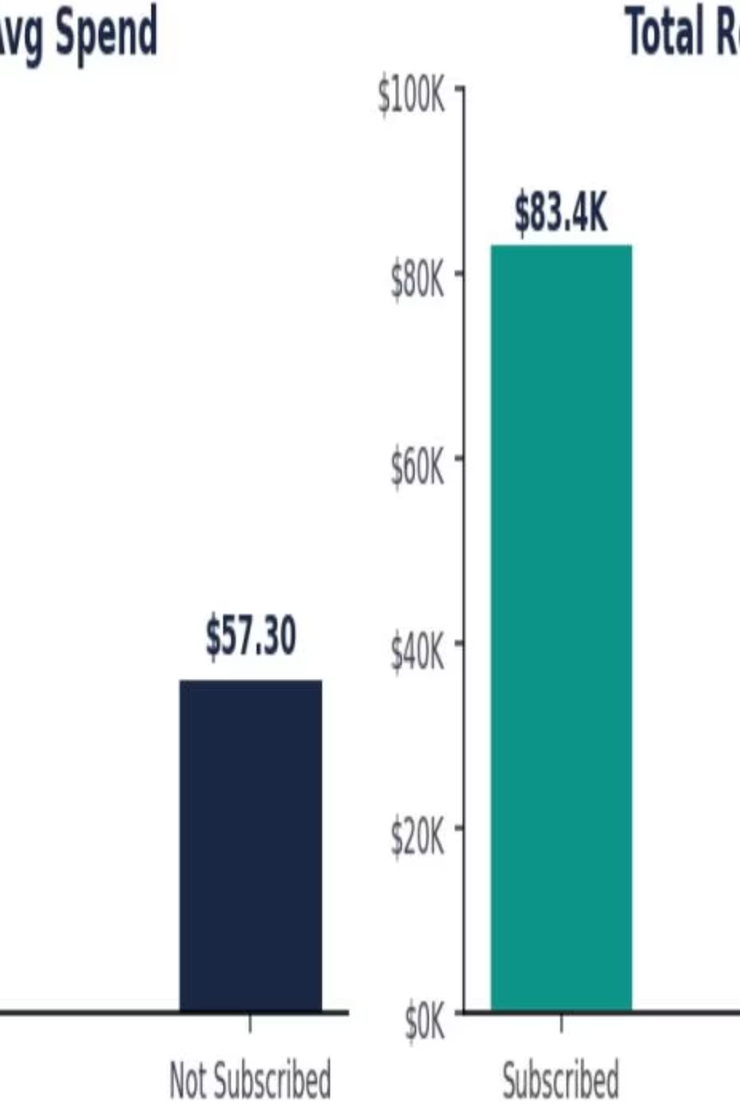
Subscriber vs Non-Subscriber Performance
Subscribed
Not Subscribed
$62.45 avg spend • $83,432 total • 61.1% revenue share
$57.30 avg spend • $48,934 total • 35.8% revenue share
Unknown
$49.80 avg spend • $4,254 total • 3.1% revenue share
Insight: Subscribers spend 9% more on average and generate 61% of total revenue. A focused subscriber-growth campaign could significantly lift overall revenue.
Notes:
7

Slide 8
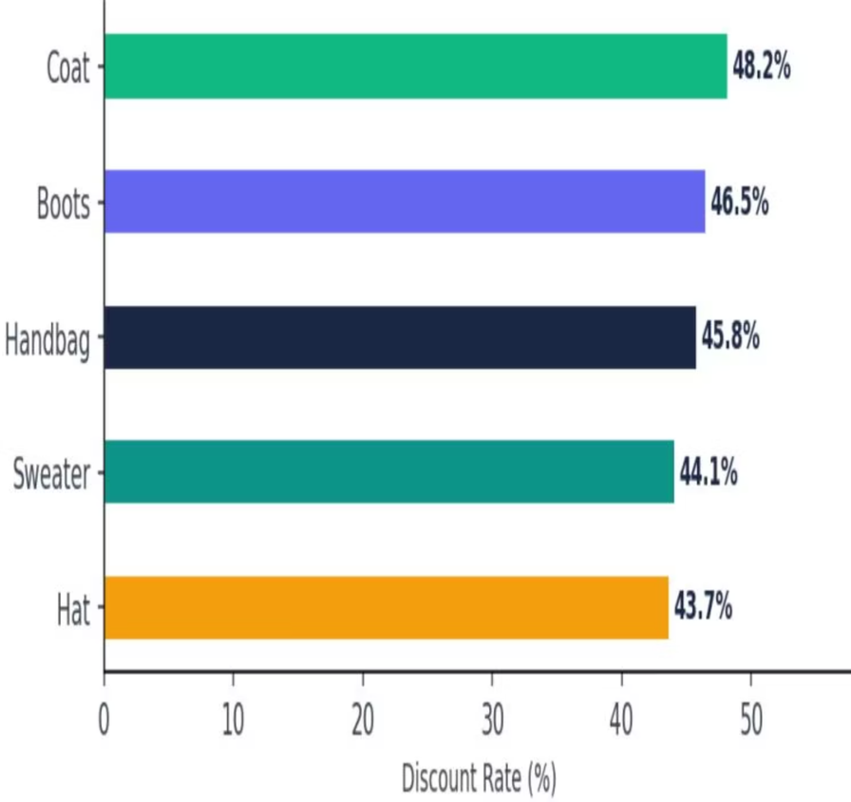
Top 5 Products by Discount Rate
01
02
03
Coat
Boots
Handbag
48.2% discount rate (229 of 475 orders)
46.5% discount rate (209 of 450 orders)
45.8% discount rate (201 of 439 orders)
04
05
Sweater
Hat
44.1% discount rate (190 of 430 orders)
43.7% discount rate (185 of 423 orders)
Insight: Winter/seasonal items show highest discount rates, indicating price sensitivity. Consider loyalty-based discounts instead of blanket promotions.
Notes:
8

Slide 9
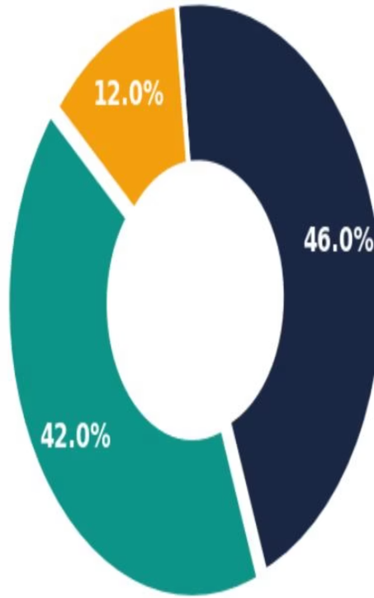
Customer Segmentation
Loyal (42%)
1,638 customers • 18.4 avg purchases • $65.80 avg spend
Returning (46%)
1,794 customers • 5.8 avg purchases • $59.20 avg spend
New (12%)
468 customers • 1.0 avg purchase • $52.10 avg spend
Insight: 88% of customers are Returning or Loyal, indicating strong retention. New customer acquisition should be prioritized to refill the funnel.
Notes:
9

Slide 10
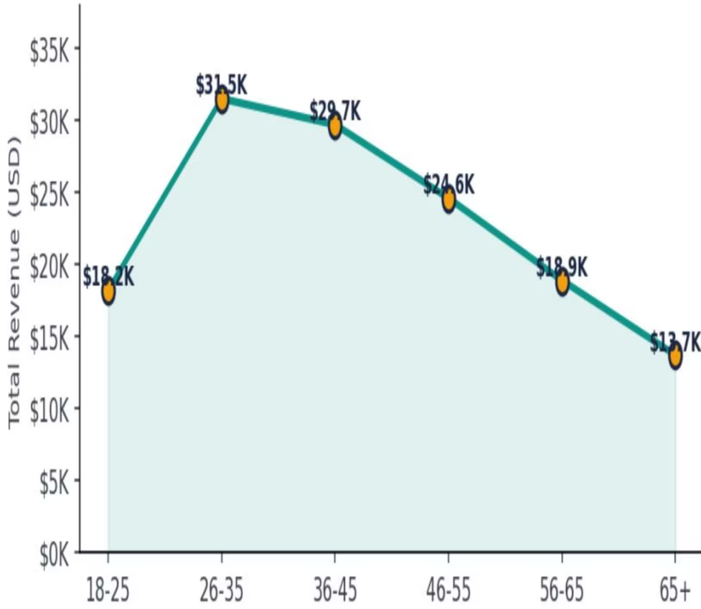






Revenue by Age Group
26-35
$31,500 • 23.1%
36-45
$29,700 • 21.7%
46-55
$24,600 • 18.0%
56-65
$18,900 • 13.8%
18-25
$18,200 • 13.3%
65+
$13,720 • 10.1%
Insight: The 26-45 age range drives nearly 45% of total revenue. Marketing budgets should be weighted toward this cohort while nurturing the growing 18-25 segment.
Notes:
10

