Slide 1
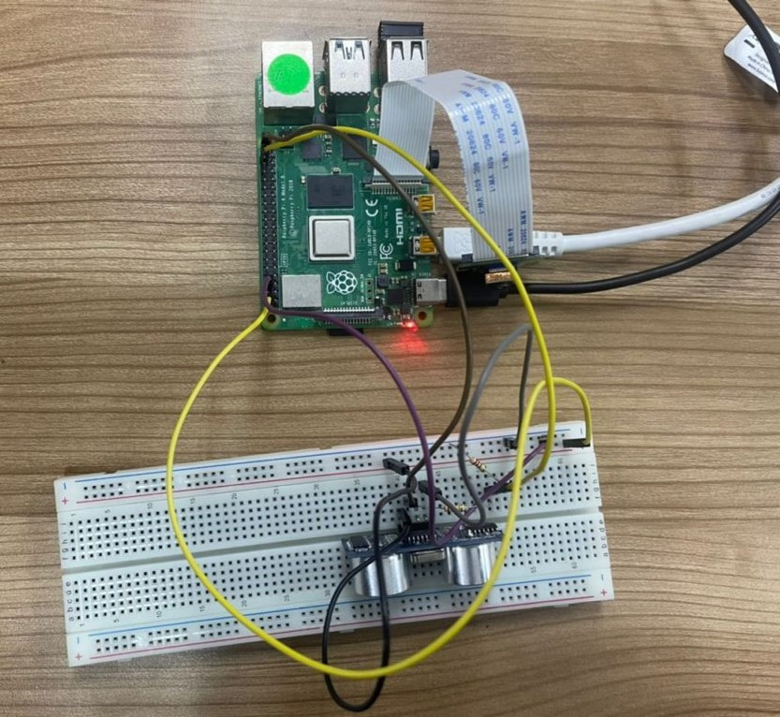
Security camera using pi camera and ultrasonic sensor
Presented By:
Group -4
Nishank Tyagi (2110014325011)
Pratishtha pandey (2110014325014)
Yashi Dixit(2110014325023)
Shweta Yadav (2110014325025)
Anand Singh(2110014325003)

Slide 2
introduction
With increase in the crimes in the recent times, several measures are being taken to prevent such crimes. A Vacant home is vulnerable to theft and vandalism, due to this monitoring of homes has seen a growing need in emerging times.
Security camera is the one that records people’s activities in order to detect and prevent crime.
This project is best suitable for the home security.

Slide 3
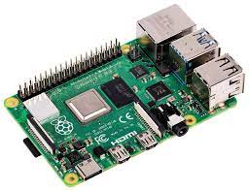
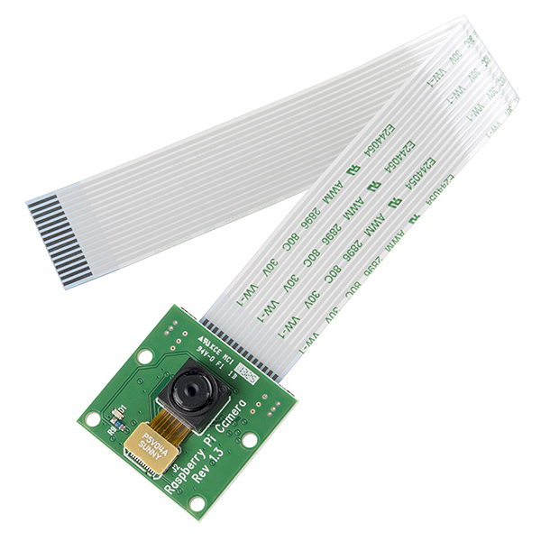
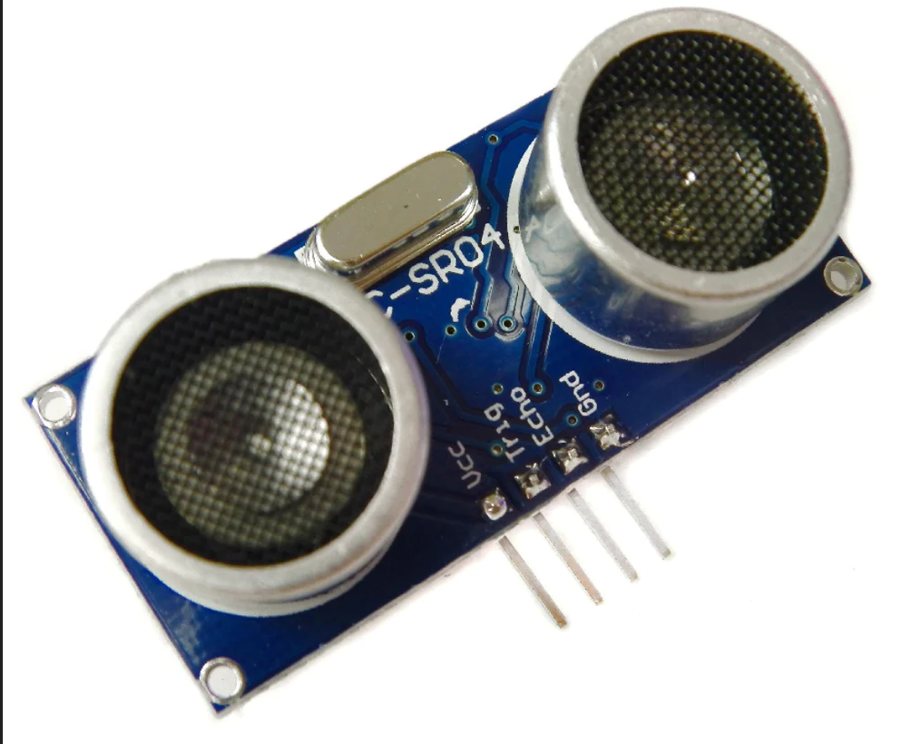
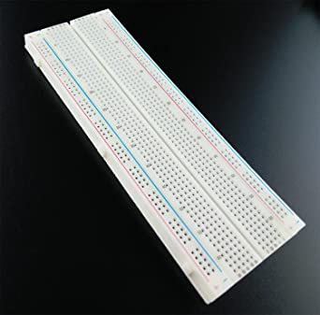
requirements
Raspberry Pi 4
Pi camera
Ultrasonic Sensors
SD Card
Power Source
Power Adapter
Jumper wires
Breadboard

Slide 4
Raspberry pi
Raspberry Pi is a single-board computer developed by Raspberry Pi Foundation in England to promote education in basic computer science in schools and developing countries.
It’s a cheap computer that runs Linux and also provides set of GPIO (General Purpose Input Output) pins.
It is an open source hardware.
It contains a RAM of minimum 1 Gigabytes.

Slide 5
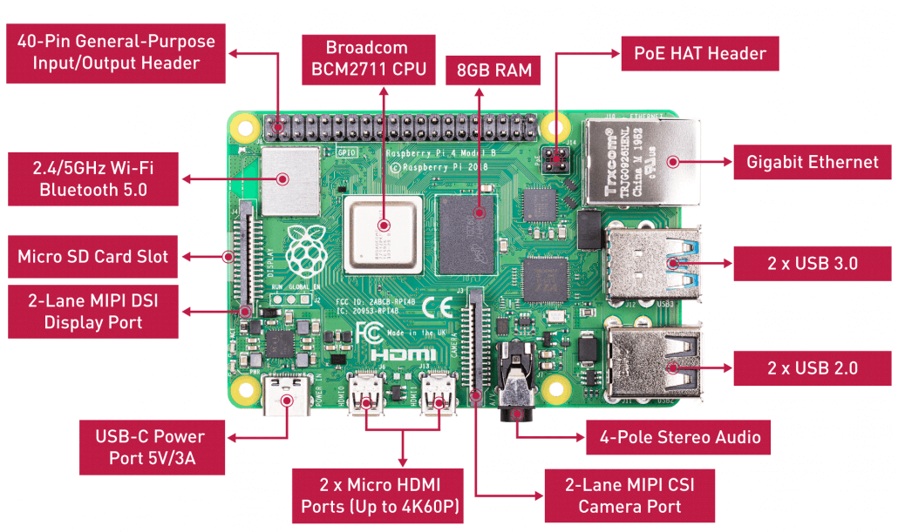
Hardware overview

Slide 6
Ultrasonic sensors
Ultrasonic sensors are widely used for distance measurement.
It is a sensor that transmits ultrasonic sound waves and receives them back to calculate the distance from the object.
Vcc and ground are power supply pins. Trig and echo are used to transmit and receive the ultrasonic pulse.

Slide 7
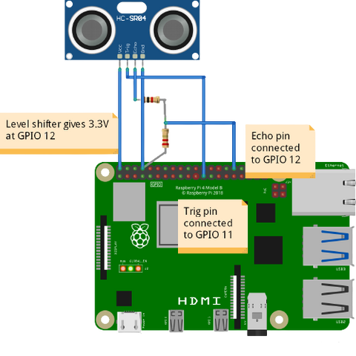
Connecting ultrasonic sensor to raspberry pi

Slide 8
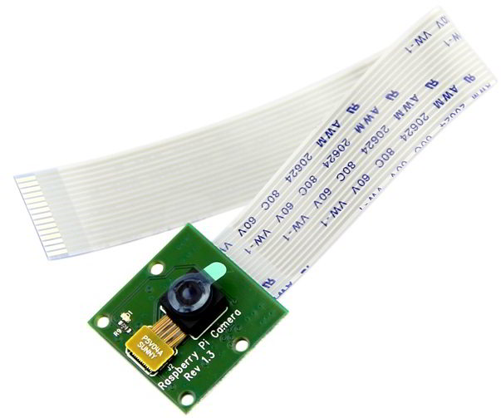
Pi camera
The pi camera module is a camera that can be used to take pictures and high definition videos.
Raspberry Pi Board has CSI (Camera Serial Interface) interface to which we can attach the PiCamera module directly.
This Pi Camera module can attach to the Raspberry Pi’s CSI port using 15-pin ribbon cable.

Slide 9
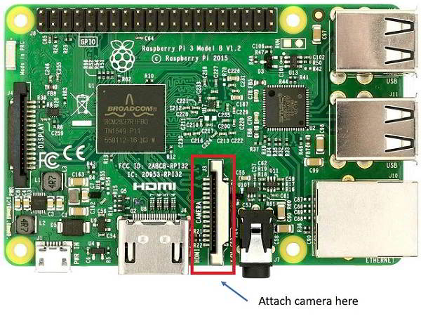
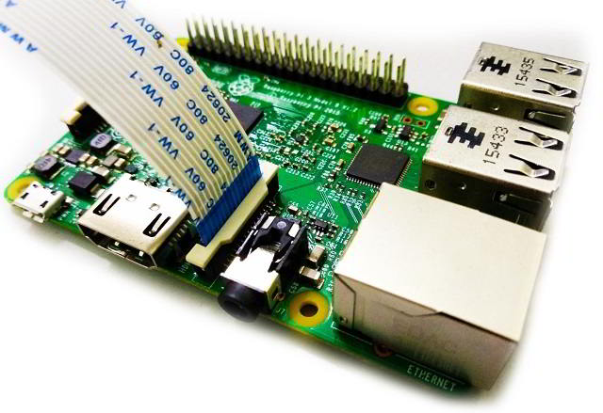
How to attach Pi camera to raspberry pi?

Slide 10
How The Project Works ?
This project can be used for home security, it can be installed within a room.
If there is any movement within the range then the image of the object or person moving is captured and saved .
Ultrasonic sensor used detects the movement, and calculates and return the distance of the object/person that is moving and the camera will capture the image and save it.
An empty home is vulnerable to theft and vandalism, this project can be installed which will capture the images if there are any movement in the home, this will help in detecting if there is any activity going on at home and if any object is missing from home.

Slide 11
THANK YOU!

