Slide 1
GENETIC-CNN
Ayush Agrawal-2018A8PS0469P(Leader)
Aryan Gupta -2018A8PS0017P
Saurav Biyani -2018A3PS0461P

Slide 2
GENETIC-CNN
Lingxi Xie, Alan Yuille
John Hopkins University

Slide 3
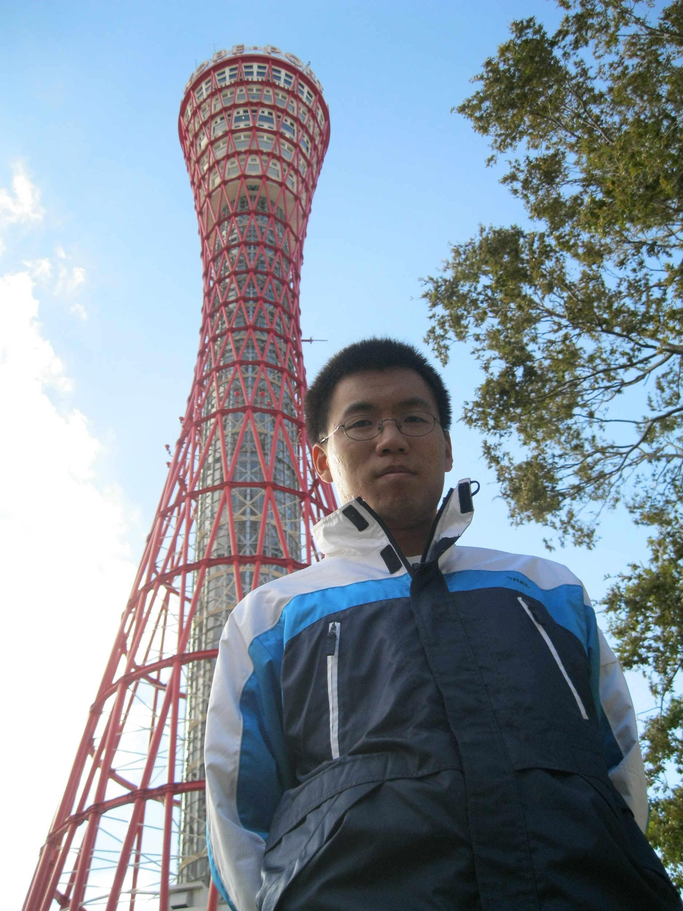

Reference to the Authors
The corresponding paper was authored by Lingxi Xie and Alan Yuille John Hopkins University
Working in John Hopkins University
Linxi Xie is presently a senior researcher at Huawei Inc and has contributed a lot to the field of machine learning specializing in image retrieval , classification and other visual problems
Alan Yuille - A Bloomberg Distinguished Professor of computer science and cognitive science at the Whiting School of Engineering and the Krieger School of Arts and Sciences. His research interests include computational models of vision, mathematical models of cognition, medical image analysis, and artificial intelligence and neural networks.
Linxi Xie
Alan Yuille

Slide 4
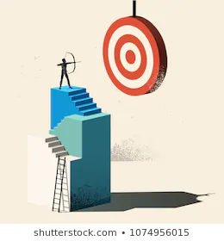
AIM-
TO DETERMINE THE OPTIMAL CNN ARCHITECTURE FOR IMAGE RECOGNITION USING GENETIC ALGORITHM

Slide 5

METHODOLOGY
In this assignment we make 13 digits bit strings called genes . That are then decoded into their corresponding CNN structure .
The string is evaluated by training the corresponding CNN structure for a certain number of epochs and then testing it on the test dataset .
After evaluation based on the fitness value the genes undergo crossover and then mutation
For training the corresponding CNN of a gene MNIST dataset is used which is easily available online .
This process is repeated for a certain generations and the best genes i.e the best structure is found .
This paper applies the genetic algorithm to propose new network structures that are more efficient. The parameters and accuracy of each structure is obtained by standalone training from scratch

Slide 6

FINAL OUTCOME
After running the algorithm for 5 epoch and 5 generations with a population of size 10
Three best structures for MNIST dataset image recognition obtained were :
1010111010111 with the testing acc . 98.54%
2) 1001000101101 with the testing acc. 98.19%
3) 0001001101110 with the testing acc. 98.38%
The algorithm took about 12 GPU hours to finish.

Slide 7
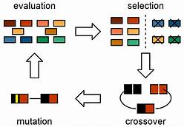
BackGround Concepts -
GENETIC ALGORITHM - The main algorithm we use to find the best structure for the CNN it consists of the following steps -:
This cycle continues to repeat to optimize our fitness function which in this case is accuracy of the CNN it represents .

Slide 8
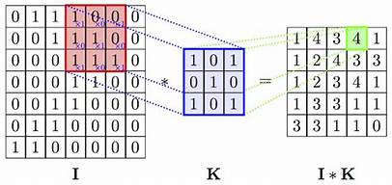
2) Convolutions-
The CNN consists of many layers and each layer has many filters and each filter perform operation known as convolution operation on the input . Each layer is normally characterised by filter size, number of filters ,padding and stride .
INPUT OUTPUT ARE GOVERNED BY THE ABOVE EQUATION IN CONVOLUTION OPERATION

Slide 9
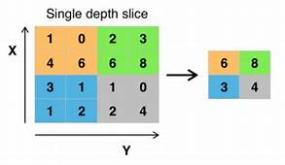
2) MAX Pooling-
The network also consists of two max pooling layer . This layer does not affect the depth of the input and only changes the length and the breadth by choosing the maximum of all the numbers spanned by the kernel i.e filter
Pooling is mainly used to reduce size of input and summarize the data and its one unique feature is it does not have any learnable parameters hence does not add to the complexity in the model very much .

Slide 10

Binary Coding Of structures
A network is composed of ‘S’ stages and the sth stage consists of Ks nodes. s={1,2,3,4….S}
The nodes at each stage are numbered, only possible connections are from lower ordered nodes to higher ordered
Meaning of each node?
Corresponds to a convolutional operation which is done after taking sum of all the inputs to that node
This is followed by batch normalization and ReLU.
At each stage we use 1+2+3+4+5…….. + Ks - 1 number of bits to encode the inter node connections

Slide 11
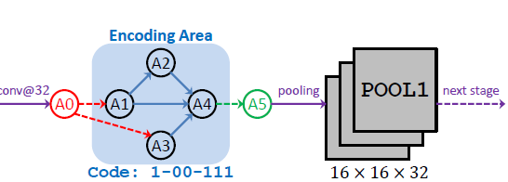
Binary Coding Of structures
The first bit represents the connection between (v_{s,1} , v_{s,2}), then the following two bits represent the connection between (v_{s,1} , v_{s,3}) and (v_{s,2} ,v_{s,3}), etc.
This process continues until the last Ks - 1 bits are used to represent the connection between v_{s,1} , v_{s,2} , ..… v_{s,Ks-1} and v_{s,Ks}
For 1 <= i < j <= Ks, if the code corresponding to (v_{s,i} , v_{s,j}) is 1, there is an edge connecting v_{s,i} and v_{s,j} , i.e., v_{s,j} takes the output of v_{s,i} as a part of the element-wise summation, and vice versa

Slide 12
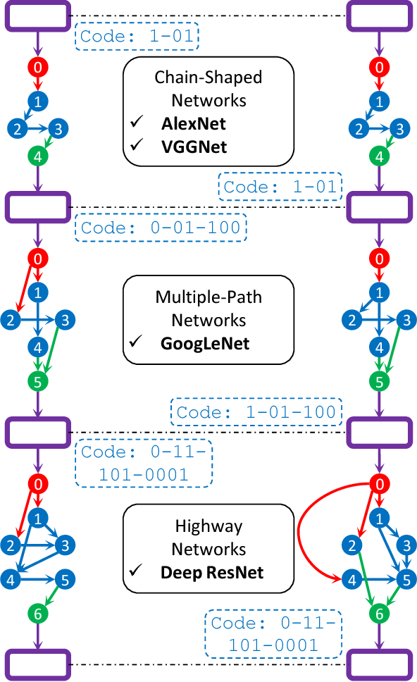
Binary Coding Of structures
A ‘S’ stage network with nodes at the is encoded in a binary string with length = (L) =
Thus there are possible structures: 2^{L}
Example of how the encoding is done
The different stages are separated by spatial pooling layers
All the convolutional operations within a stage have same number of channels, filters

Slide 13
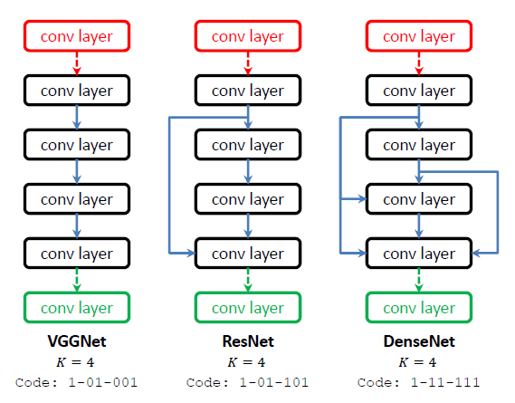
Binary Coding Of structures
2 types of nodes: Ordinary , default nodes
At each stage we require 2 default nodes to make each binary string valid
Default Input Node - receives data from previous stages,performs convolution and sends its output to every node without a predecessor.
Default Output Node - receives data from all the nodes without a successor then sums them up, performs convolution and then sends the output to the pooling layer
If any ordinary node is isolated(i.e no connection with any other ordinary nodes) then we don’t connect it to the default nodes
If there are no connections in a stage then convolution is performed only once instead of twice

Slide 14
DATASET DETAILS (MNIST) -
The MNIST database is a large database of handwritten digits that is commonly used for training various image processing systems.
The database is also widely used for training and testing in the field of machine learning . It was created by "re-mixing" the samples from NIST's original datasets.
The creators felt that since NIST's training dataset was taken from American Census Bureau employees, while the testing dataset was taken from American high school students, it was not well-suited for machine learning experiments.
Furthermore, the black and white images from NIST were normalized to fit into a 28x28 pixel bounding box and anti-aliased, which introduced grayscale levels.
The MNIST database contains 60,000 training images and 10,000 testing images .

Slide 15
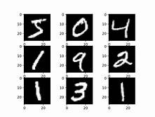
Some researchers have achieved "near-human performance" on the MNIST database, using a committee of neural networks; in the same paper, the authors achieve performance double that of humans on other recognition tasks. The highest error rate listed on the original website of the database is 12 percent, which is achieved using a simple linear classifier with no preprocessing .
Some sample images

Slide 16
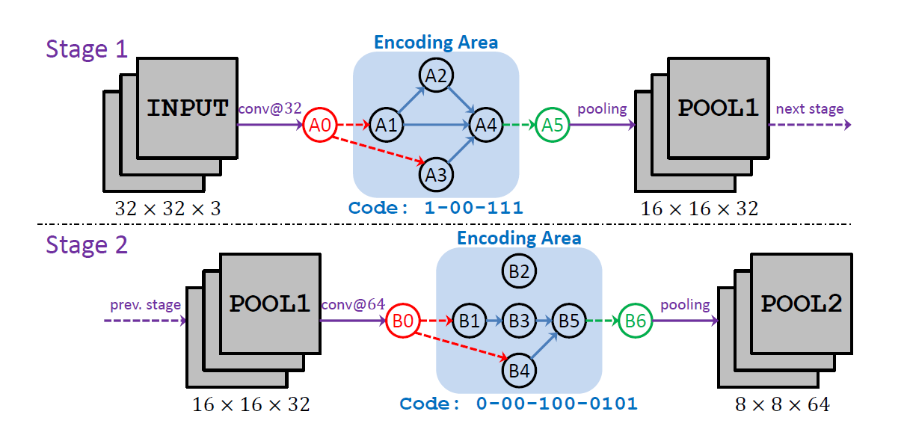
IMPLEMENTATION
Initialize population of gene length 13 . Since there are two stages with 3 and 5 nodes the corresponding gene length comes out to be 13 .
2) Using the genes various networks are formed , each gene has an unique network associated to it
for e.g ->
Gene -> 1001110001000101

Slide 17
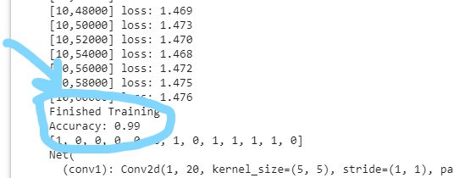

3) After training the network on the training dataset for the input number of epochs , we test the final network on the test dataset and then get the final accuracy .
After training and testing output will look like this
4) Probability for selection for crossover of each gene is chosen proportional to their fitness function

Slide 18
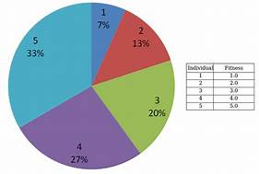
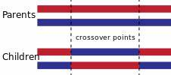
5)After finding the respective probabilities a roulette wheel selection is used to randomly select genes for mating in the crossover process .
6) In the crossover stage genes are crossovered using the crossover probability(Pc) and parameter (qc) given as input and each pair of parents are replaced with their children in the population

Slide 19
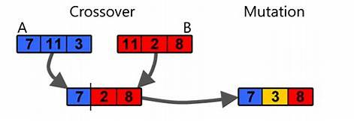
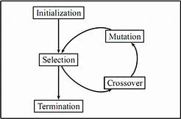
7) After the crossover stage each gene undergoes mutation using the mutation probability(Pm) and parameter (qM)that is also passed in the input .
8) After mutation one generation is over , thus we go back to step 2 for the next generation .

Slide 20
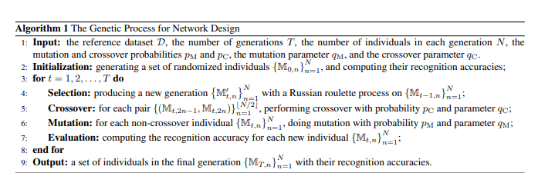
9) After many generations the process is stopped i.e terminated and the best genes are taken and their corresponding structures are decoded to get the best structure for the image recognition CNN

Slide 21
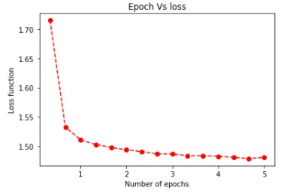
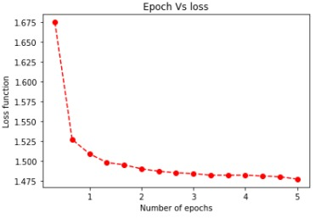
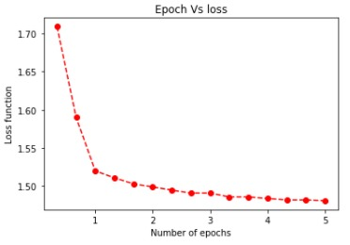
RESULTS :
After training and testing many structure using genetic algorithm it was found that the gene - 1010111010111 gave the best accuracy and that was 98.54% .
loss vs epoch graphs of top three genes has been given below
BEST
Second Best
Third Best

Slide 22
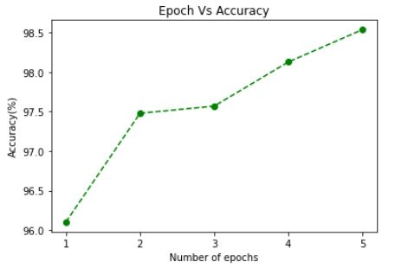
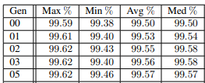
2) Accuracy of the Best gene increased considerably over several epochs as shown in the graph below.
3) On increasing the number of epochs the Generation vs accuracy came out to be like this. We calculated the the accuracy for any gene quite a few times and then calculated its avg value

Slide 23
DISCUSSIONS
Although this structure is good for MNIST but for larger and more complex datasets like CIFAR 10 would require more complex encoding and more number of stages which will require more generations to saturate and hence a lot of training time will be used .
We can try to use transfer learning to reduce training time and increase accuracy of out network .
Although the network requires a lot of time to train it’s a good way to find the best structure out of many possible structures .
We conclude that the genetic algorithm helps to find more effective and efficient structures than the dense connections.

Slide 24

CHALLENGES FACED
Time Limitation -
For each gene in population a unique CNN is trained which took a lot of time since many epochs are also required to train a CNN hence the code was hard to debug as well .
Resource Limitation -
For faster training GPU was required and acquiring this resource proved rather difficult even google colab didn’t have enough computational power to execute the algorithm for larger number of epochs and generations
Deap module -
For implementing the genetic part of the paper we used the deap module, and learning how to use this module (by reading the documentation) took a considerable amount of time.

Slide 25
4) Complex Structure -:
Since each gene represented a different CNN, making a model whose forward function depends on the bits that were used to initialize it was hard and time consuming.
5)Less number of helpful modules -:
There were many modules on how to implement genetic algorithm on CNN but all of them only optimized parameters for e.g PyGAD and not the structure and hence number of useful helpful libraries for optimizing the architecture were very limited .

Slide 26

FUTURE SCOPE
There are still a large number of networks unexplored,including those with non conventional modules like Maxout and multi-scale strategy used in inception module.
We Are using only convolutions and max pooling layers in the CNN this limits the complexity of our network .
We can create more complex encodings for convolutions so that it can handle even larger and complex datasets
Fitness function can also be changed to measure both accuracy and training time .
It would be interesting to incorporate the genetic algorithm to train the network structure and weights simultaneously

Slide 27

Learning Outcomes -:
Learnt about how to use deap module to apply genetic algorithm .
Learnt how to make a CNN network from scratch using only Pytorch .
Learnt about practical implementation of genetic algorithm to find optimal network structure for image recognition on MNIST dataset
Learnt importance of teamwork and communication .
Got first hand exposure to Tensorflow and PyTorch.
Got exposure on how to Read, Understand and Implement a Research Paper

Slide 28
References ->
Paper can be found at -> https://arxiv.org/pdf/1703.01513.pdf
Explanation can be seen at->https://www.youtube.com/watch?v=GZMcy_vl5wA&t=578s
Genetic algorithm -> https://en.wikipedia.org/wiki/Genetic_algorithm
About Linxi Xie -> http://lingxixie.com/Home.html
About Alan Yuille -> http://www.cs.jhu.edu/~ayuille/
Dataset link->https://www.kaggle.com/oddrationale/mnist-in-csv

Slide 29
THANK YOU

