Slide 1

Major Project On Q&A SYSTEM WITH DUPLICATE QUESTION DETECTION
TRIBHUVAN UNIVERSITY
INSTITUTE OF ENGINEERING
Kathmandu Engineering College
Department of Computer Engineering
SUBMITTED BY
Anurag Shukla (KAT075BCT013)
Ayush Shrestha (KAT075BCT018)
Bharat Adhikari (KAT075BCT019)
Diwash Adhikari (KAT075BCT030)

Slide 2
Slide Overview
Introduction
Problem Statement
Objectives
Scope
Application
Literature Review
Methodology
Block Diagram
Algorithms
Flowchart
Tools Used
Expected Output
Gantt Chart
References

Slide 3
Introduction
Q&A System and Duplicate Question Detection
Natural Language Processing
Stemming
Lemmatization

Slide 4
Problem Statement
Problem of different user asking similar question
Time consuming to find the best answer
Need to write same answer to different versions of questions

Slide 5
Objective
Allows user to ask questions.
Checks whether similar question already exists in the database.
Allows user to answer asked questions.

Slide 6
Scope
Useful in question answering system
Helps to find duplicate questions
Helps to find good answers easily

Slide 7
Application
Information Management systems can use it for grouping of various kinds of data based on semantic similarity.
Our system can be tuned to detect plagiarism because newer machine learning models can effectively capture the phrase changes also.
Advertising agencies can also use the similarity detection in user interests profiling to show personalized contents.

Slide 8
Literature Review
Traditional algorithms like cosine distance, Euclidean distance, and weighted Manhattan distance.
Newer approaches includes algorithms like RNN, LSTM.

Slide 9
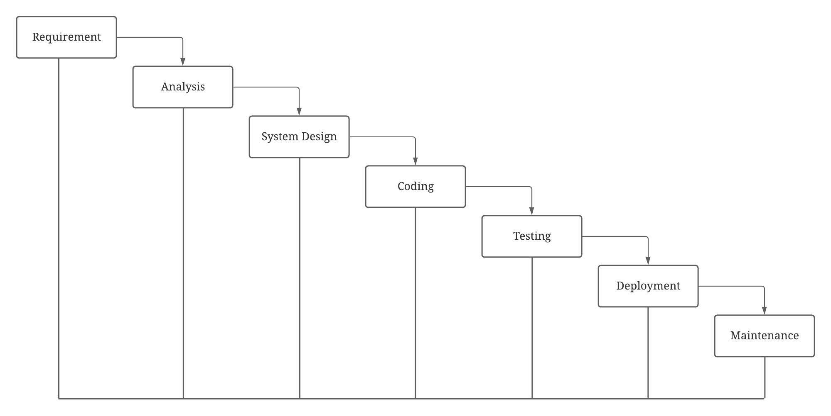
Methodology
Waterfall Model
Figure 1: Waterfall Model

Slide 10
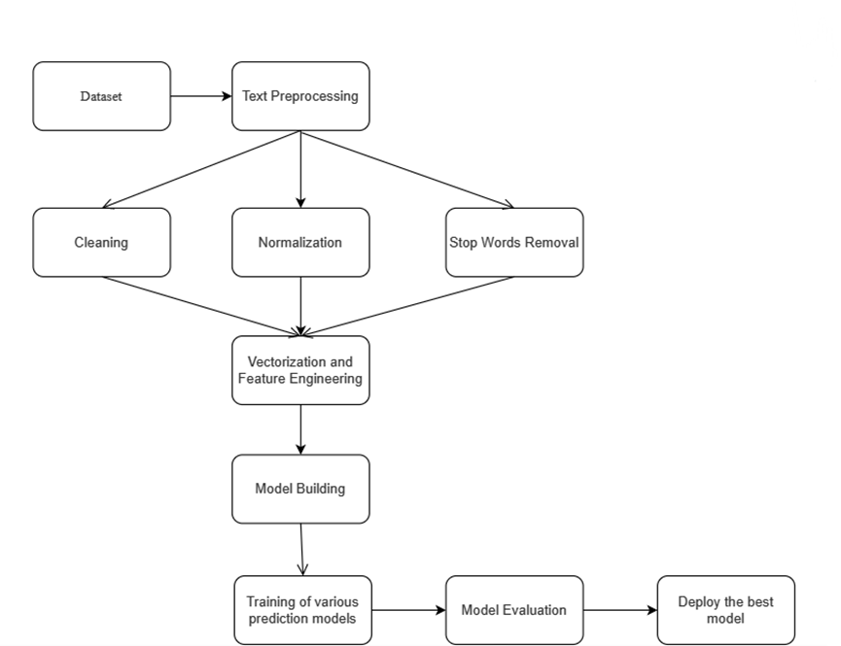
Block Diagram
Figure 2: Block Diagram

Slide 11
Algorithms :
TF-IDF
Machine Learning algorithms usually deal with numbers, but natural language is text. So, we need to transform that text into numbers known as text vectorization.
TF-IDF uses a weighting system that assigns a weight to each word in a document based on its term frequency (TF) and the inverse document frequency (IDF). After transforming words into numbers, the TF-IDF score can be fed to various ma-chine learning algorithms for training.

Slide 12
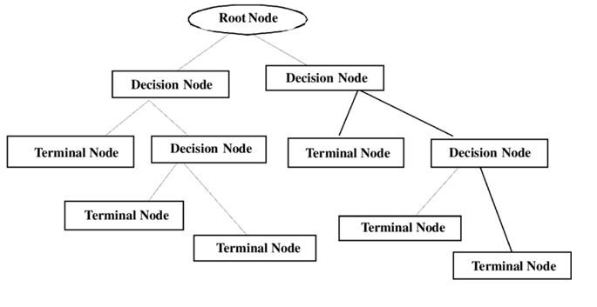
Decision Tree:
Figure 3: Decision Tree
It works by creating a model that predicts the value of a target variable by learning simple decision rules inferred from the data features.

Slide 13
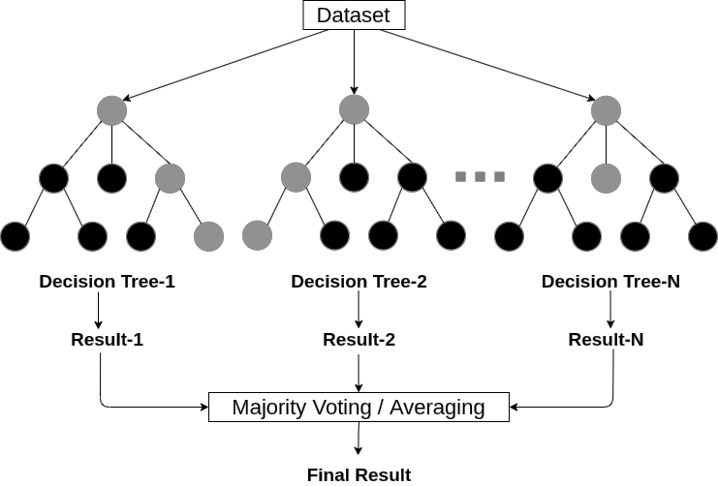
Random Forest:
Figure 4: Random Forest
Random forest is an ensemble algorithm which consists of many decision trees where each individual tree gives out a class prediction and the class with the most votes becomes the model’s prediction.

Slide 14
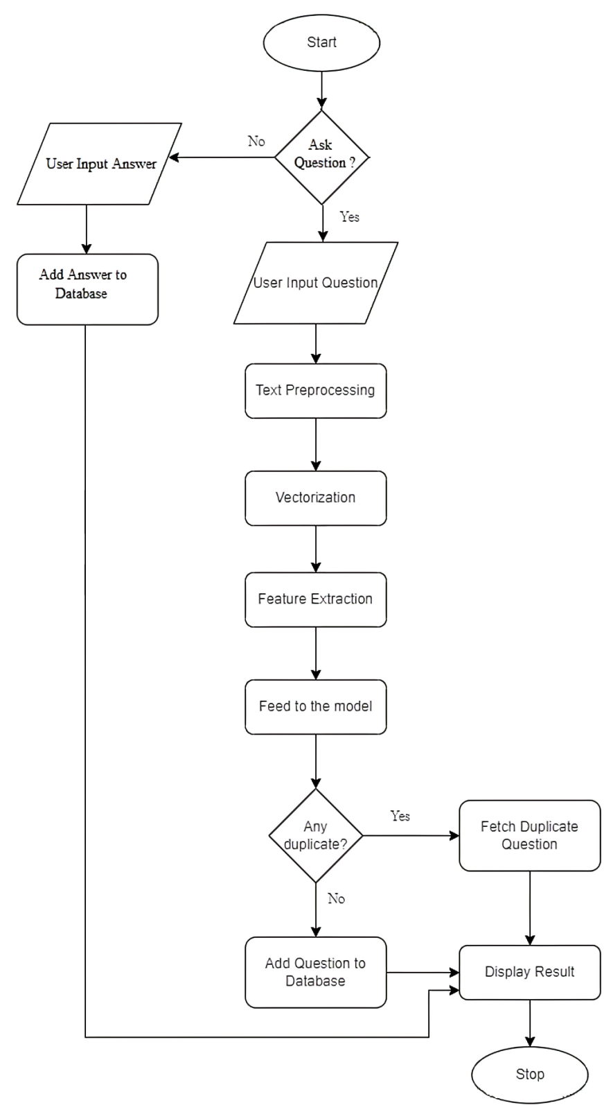
Flowchart
Figure 5: Flowchart

Slide 15
Tools Used
Python
Django
Numpy
Pandas
Matplotlib
NLTK
SKLearn
Google Colab
HTML and CSS
JavaScript
SQLite

Slide 16
Expected Output
Develop a web application of Q&A with duplicate questions detection.
Detection of duplicate or repeated questions and suggest related questions.
Allows user to read answers to their questions.
Allows user to write answer to the questions.

Slide 17
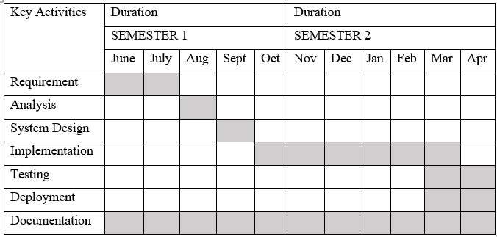
Gantt Chart
Figure 6: Gantt Chart

Slide 18
References
[1] Ansari, Navedanjum, and Rajesh Sharma. "Identifying semantically duplicate questions using data science approach: A Quora case study." arXiv preprint arXiv:2004.11694 (2020).
[2] Imtiaz, Zainab, et al. "Duplicate questions pair detection using Siamese Malstm." IEEE Access 8 (2020): 21932-21942.
[3] Patel, Uday, Amol Dattu, Pritam Patil, Renuka Khot, and Sujit Tilak. "Quora Question Duplication Problem." (2020).
[4] J. Bromley, I. Guyon, Y. LeCun, E. Säckinger, and R. Shah, ‘‘Signature verification using a ‘siamese’ time delay neural network,’’ in Proc. 6th Int. Conf. Neural Inf. Process. Syst. (NIPS), San Francisco, CA, USA, 1993, pp. 737–744.
[5] Travis Addair. 2017. Duplicate question pair detection with deep learning. Stanf. Univ. J (2017).
[6] Y Homma, S Sy, and C Yeh. 2016. Detecting Duplicate Questions with Deep Learning. 30th Conf. Neural Inf. Process. Syst. (NIPS 2016), no. Nips (2016), 1–8.
[7] A Tung and E Xu. 2017. Determining Entailment of Questions in the Quora Dataset., 8 pages.
[8] A Parikh, O Tckstrm, D Das, and J Uszkoreit. 2016. A Decomposable Attention Model for Natural Language Inference. Proc. 2016 Conf. Empir. Methods Nat. Lang. Process (2016), 2249–2255.

Slide 19
Thank You!

