Slide 1


Online Examination System
Online Examination System Today Online Examination System has become a fast-growing examination method because of its speed and accuracy. It is also needed less manpower to execute the examination. Almost all organizations now-a-days, are conducting their objective exams by online examination system, it saves students time in examinations. Organizations can also easily check the performance of the student that they give in an examination. As a result of this, organizations are releasing results in less time. It also helps the environment by saving paper. PHP is a web base language so we can create an online examination system in PHP.

Slide 2
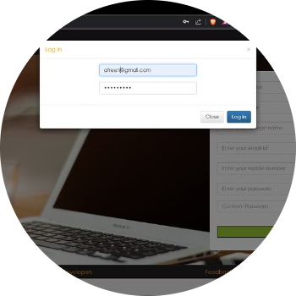
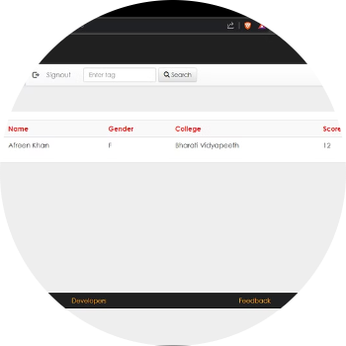
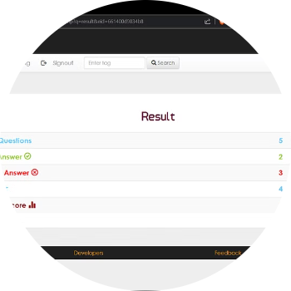
Key Features of Online Examination Systems
Secure Login
Automated Saving
Real-Time Answer Correction
Robust login mechanisms, including user IDs and passwords, ensure the integrity of the examination process and protect the privacy of candidates.
Online systems seamlessly capture and store the candidates' responses, eliminating the risk of manual errors and expediting the evaluation process.
Candidates can make necessary adjustments to their answers during the examination period, providing them with the flexibility to refine their responses.

Slide 3
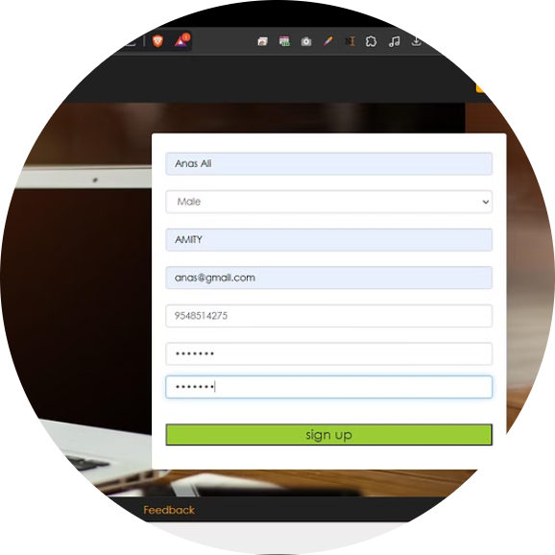
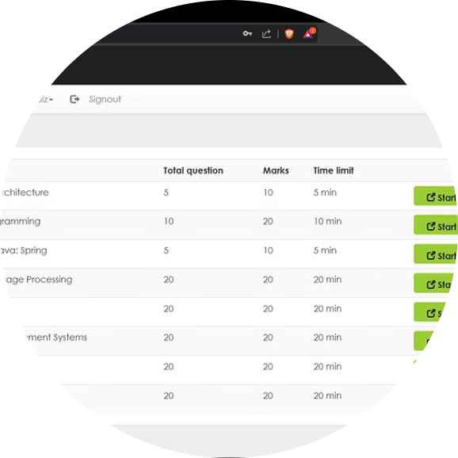
Examination Process
Registration
Exam Scheduling
Candidates can easily register for the examination through a user-friendly online platform, eliminating the need for paper-based processes.
Online examination systems facilitate the seamless scheduling of exams, allowing for greater flexibility and efficient resource allocation.

Slide 4
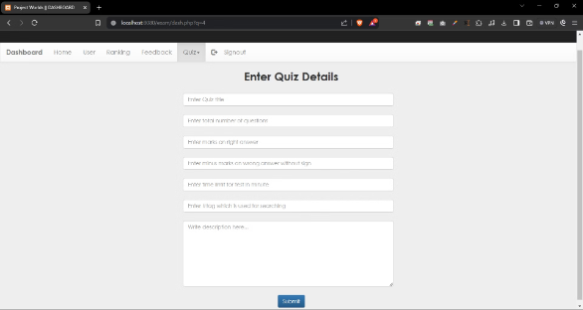
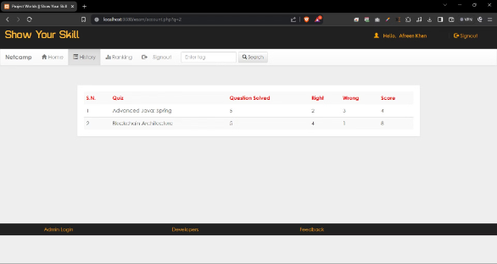
Administrative Features and Benefits
Content Management
Personalized Profiles
Online examination systems empower administrators to easily add, delete, and update exam topics and questions, ensuring the content remains current and relevant.
Candidates can access and update their profiles, accessing the latest exam information and materials through a centralized platform.

Slide 5
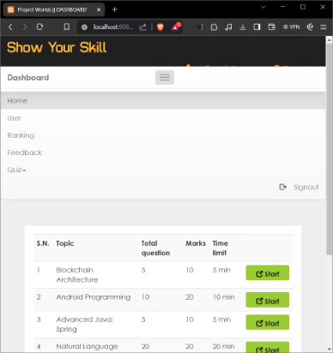
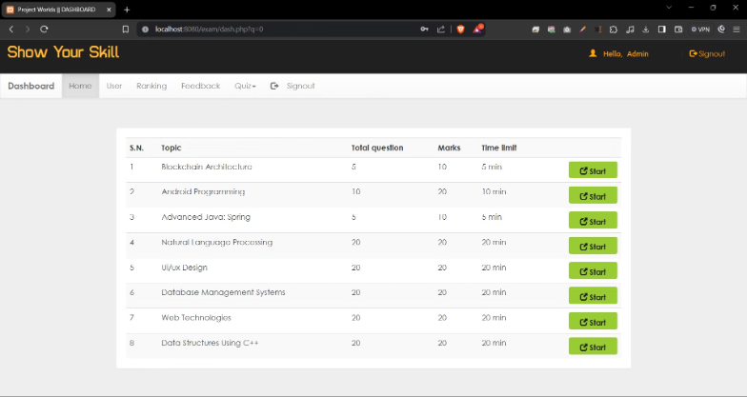
Responsive Design
Online examination platforms are designed to be mobile-friendly and accessible across a range of devices, enabling candidates to seamlessly participate in exams from anywhere.

Slide 6
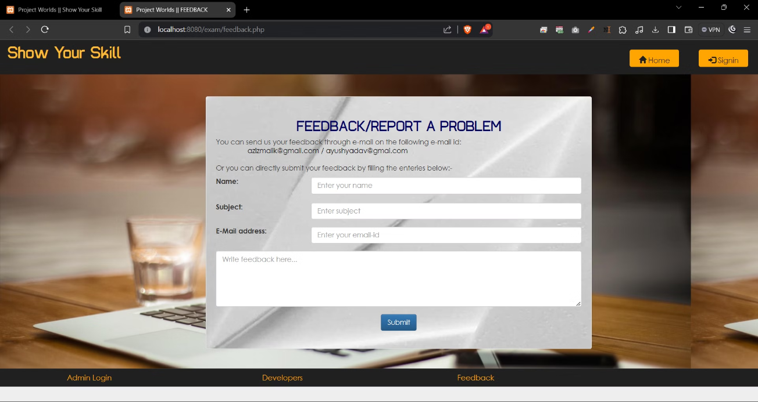
Feedback

Slide 7

Pending to do
Pending to add feedback result to admin account
Pending to add to delete the user from admin account
Pending to add ranking slot to admin account
Pending to add history for user account
"As of now, the project remains unfinished."
Thank You

