Slide 1
DevOps
It is a not a goal but a never ending process of continuous improvement. DevOps aims to shorten the systems development life cycle (SDLC) and provide continuous delivery with high software quality. DevOps is complementary with Agile software development several DevOps aspects came from Agile methodology.
1.Automation
2.Implementing agility in information
3.Culture
4.Implementing best practices with help of tools.
Devops
Dev
Developers/programmers
Ops
Admins/network technicians
coding
testing
building
customer feedback
Servers
Service
Network
Access/login

Slide 2
SOFTWARE DEVLOPMENT LIFE CYCLE (SDLC):-This method is very slow because it goes one by one like-
SLDC is also called as waterfall methodology
required gathering
required analysis
coding
testing
Drawback of waterfall
DEV OPS
1.Slow 1.uptime server for long duration
2. Bug fixing 2.poor configuration management
3.Not flexible 3.diagonise
4.Complete software 4.poor monitoring
To overcome from this waterfall method the agile methodology has came--
Faster realease
Coding bits
Coding is stable
Bug fixing become faster
Agile work on CDCTCI:-Continuous development continuous testing continuous integration
NOTE:-agile is overcome because to change the impact of “dev”but what about “ops” to change this methodology devops came in

Slide 3
Devops may control the
CDCTCI-Continuous development continuous testing continuous integration
C-deployment-Continuous Deployment
C-monitoring-continuous Monitoring
Why devops is important?
1.Integrates developers and operation teams
2.Improves collaboration and productivity by-
Automating infrastructure
Automating workflows
Continuous measuring application performance
Continuous deployment:
It is a practice where the code changes automatically buit , test, prepared for a release to production.
Continuous Management:
Standardizing resource configuration
Enforcing their state across IT infrastructure in an automated agile manner.
Eg:-puppet , ansible
Configuration management using puppet:-
Puppet is a cm tool used to manage and maintain deployment and deployment software in the computational environment.

Slide 4
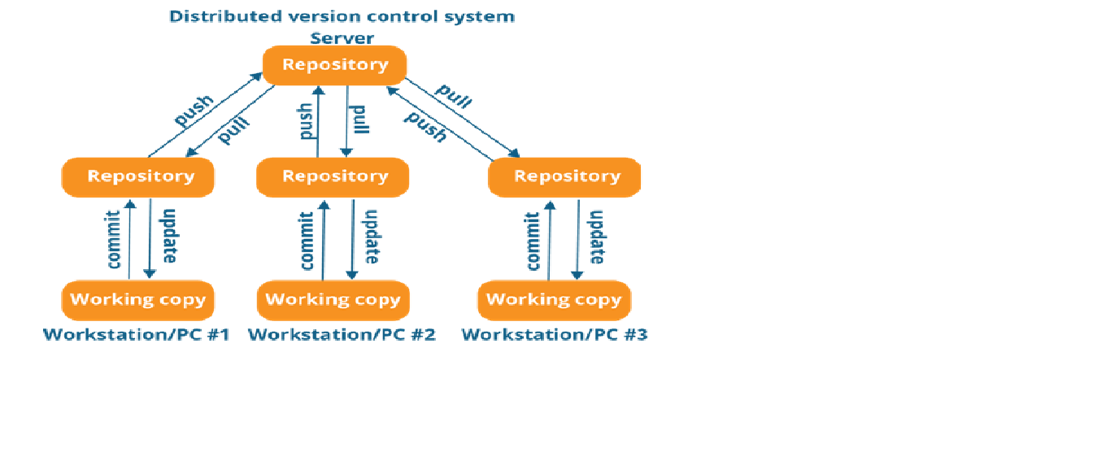
Version control
LVC
(LOCAL VERSION CONTROL)
Practices of having database in a local computer.
Local databases keep a record of the changes made in a file in a version
database.
Issues:-multiple people parallel working on the same project
CVC
(CENTRALIZED VERSION CONTROL)
A centralized repository is maintained where all the versioned files are kept.
Now user can checkout and check in files from different computer at any time.
Issue:-In case central server failure whole system goes down.
DVC
(DISTRIBUTION VERSION CONTROL)
Version database is stored at every user local system and at remote server.
User manipulates the local files and then upload the changes to the remote server.
If any of the server fails , a client server can be used to restore.

Slide 5
17 git status
18 clear
19 ls
20 git status
21 git add index1.html
22 git status
23 git commit -m "first Commit"
24 clear
25 git config --global user.name "devops"
26 git config --global user.email "devops@gmail.com"
27 git commit -m "first Commit"
28 cat ~/.gitconfig
29 clear
30 ls
31 vim index2.html
32 ls
33 git status
34 git ls-files
35 git add index2.html
36 git status
37 git commit -m "second file"
38 git status
39 ls
40 git ls-files
41 clear
42 ls
43 vim index1.html
44 git status
45 git commit -a -m "edit first file"
46 git status
47 git log
48 clear
49 git log --oneline
50 git show 28fbc14
51 clear
52 ls
53 vim file1.txt
54 cat file1.txt
55 git status
56 git add file1.txt
57 git commit -m "text file"
58 ls
59 git status
60 clear
61 vim file1.txt
62 git status
63 git diff file1.txt
64 git add file1.txt
65 git status
66 git diff --staged file1.txt
67 vim file1.txt
68 git diff file1.txt
69 git diff --staged file1.txt
70 git status
71 git commit -a -m "txt file edited"
72 git status
73 history
74 ls
75 git ls-files
76 history
77 cat file1.txt
78 ll -al
79 cat file1.txt
80 git log --oneline
81 git show 1a65f8b
82 clear
83 ls
84 git rm file1.txt
85 ls
86 git ls-files
87 git status
88 git commit -m "del txt file"
89 git status
90 ls
91 git ls-files
92 clear
93 ls
94 git rm --cached index2.html
95 ls
96 git ls-files
97 git status
98 git commit -m "del html from local repo"
99 git status
100 clear
101 git status
102 ls
103 vim .gitignore
104 git status
105 git add .gitignore
106 git commit -m "added ignore file"
107 git status
108 ll –al
109 git ls-files
110 clear
111 ls
112 git log --oneline
113 git revert 7aae155
114 git log --oneline
115 ll -al
116 git status
117 git log --oneline
118 git revert 2cdee85
119 git log --oneline
120 ll -al
121 git status
122 cat .gitignore
123 vim .gitignore
124 clear
125 git log --oneline
126 git log
127 clear
128 git log --oneline
129 git reset --hard HEAD~1
130 git log --oneline
131 git reset --hard HEAD~2
132 git log --oneline
133 git status
134 clear
135 git log --oneline
136 git reset --hard 1d2a29f
137 git log --oneline
138 git show 1d2a29f
139 clear
Commands for git:-
1.sudo su - (to switch to root user)
2.Git
3.Yum install git
4.Git --version
5.Mkdir git-demo
6.cd git-demo
7.mkdir project
8.Cd project
9.Git init
10.Yum install vim
11.Vim index1.html
12.Git status

Slide 6
140 git log --oneline
141 git status
142 ls
143 git branch
144 git branch b1 master
145 git branch
146 git status
147 git log --online master
148 git log --oneline master
149 ls
150 clear
151 git checkout b1
152 git branch
153 git status
154 ls
155 git log --oneline b1
156 ls
157 vim index3.html
158 git status
159 git add index3.html
160 git commit -m "on b1"
161 ls
162 git log --oneline
163 clear
164 ls
165 git branch
166 git checkout master
167 ls
168 git merge b1 master
169 ls
170 git log --oneline
171 git diff b1 master
172 clear
173 ls
174 vim index4.html
175 git status
176 git add index4.html
177 git commit -m "on master"
178 ls
179 git log --oneline
180 clear
181 git checkout b1
182 ls
183 vim index4.html
184 git add index4.html
185 git commit -m "on b1"
186 ls
187 git status
188 git checkout master
189 ls
190 clear
191 git diff master b1
192 clear
193 git merge b1 master
194 ls
195 vim index4.html
196 git add index4.html
197 git commit -m "resolved the conflicts"
198 git status
199 git merge b1 master
200 cat index4.html
201 ll -al
202 git checkout b1
203 cat index4.html
204 clear
205 ls
206 git branch
207 git checkout master
208 ls
209 clear
210 ls
211 git status
212 ls
213 vim index1.html
214 vim index2.html
215 git status
216 git stash
217 git status
218 clear
219 git stash list
220 git show stash@{0}
221 git status
222 clear
223 git stash list
224 git stash pop stash@{0}
225 git status
226 clear
227 git status
228 git stash
229 git status
230 git stash list
231 git show stash@{0}
232 clear
233 git stash apply stash@{0}
234 git status
235 git stash list
236 clear
237 git status
238 git stash -p
239 clear
240 git status
241 git stash list
242 git stash drop stash@{0}
243 git stash list
244 git stash clear
245 git stash list
246 history
247 git status
248 clear
249 git branch
250 git status
251 git commit -a -m "last"
252 git status
253 clear
254 git log --oneline
255 git reset --hard 1d2a29f
256 git log --oneline
257 clear
258 git log --oneline
259 git branch b2 master
260 git branch
261 git log --oneline b2
262 git status
263 ls
264 vim index3.html
265 ls
266 git add index3.html
267 git commit -m "on master"
268 clear
269 git log --oneline master
270 git checkout b2
271 ls
272 vim index4.html
273 git add index4.html
274 git commit -m "file on b2"
275 git log --oneline b2
276 git branch
277 git rebase master
278 git log --oneline b2
279 git log index1.html
280 clear
281 git log --help
288 cd /git-demo/
289 ls
290 cd project/
291 ls
292 git status

Slide 7
293 clear
294 ls
295 git status
296 git branch
297 ll -al
298 clear
299 git remote add origin https://github.com/devops-trainer/repo1.git
300 git remote -v
301 git push origin master
302 git push origin b1
303 clear
304 git branch
305 git branch -d b2
306 git checkout master
307 git branch -d b2
308 git branch -D b2
309 git branch
310 git branch -d b1
311 git branch -D b1
312 git branch
313 clear
314 git push origin --delete b1
315 ls
316 cd ..
317 ls
318 mkdir remote-project
319 cd remote-project/
320 ls
321 ll -al
322 clear
323 ls
324 git clone https://github.com/devops-trainer/repo2.git
325 ll -al
326 cd repo2/
327 ll -al
328 git remote -v
329 clear
330 vim index1.html
331 git status
332 git status index1.html
333 git add index1.html
334 git commit -m "first change“
335 git status
336 clear
337 ls
338 git push origin master
339 ls
340 git pull origin
341 ls
342 clear
343 git fetch origin
344 ls
345 git status
346 git pull origin
347 ls
348 git status
349 clear
350 ls
351 vim index4.html
352 git add index4.html
353 git commit -m "new html"
354 ls
355 git push origin master
356 git pull origin master
357 ls
358 vim index4.html
359 clear
360 git add index4.html
361 git commit -m "conflicts"
362 git push origin master
363 history
364 git remote add origin1 https://github.com/devops-trainer/repo1.git
365 git remote -v
366 git push origin1 master
368 git branch -a

