Slide 1
Study on Image Segmentation
Made By-
Shashank Pathak (15BCE1287)
Ayush sharma (15BCE1335)
Shashank Shekhar Shukla (15bce1012)
aAyush Pandey (15BCE1287)
KuNAL S Kasodekar (15BCE1012)
Made For-
Course code: cse4019
Course name: Image Processing
Faculty: DR. Rajesh Kanna

Slide 2
Segmentation
Segmentation partitions automatically one image into regions.
Segmentation algorithms consider the context, scale, neighbourhood meaning.
Types of Segmentation:
Thresholding (Adaptive and OTSU)
Edge Detection (Sobel , Canny , Laplacian)
Watershed
K means

Slide 3
Objective Image
The objective of our work is nuclear segmentation. We are using a cell sample dataset available at murphy labs for our work . In this dataset we are provided with fifty images of cell sample and the fifty images have been hand segmented also for comparing the result of the segmentation with the standard image that has been manually segmented.

Slide 4
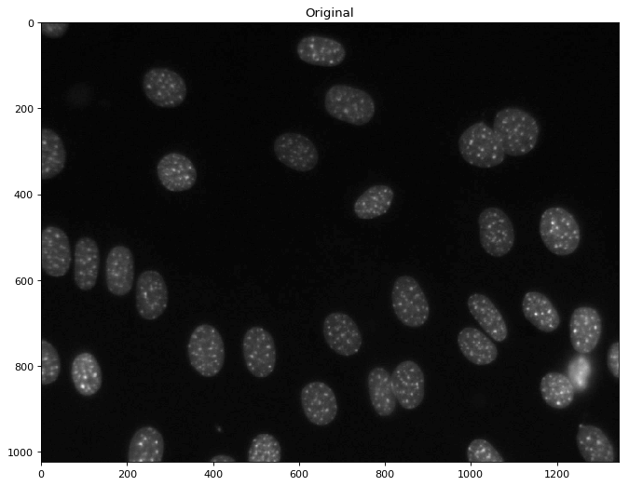
Sample Image

Slide 5
Thresholding
Thresholding provides an easy and convenient way to perform the segmentation on the basis of the different intensities or colors in the foreground and background regions of an image. It is useful to be able to separate out the regions of the image corresponding to objects in which we are interested, from the regions of the image that correspond to background.

Slide 6
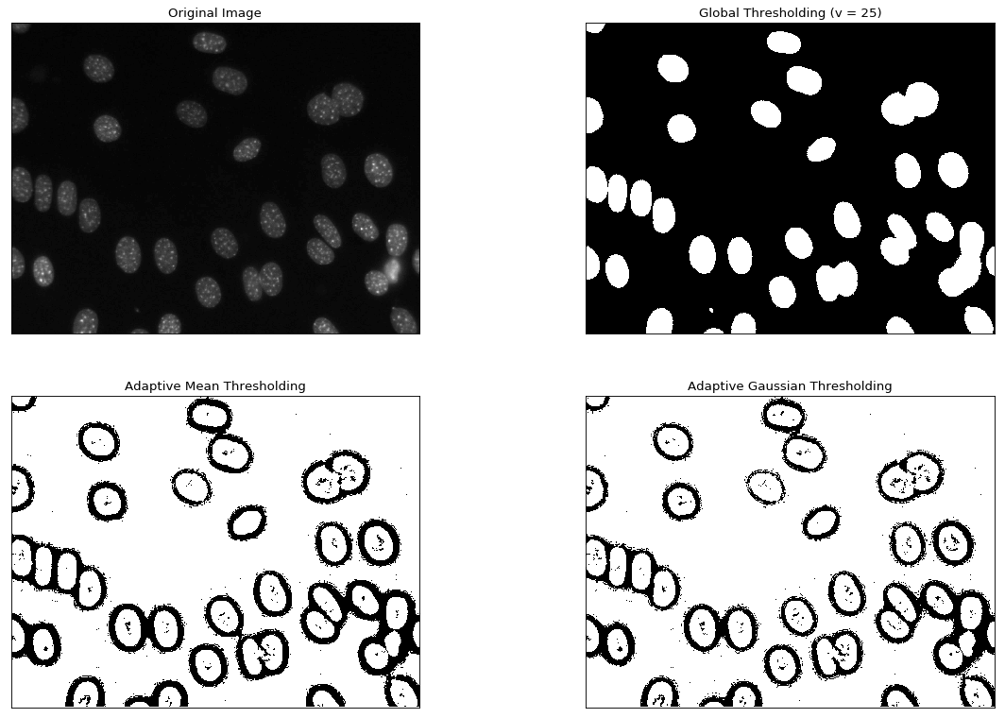
Output of Thresholding (Adaptive)

Slide 7
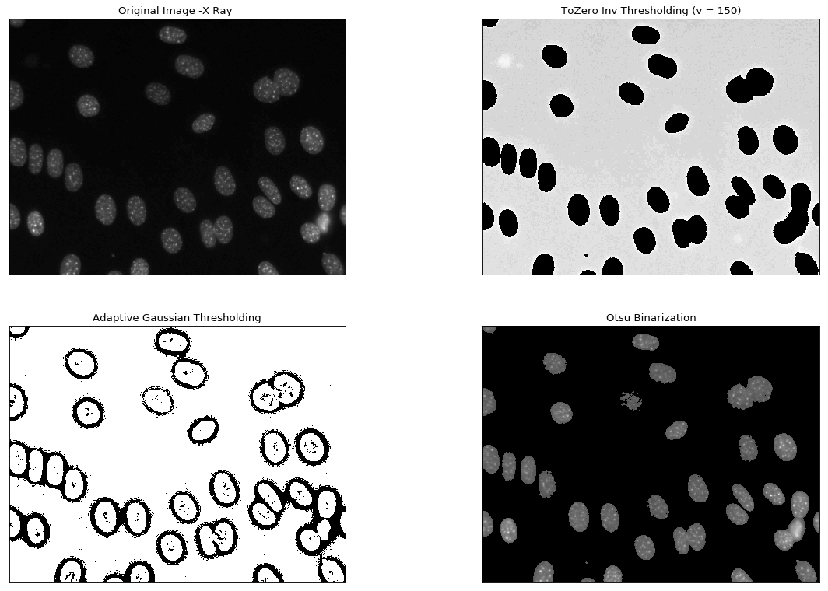
Output of Thresholding (OTSU)

Slide 8
Edge Detection
Edge detection is finding the boundary which separates the two regions. Edge detection detects the edges of the regions and creates a segmentation based on the detected edges. Segmenting the region inside one edge as one segment.
We have used Canny , Sobel and Laplacian edge detection
methods to segment our images from the dataset.

Slide 9
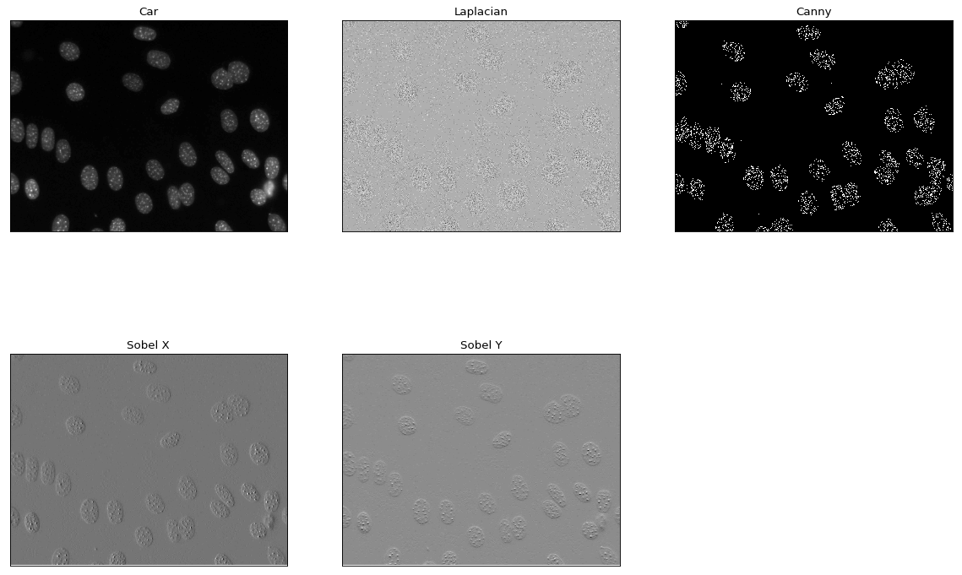
Output

Slide 10
K means
K -means clustering algorithm is an unsupervised algorithm and it is used to segment the interest area from the background. K means uses clustering to segment the image. Using intensities values of the pixel the image is segmented into K color channel crystals. We can specify the K value and the intensities of the image are clustered into K clusters.

Slide 11
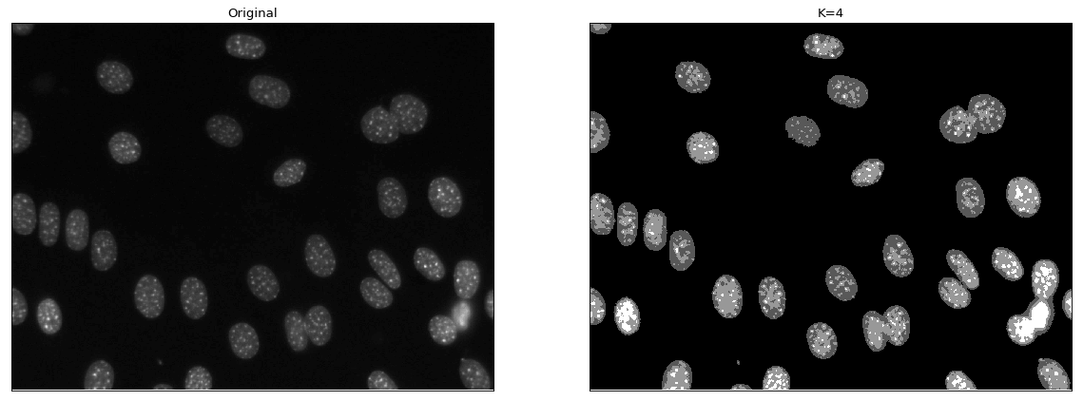
Output

Slide 12
Watershed
Watershed segmentation algorithm finds the “watershed lines” in an image in order to separate the distinct regions. To imagine the pixel values of an image is a 3D topographic chart, where x and y denote the coordinate of plane, and z denotes the pixel value. The algorithm starts to pour water in the topographic chart from the lowest basin to the highest peak.

Slide 13
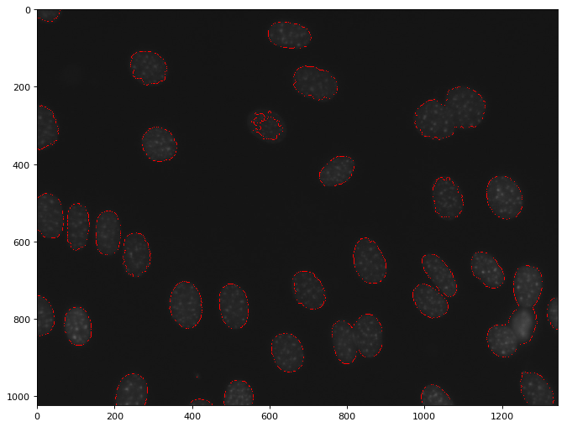
Output

Slide 14
Problem in Basic Segmentation Techniques
The certain images have very closely packed cell structure and the segmentation algorithms were not able to properly segment the images and this gives an irregular shaped segment without proper cell boundary.

Slide 15
Solving the Problem
We used different combination of segmentation techniques to segment the images and the result were somewhat better than the basic segmentation techniques.
The best combination found was implementing the watershed segmentation along with thresholding.

Slide 16
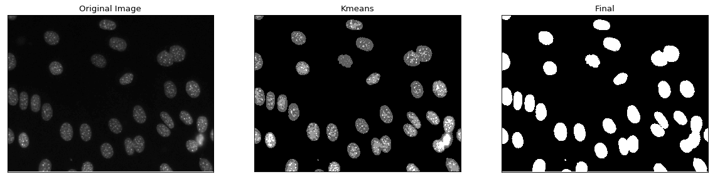
Enhanced Methods

Slide 17
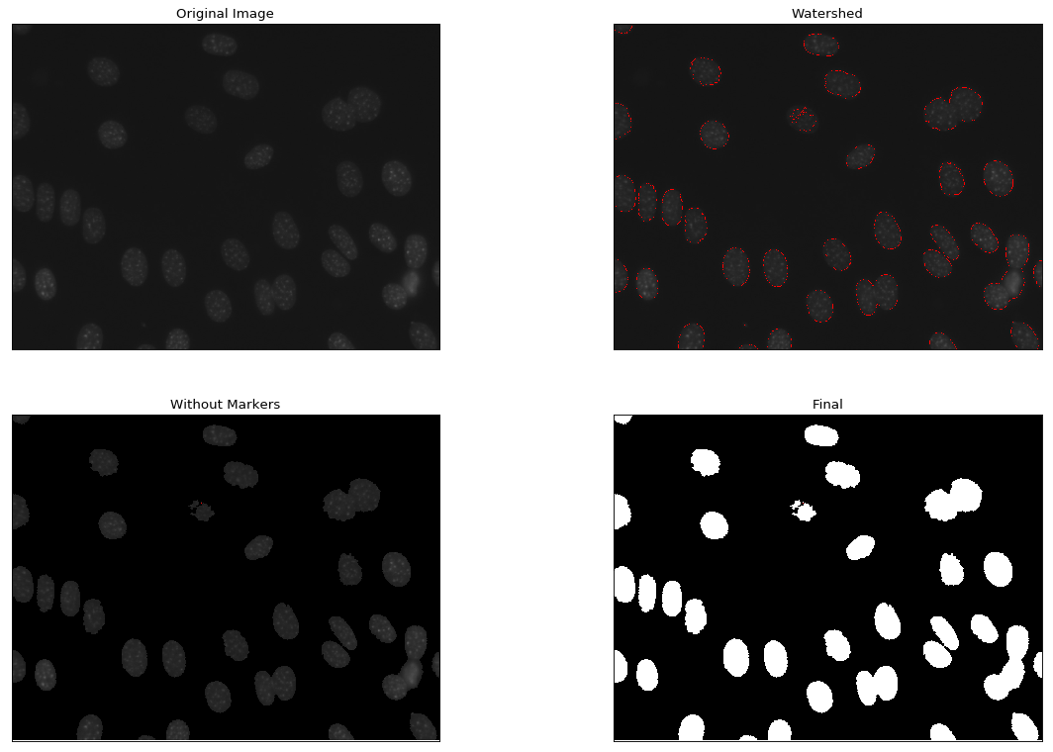
Enhanced Methods

Slide 18
Parallel Image Segmentation
How to do the computing fast

Slide 19
Why a Parallel Approach

Slide 20
Why a parallel approach
For most computing tasks, there is great advantage to splitting up workload into multiple workers and partitioning the task into different, multiple tasks for these multiple actors.

Slide 21
Approaches
Two common ways of doing this are multi-threaded programs and multi-process systems. Understanding the best choice for your program and workload requires understanding the advantages and disadvantages of multi-threaded programs:

Slide 22
Multiprocessing
Separate memory space
Code is usually straightforward
Takes advantage of multiple CPUs & cores
Avoids GIL limitations for cPython
Eliminates most needs for synchronization primitives unless if you use shared memory (instead, it's more of a communication model for IPC)
Child processes are interruptible/killable
Python multiprocessing module includes useful abstractions with an interface much like threading.Thread
A must with cPython for CPU-bound processing
In multi-process systems, there are multiple actors but each lives in its own independent program context.

Slide 23
Multithreading
In a multi-threaded program, multiple actors live in a shared program context.
Lightweight - low memory footprint
Shared memory - makes access to state from another context easier
Allows you to easily make responsive UIs
cPython C extension modules that properly release the GIL will run in parallel
Great option for I/O-bound applications

Slide 24
What to use for Image
Processing
You cannot speed it up using threading due to the Global Interpreter Lock. Certain internal state of the Python interpreter is protected by that lock, which prevents different threads that need to modify that state from running concurrently.
You could speed it up by spawning actual processes using multiprocessing. Each process will run in its own interpreter, thus circumventing the limitation of threads. With multiprocessing, you can either use shared memory, or give each process its own copy/partition of the data.
Another way for improving performance of such operations is to try writing them in Cython, which has its own support for parallelization using OpenMP

Slide 25
“But we tried implementing threads for image segmentation
”

Slide 26
The main challenges were the Global Interpreter Lock and Shared memory

Slide 27
How?
Data parallelism
Task Parallelism:
Splitting the image into subimages and processing them on different thread
For a colored image the task can be divided on the basis of the color channel

Slide 28
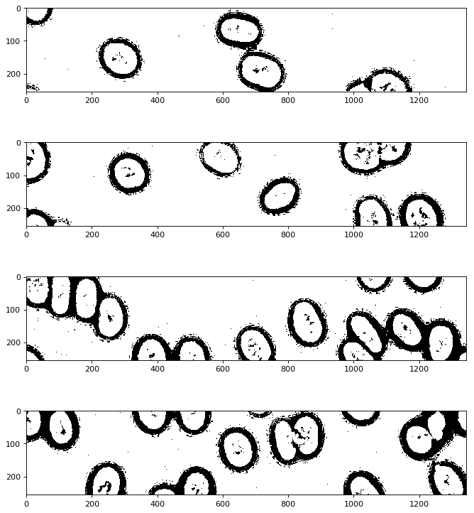
Threading Implementation Adaptive Thresholding

Slide 29
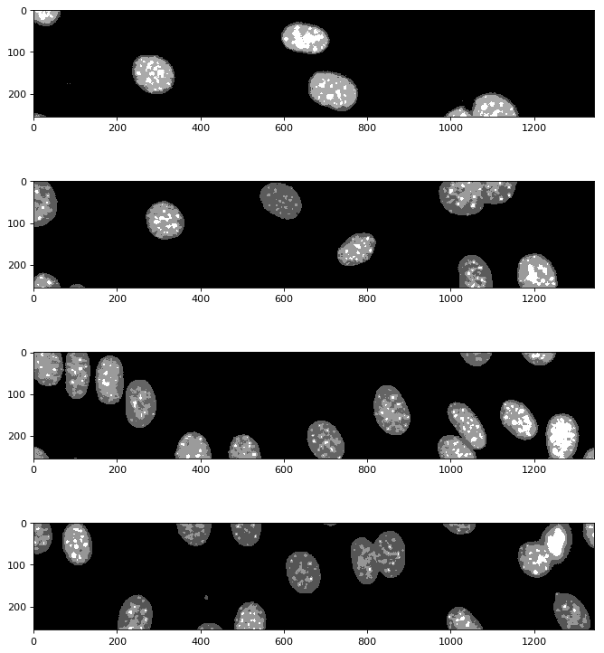
Threading Implementation K Mean

Slide 30
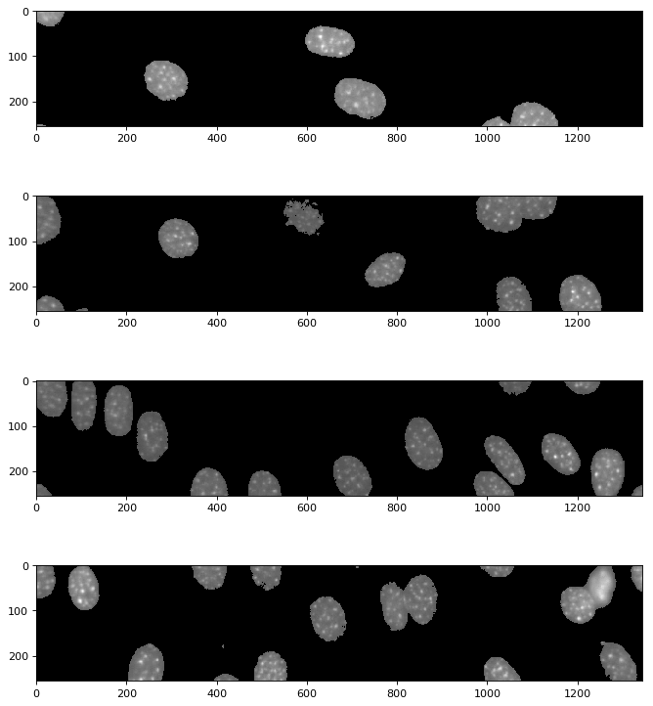
Threading Implementation OTSU

Slide 31
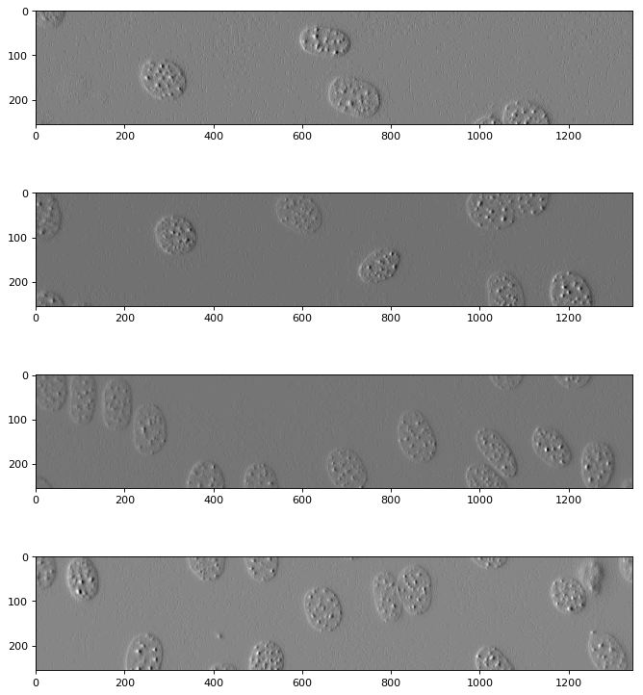
Threading Implementation Sobel

Slide 32
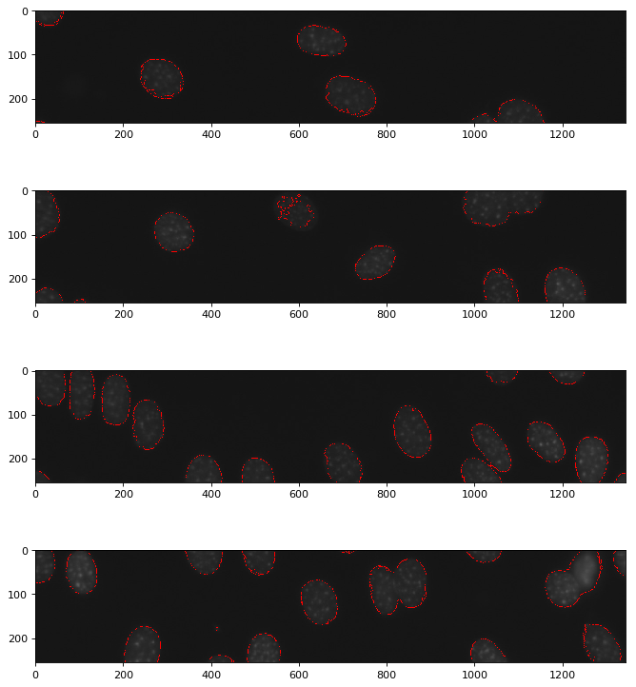
Threading Implementation Watershed

Slide 33
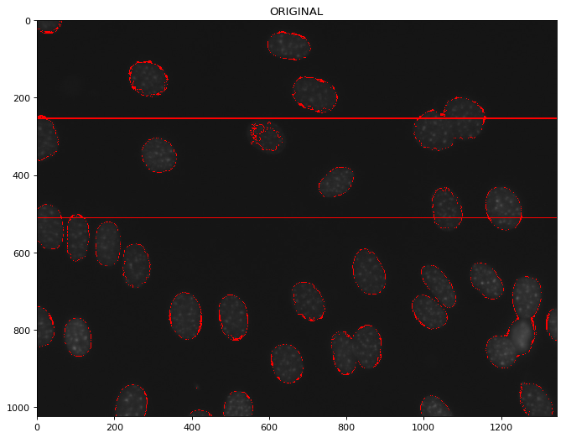
After Merging

Slide 34
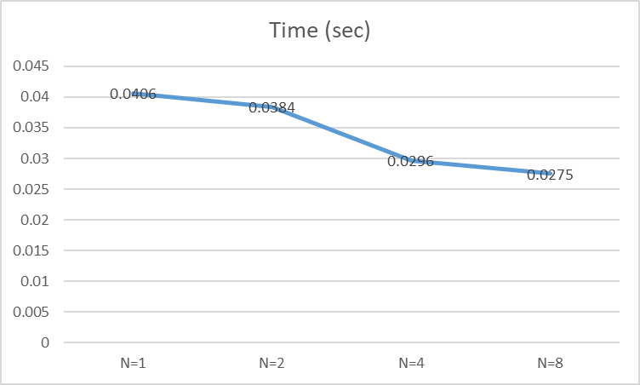
Watershed performance (threading)

