Slide 1
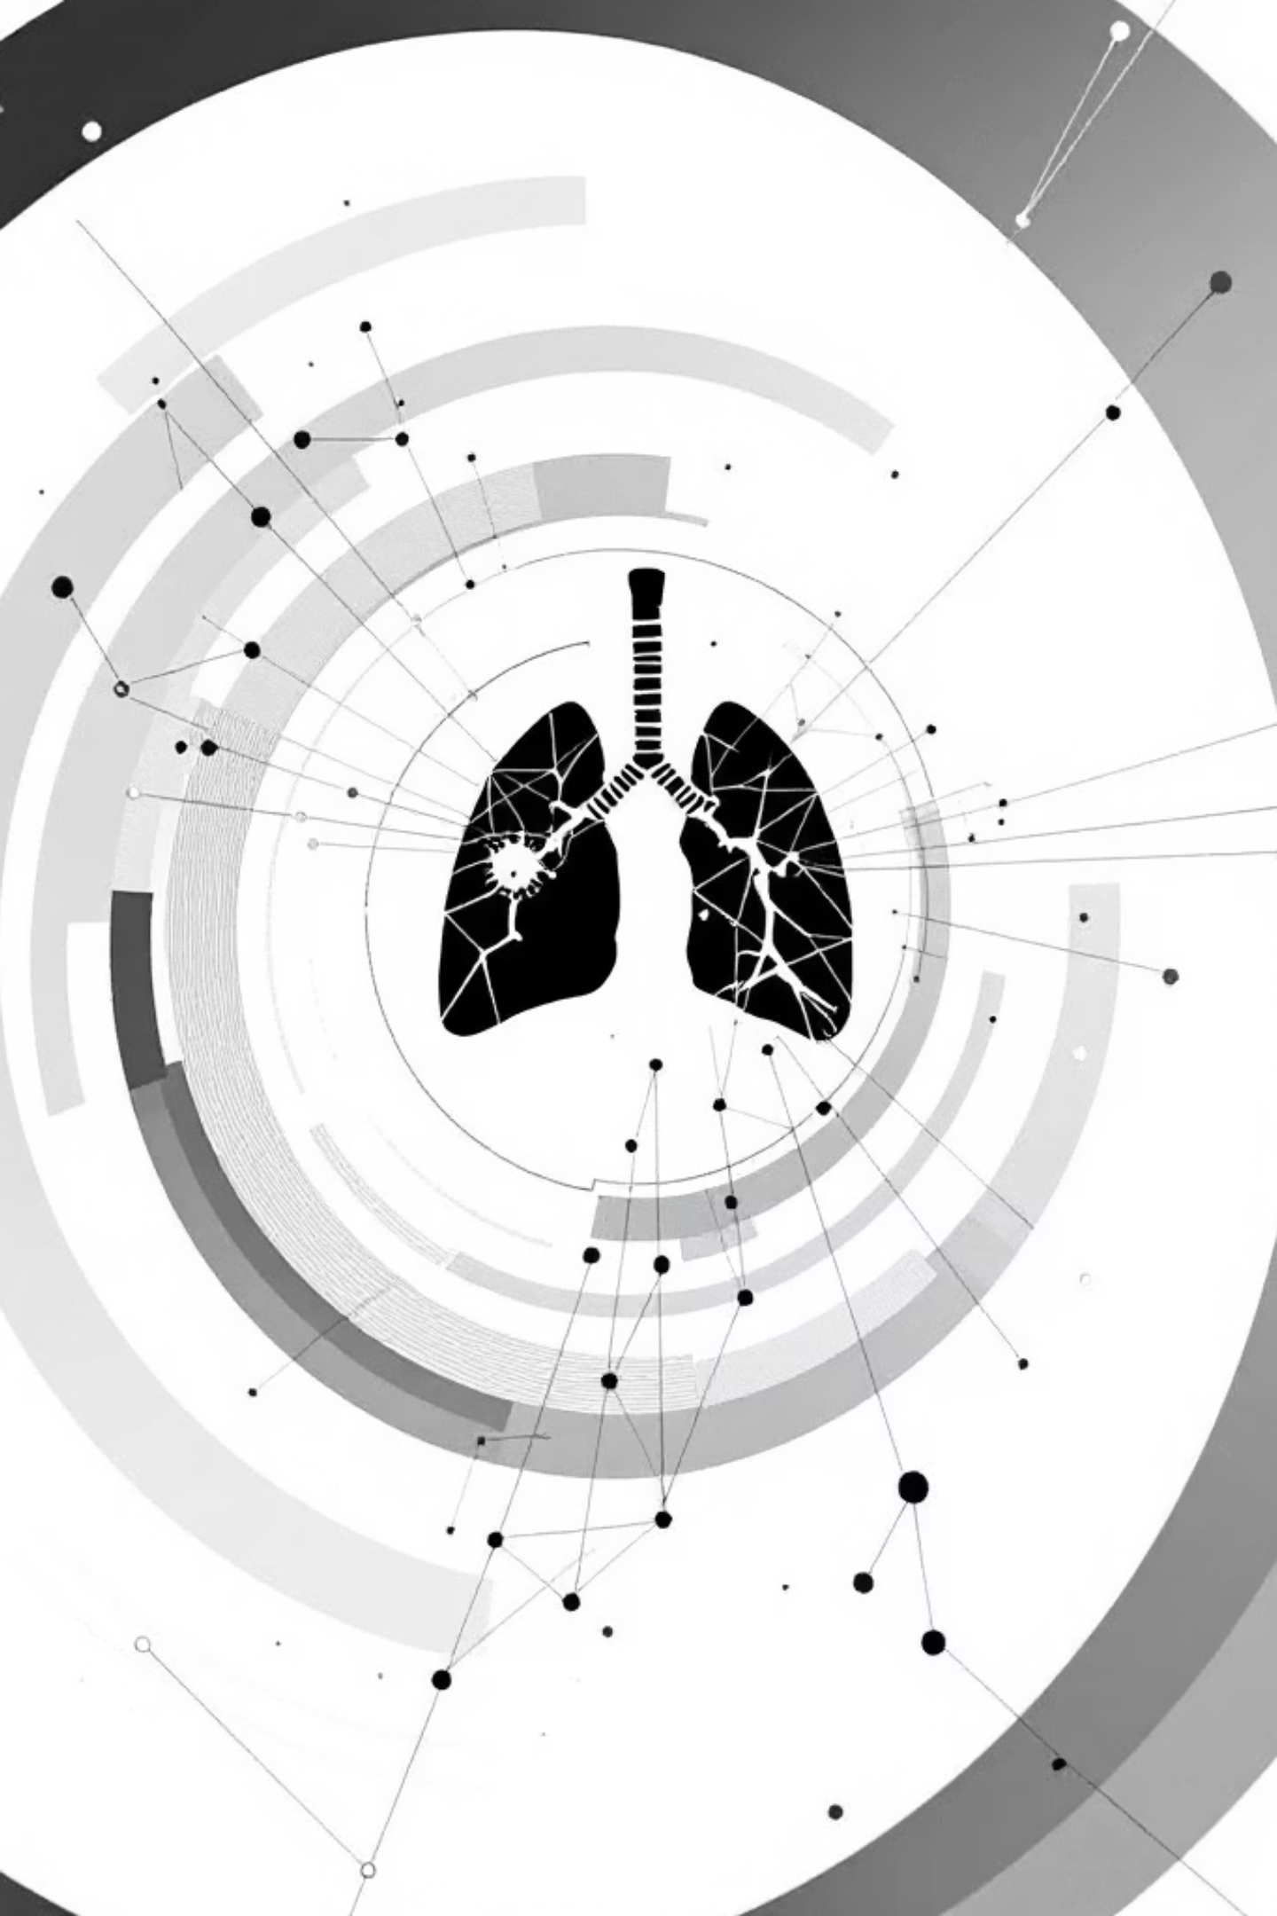
Lung Cancer Detection using Convolutional Neural Networks
Deep Learning Based Medical Image Classification
Ayush Deep

Slide 2
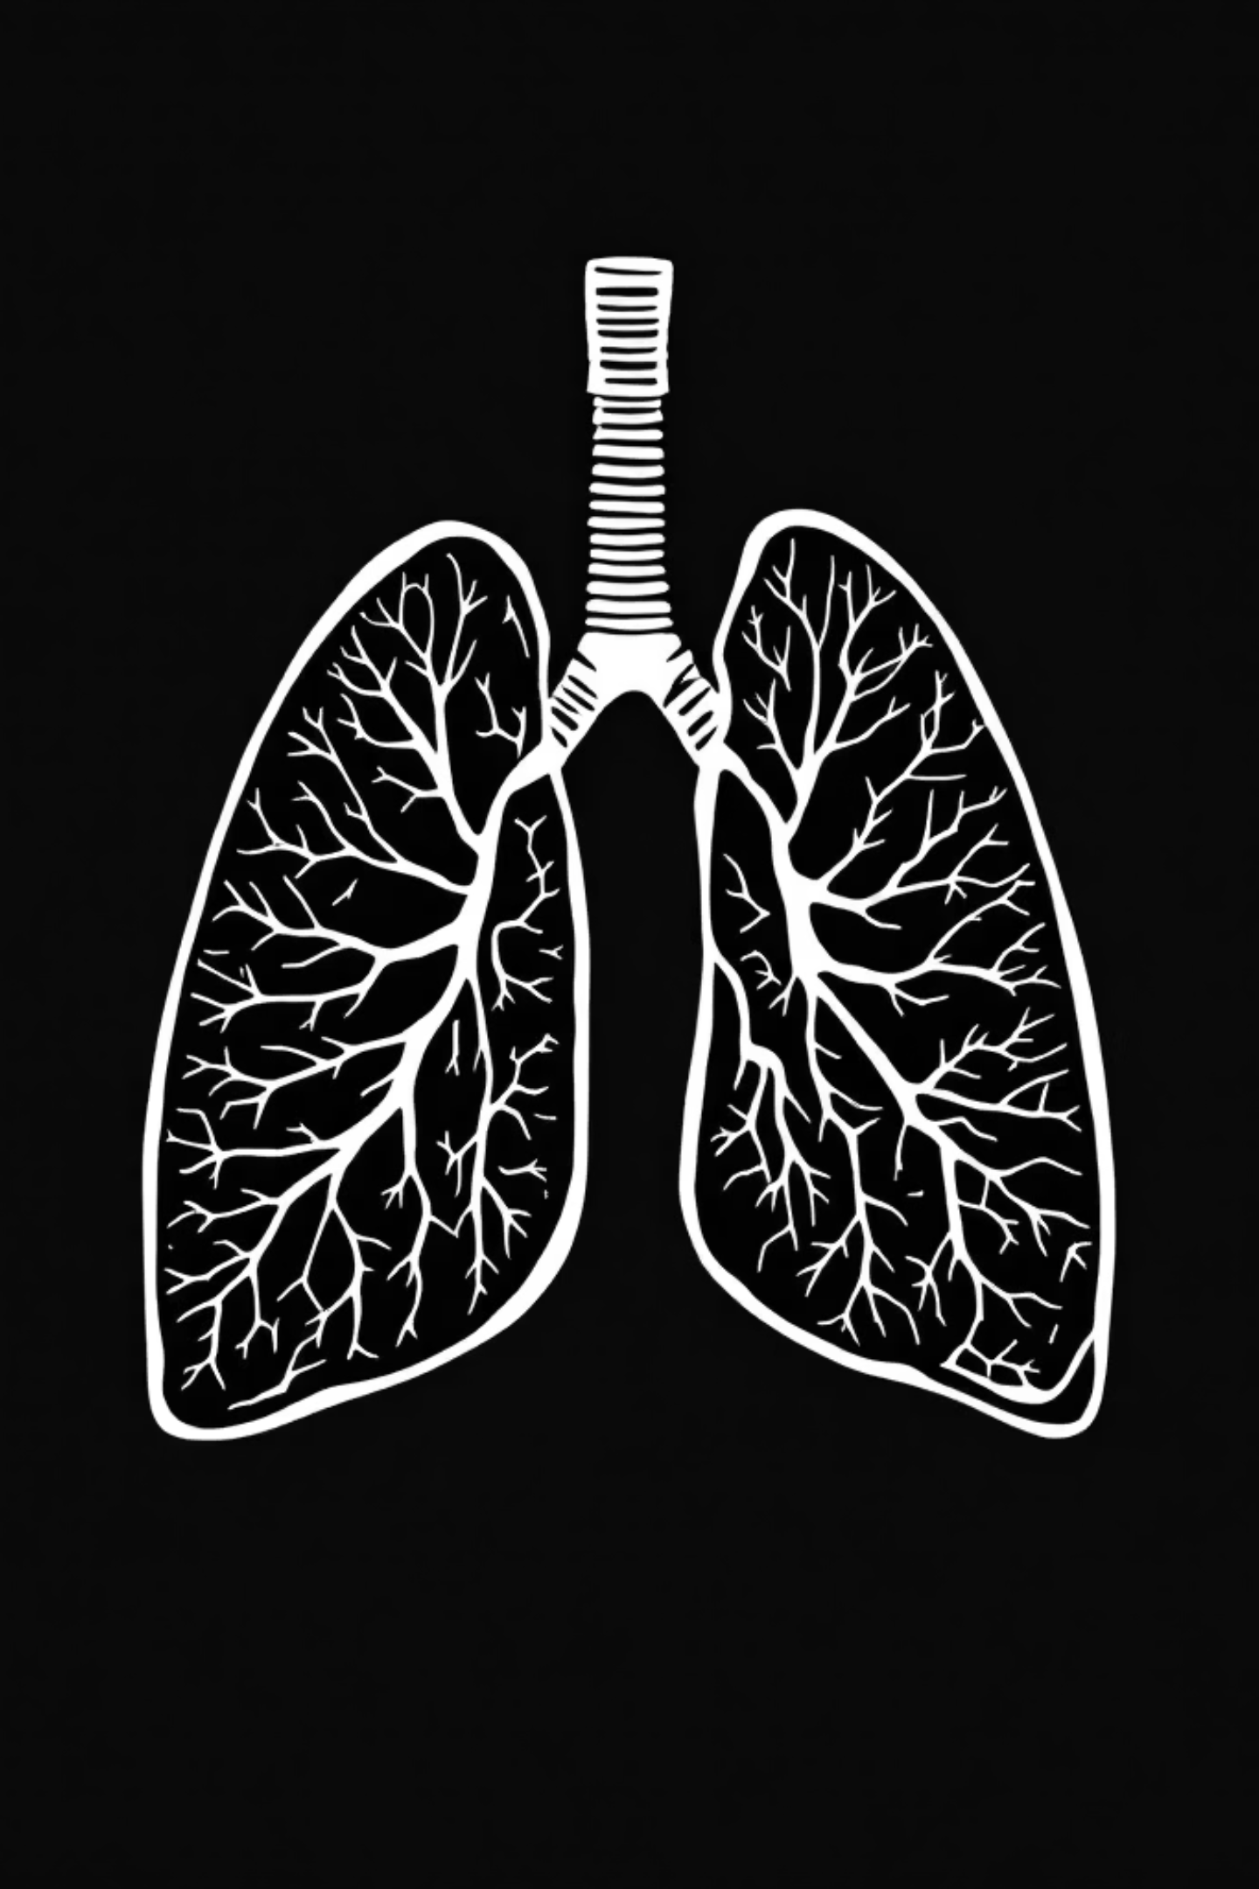
Problem Statement
Challenge
Large volume of CT scan images requiring expert analysis
Manual Limitations
Time-consuming analysis with potential for human error
Objective
Automatically classify CT scans as cancerous or non-cancerous using CNN

Slide 3
Dataset & Preprocessing
01
Dataset Size
Raw CT Images
Original scan data collection
1000 total CT scan images
02
Image Resizing
Training Set
Standardize dimensions (224×224)
613 images
03
Normalization
Validation Set
Scale pixel values (0-1)
04
72 images
Data Augmentation
Rotation, flip, zoom variations
Test Set
05
315 images
Model Input
Prepared tensor format

Slide 4





CNN Model Architecture
Input
Conv 32
ReLU
MaxPool
Conv 64

Slide 5






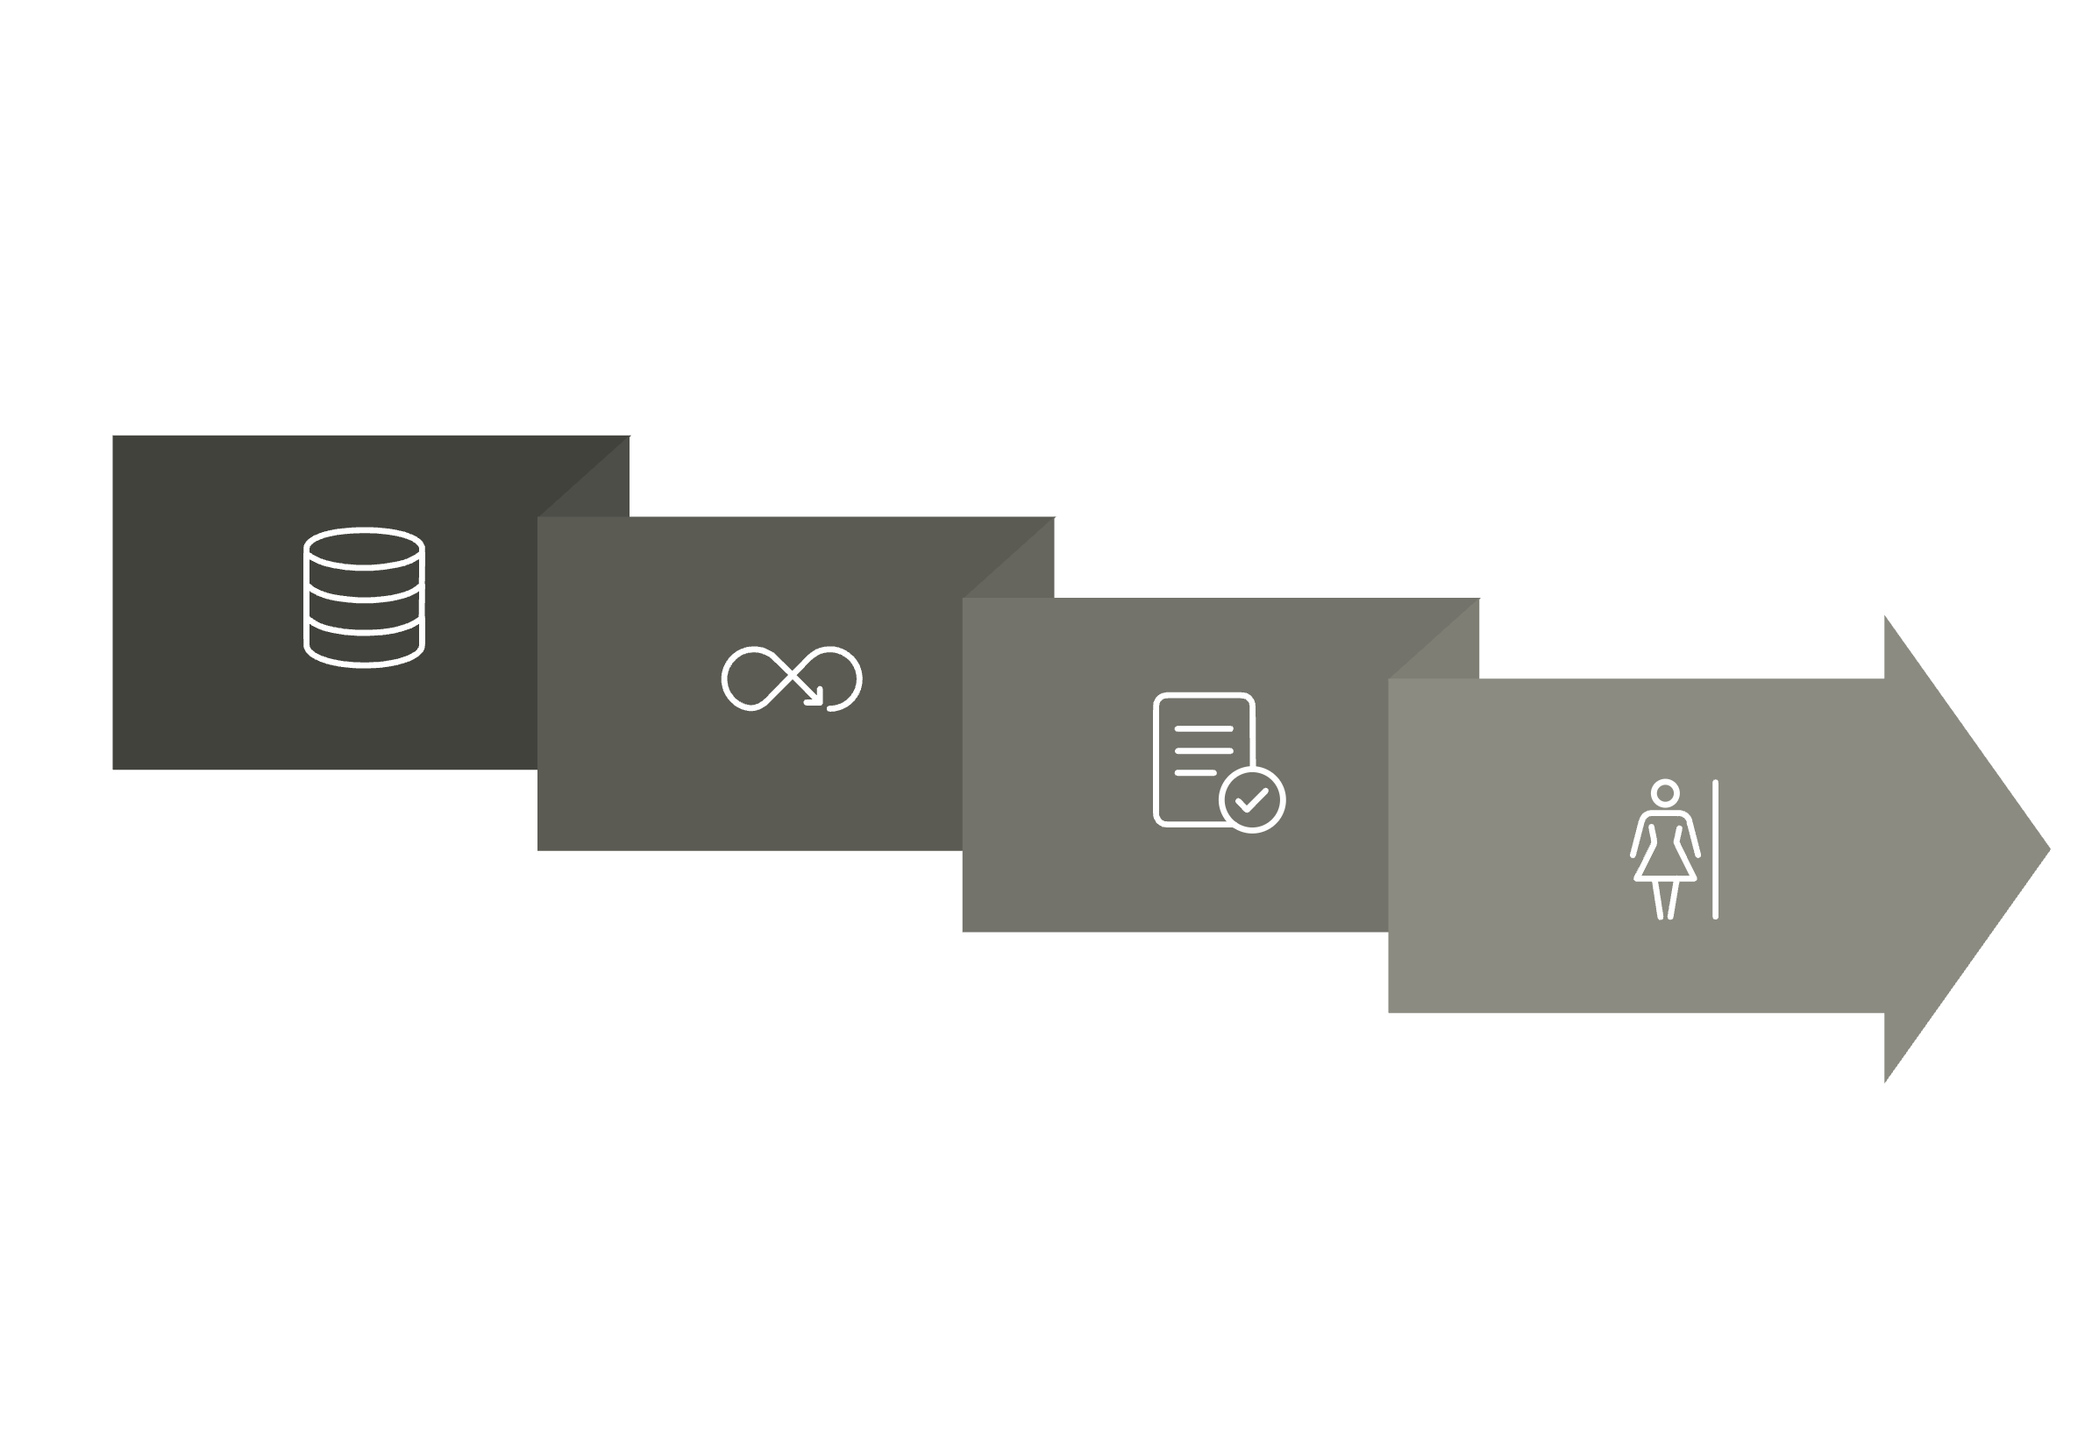
Model Training Configuration
Framework
Loss Function
Epochs
Batch Size
TensorFlow / Keras
Binary Cross Entropy
20 training iterations
32 images per batch
Optimizer
Metrics
Adam
Accuracy, Precision, Recall
Training Loop
Trained Model
Dataset
Backpropagation

Slide 6




System Workflow & Architecture
Image Upload
Preprocessing
User submits CT scan
Resize, normalize, validate
CNN Prediction
Dashboard
Model inference
Display results
Backend Stack
Frontend Interface
Python 3.11
TensorFlow 2.12
NumPy / Pillow
Streamlit framework
Web-based UI
Real-time predictions

Slide 7

Results & Evaluation Metrics
93.8%
83.1%
93.2%
0.88
Accuracy
Precision
Recall
F1 Score
Overall correct predictions
Proportion of true positives
Cancer detection rate
Balanced metric
Evaluation Method: Confusion matrix analysis on test set. Metrics calculated using scikit-learn implementation.

Slide 8
Conclusion & Future Work
Conclusion
Future Improvements
Feature Extraction
Larger Datasets
CNN effectively learns discriminative features from CT images
Expand to [X]+ annotated scans
Transfer Learning
Clinical Assistance
Implement ResNet, VGG, or Inception architectures
Model supports early detection of lung cancer
Explainability
Usable Interface
Integrate Grad-CAM for visual explanations
Streamlit dashboard enables simple model interaction
Hospital Integration
PACS system compatibility

