Slide 1
Semantic Analysis
In this step, NLP checks whether the text holds a meaning or not.
It tries to decipher the accurate meaning of the text.
Semantic Analyzer will reject a sentence like “ dry water, “hot ice-cream”
The several techniques used for Semantics Analysis are:
Named Entity Recognition (NER)
Word Sense Disambiguation
Natural Language Generation

Slide 2
NLP Libraries
Scikit-learn: It provides a wide range of algorithms for building machine learning models in Python.
Natural language Toolkit (NLTK): NLTK is a complete toolkit for all NLP techniques.
Pattern: It is a web mining module for NLP and machine learning.
TextBlob: It provides an easy interface to learn basic NLP tasks like sentiment analysis, noun phrase extraction, or pos-tagging.
Quepy: Quepy is used to transform natural language questions into queries in a database query language.
SpaCy: SpaCy is an open-source NLP library which is used for Data Extraction, Data Analysis, Sentiment Analysis, and Text Summarization.
Gensim: Gensim works with large datasets and processes data streams.

Slide 3
Basics of Text Processing
Tokenization
Stemming
Lemmatization
POS tagging

Slide 4
1.Tokenization
Tokenization is text pre-processing technique, used to split text data in into smaller units which can be words, phrases, or even individual characters. These smaller units are called tokens.
Need:
it allows a computer to understand and process textual data.
By breaking down the text into tokens, the computer can analyze the structure and meaning of the content more effectively.

Slide 5
Types:
Word Tokenization:
The most common form of tokenization is word tokenization, where a text is split into individual words.
Punctuation marks and special characters are often treated as separate tokens.
Whitespace (spaces, tabs, line breaks) is a common delimiter.
Sentence Tokenization:
In addition to word tokenization, some applications require breaking down a text into sentences.
This is particularly useful for tasks such as sentiment analysis or language translation.
Character Tokenization:
In certain scenarios, especially for languages with complex scripts, tokenization may occur at the character level.

Slide 6
Example:
Success doesn't come from what you do occasionally but what you do consistently.
Tokens:
Word
Sentence
Character

Slide 7
Natural Language Toolkit
import nltk
It is a powerful library in Python for working with human language data.
It provides easy-to-use interfaces to over 50 corpora and lexical resources, such as WordNet. Additionally, NLTK contains a suite of text processing libraries for classification, tokenization, stemming, tagging, parsing, and semantic reasoning.
When you see the statement ‘import nltk’, it means that the code is incorporating the NLTK library into the program. This enables the use of various NLP functionalities that NLTK provides.

Slide 8
common tasks with NLTK:
Tokenization:
Break text into words or sentences.
from nltk.tokenize import word_tokenize, sent_tokenize
Stopwords:
Remove common words (stopwords) that often don't contribute much to the meaning.
from nltk.corpus import stopwords
Stemming and Lemmatization:
Reduce words to their base or root form.
from nltk.stem import PorterStemmer, WordNetLemmatizer
4. Part-of-Speech Tagging:
Assign grammatical categories to words.
from nltk import pos_tag

Slide 9
5. Named Entity Recognition (NER):
Identify entities such as names, locations, and organizations.
from nltk import ne_chunk
6. Frequency Distribution:
Analyze word frequencies in a text.
from nltk import FreqDist
7. WordNet Interface:
Access lexical database of English.
from nltk.corpus import wordnet
8. Downloading Resources:
Download additional datasets and models.
import nltk
nltk.download('punkt')

Slide 10
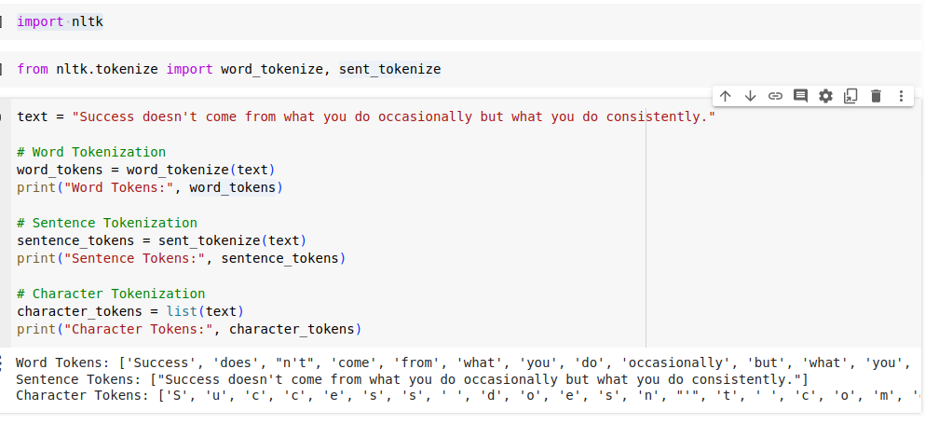

Slide 11
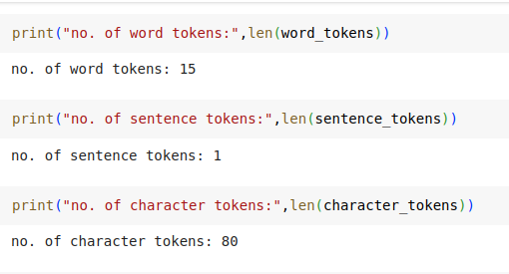

Slide 12
Solution:
Word Tokens: ['Success', 'does', "n't", 'come', 'from', 'what', 'you', 'do', 'occasionally', 'but', 'what', 'you', 'do', 'consistently', '.']
Sentence Tokens: ["Success doesn't come from what you do occasionally but what you do consistently."]
Character Tokens: ['S', 'u', 'c', 'c', 'e', 's', 's', ' ', 'd', 'o', 'e', 's', 'n', "'", 't', ' ', 'c', 'o', 'm', 'e', ' ', 'f', 'r', 'o', 'm', ' ', 'w', 'h', 'a', 't', ' ', 'y', 'o', 'u', ' ', 'd', 'o', ' ', 'o', 'c', 'c', 'a', 's', 'i', 'o', 'n', 'a', 'l', 'l', 'y', ' ', 'b', 'u', 't', ' ', 'w', 'h', 'a', 't', ' ', 'y', 'o', 'u', ' ', 'd', 'o', ' ', 'c', 'o', 'n', 's', 'i', 's', 't', 'e', 'n', 't', 'l', 'y', '.']

Slide 13
Example:
“The future belongs to those who believe in the beauty of their dreams“
Tokenization is performed to break the data into individual parts, in order to understand it by machines.
With tokenization for above sentence, we’d get something like this:
‘The’, ‘future’, ‘belongs’, ‘to’ , ‘those’ , ‘who’ , ‘believe’, ‘in’, ‘the’, ‘beauty’, ‘of’, ‘their’, ‘dreams’

Slide 14
Importance of Tokenization:
Text Analysis:
Tokenization is a crucial step in text analysis tasks, allowing computers to understand and process the structure of a text.
Information Retrieval:
In search engines, tokens help in retrieving relevant documents based on user queries.
Machine Learning:
Tokenized text is often used as input for machine learning models in natural language processing applications.
Language Understanding:
Tokenization provides a foundation for other NLP tasks such as stemming, lemmatization, and part-of-speech tagging.

Slide 15
Tools used for Tokenization:
White Space Tokenization
NLTK Word Tokenize
Word and Sentence tokenizer
White Space Tokenizer
Punctuation-based tokenizer
Treebank Word tokenizer
Tweet tokenizer
MWE tokenizer
TextBlob Word Tokenizer
spaCy Tokenizer
Gensim word tokenizer
Tokenization with Keras

Slide 16
White Space Tokenization
This is the simplest way of tokenization. It uses white space to separate tokens from one another.
This can be accomplished with Python’s split function. Split function is available on all string object instances as well as on the string built-in class itself.
You can change the separator any way you need.

Slide 17
Example
data= Like a flower in the dessert, I have to grow in the cruelest weather. Holding on to every drop of rain, just to stay alive. But it’s not enough to survive, I want to bloom beneath the blazing sun. And show y'all the colours that live inside of me. I want you to see what I can become. ‘Christy Ann Martine’

Slide 18
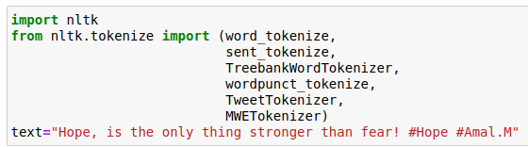
2. NLTK Word Tokenize
NLTK (Natural Language Toolkit) is an open-source Python library for Natural Language Processing. It has easy-to-use interfaces such as WordNet, along with a set of text processing libraries for classification, tokenization, stemming, and tagging.
You can easily tokenize the sentences and words of the text with the tokenize module of NLTK.

Slide 19
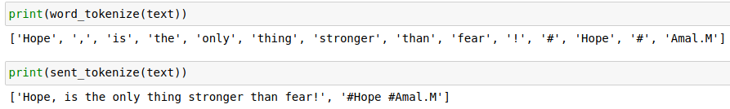
Word and sentence tokenizer

Slide 20
b. Punctuation-based tokenizer
This tokenizer splits the sentences into words based on white spaces and punctuations.

Slide 21
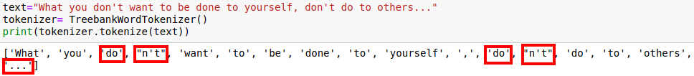
c. Treebank Word Tokenizer
This tokenizer has a variety of common rules for english word tokenization.
It separates phrase-terminating punctuation like (?!.;,) from adjacent tokens and retains a single token. Besides, it contains rules for English contractions.
For example:
“don’t” is tokenized as [“do”, “n’t”].
Rules for the Treebank Tokenizer at this link.

Slide 22
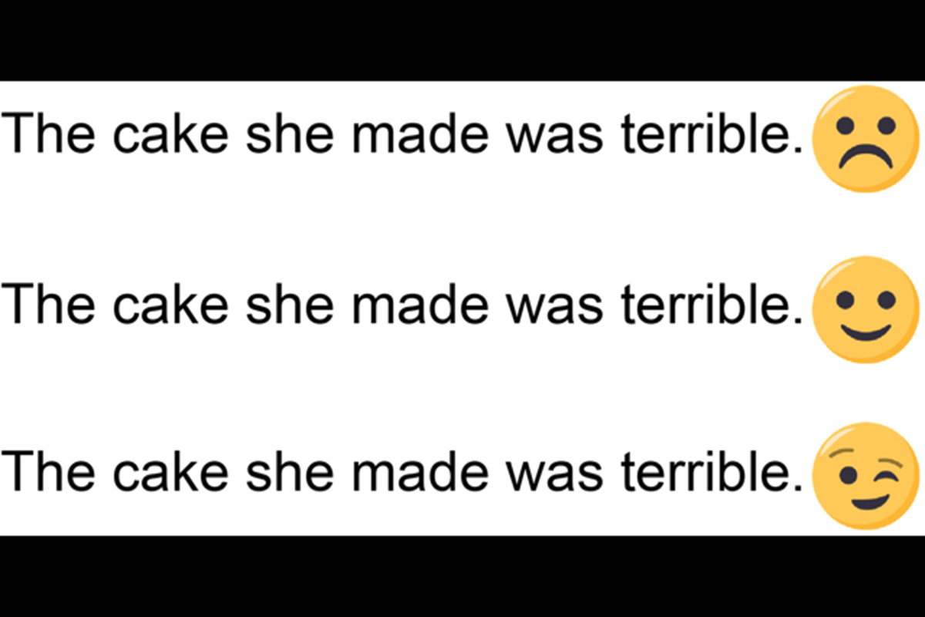
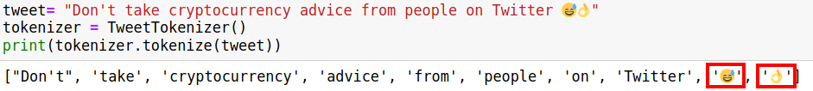
d. Tweet Tokenizer
When we want to apply tokenization in text data like tweets, the tokenizers mentioned above can’t produce practical tokens.
Through this issue, NLTK has a rule based tokenizer special for tweets. We can split emojis into different words if we need them for tasks like sentiment analysis.

Slide 23
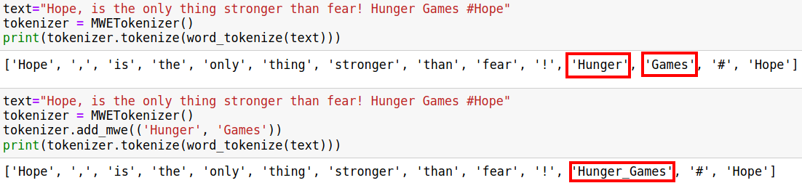
e. MWE Tokenizer
NLTK’s multi-word expression tokenizer (MWETokenizer) provides a function add_mwe() that allows the user to enter multiple word expressions before using the tokenizer on the text. More simply, it can merge multi-word expressions into single tokens.

Slide 24
3. TextBlob Word Tokenizer
TextBlob is a Python library for processing textual data.
It provides a consistent API for diving into common natural language processing (NLP) tasks such as part-of-speech tagging, noun phrase extraction, sentiment analysis, classification, translation, and more.
Let’s start by installing TextBlob and the NLTK corpora:
$pip install -U textblob
$python3 -m textblob.download_corpora

Slide 25
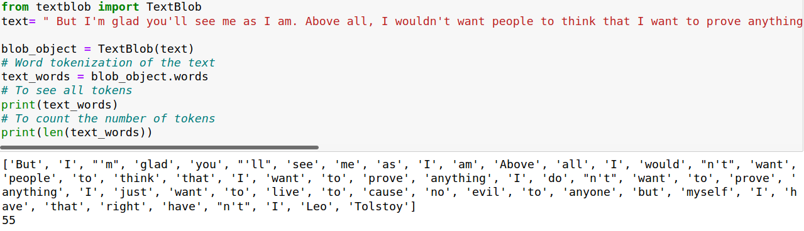

Slide 26
4. Spacy Tokenizer
The spaCy library is one of the most popular NLP libraries along with NLTK.
The basic difference between the two libraries is the fact that NLTK contains a wide variety of algorithms to solve one problem whereas spaCy contains only one, but the best algorithm to solve a problem.
Before you can use spaCy you need to install it, download data and models for the English language.
>>> pip install spacy
>>> python3 -m spacy download en_core_web_sm

Slide 27
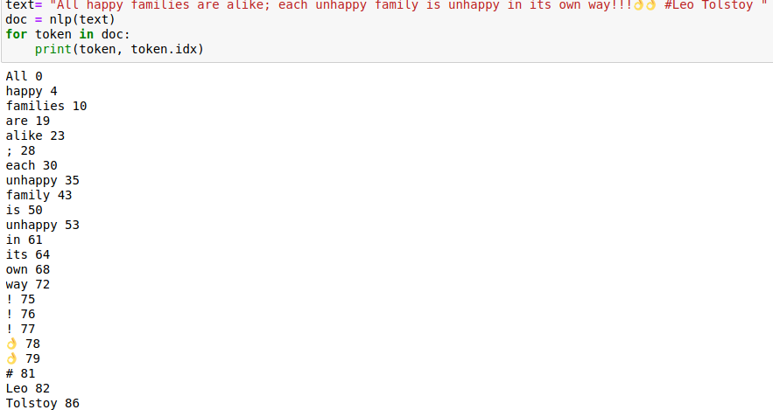

Slide 28
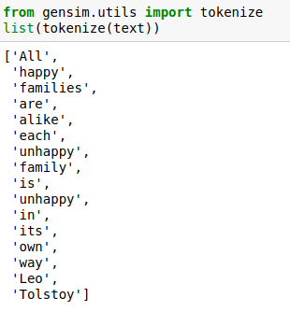
5. Gensim word tokenizer
Gensim is a Python library for topic modeling, document indexing, and similarity retrieval
It offers utility functions for tokenization.

Slide 29
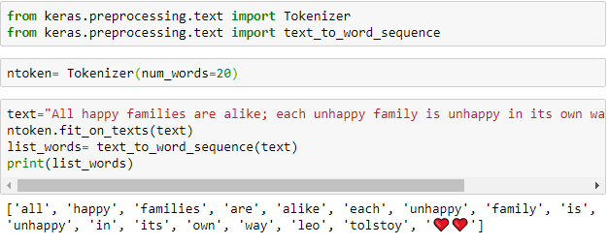
6. Tokenization with Keras
Keras open-source library is one of the most reliable deep learning frameworks
To perform tokenization we use: text_to_word_sequence method from the Class Keras.preprocessing.text class. The great thing about Keras is converting the alphabet in a lower case before tokenizing it, which can be quite a time-saver.

Slide 30
Stemming
Stemming is a text normalization technique in natural language processing and information retrieval that involves reducing words to their base or root form.
The goal of stemming is to map words with similar meanings to a common representation, thereby simplifying the analysis of the text.
Stemming involves removing prefixes, suffixes, or other affixes from words, leaving only the core meaning or the root.

Slide 31
Need?
Embrace the journey of becoming a studious student by dedicating time to study regularly. Engage in your studies with passion and commitment, for a studious approach unlocks the doors to knowledge and success. The studiousness you exhibit today will shape your future, ensuring that every moment spent studying contributes to your academic growth. Remember, a successful student is one who embraces the joy of learning through consistent study habits. Let your dedication to studies reflect in every assignment and exam, showcasing the true essence of a studious and thriving student.

Slide 32
The English language provides numerous examples of words with various inflections and derivations. Let's take the word "talk" as an example:
Base Form: talk
Talks: third person singular present (e.g., She talks a lot.)
Talked: past tense (e.g., They talked for hours.)
Talking: present participle/gerund (e.g., I enjoy talking with friends.)
Talker: agent noun (e.g., She is an excellent talker.)
Talks: referring to a series of spoken exchanges (e.g., The talks between the two nations were productive.)
Talkative: inclined to talk a lot (e.g., He's a very talkative person.)
Talkatively: in a talkative manner (e.g., She explained the concept talkatively.)

Slide 33
Inflections are changes made to the base form of a word to convey grammatical information, such as tense, number, gender, case, or person.
Base Form: "Run" Inflected Forms:
"Runs" (third person singular)
"Running" (present participle)
"Ran" (past tense)
"Runner" (noun form)
Derivations involve creating new words by adding affixes (prefixes, suffixes, infixes) to an existing base or root word. Derivations often result in changes in meaning or part of speech.
Base Word: "Friend" Derived Words:
"Friendly" (adjective)
"Friendship" (noun)
"Unfriend" (verb)
Morphological variations encompass a broader set of changes in the form of a word. This includes inflections, derivations, and other alterations based on morphological rules.
Base Word: "Happy" Morphological Variations:
"Happier" (comparative)
"Happiest" (superlative)
"Happiness" (noun)
"Unhappy" (negation)

Slide 34
Advantages:
Text Normalization:
This simplifies the analysis of text data by treating different forms of a word as the same, leading to more consistent and meaningful results.
Efficient Information Retrieval:
Users may use different word forms when searching for information. Stemming helps in matching these variations.
Document Clustering:
Stemming aids in grouping related documents together based on similar word stems.

Slide 35

2. Stemming
Stemming is used to normalize words into its base form or root form.
For example,:
celebrates, celebrated and celebrating, all these words are originated with a single root word "celebrate."
The big problem with stemming is that sometimes it produces the root word which may not have any meaning.
For Example:
intelligence, intelligent, and intelligently, all these words are originated with a single root word "intelligen." In English, the word "intelligen" do not have any meaning.

Slide 36
Stemming Algorithms:
There are several different algorithms for stemming Such as:
Porter stemmer
Snowball stemmer
Lancaster stemmer
The Porter stemmer is the most widely used algorithm, used to remove common suffixes from words.
The Snowball stemmer is a more advanced algorithm that is based on the Porter stemmer, but it also supports several other languages in addition to English.
The Lancaster stemmer is a more aggressive stemmer and it is less accurate than the Porter stemmer and Snowball stemmer.

Slide 37
Porter Stemmer
It is one of the most commonly used stemmers, developed by M.F. Porter in 1980.
Porter’s stemmer consists of five different phases. These phases are applied sequentially.
Within each phase, there are certain conventions for selecting rules.
The entire porter algorithm is small and thus fast and simple.
The drawback of this stemmer is that it supports only the English language, and the stem obtained may or may not be linguistically correct.

Slide 38
Vowels: a, e, i, o, u and y preceded by consonant
Consonant: is a letter other than the vowels and other than a letter “Y” preceded by a consonant.
A consonant will be denoted by c, a vowel by v.
A list ccc... of length greater than 0 will be denoted by C, and a list vvv... of length greater than 0 will be denoted by V. Any word, or part of a word, therefore has one of the four forms:
CVCV ... C
CVCV ... V
VCVC ... C
VCVC ... V

Slide 39
(C) (VC)^{m} (V)
m=0: TREE.
m=1: TROUBLE
m=2: TROUBLES, PRIVATE

Slide 40
To remove common suffixes, Porter stemmer applies more than 50 rules, grouped in 5 steps and some substeps. All rules have a form:
(condition) S1 -> S2
This means that if a word ends with the suffix S1, and the stem before S1 satisfies the given condition, S1 is replaced by S2. The condition is usually given in terms of m, e.g.
Example:
(m > 1) EMENT ->
Here S1 is 'EMENT' and S2 is null.
This would map REPLACEMENT to REPLAC, since REPLAC is a word part for which m = 2.
The 'condition' part may also contain the following:
*S - the stem ends with S (and similarly for the other letters).
*v* - the stem contains a vowel.
*d - the stem ends with a double consonant (e.g. -TT, -SS).
*o - the stem ends cvc, where the second c is not W, X or Y (e.g. -WIL, -HOP).
And the condition part may also contain expressions with and, or and not, so that:
(m>1 and (*S or *T)) : tests for a stem with m>1 ending in S or T,
(*d and ! (*L or *S or *Z)) : tests for a stem ending with double consonant other than L, S or Z.

Slide 41
Step 1a:
Some rules don’t have conditions. Below are some rules with word stemming examples:
In a set of rules written beneath each other, only one is obeyed, and this will be the one with the longest matching S1 for the given word. For example, with
SSES -> SS
IES -> I
SS -> SS
S -> ε
(here the conditions are all null)
CARESSES maps to CARESS since SSES is the longest match for S1. Equally CARESS maps to CARESS (S1=SS) and CARES to CARE (S1=S).

Slide 42
Example:
Tosses
Dresses
Remains
Mass
Classes
Biogasses
Batteries
Loss
activities
ambiguities
statistics
Across
accessories
unless

Slide 43
Step 1b:
No. | Rule | Condition Verified | Condition not Verified
1 | (m>0) EED -> EE | agreed -> agree | feed -> feed
2 | (*v*) ED -> | plastered -> plaster | bled -> bled
3 | (*v*) ING -> | motoring -> motor | sing -> sing

Slide 44
If the Rules 2 & 3 in Step 1b is satisfied, apply following rules:
No | Rule | Condition Verified | Condition not Verified
1 | AT -> ATE | Conflated -> conflate
2 | BL -> BLE | Troubling -> Trouble
3 | (*d&!(*L or *S or *Z )) -> single letter | Hopping -> hop Tanned -> tan | Falling -> fall
4 | ( m=1 & *o) -> e | Filing -> File | Fail -> Fail

Slide 45
Step 1c:
No | Rule | Condition Verified | Condition not Verified
1 | (*v*) Y -> I | happy -> happi | sky -> sky
Step 1 deals with plurals and past participles. The subsequent steps are much more straightforward.

Slide 46
Step 2: Derivational Morphology I
The test for the string S1 can be made fast by doing a program switch on the penultimate letter of the word being tested.
This gives a fairly even breakdown of the possible values of the string S1.
It will be seen in fact that the S1-strings in step 2 are presented here in the alphabetical order of their penultimate letter.
Similar techniques may be applied in the other steps.

Slide 47
No | Rule | Example
1 | (m>0) ATIONAL -> ATE | relational -> relate
2 | (m>0) TIONAL -> TION | (conditional -> condition ; rational -> rational)
3 | (m>0) ENCI -> ENCE | (valenci -> valence)
4 | (m>0) ANCI -> ANCE | (hesitanci -> hesitance)
5 | (m>0) IZER -> IZE | ( digitizer -> digitize)
6 | (m>0) ABLI -> ABLE | (conformabli -> conformable)
7 | (m>0) ALLI -> AL | ( radicalli -> radical)
8 | (m>0) ENTLI -> ENT | (differentli -> different)
9 | (m>0) ELI -> E | (vileli -> vile)
10 | (m>0) OUSLI -> OUS | (analogousli -> analogous)

Slide 48
No | Rule | Example
11 | (m>0) IZATION -> IZE | (vietnamization -> vietnamize)
12 | (m>0) ATION -> ATE | (predication -> predicate)
13 | (m>0) ATOR -> ATE | (operator -> operate)
14 | (m>0) ALISM -> AL | (feudalism -> feudal)
15 | (m>0) IVENESS -> IVE | (decisiveness -> decisive)
16 | (m>0) FULNESS -> FUL | (hopefulness -> hopeful)
17 | (m>0) OUSNESS -> OUS | (callousness -> callous)
18 | (m>0) ALITI -> AL | (formaliti -> formal)
19 | (m>0) IVITI -> IVE | (sensitiviti -> sensitive)
20 | (m>0) BILITI -> BLE | (sensibiliti -> sensible)

Slide 49
Step 3: Derivational Morphology II
No | Rule | Example
1 | (m>0) ICATE -> IC | triplicate -> triplic
2 | (m>0) ATIVE -> | formative -> form
3 | (m>0) ALIZE -> AL | formalize -> formal
4 | (m>0) ICITI -> IC | electriciti -> electric
5 | (m>0) ICAL -> IC | electrical -> electric
6 | (m>0) FUL -> | hopeful -> hope
7 | (m>0) NESS -> | goodness -> good

Slide 50
Step 4: Derivational Morphology III
No | Rule | Example
1 | (m>1) AL -> | revival -> reviv
2 | (m>1) ANCE -> | allowance -> allow
3 | (m>1) ENCE -> | inference -> infer
4 | (m>1) ER -> | airliner -> airlin
5 | (m>1) IC -> | gyroscopic -> gyroscop
6 | (m>1) ABLE -> | adjustable -> adjust
7 | (m>1) IBLE -> | defensible -> defens
8 | (m>1) ANT -> | irritant -> irrit
9 | (m>1) EMENT -> | replacement -> replac
10 | (m>1) MENT -> | adjustment -> adjust

Slide 51
Step 4: Derivational Morphology III
No | Rule | Example
11 | (m>1) ENT -> | dependent -> depend
12 | (m>1 and (*S or *T)) ION -> | adoption -> adopt
13 | (m>1) OU -> | homologou -> homolog
14 | (m>1) ISM -> | communism -> commun
15 | (m>1) ATE -> | activate -> activ
16 | (m>1) ITI -> | angulariti -> angular
17 | (m>1) OUS -> | homologous -> homolog
18 | (m>1) IVE -> | effective -> effect
19 | (m>1) IZE -> | bowdlerize -> bowdler

Slide 52
Step 5a: (cleanup)
No | Rule | Example
1 | (m>1) E -> | probate -> probat Rate -> Rate
2 | (m=1 and !*o) NESS -> | goodness -> good

Slide 53
Step 5b: (cleanup)
No | Rule | Condition Verified | Condition Not Verified
1 | (m>1) & *d & *L -> single letter | controll -> control | Roll ->roll

Slide 54
Example 1: MULTIDIMENSIONAL CHARACTERIZATION

Slide 55
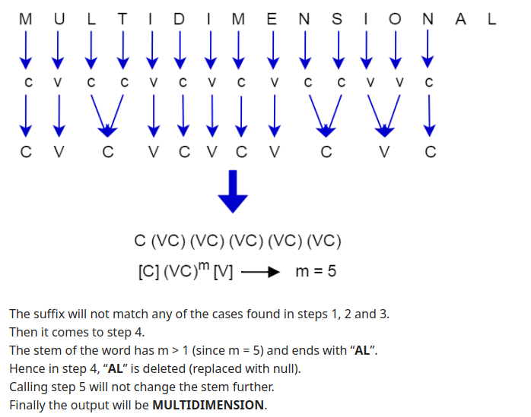
Example 1: MULTIDIMENSIONAL

Slide 56
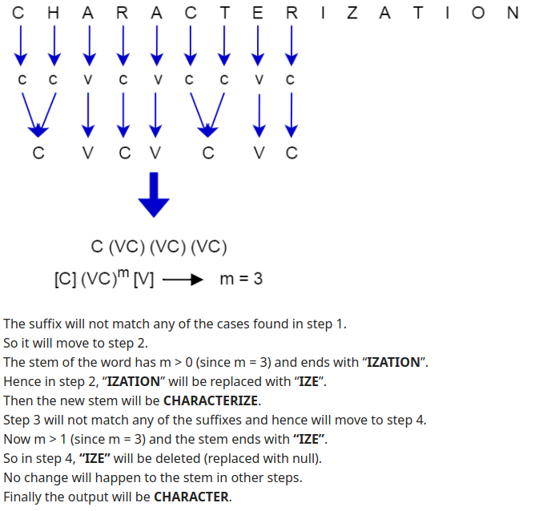
Example 1: CHARACTERIZATION

Slide 57
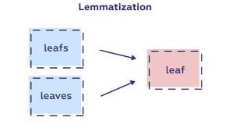
3. Lemmatization (token → lemma)
Lemmatization is quite similar to the Stemming.
Lemmatization is a text normalization technique used in Natural Language Processing (NLP), that switches any kind of a word to its base root mode. Lemmatization is responsible for grouping different inflected forms of words into the root form, having the same meaning.
Lemma: A basic word form (e.g. infinitive or singular nominative noun) that is used to represent all forms of the same word
An inflected form of a word has a changed spelling or ending that shows the way it is used in sentences:
"Finds" and "found" are inflected forms of "find".
The main difference between Stemming and lemmatization is that it produces the root word, which has a meaning.
For example:
In lemmatization, the words intelligence, intelligent, and intelligently has a root word intelligent, which has a meaning.

Slide 58
Use cases:
Lemmatization is among the best ways to help chatbots understand your customers’ queries to a better extent.
Since this involves a morphological analysis of the words, the chatbot can understand the contextual form of the words in the text and can gain a better understanding of the overall meaning of the sentence that is being lemmatized.
Lemmatization is also used to enable robots to speak and converse. This makes lemmatization a rather important part of natural language understanding (NLU) and natural language processing (NLP) in artificial intelligence.
‍

Slide 59
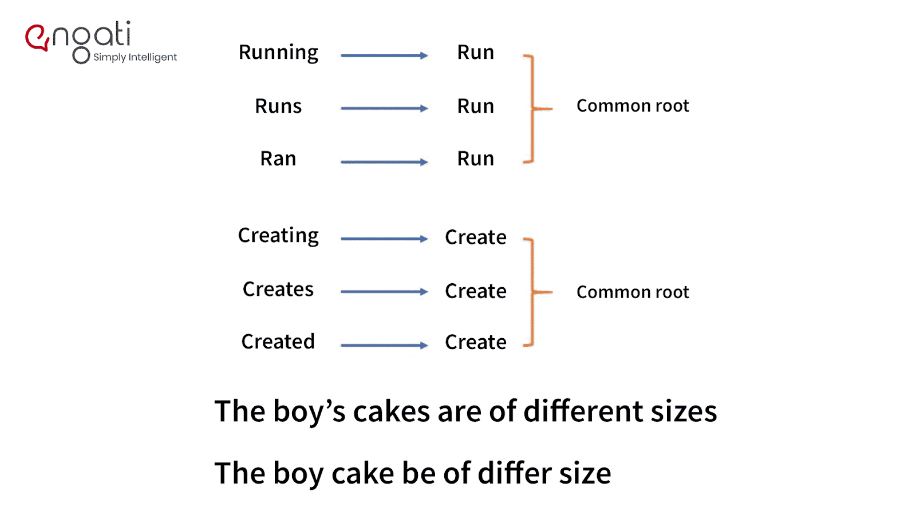
Example

Slide 60
Various Approach to Lemmatization
We will be going over 9 different approaches to perform Lemmatization along with multiple examples and code implementations.
WordNet
WordNet (with POS tag)
TextBlob
TextBlob (with POS tag)
spaCy
TreeTagger
Pattern
Gensim
Stanford CoreNLP

Slide 61
# Stemming
from nltk.stem import PorterStemmer
from nltk.stem import SnowballStemmer
PorterStemmer()
SnowballStemmer('english')
# Lemmatization
import nltk
nltk.download('wordnet')
from nltk.stem import WordNetLemmatizer
WordNetLemmatizer()

Slide 62
4. POS Tagging
POS stands for parts of speech, which includes Noun, verb, adverb, and Adjective.
It indicates that how a word functions with its meaning as well as grammatically within the sentences.
A word has one or more parts of speech based on the context in which it is used.
Example: "Google" something on the Internet.
In the above example, Google is used as a verb, although it is a proper noun.

Slide 63
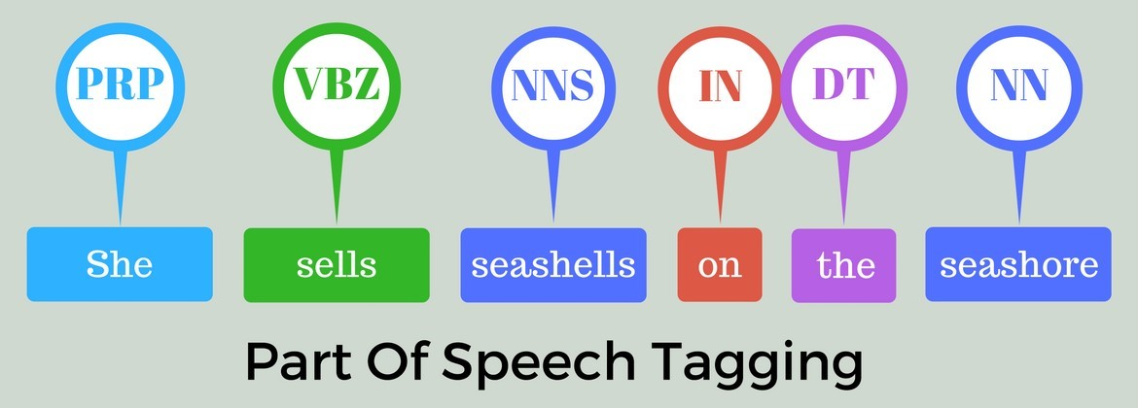

Slide 64
CC coordinating conjunction CD cardinal digit DT determiner EX existential there (like: “there is” … think of it like “there exists”) FW foreign word IN preposition/subordinating conjunction JJ adjective ‘big’ JJR adjective, comparative ‘bigger’ JJS adjective, superlative ‘biggest’ LS list marker 1) MD modal could, will NN noun, singular ‘desk’ NNS noun plural ‘desks’ NNP proper noun, singular ‘Harrison’ NNPS proper noun, plural ‘Americans’ PDT predeterminer ‘all the kids’ POS possessive ending parent’s | PRP personal pronoun I, he, she PRP$ possessive pronoun my, his, hers RB adverb very, silently, RBR adverb, comparative better RBS adverb, superlative best RP particle give up TO, to go ‘to’ the store. UH interjection, errrrrrrrm VB verb, base form take VBD verb, past tense took VBG verb, gerund/present participle taking VBN verb, past participle taken VBP verb, sing. present, non-3d take VBZ verb, 3rd person sing. present takes WDT wh-determiner which WP wh-pronoun who, what WP$ possessive wh-pronoun whose WRB wh-abverb where, when
The POS tagger in the NLTK library outputs specific tags for certain words.
The list of POS tags is as:

Slide 65
Example:
import nltk
from nltk import word_tokenize, pos_tag
sentence1 = "Keep the book on top shelf"
print (pos_tag(word_tokenize(sentence1)))

