Slide 1
Seminar Topic Selection
Caesar Cipher Text Encryption
Image Encryption
Web Application Firewall
-Ayush S Acharya
TE-1 Roll no-35

Slide 2
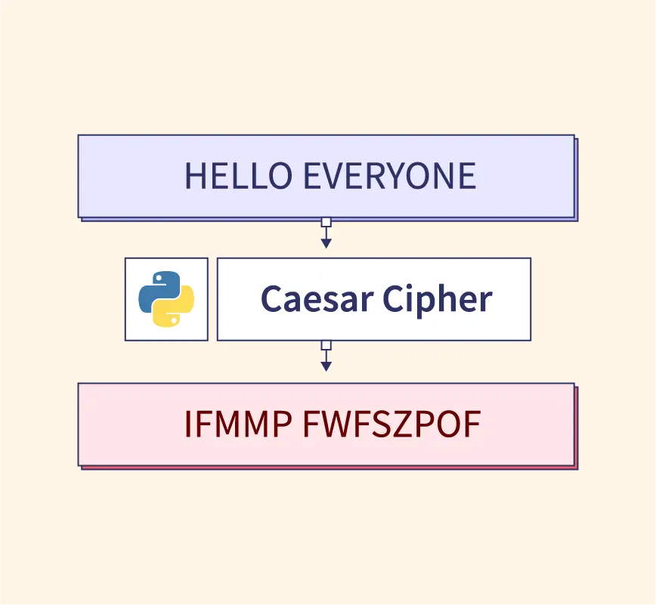
1. Caesar Cipher Text Encryption
A simple encryption technique, that works by shifting the letters in plaintext message by a certain number of positions, called as “shift” or “key”.
It is simply a type of substitution cipher, i.e. each letter is replaced by another letter with a fixed no. of positions.
The encryption of a letter ‘x’ by a shift ‘n’ can be described mathematically as,
Encryption : Eₙ(x)=(x+n) mod 26.
it shifts the letter to Eₙth right of x.
Decryption : Dₙ(x)=(x-n) mod 26.
it shifts the letter to Dₙth left of x.

Slide 3
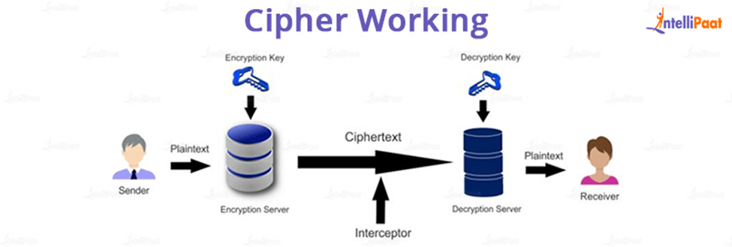
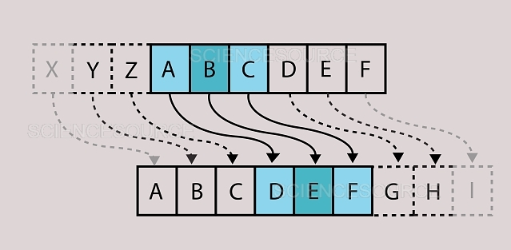

Slide 4
Eg.(1) Consider the plain text: “THIS IS A SECRET MESSAGE”.
By using the shift of 3, we get the cipher text as follows:
“WKLV LV D VHFUM PHVVDJH”.
Eg.(2) Consider the plain text : “HELLO”.
By using the shift of 15,we get the cipher text as follows:
“WTAAD”.

Slide 5
Applications :
Checksum Protocols.
Basic Data Masking.
Data encoding in non essential situations.
Creating secret messages.
Cryptography workshops.

Slide 6
IEEE Research Paper:
https://drive.google.com/file/d/1v1JhdvbdR88Y23NXZqAVKlHAitxtxLT9/view?usp=drive_link
IJ Research Paper:
https://drive.google.com/file/d/1jsW-sJXGwfey-RQhAC-GJKYqYXAjJYn1/view?usp=drive_link

Slide 7
2. Image Encryption
Image encryption is a crucial component of Information security that focuses specifically on safeguarding the confidentiality and integrity of digital images.
The primary objective of online image encryption is to transform the visual data within an image into an unreadable and unintelligible form, making it inaccessible to unauthorized individuals.
Image encryption techniques employ mathematical algorithms and cryptographic methods to alter the pixel values or the visual representation of an image.
Various encryption algorithms can be used for image encryption, including symmetric key encryption and public key encryption. Symmetric key encryption involves using a shared secret key for both encryption and decryption. Public key encryption, on the other hand, employs a pair of keys: a public key to encrypt pictures and a private key to decrypt the same.

Slide 8
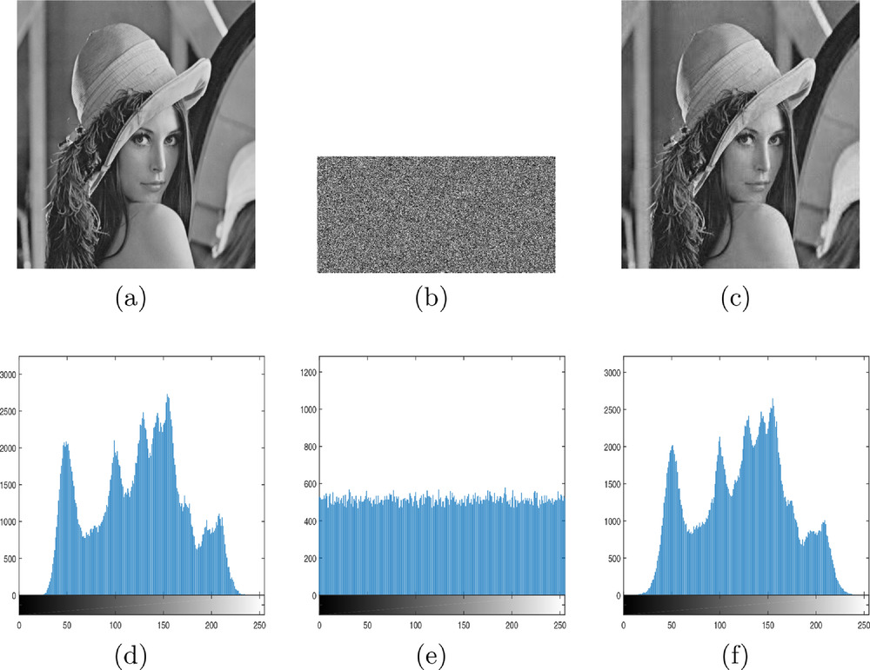
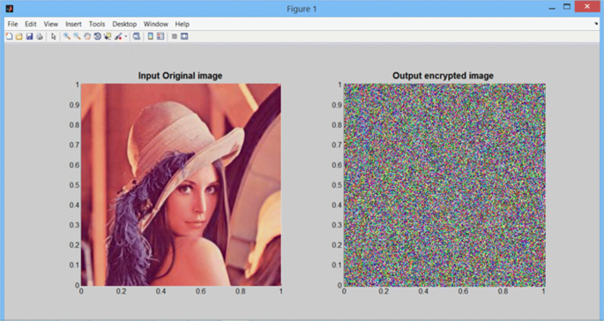

Slide 9
Brief Methodology
Input Image
Encryption Algorithm Selection
Key Generation
Block Division
Encrypt Image
Scrambled Image
Key Management
Decryption Process
Decrypted Image

Slide 10
Applications Of Image Encryption:
Medical Imaging
Educational Institutions
Legal & Forensic Investigations
Military & Defense
Satellite image data

Slide 11
IEEE Research Paper:
https://drive.google.com/file/d/1wmMKqQHSs0C2eX_jWg7ZYdHVxPmtn_wm/view?usp=drive_link
IJ Research Paper:
https://drive.google.com/file/d/1PxXAWQBKpD6FU9kZhqTrPFwomFlQRWD/view?usp=drive_link

Slide 12
3.Web Application Firewall
Web application firewalls help protect web applications from malicious attacks and unwanted internet traffic, including bots, injection and application-layer denial of service (DoS).
The WAF will help you establish and manage rules for avoiding internet threats, including IP addresses, HTTP headers, HTTP body, URI strings, cross-site scripting (XSS), SQL injection, and other OWASP-defined vulnerabilities.
Web application firewall are deployed to protect web-facing applications and collect access logs for compliance, and analytics.
WAFs protect internet-facing applications from attacks as a result of integrated threat intelligence that aggregates from multiple sources and Open Web Application Security Project (OWASP) detection rules.

Slide 13
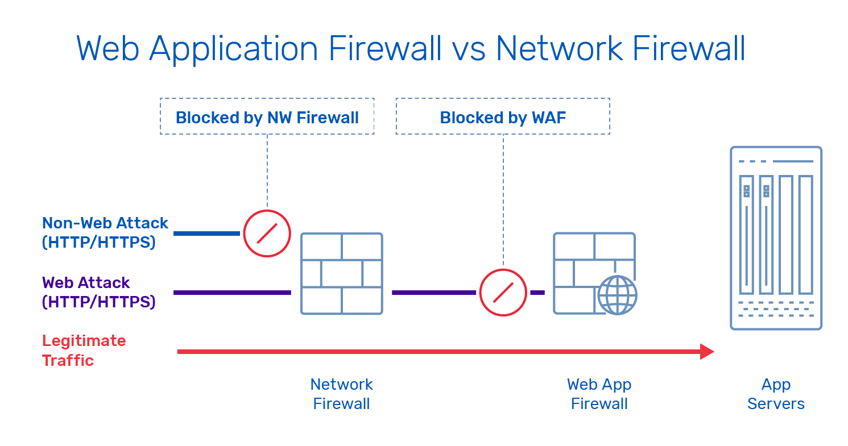
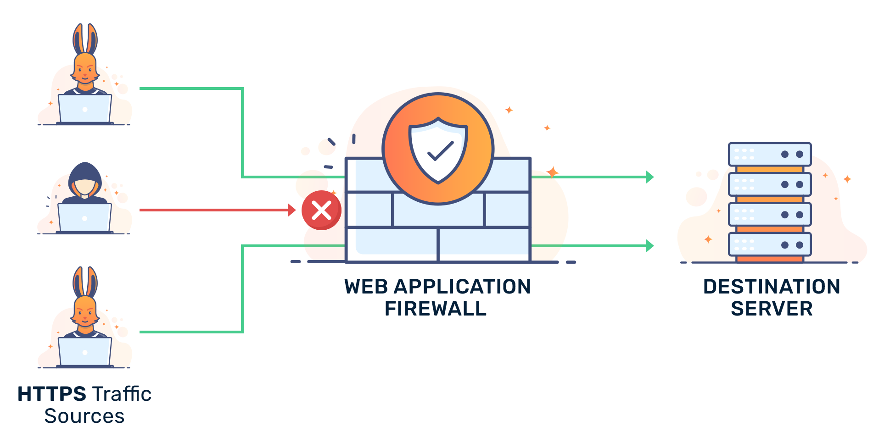

Slide 14
Working:
WAFs intercept and examine all HTTP requests.
Bogus traffic is simply blocked or tested with CAPTCHA tests designed to stump harmful bots and computer programs.
The fine print of WAF administration is based on security procedures that are built upon customized policies, which should address the top web application security flaws listed by the Open Web Application Security Project (OWASP).

Slide 15
Attacks prevented by WAFs:
Cross-site Scripting (XSS) — Attackers inject client-side scripts into web pages viewed by other users.
SQL injection — Malicious code is inserted or injected into an web entry field that allows attackers to compromise the application and underlying systems.
Cookie poisoning — Modification of a cookie to gain unauthorized information about the user for purposes such as identity theft.
Unvalidated input — Attackers tamper with HTTP request (including the url, headers and form fields) to bypass the site’s security mechanisms.
Layer 7 DoS — An HTTP flood attack that utilizes valid requests in typical URL data retrievals.
Web scraping — Data scraping used for extracting data from websites.

Slide 16
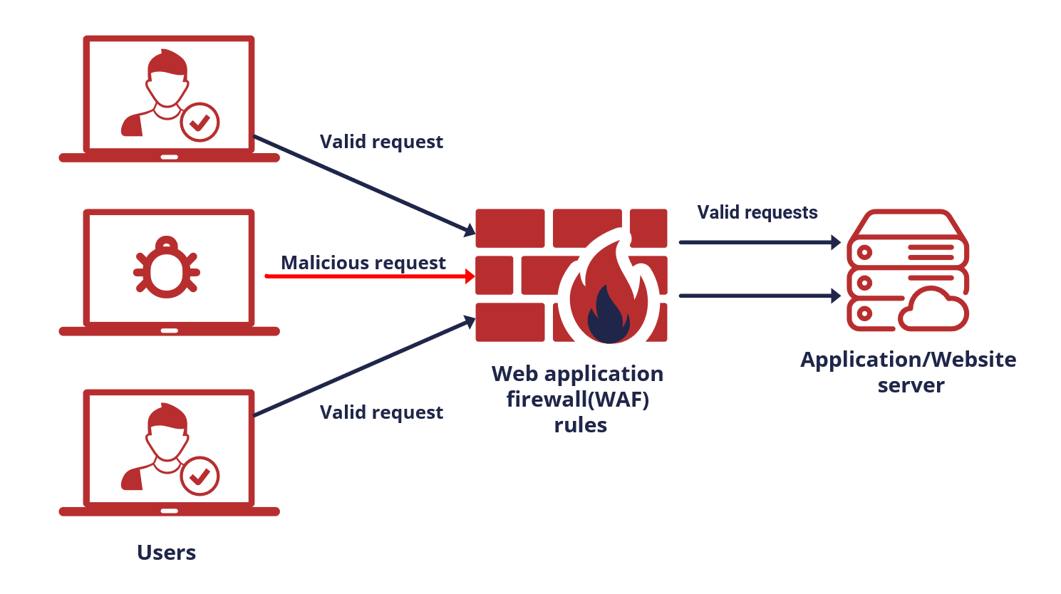
Applications:
E-Commerce Websites
Online Banking & Finance
Government Websites
Military Applications
Social Media Platforms
Educational Institutions
Web based applications

Slide 17
IEEE Research Paper:
https://drive.google.com/file/d/1VXg7nPM2zfXilSP4Jg9z2pQR3dZhL0ve/view?usp=drive_link
IIT-KG Research Paper:
https://drive.google.com/file/d/1xTR6echE282RKeQgR3C66fYUhIeqp5Da/view?usp=drive_link

Slide 18
THANK YOU !

