Slide 1
Pair Duels
Presented by:
Shreyansh Gupta (IIM2015001)
Abhishek Pasi (ICM2015002)
Ayush Agnihotri (IIM2015004)
Nidheesh Pandey (IIM2015501)
Vishal Kumar Singh (IIT2015141)

Slide 2
INTRODUCTION
Pair duels is a two player memory based tile matching game.
This project is implemented using JavaFX libraries and some styling using CSS.
Player can choose between various interesting themes (including Anime) and grid size (4x4 and 6x6).

Slide 3
MOTIVATION
We chose to work on a game rather than conventional projects because a game reflects use of GUI better.
Pair Duels test player’s concentration and memorizing power which make it interesting and unique.
There always a surprise element in the game which prevent it from getting monotonous as player has new set of puzzle every time he/she plays.

Slide 4
JavaFX
JavaFX is set of graphic and media packages that help developer to add and create various graphic rich applications.
JavaFX is being considered as future alternative of Java Swing library for Standard Java GUI library.
As our project is a game so we have used JavaFX instead of Java Swing as working with animation is easier in JavaFX. Moreover, JavaFX is skinnable with CSS.

Slide 5
Some OOM Concepts Used
We created a Tile class which is our user defined layout. Tile class extends Stack Pane (library class) and adds some extra features to it.
All the tiles are organized so as to form a grid.
Main objective is to match pair of tiles.
problem :- Each tile object is different.
solution :- Match image instance of Tile objects.
Since, one image is loaded for two tile
objects. (ScreenShot)
Used static variables for attributes common to class or when it is needed globally for more than one class.

Slide 6
Some OOM Concepts Used
Problem :- Scene class has a attribute Parent but createContent (Present in Game_Screen , Main_Screen and End_Screen) returns Pane object. How to change Scenes ?
Solution :- Polymorphism.
Navigation class (used to Switch Scenes) has three instance variables of type Parent which hold the return value of values of respective createContent functions. These variables are given as argument to Scene constructors. Thus , enabling flawless switching between Scenes.
(ScreenShot)

Slide 7
UML Diagram
Use Case Diagram
CRC Diagram
Class Diagram
State Chart Diagram
Activity Diagram
Sequence Diagram

Slide 8
Code
Navigation class (Stage Class)
Main Screen (Scene Class)
Game Screen (Scene Class)
End Screen (Scene Class)

Slide 9
THANK YOU

Slide 10
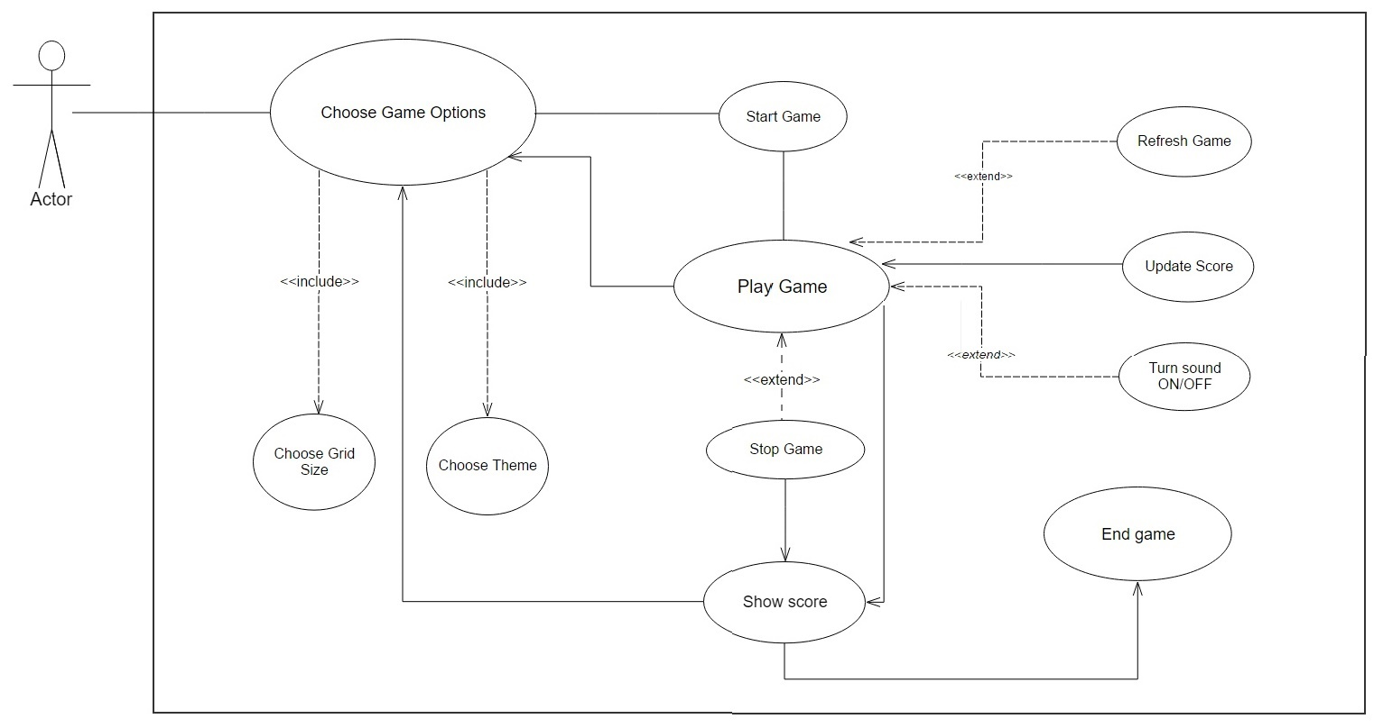
Use Case Diagram
Open .jpg Form
BACK

Slide 11
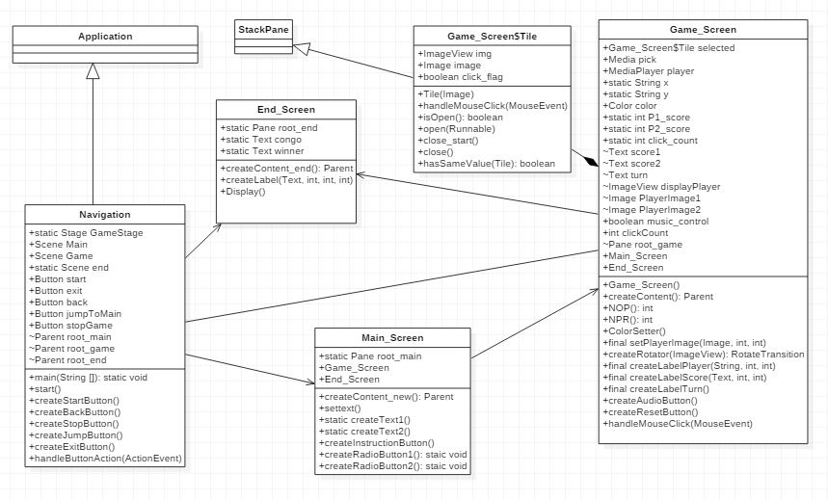
Class Diagram
Open .jpg Form
BACK

Slide 12
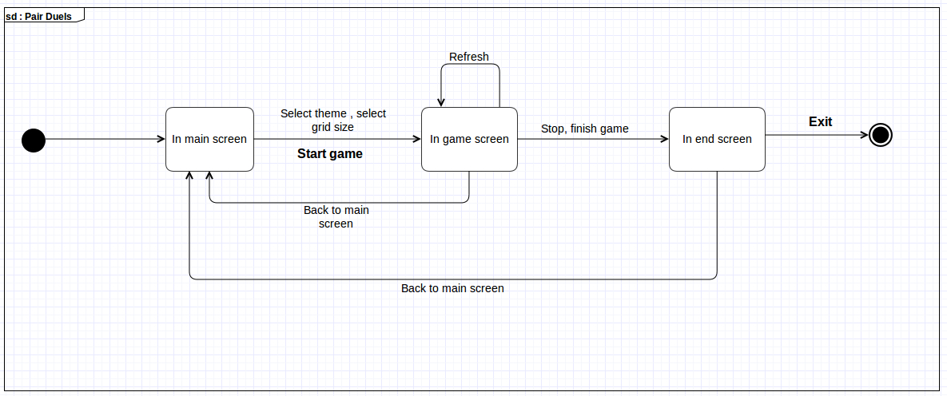
State Chart Diagram
Open .jpg Form
BACK

Slide 13
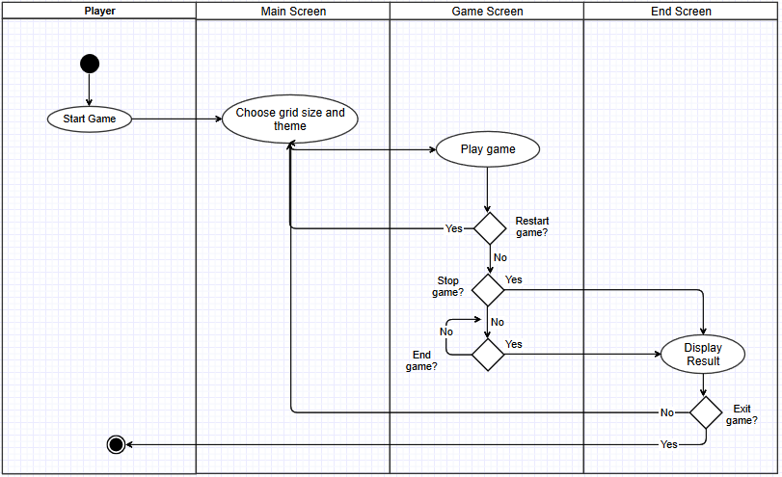
Activity Diagram
Open .jpg Form
BACK

Slide 14
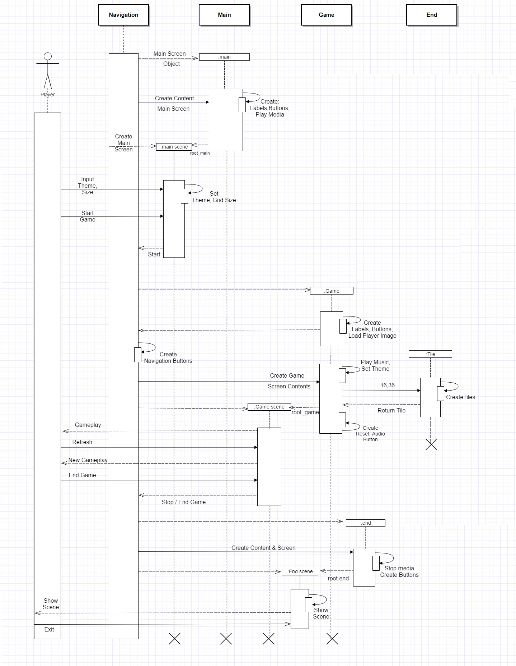
Sequence Diagram
JPG
BACK

Slide 15
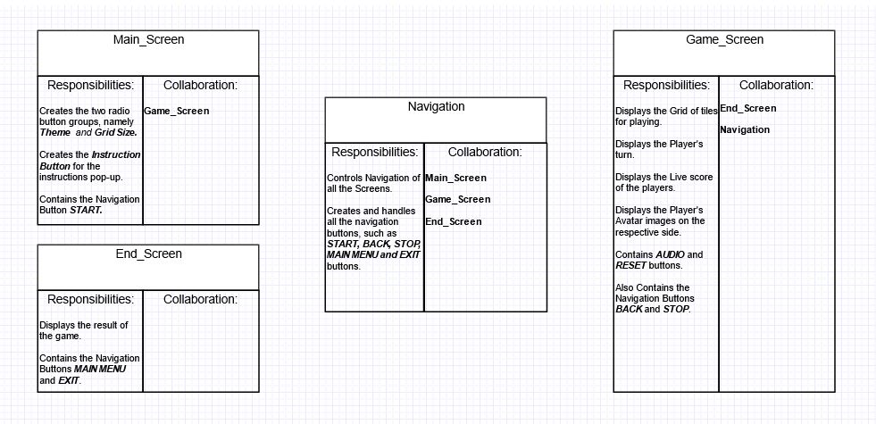
CRC Diagram
Open .jpg Form
BACK

